Slide 1
Center for Adult Education
1025 Main Street

Slide 2
Our Team
Mary Foley Executive Director; WTED
Matt Connell Coordinator; Adult Education
Susanna Yarmer Testing and Support Specialist
Anita Ellison Data Specialist (P/T)
Jamie Buehler Instructor (ABE; Great Bend)
Kim Walter Instructor (AO-K; Main Campus) (P/T)
Luke Seitz Instructor (ABE; ECF)
Angie Reed Instructor (AO-K; ECF)
Ash Norton Instructor (ABE; LCMHF)
Reva Preeo Instructor (ABE; LCMHF)
TBD Instructor (AO-K; LCMHF)
Melanie Moeder Instructor (ABE; Russell) (P/T)

Slide 3
Programs Offered
Adult Basic Education
  Kansas High School Diploma
    AO-K – Partnership with CTE
Adult Basic Education – Correctional Facility
  Kansas High School Diploma
    AO-K – Partnership with CTE
  Kansas Workready! Certification

Slide 4
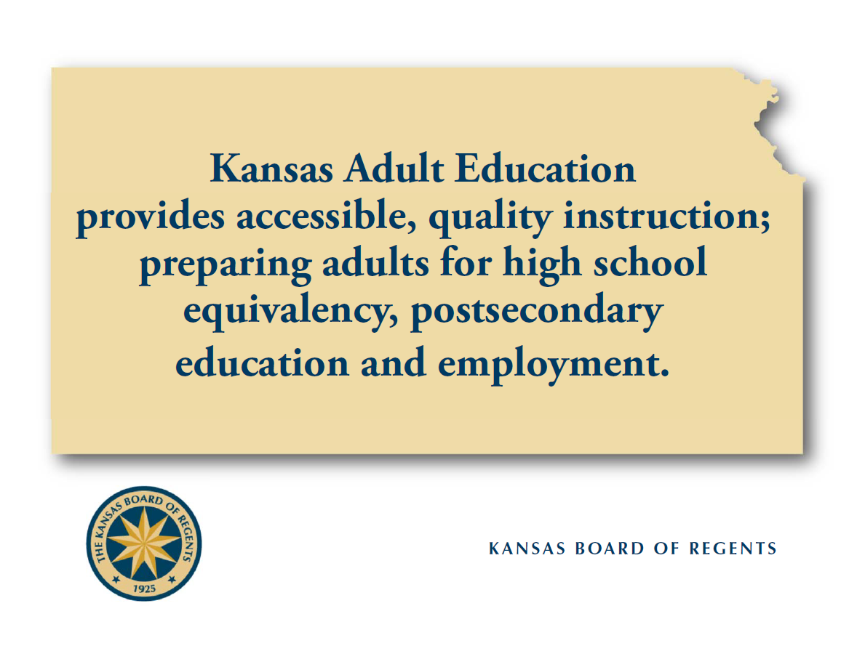

Slide 5
Funding
The Center for Adult Education is funded three ways.
  AEFLA Grant (Adult Education and Family Literacy Act)
    Enacted as Title 2 of the Workforce Investment Act of 1998
    Primary funding source of Adult Education
  IRE Grant (Improved Reentry Education)
    Supports our technology efforts at the Correctional Facilities
  DOC Contract (Dept. of Corrections Contract with Barton CC)
    Supports personal and supplies at the Correctional Facilities
Non-Correctional students pay a one-time student/materials fee of $65.⁰⁰ plus the cost of any appropriate tests.

Slide 6
Students Served
FY 19 (YTD)
  104 Students Served (all locations/programs)
FY 18
  250 Students Served (all locations/programs)
FY 17
  185 Students Served (all locations/programs)
FY 16
  184 Students Served (all locations/programs)
FY 15
  176 Students Served (all locations/programs)
FY 14 **The GED test was changed in January of FY 14
  231 Students Served (all locations/programs)
FY 13
  276 Students Served (all locations/programs)
FY 12
  292 Students Served (all locations/programs)

Slide 7
Participants by Age, Ethnicity and Gender
(All Locations/Programs)
FY 18
 | American Indian or Alaskan Native |  | Asian |  | Black or African American |  | Hispanic |  | Native Hawaiian or Other Pacific Islander |  | White |  | More than One Race
 |  |  |  |  |  |  | Latino
Age Group | Male | Female | Male | Female | Male | Female | Male | Female | Male | Female | Male | Female | Male | Female | Total
16-18 | 0 | 0 | 0 | 0 | 0 | 0 | 1 | 2 | 0 | 0 | 4 | 4 | 2 | 1 | 14
19-24 | 1 | 0 | 0 | 0 | 30 | 0 | 15 | 1 | 1 | 0 | 33 | 4 | 7 | 0 | 92
25-44 | 1 | 0 | 0 | 1 | 17 | 0 | 9 | 4 | 0 | 0 | 37 | 11 | 4 | 1 | 85
45-54 | 0 | 0 | 0 | 0 | 2 | 0 | 2 | 0 | 0 | 0 | 4 | 1 | 1 | 0 | 10
55-59 | 0 | 0 | 0 | 0 | 0 | 0 | 1 | 0 | 0 | 0 | 0 | 1 | 0 | 0 | 2
 | 2 | 0 | 0 | 1 | 49 | 0 | 28 | 7 | 1 | 0 | 78 | 21 | 14 | 2 | 203

Slide 8
Goals
Increase the Number of Adult Ed Students (Program Wide)
  Continue / Increase the Number of AO-K Students
Continue AO-K Model Training/Professional Development for All Staff
Increase Student Transition to Post-Secondary
Increase and Sustain GED Completion Rates/Educational Gains

Slide 9
Questions?

