Slide 1
TEST ANXIETY
TEST PREPARATION

Slide 2
What Causes Test Anxiety?
We should really call it performance anxiety, not TEST anxiety. Test Anxiety is actually an accessing problem, not a memory problem.
We have an accessing problem because of WHITE NOISE!

Slide 3
What Causes Test Anxiety?
White noise is the result of a heart-mind connection. When we become anxious, our heart rate becomes erratic, and it send a message to our brain that we’re in danger. Our brain sends out a neurotransmitter that creates “static” in the brain and we become unable to remember or process thought efficiently.

Slide 4
What Causes Test Anxiety?
  Mental Mind Set
    Fear of Failure
    Unrealistic Expectations
    Past Experience

Slide 5
What Causes Test Anxiety?
Passing vs. Taking the Exam
You can become so focused on passing the exam that you end up taking the exam with only half of your brain and half of your energy. Half of your brain will be afraid of failure, and thus focused on this outcome! The secret is to get your WHOLE mind focused on taking the exam. Passing the exam will follow!!
HAVE THE DESIRE TO DO WELL ON THE TEST, AND THEN LET IT GO. The desire will have a better chance of being fulfilled.

Slide 6
What Causes Test Anxiety?
Automatic Thoughts
Emotional Interpretations (“This will be too hard”)
A B C
Event Feeling Behavior
(Test) (Panic) (Forget)

Slide 7
Changing the Stress Response
It is the emotional response to our interpretation of the event that causes the “white noise” which affects our ability to take tests.
The good news is that we can learn a technique to manage and decrease this white noise!

Slide 8
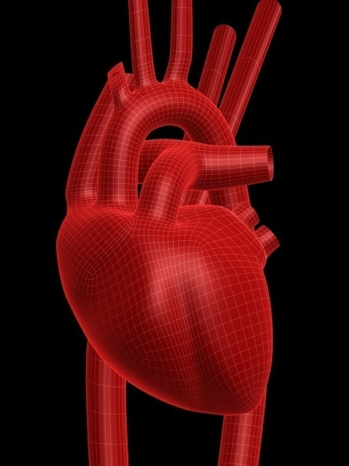
Changing the Stress Response
The secret is “breathing through the heart” while having feelings of appreciation or deep caring about something or someone.

Slide 9
Breathe and Appreciate
Imagine that your heart has a large vent in it, and that you can actually take in air through this vent, expelling it through the belly button.
Learn to breathe slowly and deeply through the “heart” while at the same time, emoting appreciation for a person, animal, event, place that you care about…..don’t just think about the person, actually feel the emotion.

Slide 10
Breathe and Appreciate
Breathing in this manner, while experiencing feelings of appreciation, is the most powerful tool for overcoming test anxiety because it acts on the neurotransmitters which are causing the static in your brain. It helps you create a new internal pharmacy which helps you to feel better.

Slide 11
TOOLS TO HELP - PREPARATION
Go to class. This is the number one predictor of success!
Memory and learning begin with attention. Be here now! Bring yourself back if you begin to daydream, and don’t sleep in class.
Tape the lecture or take notes.
  Cornell Method - Headings in left margin, notes on right side. Can cover the notes and quiz yourself by looking at the headings and reciting what the notes in that area contain.
  Mind Map – Non-linear way of remembering….
White
Dark
Chocolate
Cocoa
Milk

Slide 12
TOOLS TO HELP - PREPARATION
Know how to read a text book.
  Make questions out of the headings, then see if you can answer the questions. This simulates test questions.
  Note bolded words and their meaning.
  Be aware of remembering – note to yourself when you want to remember something….this will help you remember it.
Read the chapter before the lecture – the lecture becomes a review.
Distributed practice. Study and review a little every day, rather than one marathon session…..just like you would practice for a sport.

Slide 13
TOOLS TO HELP - PREPARATION
PHYSICAL STRATEGIES TO HELP
  Food Choices Matter – Carbs and sugars cause you to crash!
  Get Enough Sleep – Sleep deprivation hampers memory!
  Drugs – Hamper memory – even days later!
  Hydration – Dehydration affects concentration!

Slide 14
TOOLS TO HELP - PREPARATION
Organize and integrate what you learn with what you already know. Memory is more a matter of TYING than TRYING.
Rick Bealer

Slide 15
TOOLS TO HELP – JUST BEFORE THE TEST
WAKE UP BOTH SIDES OF YOUR BRAIN!
  Eat a peppermint
  Read a newspaper
  Sing a song, count to ten, sing a song
  Alternately raise your knees up and slap them with the opposite hand

Slide 16
TOOLS TO HELP – JUST BEFORE THE TEST
Take a break from studying before the exam. Go outside and “appreciate” something from nature.
Just before the exam, stay quiet and focused – talking to others about what they studied will just make you anxious.
Deep breathe and express appreciation for a person, event or place.
Focus on wood grain on the desk or something similar.

Slide 17
TOOLS TO HELP – DURING THE TEST
Watch out for negative thoughts
Reframe thoughts (“I have studied for this”, NOT “this is too hard.”)
Positive self-talk (“I know I can do this.”)
Dissociate – pretend you are fly on the wall watching yourself study for the test. You KNOW the material, you can see yourself learning it.
Turn it over to your unconscious mind. Skip a question you don’t know and move on….your mind will still be working on the question and the answer may come to you later.

Slide 18
TOOLS TO HELP – DURING THE TEST
Pretend the test is a conversation between you and the instructor and not a test – how would you answer?
On multiple choice questions, cover the answers and answer on your own – then see which answer matches yours.

Slide 19
THE GUARANTEE
When you take the exam in the manner described, you will not do any worse than before, and will dramatically increase the probability of doing much better.
You have NOTHING to lose and A LOT to gain by using these strategies on the next exam.

Slide 20
We see the world not how it is, but how we are.
Ron Willis

