Slide 1
TEEN RELATIONSHP VIOLENCE

Slide 2
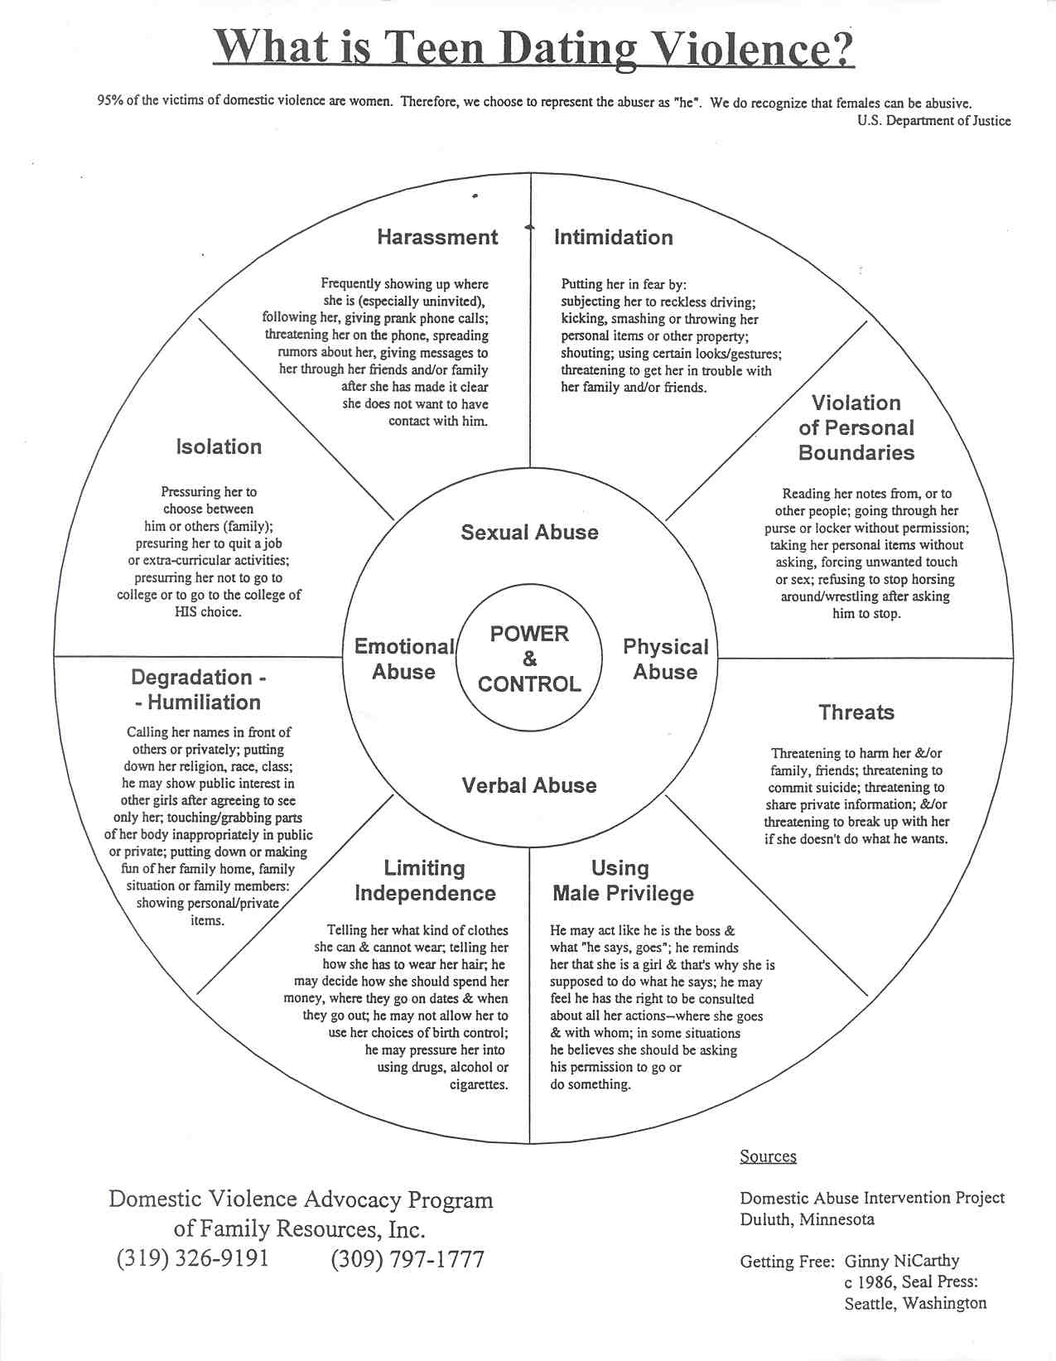
Notes:
Read put downs.

Slide 3
Verbal Abuse
Verbal abuse is “words that attack or injure, that cause one to believe the false, or that speak falsely of one. VERBAL ABUSE CONSTITUES PSYCHOLOGICAL VIOLENCE.”
Verbal abuse is hurtful, esp. when it is denied and the victim’s perception of the abuse is discounted. This causes the victim to begin to doubt herself, and she may begin to believe there is something wrong with her.
Verbal abuse can be overt (blaming and accusatory) or covert (hidden aggression, very subtle.) Belittlement may be voiced in an extremely sincere and concerned way, which makes it hard to pinpoint.
Verbal abuse is manipulative and controlling. Usually the victim does not know she’s being manipulated.

Slide 4
Verbal abuse is unpredictable.
Verbal abuse is sinister. It disregards, disrespects, or devalues the person. The victim’s self-esteem and confidence decreases. She may try to change her behavior to avoid upsetting the abuser.
Verbal abuse is the problem….there is no specific conflict, the abuse is the issue and it is not resolved.
Verbal abuse expresses a double message between what the abuser says and feels.

Slide 5
Why Would Someone Put Up With Verbal Abuse?
Buys into the belief that there is something wrong with him/her because she is blamed for the problem
Victim is confused because sometimes the abuser is nice……it’s like slot machines……intermittent reinforcement is the hardest to break. Victim forgets the bad times.
Victim believes her perceptions are wrong because she has been told this so many times.
The victim is too stunned or thrown off-balance to think clearly about what is happening to him/her.
Victim believes that when the abuser is angry, she has done something to hurt him.
Self esteem is so low that there isn’t any energy to fight
The abuse comes on gradually

Slide 6
Forms of Dating Violence
Does he/she isolate you?
Does he/she make fun of you?
Does he/she use intimidation to get you to do what he wants?
Does he make you feel trapped in the relationship?
Does he make you perform sexual acts you don’t want to?
Does he threaten you with force, words, weapons, leaving you?
Does he use alcohol or drugs as an excuse for bad behavior toward you or others?
Does he get extremely angry frequently and you don’t understand why?
Does he not believe he has hurt you, or blames you for what he has done?
Does he physically force you to do what you do not want to do?

Slide 7
PROFILING AN ABUSER AND VICTIM
HE:
Believes the man should make all the decisions.
Has a poor self-image
Is very jealous—won’t let her talk to anyone else.
Has outbursts of temper for no reason.
Abuses drugs or alcohol
Wants to control her actions
SHE:
has a poor self-image
believes an abusive boyfriend is better than no boyfriend
Starts doing poorly in school
Is isolated from her former friends
Is dependent on him for all the decisions (where they go, what they do, who they see)
Is no longer in control of her life (he picks out her clothes, hairstyle, etc.)
Makes excuses for his behavior

Slide 8
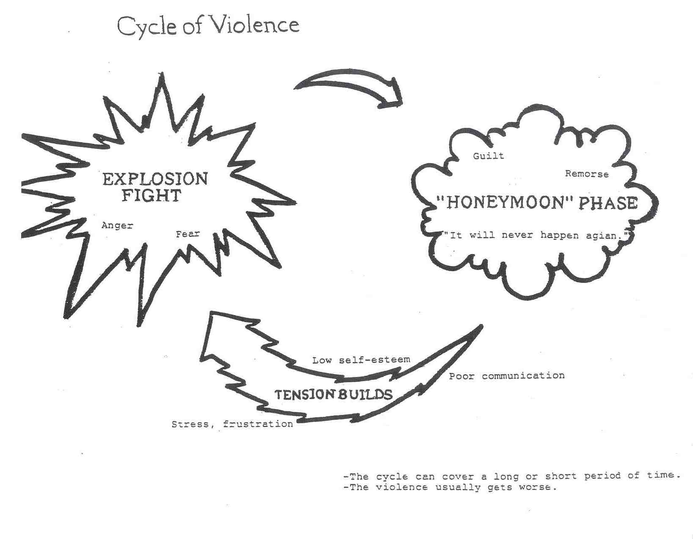
Notes:
Tension Building: Minor incidents occur
She tries to calm him
She denies anger, fear, etc. but yet they increase
She feels helpless
He becomes afraid she’ll leave, so he tries to control her more – gets jealous and possessive
Explosion:
Man loses control over his behavior
He’s going to teach her a lesson
He is angry, no matter what she has done or not done….he will find a reason to justify his behavior
She is simply waiting for the “other shoe to drop”
Anticipation of theis causes severe psychological stress: can’t sleep, loses appetite or overeats, constant fatigue or headaches
Women do not seek help during this phase, unless needing emergency room treatment. She tends to return to the abuser from the emergency room.
Honeymoon Phase:
He is contrite, sorry, says he will never do it again.
He agrees to go to counseling/ etc.
She likes the attention he gives. She believes he will change.
He reminds her of how much he needs her (each are dependent on the other) and they both want the relationship to work.

Slide 9
ARE YOU A VICTIM OF DATING VIOLENCE?
Are you frightened of your boyfriend or girlfriend’s temper?
Are you afraid to disagree with him or her?
Do you find yourself apologizing to yourself or others for your boyfriend or girlfriend's behavior when you are treated badly?
Have you been frightened by his or her violence towards others?
Have you been hit, kicked, shoved or had things thrown at you?
Do you not see friends or family because of his jealousy?
Have you become secretive, ashamed, or hostile to your parents because of this relationship?
Have you been forced to have sex, or to go further than you were comfortable with?

Slide 10
Have you been wrongly and repeatedly accused of flirting or having sex with others?
Are you unable to go out, get a job, or go to school without his/her permission?
Do you spend more time hurting in the relationship than feeling good?
Have you been afraid to say no to sex?
Are you forced to justify everything you do, every place you go, and every person you see to avoid his/her temper?

Slide 11
RUN THE OTHER WAY!
If he/she is EXTREMELY JEALOUS and gets angry and abusive or sulky if you have friends or any warm feelings for anyone else.
If he/she is POSSESSIVE and feels you “belong” to them so much so that others can not have any of your time or attention.
If he/she is EXPLOSIVE and yells, screams, hits walls or hits or threatens to hit others.
If he/she CANNOT ACCEPT RESPONSIBILITY AND BLAMES OTHERS for their own abusive or violent behaviors.
If he/she is CONTROLLING OR DICTATORIAL …your partner defines how you should look, what you should say, where you should or shouldn’t go, and who you should talk with. Partner makes all the important decisions.

Slide 12
If he/she HAS LOW SELF-ESTEEM and declares they aren’t anything without you, or show other signs of low self-worth.
If they want to “TAKE CARE OF YOU” or want you to “take care of them.
If h/she has a FAMILY HISTORY OF VIOLENCE OR ABUSE between parents, relatives, or significant others. If you witness name-calling, fighting, hitting, pushing, shoving, weapons use, etc.
If he/she makes FREQUENT USE OF ALCOHOL OR DRUGS, and blames the chemicals for abusive or violent behaviors.
If he/she has RIGID SEX ROLE EXPECTATIONS, such as men should always be the boss and be in charge, and women have low status or are less important.
If he/she displays a DR. JEKYLL-MR. HYDE PERSONALITY with marked shifts back and forth from being angry, controlling, abusive to nice, charming, and loving. Mood swings are unpredictable.

Slide 13
DATING BILL OF RIGHTS
I HAVE THE RIGHT:
To ask for a date.
To refuse a date.
To suggest activities.
To refuse any activities, even if my date is excited about them.
To have my own feelings and be able to express them.
To say I think my friend's information is wrong or his/her actions are unfair or inappropriate.
To tell someone not to interrupt me.

Slide 14
To have my limits and my values respected.
To tell my partner when I need affection.
To be heard.
To refuse to lend money.
To refuse affection.
To refuse sex with anyone just because they took you out on an expensive date.
To refuse sex anytime for any reason.
To have friends and space from my partner.

Slide 15
I HAVE THE RESPONSIBILITY:
To respect the limits of others.
To communicate clearly and honestly.
To not violate the limits of others.
To ask for help when I need it.
To be considerate.
To check my actions/decisions to determine if they are good or bad for me.
To set high goals.
To determine my limits and values.

Slide 16
REAL CARING IS SHOWN BY RESPECTING YOUR PARTNER OR FRIEND AND LOOKING OUT FOR WHAT IS BEST FOR HIM/HER. REAL CARING MEANS BEING A BALCONY PERSON FOR YOUR PARTNER OR FRIEND AND ALWAYS TRYING TO RAISE THEM UP TO GROW AND THRIVE.
TRYING TO CONTROL YOUR PARTNER OR FRIEND IS SIMPLY A MANIFESTATION OF YOUR OWN LOW SELF-ESTEEM AND INSECURITY. IT IS THE OPPOSITE OF CARING. TRYING TO CONTROL ANOTHER PERSON TO GET THEM TO BE OR DO WHAT YOU WANT IS BEING A BASEMENT PERSON FOR YOUR PARTNER OR FRIEND, BRINGING THEM DOWN.

Slide 17
SIGNS OF A GOOD RELATIONSHIP Does your partner or friend have a sense of joy in life?
Do you enjoy his/her ideas and have a good rapport with them?
Do you feel a real connection, laughing together and catching meanings in the same way?
Is there a “best friend” quality to your relationship?
Can you really be yourself without criticism?
Do you feel relaxed with him/her?
Do you feel warmth and understanding from him/her?

