Slide 1
O365 Canvas Integration App
TOD-TALK

Slide 2
Agenda
• Submit Assignments
• Speedgrader
• Rich Content Editor
• Include Office 365 documents in your Modules
• Create Collaborations
• OneNote Class Notebook Grade Push

Slide 3


Applications??
• Students can submit Office 365 files directly to Canvas Assignments
• Teachers can access Office 365 documents through SpeedGrader to add feedback
• Link Office 365 documents anywhere you use the Rich Content Editor
• Include Office 365 documents in your Modules
• Create Collaborations for course groups, student groups, and on-demand groups using Office documents
• Create and grade assignments in your Microsoft OneNote Class Notebook, then push those grades to Canvas (Integration developed by Microsoft)

Slide 4
Submission

Slide 5
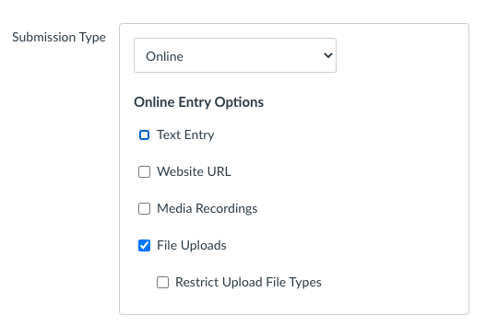
Teacher: File Submission Choice

Slide 6
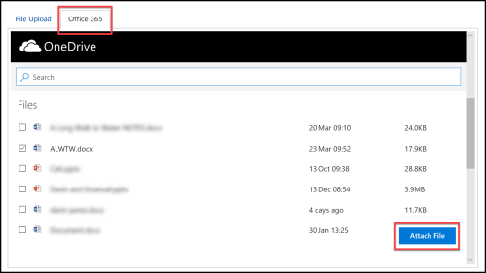
What Students See

Slide 7
SPeedGrader

Slide 8
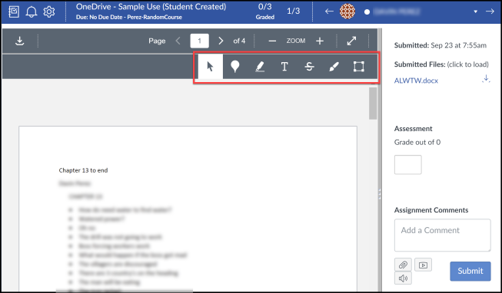
Speedgrader
After you click on the SpeedGrader, you will notice the standard SpeedGrader format but be able to add additional feedback because of the SpeedGrader file feedback tools.

Slide 9
Rich Content Editor

Slide 10
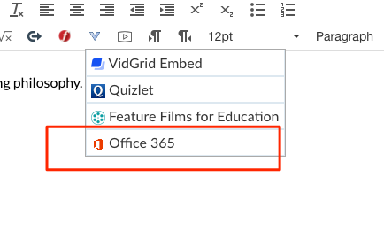
Rich Content Editor

Slide 11
Add to Module

Slide 12
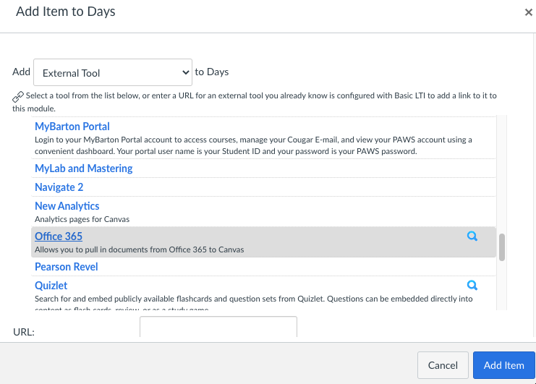
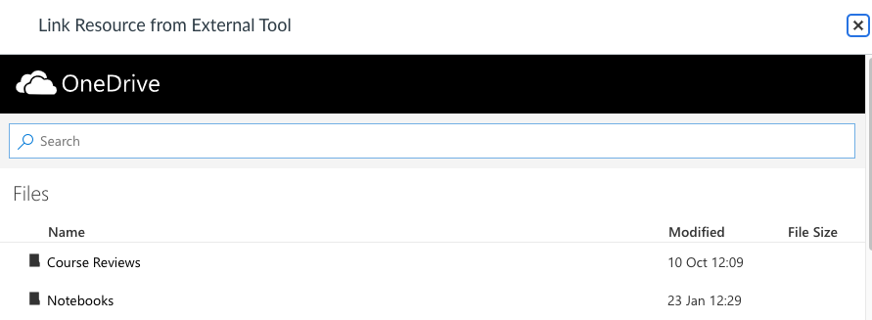
Module Add

Slide 13
Collaborations

Slide 14
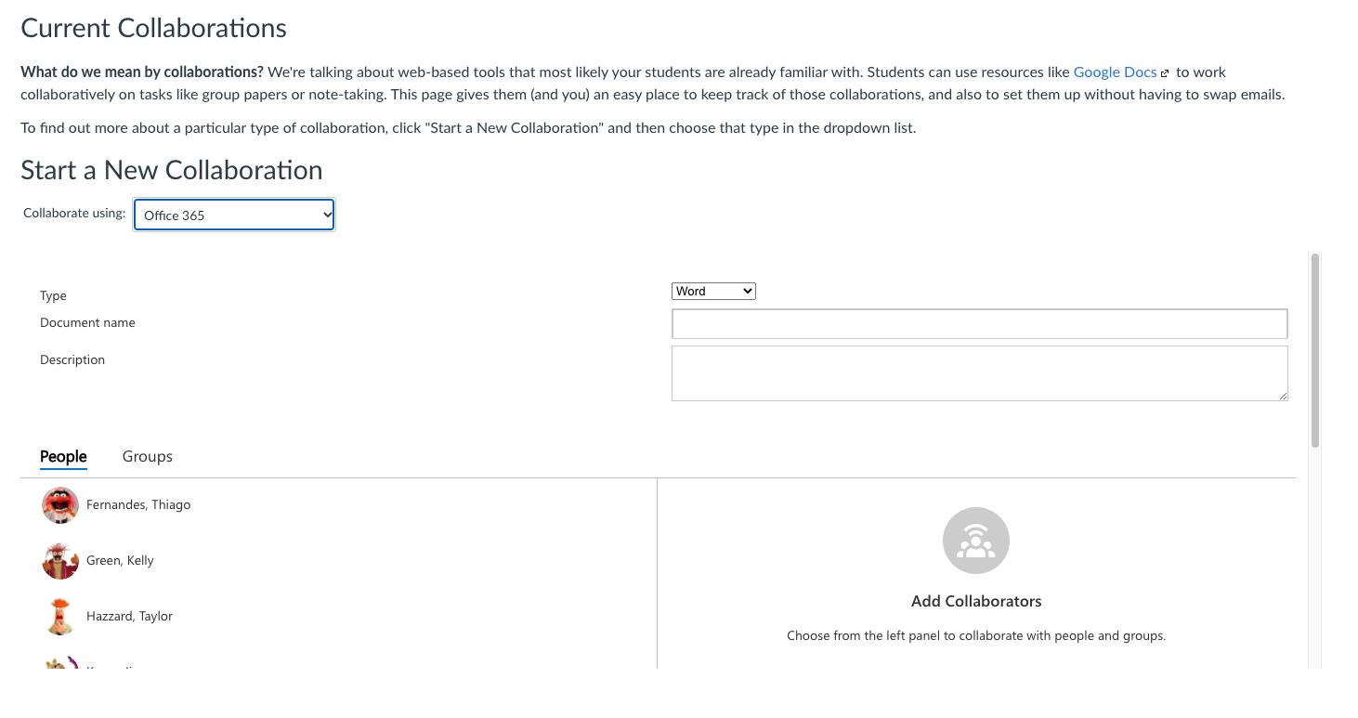
Collaborations

Slide 15

One note LTI Integration

