Slide 1
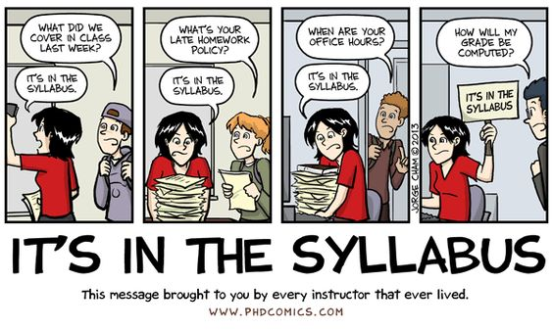
Concourse Syllabus
Brian Howe
Ange Davied

Slide 2
HLC Takeaways
Too many blank syllabi leading up to visit
More detailed instruction for completion
Minimum requirements on several syllabi components
Changes were needed for compliance

Slide 3
Overview of Concourse

Slide 4
Upcoming Template Changes Summer/Fall 2023
Contact Information
Textbook Information
Name, Email address & Preference
Availability
Link To Bookstore Added

Slide 5
Grading Method Section

Slide 6
Course Outline Changes
Curricular Mapping Information
Column Method
Module Information Listing
Topic List

Slide 7
Syllabus Change Process
New Syllabus
Changes in Syllabus (Outcomes, Hours, Description, Title)
New Program
Program Revisions
LICC Website
liccdocs@bartonccc.edu

Slide 8
FAQs
When do Concourse syllabi become active to edit for a subsequent term?
About three months before the beginning of the term. It is strongly encouraged to populate your syllabi for upcoming classes when they become active.
When do I need to complete my syllabi?
Do It Now!
What do I do if there is an issue with my syllabus?
concourse@bartonccc.edu
Tutorials & Videos
https://internal.bartonccc.edu/faculty/licc

