Slide 1
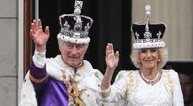
The CAT (reporting) is dead. Long Live the Course Assessment Report

Slide 2
Session Objectives
Session Objectives
Summarize the current expectation around the classroom level of assessment
Articulate the place course assessment reporting plays in Barton’s larger culture of assessment
Describe the current process for submitting a course assessment report
Recognize best-practices for high-quality course assessment reporting
Notes:
https://bartonccc.edu/assessments/student-learning

Slide 3
Why do we assess?
HLC Criterion 4B
The institution has effective processes for assessment of student learning and for achievement of goals in academic and co-curricular activities
The institution uses the information gained from assessment to improve student learning
The institution's processes and methodologies to assess student learning reflect good practice, including the substantial participation of faculty, instructional, and other relevant staff members

Slide 4
Barton’s Principle of Assessment
Assessment at Barton …
serves to improve student learning
is comprehensive and based upon the values reflected in the mission of the college
involves a variety of assessment methods
is a systematic and continuous process for gathering and using information about student learning
confirms the achievement of student learning outcomes at Barton
is integrated as part of the culture at Barton
is supported through on-going training and budgeting processes
Notes:
https://bartonccc.edu/assessments/student-learning

Slide 5
Course Assessment in the Big Picture

Slide 6
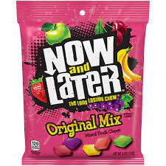
Course vs Classroom Assessment
Now (CATs)
Day-in-day-out adjustments within the same course are still expected
Later (Course)
Assessments of student learning vis-à-vis course competencies at the conclusion of a course
Reporting on those adjustments is no longer required
Reporting is required every Fall and Spring

Slide 7
Course Reporting Rates
Course Assessment Reporting Rates
Fall 2021 – 51%
Spring 2022 – 70%
Fall 2022 – 89%
Fall 2022 Reporting
Great Bend campus – 84%
Ft. Riley – 96%
Ft. Leavenworth, Grandview, Barton Online – 100%

Slide 8
Course adjustments
93% of instructors reported making adjustments to their courses. Adjustments include:
Altering existing course materials
68% of instructors provided specific quantitative data
creating or finding new course materials,
attempting new/different instructional approaches,
changing the sequence or relative emphasis of topics covered in class

Slide 9
Current Procedure
Current Procedure
Lag between one semester and the next
Passive data collection at end of semester
Active data collection at start of next semester

Slide 10
Spring 2023 Data collection
Passive data collection is already open
Submitting a Report
Active solicitation via email
One blanket email on Friday August 11
Targeted email reminders Friday August 18, 25, and September 1
https://forms.office.com/r/1T44RfFKZW
Deadline is Monday, September 4 at 11:59 PM
57 Responses through Sunday, August 6th

Slide 11
Future Procedure
Future Procedure
Starting Fall 2023, we will be collecting at the end of the semester (November-December 2023)
Why???
Little difference between reporting prospective vs retrospective changes is not
Fall vs Spring verbiage can be confusing with the data lag
Advantage of reporting while it’s still fresh in our minds

Slide 12
Rationale for Process Change
Response rates have been good and rising steadily
Want to focus on what we are actually putting in our reports
Good numbers are a good start
Shift are focus to better quality and detail within our reports

Slide 13
Tie it to a specific competency
Have empirical data to back it up
Keep the focus on ‘Later’
Be as detailed in describing your adjustment as possible
Ex: 78% of students were …
Ex: Next time I teach this course …

Slide 14
Citing Specific Competencies
Good Examples
Needs Improvement
“ Technique”
“H2 Work in a group setting safely and effectively, using scientific equipment carefully and correctly.”
“Speaking and Listening”
“Define the role of the Electoral College in the election of a president.”

Slide 15
Base Your Adjustments on Data
Good Examples
Needs Improvement
“Student had difficulty interpreting map distances and related questions.”
“67% of students were unable to use sources to effectively manage their sources in the Rhetorical Situation given in the assignment.”
“They need to improve the proper form of weightlifting.”
“10 of 24 students were unable to properly demonstrate proper tie down methods.”

Slide 16
Provide Adequate Information
Good Examples
“Provide more examples”
“I plan to add additional question on the thesis approval form including "Why should this thesis be argued?" and "What could we spend more time on in class to help you with this thesis?"
“Spend more time teaching”
“I added an activity for students to look at the tax documentation from someone who owns real estate to see the division of taxes that go to the school…’
Needs Improvement

Slide 17
Focus on the ‘Later’
Good Examples
Needs Improvement
“Through the year, the one consistent comment that was in all of the CATS was about the accountability forms.”
“This was missed on three assessments ie. Quiz, unit Exam, and final Exam. Differentiating between Schizophreniform, Schizoaffective, and Schizophrenia proved to be difficult.“
“My student reported on the one-minute paper stating that she needed clarification on this.”
“Only 43 out of 81 students were able to give a correct response to this question on the Post Test (Course Assessment)”

Slide 18
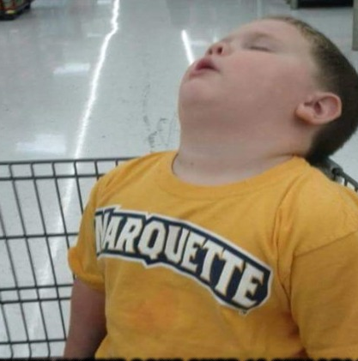
Questions??

