Slide 1
Outcomes in Canvas
Presenter:
Jo Harrington

Slide 2
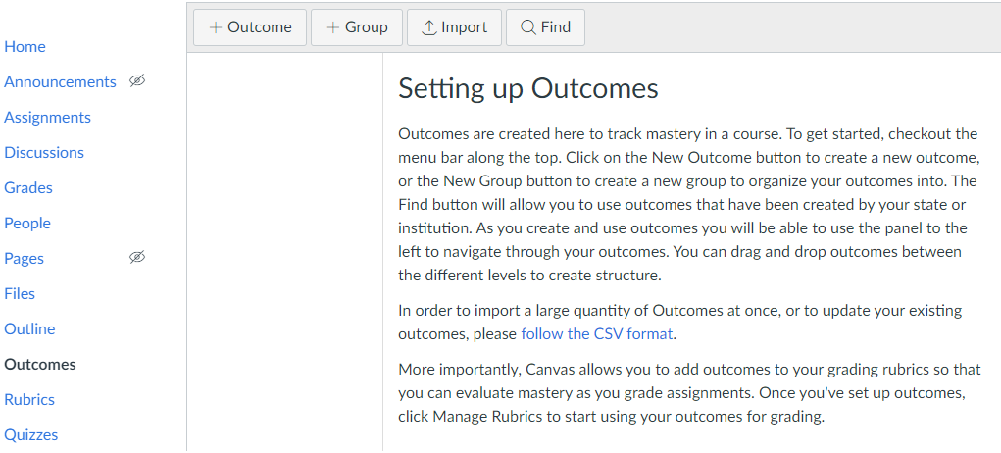
Outcomes
2
3
1

Slide 3
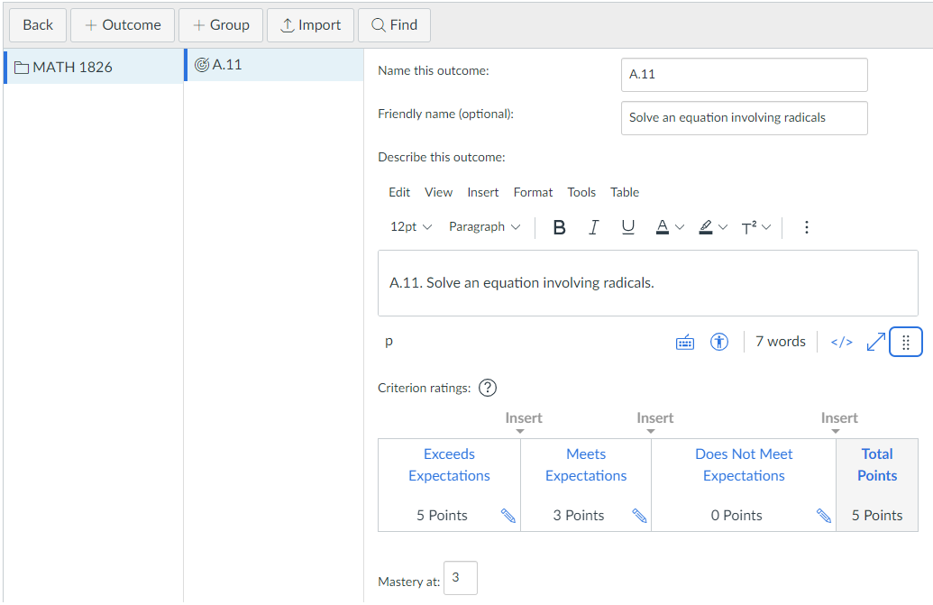
Competencies
1
2
Save
3

Slide 4
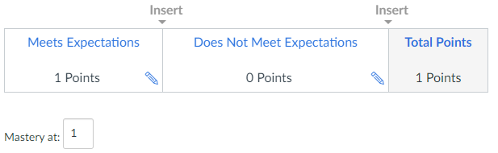
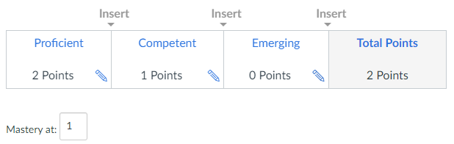
Examples

Slide 5
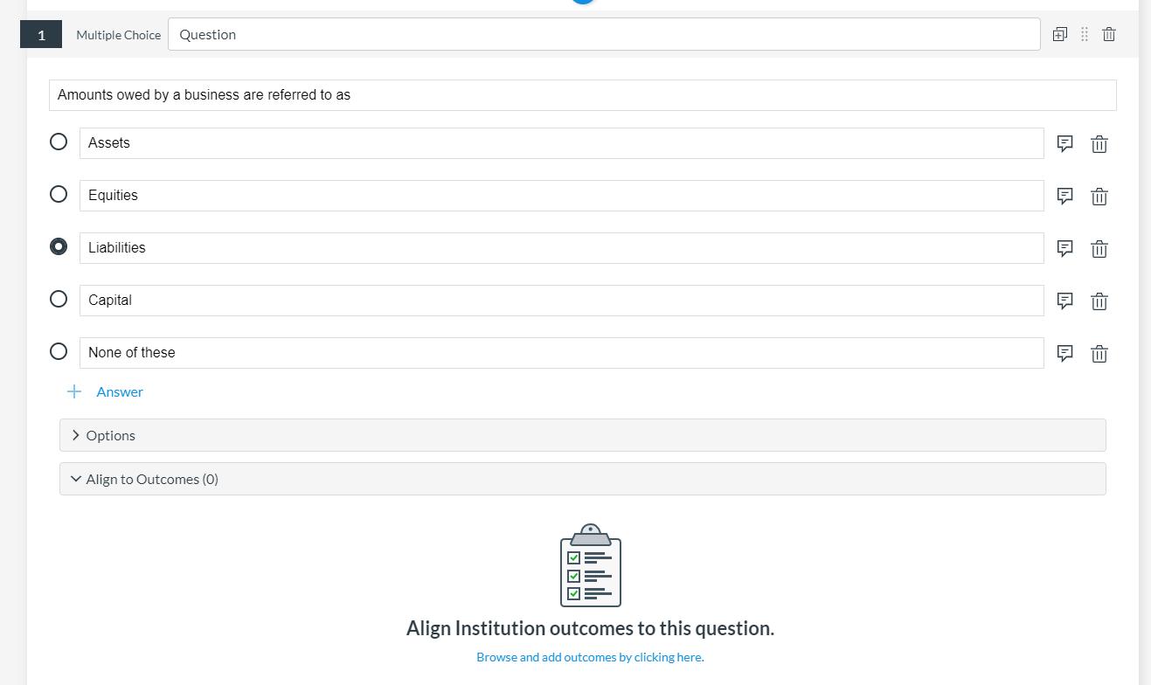
“New Quizzes” - Quiz Questions
1
2
3

Slide 6
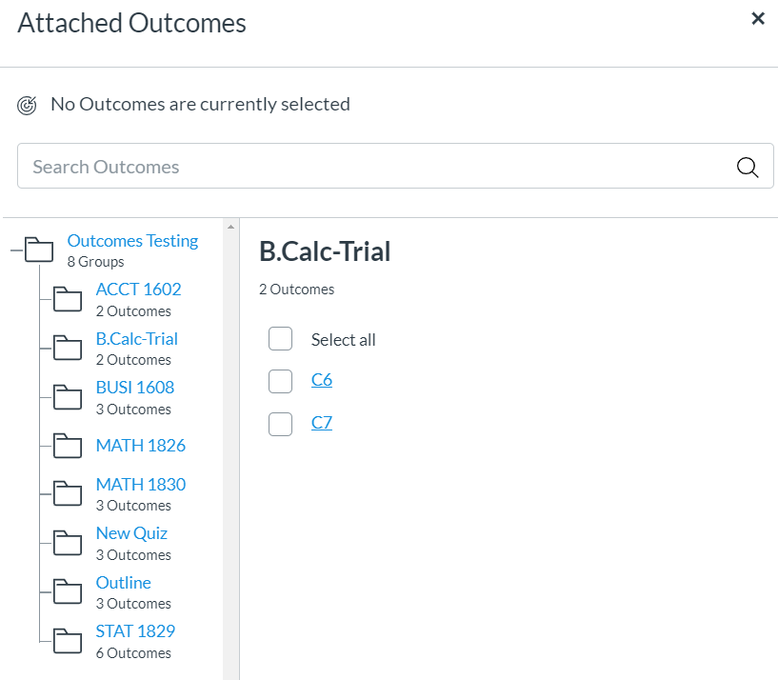

“New Quizzes” - Quiz Questions
1
2
Save

Slide 7
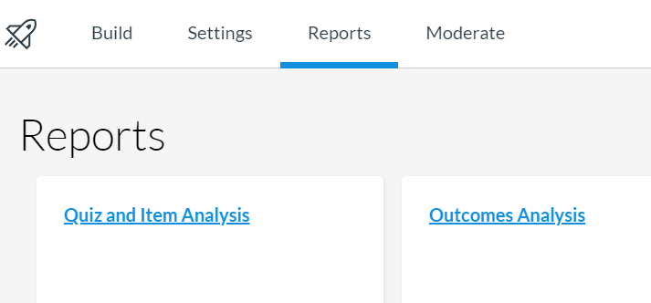
“New Quizzes” - Reports
1
2

Slide 8
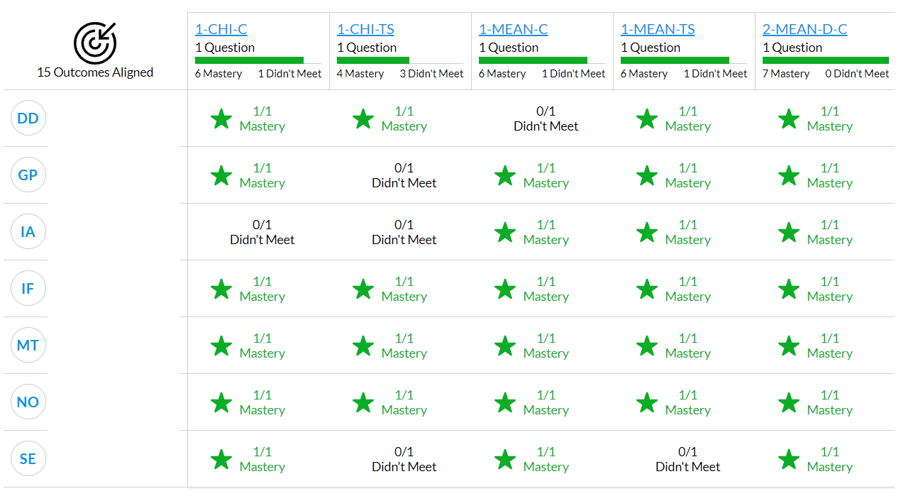
“New Quizzes” - Reports

Slide 9
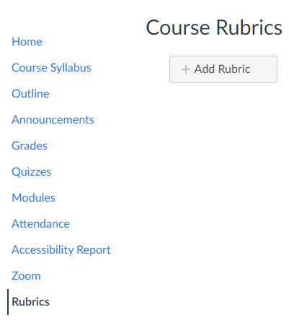
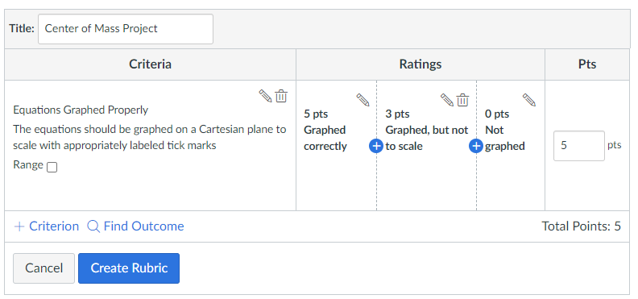
Rubrics
3
2
4
5
1

Slide 10
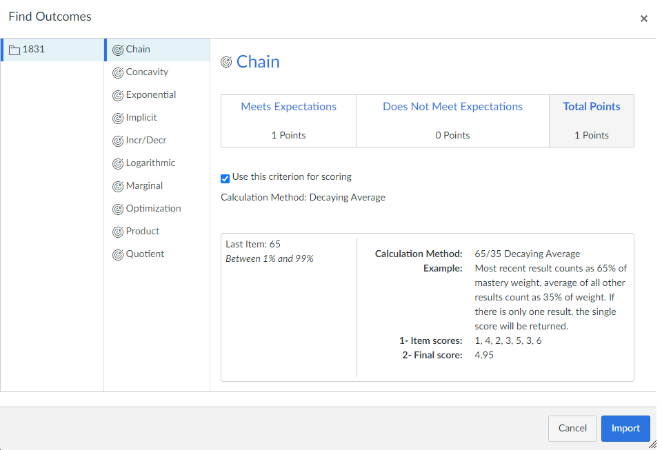
Rubrics
2
1
3
4

Slide 11
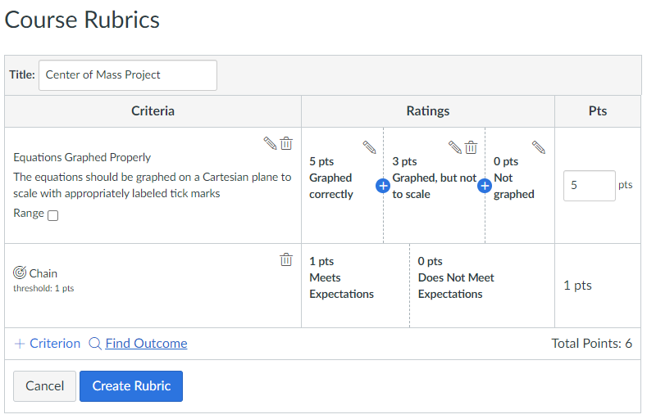
Rubrics

Slide 12
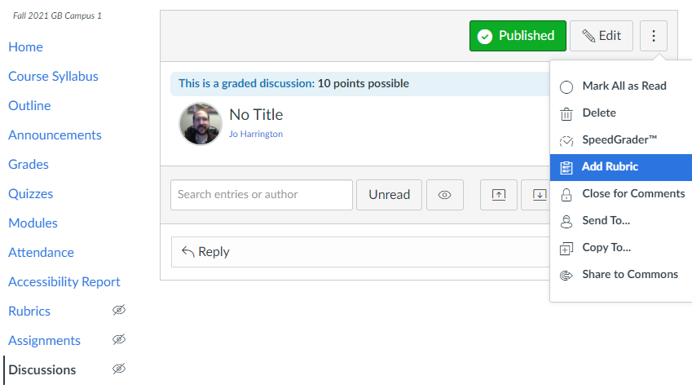
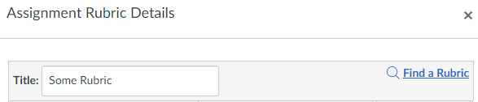
Discussions
2
3
4
1

Slide 13
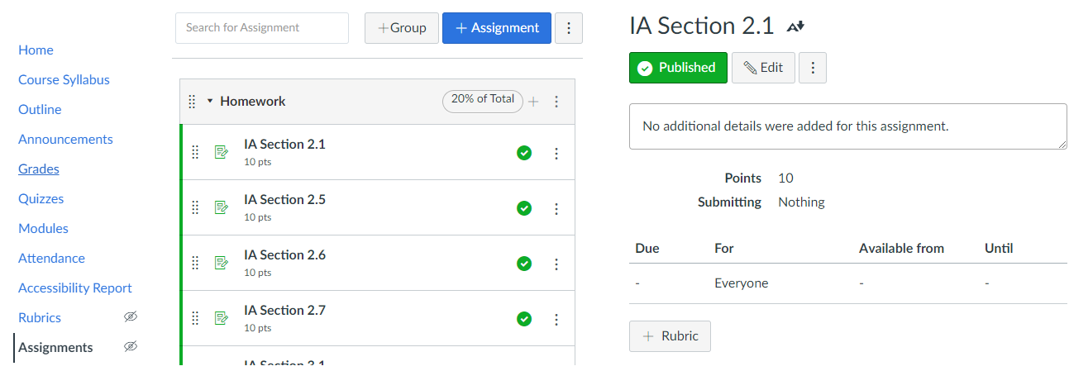
Assignments
2
1
3
4

Slide 14
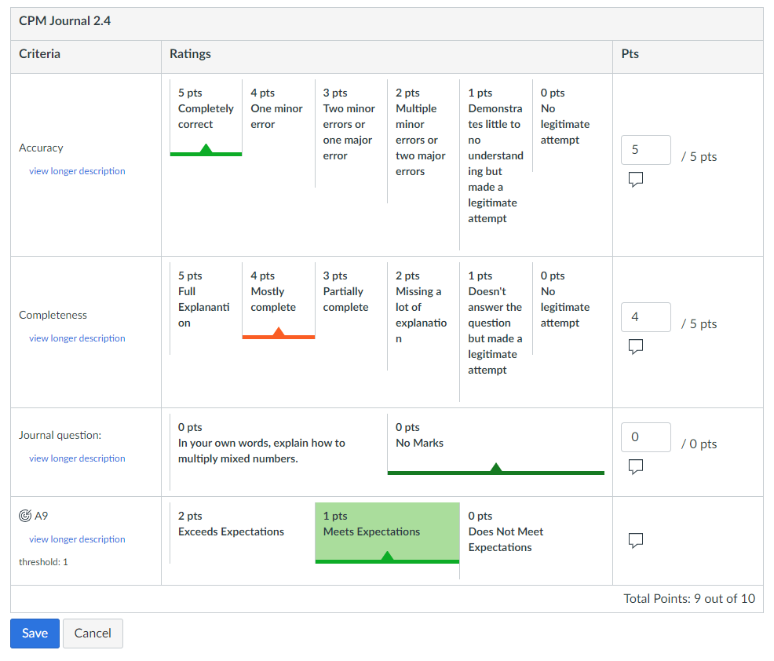
SpeedGrader

Slide 15
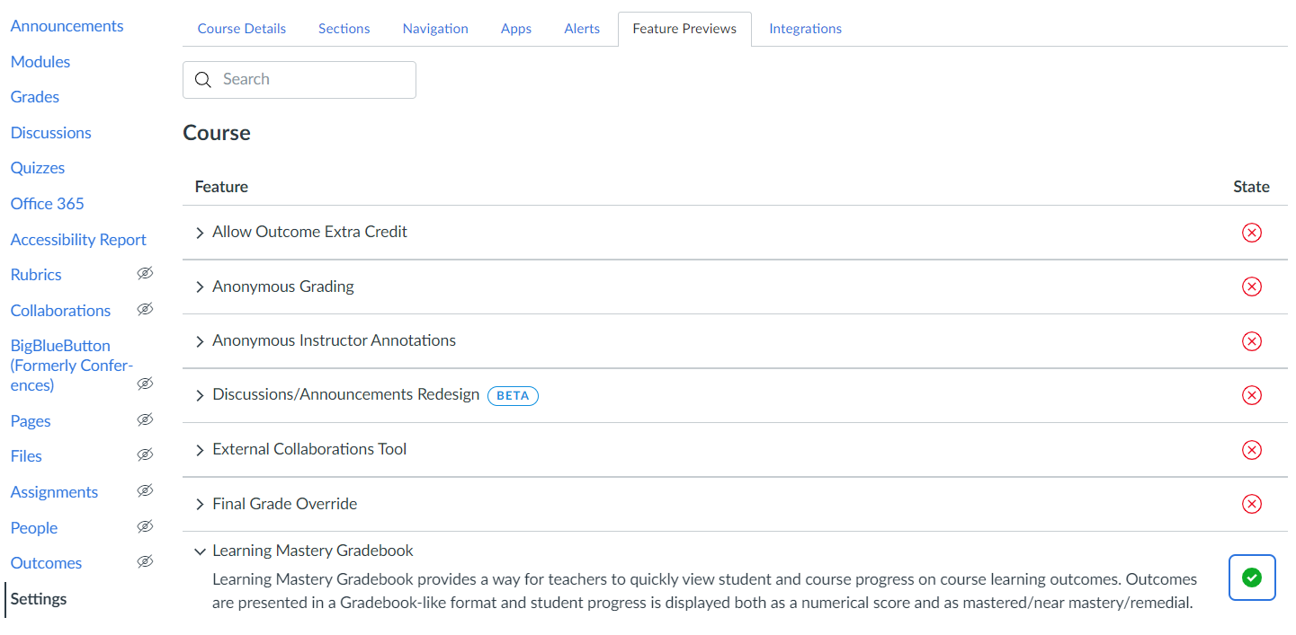
Learning Mastery Gradebook
2
3
1

Slide 16
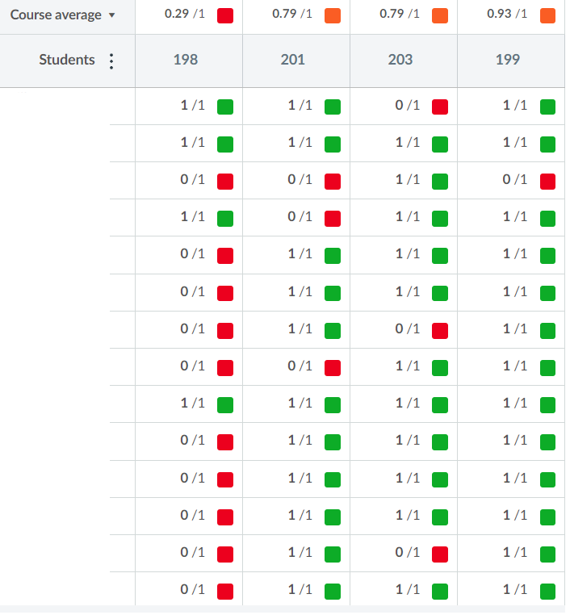
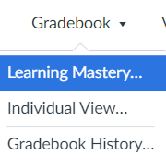
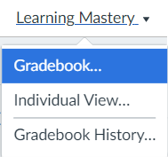
Learning Mastery
Gradebook
1
2
3
4

