Slide 1
Conducting and Documenting Course Assessment

Slide 2
Session Objectives
Understand importance of classroom assessment in meeting HLC Criterion (4b)
Develop a plan to document adjustments made to at least one course based on course assessment data for Fall 2021 semester
Describe process to submit course assessment documentation

Slide 3
HLC Criterion 4B
The institution engages in ongoing assessment of student learning as part of its commitment to the educational outcomes of students

Slide 4
HLC Criterion 4B
The institution has effective processes for assessment of student learning and for achievement of goals in academic and co-curricular activities
The institution uses the information gained from assessment to improve student learning
The institution's processes and methodologies to assess student learning reflect good practice, including the substantial participation of faculty, instructional, and other relevant staff members

Slide 5
Course Assessment
Place of Course Assessment in Big Picture

Slide 6
3 T’s of Assessment
Today – Classroom Assessments
Tomorrow – Course Assessments - Me
Together – Course Assessments -We
Notes:
https://www.screencast.com/t/WEUgMPtaR
Faculty are required to do multiple CATs each term and will continue to document one
Faculty are required to teach and assess all of the stated competencies in a given syllabus and now document two competencies from one course each term beginning in fall 2021

Slide 7
https://www.screencast.com/t/WEUgMPtaR

Slide 8
Course Competencies
Fall 2021
Faculty have always been required to teach and assess all of the stated competencies in a given syllabus
A given course is simply the totality of all of its competencies
Faculty will now be required to document student learning based on the competencies in ONE course
Faculty will need to submit results for two different competencies – one that could be deemed a strength and another that could be deemed a weakness
Link to a form will be emailed to faculty as the Fall 2021 semester ends

Slide 9
Exams
Projects
Capstones
Speeches
Recitals
Portfolios
Notes:
Three pillars again

Slide 10
I reworked my entire lecture where I cover competency 2A
I added a capstone project that better addressed competencies 3A-F
I added a supplemental text that addresses competencies 4A-C
I developed a new rubric to better assess student learning
Notes:
Three pillars again

Slide 11
Timeline – Where we’re headed
Cougar TALEs (Fall 2020)
Pilot Round II (Fall 2020)
Lessons Learned/Adjustment (Spring 2021)
Campus Wide (Fall 2021)
HLC Visit (October 24-25, 2022)

Slide 12
The form
https://forms.office.com/Pages/ResponsePage.aspx?id=jzFwT5Y5jEGhyumzq5b4FNoObP_xrnFNo8FfHEHOW9ZUNURSWjNJRTJUMzIxMFZBSjk1TEhJTkg0Si4u

Slide 13
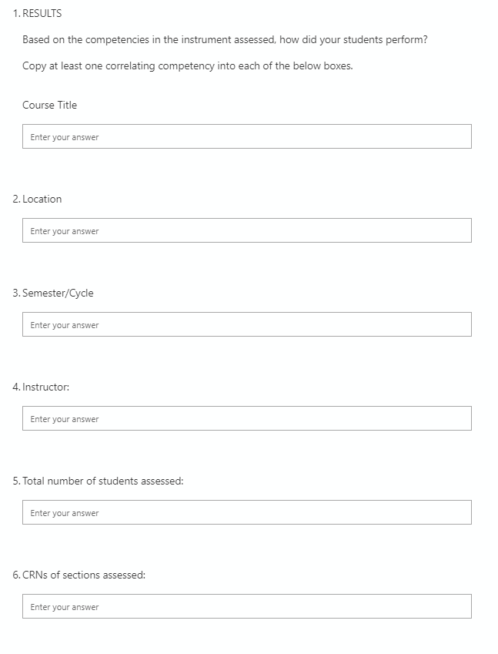
The form

Slide 14
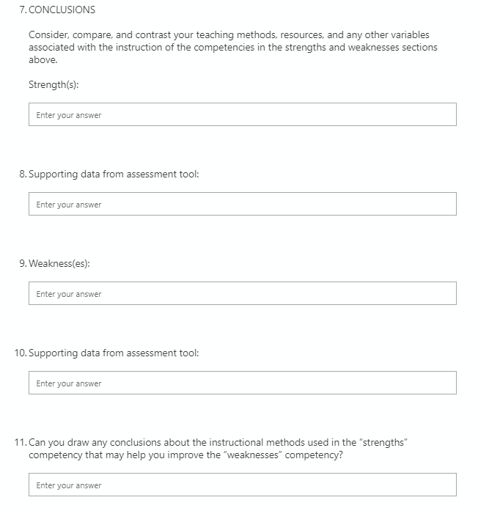

Slide 15
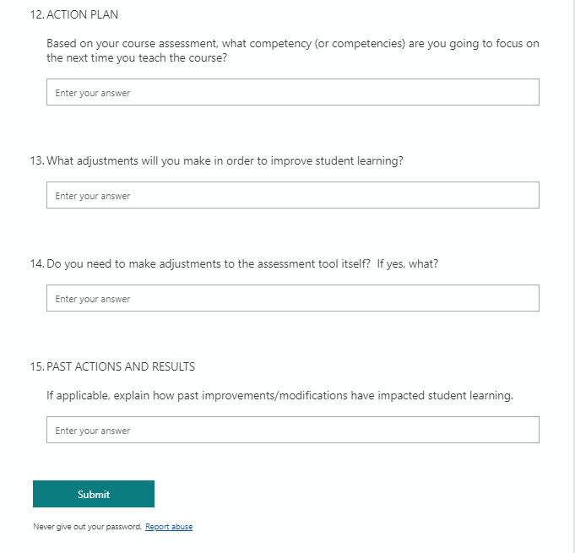

Slide 16
Your Turn
The remainder of the session will be used for workshop time where you may test out the form, submit sample results, ask questions of committee members, etc.

Slide 17
Committee Members
Charlotte Cates
Emily Cowles
Kurt Konda
Karly Little
Scott McDonald
Dr. Oleg Ravitskiy
Laura Schlessiger

Slide 18
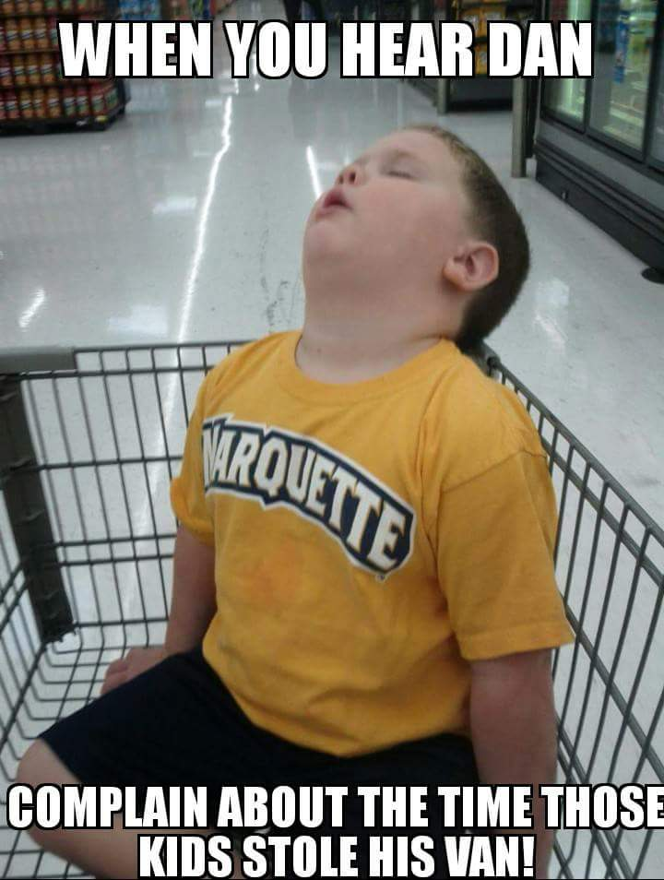
Questions??

