Slide 1
Psychological First Aid
Jacquelyn Maser, MS LPC
Recovering After a Crisis
Supporting Through a Crisis

Slide 2
PFA- WHAT IS IT?
A supportive and compassionate presence designed to stabilize and mitigate acute distress, as well as facilitate access to continued care.
Traumatic Stress is not mental illness. It is an ordinary reaction to an extraordinary event.
Does not entail diagnosis and treatment
Is a form of Crisis Intervention
Can be traced back to WWI

Slide 3
If one is truly to succeed in leading a person to a specific place, one must first and foremost take care to find him where he is and begin there.”
-Kierkgaard, 1948/1998, p. 48

Slide 4
PFA
Action of PFA are:
Goals of PFA are:
Meet Basic Needs
Stabilize acute psychological/behavioral reactions
Assist in recovery of some degree of resiliency
Foster natural coping and resilience mechanisms
Facilitate access to continued support for higher level of care
Comfort and consolation
Physical Protection
Provision of physical necessities
Channeling energy into constructive behaviors
Reuniting victims with families
Behavioral/emotional support
Allowing emotional ventilation
Re establishing a sense of security
Utilization of acute social and community support networks
Referral for those in need
(John Hopkins Model, 2017)

Slide 5
PFA
Carl Rogers noted 3 things required to provide psychological support:
Two or more people need to be present and one needs to have less need for psychological support than the other at that moment in time.
The person with less need for psychological support needs to genuinely care about the other person whose need is greater.
The person with greater need for support must be aware that the other person cares.
#1 Factor: Approachability: Friendly, trustworthy, authentic.

Slide 6
“I don’t like that man… I must get to know him better.”
- Abraham Lincoln

Slide 7
John Hopkins Public Health perspective recognizes that in the wake of disaster, 3 dynamics would come into play:
Mental Health casualties would far outnumber physical casualties, depending on cause of disaster.
Psychological distress is potentially “contagious”
A distinct shortage of mental health clinicians available to provide psychological services means personnel outside of the mental health professions, such as educators and emergency services personnel need to be trained.
(The John Hopkins Guide to Psychological First Aid, 2016)

Slide 8
PFA- Reaction Phases
Hero Phase: Everyone bans together to help
Honeymoon Phase: Appreciation of assistance efforts, community cohesion, camaraderie
Disillusionment- Realizes magnitude of loss
Reconstruction- Accept losses, builds new normal.

Slide 9
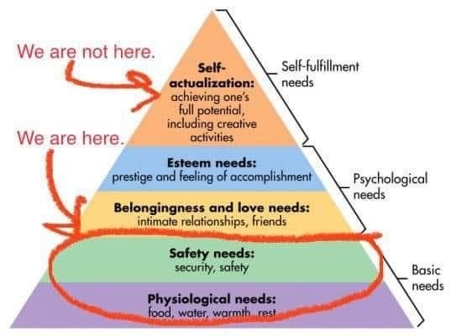
PFA- Contributing Factors
Contributing Factors to Psychological Impact:
Length of disaster
# of deaths
Extent of devastation
Occurred with or without warning
Unknown causation
Management of disaster relief operation
Quality of communication by officials
Whether families are separated.

Slide 10
PFA- Stress Reactions
Stress reactions often occur months after the event.
Other stressors become more prevalent.
Emotional Reactions
Anxiety
Fear
Depression
Numbness
Withdrawal
Anger
Irritability
Physical Reactions
Arousal of nervous system
Gastrointestinal issues
Increase in blood pressure, blood sugar and heart rate
Sleep difficulties
Suppression of the immune system.
Behavioral Reactions
Self medicate
Increase in family trouble, abuse
Avoidance, isolation
Overprotective parents
Cognitive Reactions
Difficulty processing information
Difficulty in concentration, short term memory, thinking clearly and decision making.

Slide 11
PFA- Skills
Support is often found in Silence.
Buddhist approach to disaster psychology.
Active listening or “Wawokiya”.
I’m all EARS.
E- Encourage
A- Ask ?’s
R- Reflect
S- Summarize

Slide 12
PFA- Skills
Help to identify acceptable responses to a problem:
Change Situation
Avoid Situation
Tolerate Situation

Slide 13
PFA- SKILLS
Evaluate for the need for professional help.
Unpleasant symptoms last more than a month
Difficult to function effectively in work, school, home
Concern about behaviors or emotions
You suspect person poses a risk to self or others
You feel persons difficulties are uncomfortably beyond your skill level
You are in need of as much or more psychological support than the person you are trying to help. **

Slide 14
PFA- SKILLS
Distress
Dysfunction
Difficulty concentrating
Reduced problem solving capacity
Feeling overwhelmed/overloaded
Anxiety
Irritability
Frustration
Compulsions
Sleep/Eat disturbance
Easily Startled
Questioning faith
Headaches, stomach aches, muscle spasms
Easily injured
Frequent colds (decreased immunity)
Hopelessness
Confusion
Suicidal thoughts
Delusions
Panic Attacks
PTSD
Immobilizing depression
Affective numbing
Aggression
Excessive substance abuse
Persistent avoidance
Cessation of faith
Chest pain, dizziness
Change in cardiac or gastrointestinal function
VS

Slide 15
PFA- Skills
Self Care
Self care is critical to remaining effective in supporting others through the lengthy process of recovery.
Self Care Strategies
Maintain a Routine
Get adequate Sleep
Exercise
Eat healthy
Support from Family and Friends
Avoid self medicating
Take Breaks
“It is common for people to want to push themselves until they drop organizing their own affairs or helping others. The problem with this strategy is that the ability to be effective steadily declines with prolonged continuous work hours. Efforts expanded become steadily less useful until a person’s efforts may even be counterproductive and can even interfere with effective recovery. In addition, this constantly driven behavior may result in dangerous levels of physical and psychological stress on the individual.”
(Jacobs, 2016, p.83-85)

Slide 16
Everly, George S., & Lating, Jeffrey M. (2017). The John Hopkins Guide to Psychological First Aid. John Hopkins University Press.
Jacobs, Gerard A. (2016) Community Based Psychological First Aid: A Practical Guide to Helping Individuals and Communities during Difficult Times. Elsevier.

