Slide 1
OER vs Barton OER Initiative
Clarifying Opportunities

Slide 2
Discussion Points
OER vs Barton OER Initiative
How To’s
Journals and Step-by-Step Guide
Notes and Tips

Slide 3
What is OER?
“Open Educational Resources are teaching, learning, and research resources that reside in the creative commons and/or public domain or have been released under an intellectual property license that permits their use and repurposing by others. OER may include full courses, course materials, modules, text-books, streaming videos, tests…used to support access to knowledge.”
Based around the 5Rs –
Retain, Remix, Reuse, Revise, and Redistribute
"OER Defined" by Larry Kramer, William & Flora Hewlett Foundation –
A derivative from the original work

Slide 4
Updated OER Definition - UNESCO
“Open Educational Resources (OER) are teaching, learning and research materials in any medium – digital or otherwise – that reside in the public domain or have been released under an open license that permits no-cost access, use, adaptation and redistribution by others with no or limited restrictions.”
“OER form part of ‘Open Solutions’, alongside Free and Open Source Software (FOSS), Open Access (OA), Open Data (OD) and crowdsourcing platforms.”
United Nations Educational, Scientific, and Cultural Organization – Nov 2019 – https://en.unesco.org/themes/building-knowledge-societies/oer/recommendation

Slide 5
Barton OER Initiative
Terms
No-Cost – no cost to the student
Low-Cost – below $50 student cost
Use of OER is one option to achieve the goal of transitioning to OER. By using these terms we open opportunity for faculty chose appropriate and diversify resources.
Resource options:
OER (Creative Commons including BY, SA, NC, & ND); Public Domain; Open Solutions (Open Data, Open Source, Open Access, etc.); Library Resources; Access to content with permissions; Educational Purpose content; “Free” content; low-cost resources; and Fair Use.

Slide 7
How To’s
Places to start OER Research:
OpenStax – https://openstax.org/
Libretext – https://libretexts.org/
Open Textbook Library – https://open.umn.edu/opentextbooks
BCCampus – https://open.bccampus.ca/
Galileo – https://oer.galileo.usg.edu/
Open Solution Examples:
Open Hardware (LC) – Arduino - https://www.arduino.cc/ or Raspberry Pi
Open Data - https://www.data.gov/open-gov/
Open Access - https://doaj.org/oainfo
Notes:
Arduino is an open hardware development board that can be used by tinkerers, hobbyists, and makers to design and build devices that interact with the real world.
The Raspberry Pi is a very cheap computer that runs Linux - people use Raspberry Pis to learn programming skills, build hardware projects, do home automation, and even use them in industrial applications.

Slide 8
How To’s
YouTube Shortcut:
Type in what you are looking for in the search field
Go to the “Filter” option
Select the “Creative Commons” (CC) option
All of the items in the search should be marked under CC
Some my indicate “Educational Use” or “Free” and that is fine
Double check by scrolling down and selecting “Show More” under your video
When that “Show More” opens make sure you see a CC license or other form of permissions
If you have questions please feel free to send me a link and I can help verify use or answer questions.

Slide 9
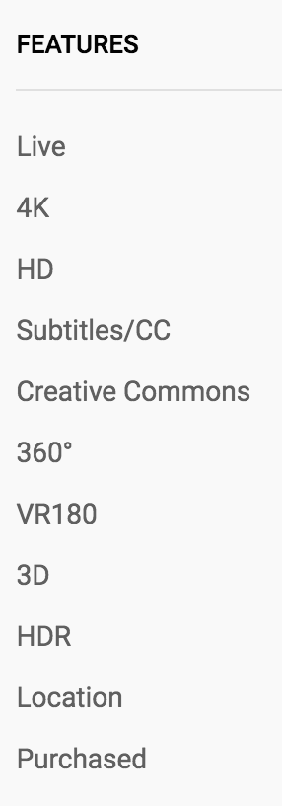
#1
#2
#3
#4
#5

Slide 10
Example Search Demonstration
Business

Slide 11
Instructional Course Design Journal & Step-by-Step OER Guide
Pick up at the Library – Murphy’s Landing

Slide 12
Notes and Tips
Website Use – “Personal Use” only – Refer to Fair Use
I will typically recommend or indicate replacing
Comment on ADA
ADA is federally required and everyone will be contacted at some point
ADA is a part of the OER process – OER is not a part of the ADA requirement
Canvas ADA checker will catch LMS items that Ally will not catch.
Ally will provide benefits that the Canvas ADA checker does not have
In short – Please use both: Canvas ADA Checker and Ally

Slide 13
Questions or Comments

