Slide 1

Course Assessment

Slide 2
Objectives
Differentiate between Course and Classroom Assessment Techniques
Understand importance of classroom assessment in meeting HLC Criterion (4b)
Outline ways to document ongoing course assessment in your own courses

Slide 3
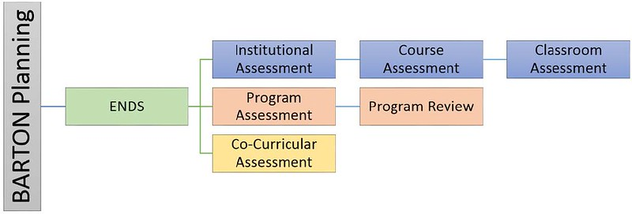
Course Assessment
Place of Course Assessment in Big Picture

Slide 4
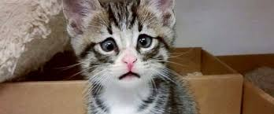
What is Course Assessment?
Notes:
First off – it is not a CAT

Slide 5
CATs versus Course Assessment
CATS | Course Assessment
Been doing for years | New committee; procedures in development
Changes enacted in current semester with same section of students (e.g. Monday to Wednesday) | Changes are enacted from one course to the next (e.g Spring to Fall)
Micro changes for a singular class/section | Macro changes to overall course
Notes:
Three pillars again

Slide 6
Course Assessment
We’ve been doing CATS (Classroom Assessment) and we’ve been doing Program Assessments.
We have a gap with Course level assessment.
In theory, we all are already doing course assessment, but …

Slide 7

Why Course Assessment?

Slide 8
Course Assessment
An official course assessment procedure simply formalizes the activities we are already doing as faculty.
Course assessment procedures allow us to document what we are doing to meet HLC requirements and supports our own efforts at improving our courses.

Slide 9
HLC Criterion 4B
The institution engages in ongoing assessment of student learning as part of its commitment to the educational outcomes of students

Slide 10
HLC Criterion 4B
  The institution has effective processes for assessment of student learning and for achievement of goals in academic and co-curricular activities
  The institution uses the information gained from assessment to improve student learning
  The institution's processes and methodologies to assess student learning reflect good practice, including the substantial participation of faculty, instructional, and other relevant staff members

Slide 11
Timeline – Where we’re headed
Cougar TALEs (Fall 2020)
Pilot Round II (Fall 2020)
Lessons Learned/Adjustment (Spring 2021)
Campus Wide (Fall 2021)
HLC Visit (2023)

Slide 12
Documenting an Improvement
Examples could include
  I reconsidered my entire lecture on competency B4
  I added a new project to better address competency C2
  I added a new text that better addressed competencies C1-C6
  I developed a new rubric to better assess what students were learning
This stands in contrast to CAT, where the typically small, targeted improvements might be something like
  Based on muddiest point feedback, I went over topic again for 15 minutes next class period

Slide 13
Documenting an Improvement
  Sociology example:
  D3: Apply the sociological imagination to a specific situation.
    Consistently one of lowest scores on post-assessments; revamped lectures to keep going back to concept and added final project based on race/class/gender and the sociological imagination
    Even with COVID-19 disruptions last semester, percentage of students able to accurately provide an example of the sociological imagination at post-assessment increased by a factor of 3.5

Slide 14
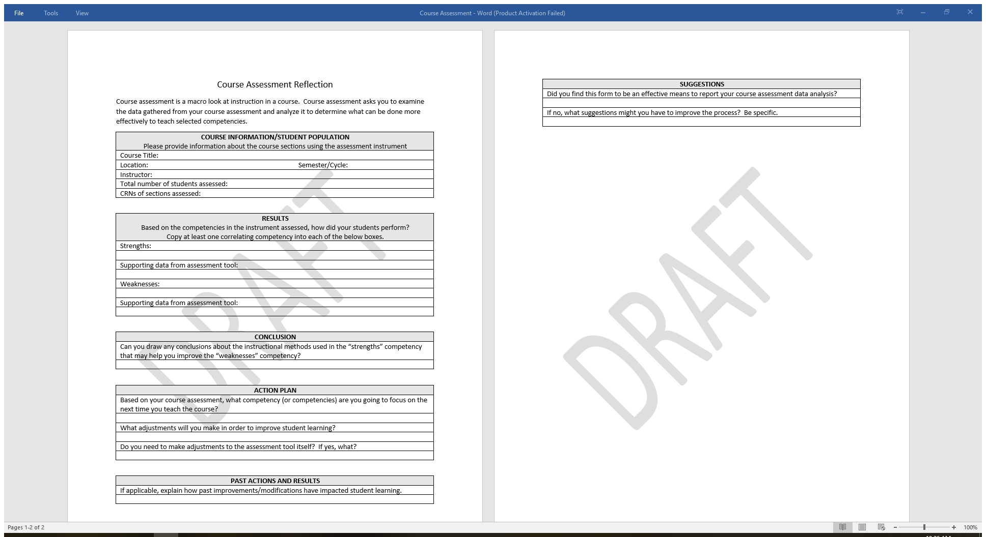
The form

Slide 15
Your Turn
May not have your competencies or exact data in front of you, but think of a similar change you have made
Take a couple of minutes to briefly share in the ‘chat’ on Zoom

Slide 16
What Now?
Process – we make the form available for review along with the slides of this presentation to Jenna Wornkey
For those in initial pilot group, we will be sending the form directly via email and old school Word document later on this semester
Meant to differentiate process from CATS –
More courses in Spring 2021; campus wide Fall 2021

Slide 17
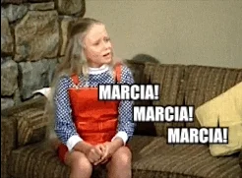
Competencies, competencies, competencies
It all comes back to the competencies

Slide 18
Competencies
In every syllabus – the competencies we will address form the backbone of our contract with our students: “this is what you will learn.”
KBOR and Transfers – the competencies are what our colleges look at with transfers. What are our students learning and what can incoming colleges expect our students to know?
Formal Course Assessment – formalizing what we are already doing, simply builds on this reality and allows us to meet HLC Criterion 4B

Slide 19
Competencies
A good grade doesn’t mean they learned the material; assessments based on the competencies do a better job of this.
A focus on the competencies allows us to identify what they are learning and not learning and allows us to focus and redouble our efforts in areas we are falling short and reinforce and expand those areas we are doing well.
Again, if you don’t document this, then it didn’t happen.

Slide 20
Committee Members
Charlotte Cates
Kurt Konda
Karly Little
Scott McDonald*
Dr. Oleg Ravitskiy*
Laura Schlessiger

