Slide 1

Navigating
Academic Integrity
COUGAR TALES PRESENTATION 2025

Slide 2

  Basic Terms
  Walk Through of Decision-Making Process
  Student Due Process
  Faculty & Tools
  Student Artificial Intelligence Survey
  Breakout Rooms
Agenda

Slide 3

Basic Terms
Basic Violation -
  Violations identified at the faculty level like plagiarism, basic inappropriate AI use, and other forms of basic cheating. (Faculty led)
Capital Violation -
  Violations that rise in severity or multiple basic violations. These can include fraudulent completion of course work, contract cheating, or violations involving Student Code of Conduct. (Administratively managed)
XF -
  Sanction that can be given for a basic or capital violation
AIVR Form -
  Academic Integrity Violation Form
Generative AI:
  “Generative artificial intelligence (AI) describes algorithms (such as ChatGPT) that can be used to create new content, including audio, code, images, text, simulations, and videos” McKinsey.com
Problem-Resolution Procedure (2615):
  How students appeal a basic violation.
Student Code of Conduct Procedure (2611)
  How students appeal a capital violation.

Slide 4

Decision Points
  Did a violation occur - preliminary assessment ?
    Yes/No???
    Basic/Capital???
Notes:
Ask Jenna to drop the flow chart into the chat as a PDF and a quick snapshot of the red and green arrows.

Slide 5

  Similar to Previously Submitted Work
  Something Feels Off
  Turnitin or Respondus LockDown Browser Information
  Wrong Assignment Submitted
  Not the Student’s Voice
  Wrong Name on Assignment
  Notification from Staff Member
Awareness of Concern

Slide 6

Past Case Example
3 Student Case:
  Degrees of connection
  Student interview
  Opportunity to be curious, ask questions, and learn.

Slide 7
Decision Points
  Did a violation occur - preliminary assessment ?
    Yes/No???
    Basic/Capital???
  What is the sanction?
    Educational Opportunity
    Grade-Based
    XF
    Course Specific
Notes:
Ask Jenna to drop the flow chart into the chat as a PDF and a quick snapshot of the red and green arrows.

Slide 8

What would you do?
  How do you determine the level of sanction?
  Student submits assignment that does not cite sources, and content is clearly not “common knowledge.”
  Student is recorded on proctored exam talking with a person outside of the frame about how to cheat.
  Student denies cheating but cannot reproduce work or explain process.

Slide 9
AIVR Form
Academic Integrity Violation Reporting Form
AIVR Form - link
  When a sanction affects a grade or course standing, procedure states AIVR needs to be completed.
  Good practice for third situation - Use the AIVR form to document the concern and document the conversation.

Slide 10

Student Communication
Minimal Needed Shared Information:
  What is the issue or concern?
  Notice of sanction
Best practice with the AIVR form:
  Reference to policy and appeal
  Student’s next steps or options
***Faculty responsibility is to maintain student privacy.

Slide 11
Decision Points
  Did a violation occur - preliminary assessment ?
    Yes/No???
    Basic/Capital???
  What is the sanction?
    Educational Opportunity
    Grade-Based
    XF
    Course Specific
  Student Response to Student Communication
    Accept/ Wish to Appeal
  Is the faculty sanction upheld after problem resolution review?
    Yes - student can appeal again
    No - sanction is overturned
Notes:
Ask Jenna to drop the flow chart into the chat as a PDF and a quick snapshot of the red and green arrows.

Slide 12

Student Due Process
Evidence / Participation:
Opportunity to respond.
Fair / Unbiased:
Policy, Documentation, Privacy
Notice:
Communication is required.
Notes:
A gradebook comment is not always sufficient -
Ex. Note to the student for to follow up with the faculty member and then follow up with an email.
Faculty - you will receive notice that you have a student in your class who is in your class, but the information will be limited to remain anonymity of the student.

Slide 13
Faculty Tools
Academic Integrity Violation Form
Your Gut
Evidence
Course Design
Student Conversation
Respondus
Turnitin

Slide 14
Student AI Survey

Slide 15
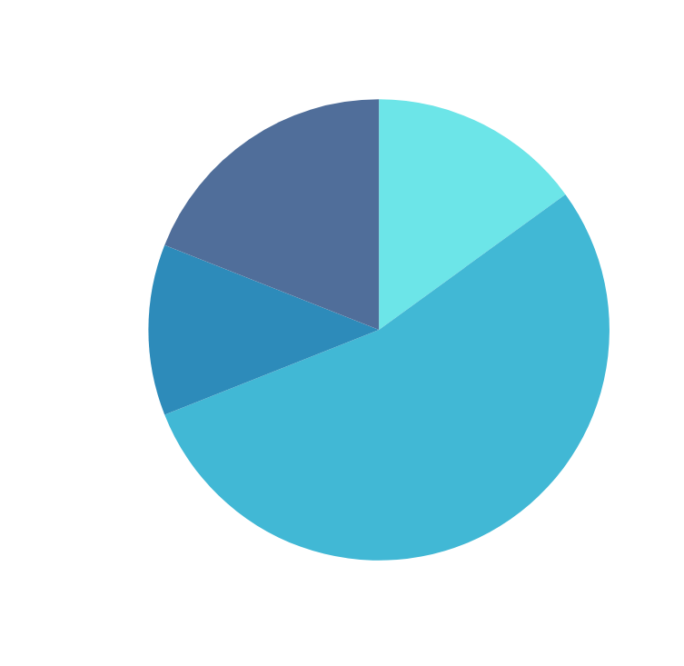
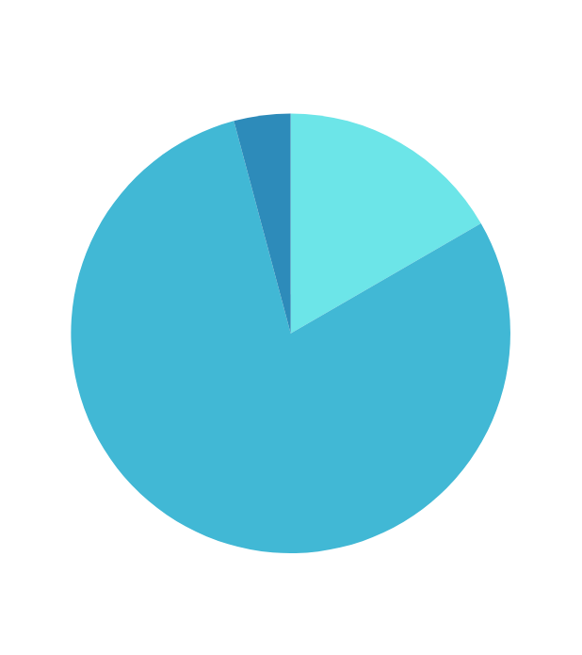
Student AI Survey
Have you ever used AI to complete homework in a way that your instructor would consider cheating?
How Often Do You Use AI?

Slide 16
Student AI Survey
When Do Students Use AI?
Impact on Learning
IDEA GENERATION
WHAT PROMPTS STUDENTS?
  Using when they need inspiration or don’t know where to start
  Students use because of ease and convenience. They also find it tailored to their needs, and reliable. Interestingly, some use it because they doubt their abilities.
RESEARCH/HOW-TO
  Use it a lot like Google - when they want an answer, quickly, or to see highlights of information
DOES IT IMPACT LEARNING?
IT DEPENDS
  The majority of students noted negative impacts on learning: over-reliance or laziness and replacing learning process.
  The good impacts listed: helps with chunking/organization and idea generation
HOMEWORK HELP
  When they don’t understand how to do homework or when they want what they would consider helpful hint/hand

Slide 17
Student AI Survey
Key Take Aways
QUESTIONS REMAIN
Students need help identifying when and where and why -
  Instructions from Instructors must be specific and continuous
  Explanation of assignment purpose, impact on learning helpful
POLICY IMPLICATIONS
  Students want opportunity to discuss
  Would like warning of mis-use (educational opportunities)
  Need clarity of how to respond to instructor concerns
ADDITIONALLY
If we know how and why students are using, how can we use that to support them?
  Better chunking of information/notes/assignments?
  What “Google” information are they getting that is incorrect?
  Students know which of their faculty “know” and “care” about AI

Slide 18
Breakout
Rooms

Slide 19
Thank You!

