Slide 1
Tales from the Data Side
The
^

Slide 2
Session Objectives
Session Objectives
Describe three best practices to submit higher quality course assessment data
Prepare a strategy to implement one best practice for your Fall 2024 Course assessment reporting
Detail the current procedure for reporting course assessment data
Articulate the importance of course assessment as part of the larger culture of assessment at Barton
Notes:
https://bartonccc.edu/assessments/student-learning

Slide 3
Why we Assess
HLC Criterion 4B-2
The institution uses the information gained from assessment to improve student learning
Barton Assessment
Confirms the achievement of student learning outcomes at Barton
Is integrated as part of the culture at Barton

Slide 4
Course Assessment in Barton Culture

Slide 5
Current Highlights
Highlights from Spring 2024 Report
Over 80% response rate for third cycle in a row (but slight downward trend)
Instructors are using an average of 1.8 assessment strategies (e.g. regular assignments, final exams, direct observation)
State of Spring 2024 Data Collection
168 responses through May 17th
181 responses as of August 12th (78%)
74% of respondents provided empirical data to support their course adjustments
“Last chance” Spring 2024 data collection through Monday, September 2nd

Slide 6
Current Procedure
What to Look for Fall 2024
Key Fall 2024 Course Assessment Dates
Data ‘mentors’ – one primary point of contact from Course Assessment committee
November 22nd – data collection opens
Active reminders December 2nd, 6th, and 13th
Fall data ‘closes’ December 15th
Last chance January 5th

Slide 7
Moving Forward
Shift from quantity to quality
80% + response rates are great, but …
It’s about how we are using these data to improve student learning
You can only get quality improvements out of your data if you have quality data to begin with

Slide 8
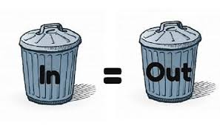
Session Objectives
Notes:
https://bartonccc.edu/assessments/student-learning

Slide 9
Best Practice #1

Slide 10
Work Smarter, not Harder
Don’t duplicate your efforts
How many of you already report quantitative assessment data (numerical data) at the end of each semester to Jo Harrington or a department chair?
Consider reporting your course assessment data at the same time
Link whatever adjustments you are going to make to that quantitative data

Slide 11
Best Practice #2

Slide 12
Work Together
Program level assessment
Instructional Review goals
Multiple sections/multiple instructors

Slide 13
Program Level Examples

Slide 14
Instructional Review Example
Check your current instructional review goals – at least one of those goals should support student learning
If that goals refers to specific competencies your entire instructional area is focusing on this cycle, consider using that data for your Fall 2024 Course Assessment reporting

Slide 15
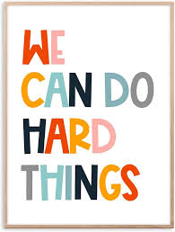
Best Practice #3

Slide 16
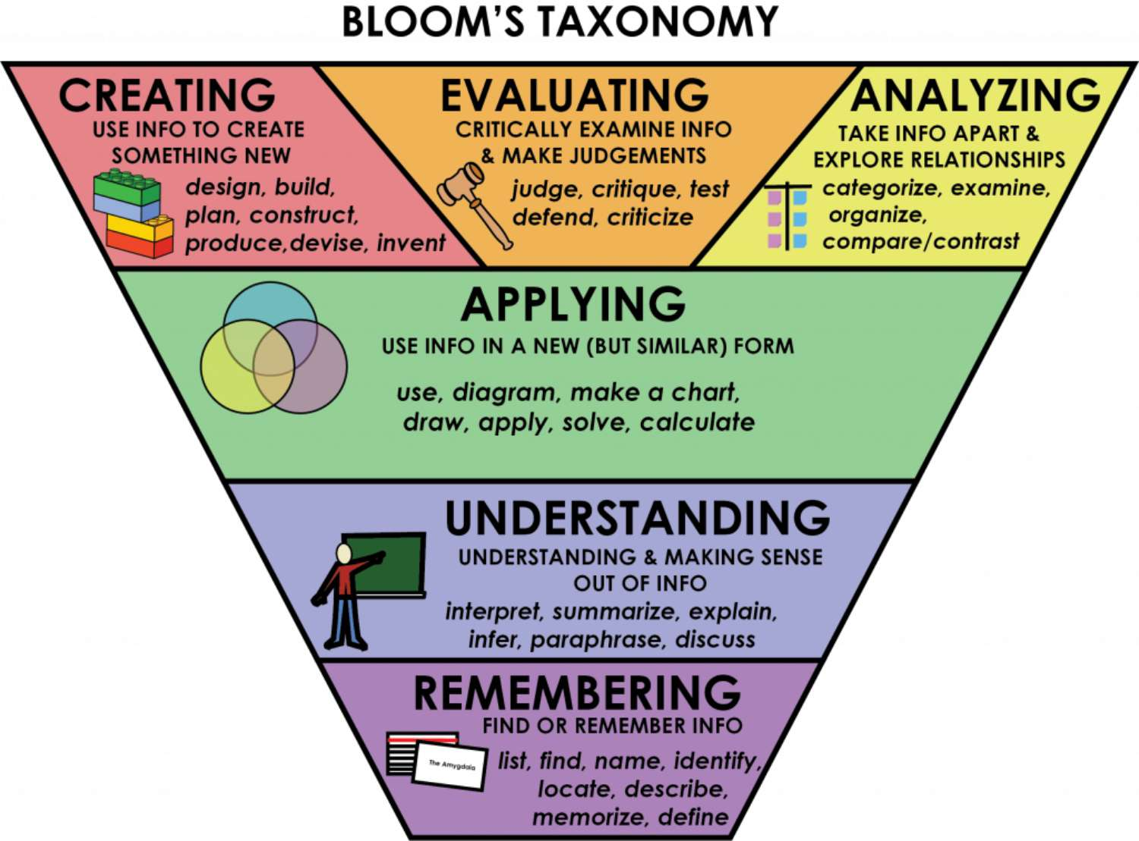
Best Practice #3

Slide 17
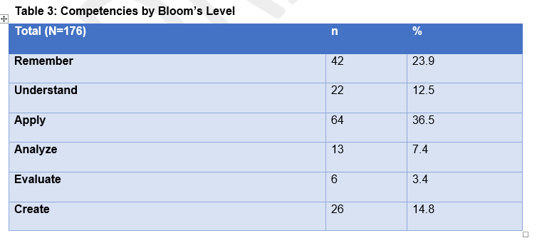
Upping Our Bloom’s Game

Slide 18
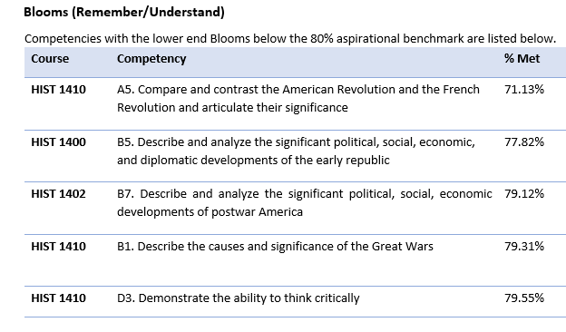
Upping Our Bloom’s Game

Slide 19
Upping Our Bloom’s Game
Before the semester begins …
Look at all of your course competencies
Identify and flag at least three Higher level competencies (Creating, Evaluating, Analyzing)
Identify and flag at least three Lower level competencies (Remembering and Understanding)
At the end of the semester …
Return to those flagged competencies
Report on either a Higher level competency that needs improvement OR
A lower level competency with a low ‘met’ rate

Slide 20
Session Objectives
New Fall 2024 Project
Course Assessment Reporting Form is designed to be short and sweet
Longer stories that don’t ‘fit in the box’ are of great value too
We will be reaching out later this semester to anyone who wants to share longer testimonials like this
Course assessment is looking for volunteers to share in more detail about how course assessment has improved student learning in their courses
Notes:
https://bartonccc.edu/assessments/student-learning

Slide 21
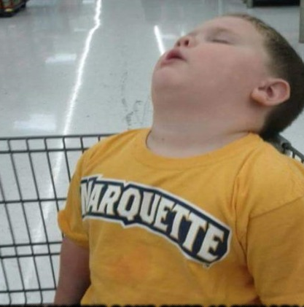
Questions??

