Slide 1
Welcome to the Fall 2020 BARTonline Division Meeting
Wednesday, July 22nd from 7-8 am
and
Thursday, July 23rd from 7-8 pm

Slide 2
Introductions
Hosts
Erin Eggers
Claudia Mather
Joining Us
Elaine Simmons
Kathy Kottas
Brian Howe
Kurt Teal
Special Guests
Ange Davied
Lee Miller
Todd Mobray

Slide 3
Meeting Agenda
BARTonline Updates
College-Wide Initiatives
Q & A

Slide 4
BARTonline Updates
Substantive Interaction
Ally
Canvas Updates

Slide 5
Substantive Interaction
Substantive Interaction Draft Communication

Slide 6
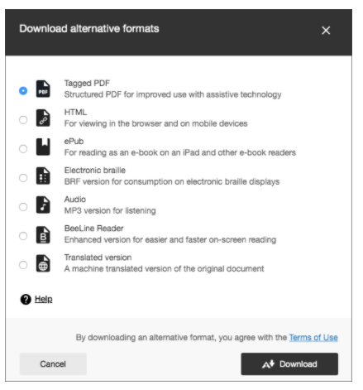
Ally
ADA Course Compliance Process

Slide 7
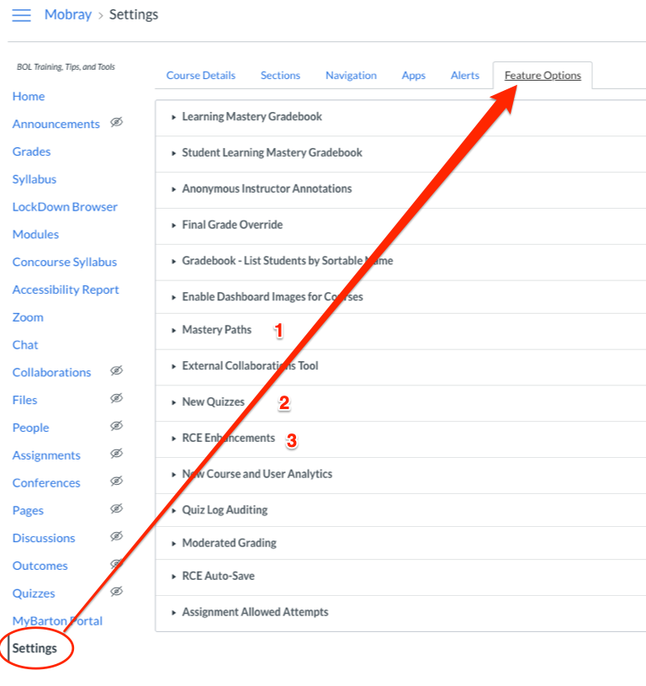
Canvas Updates
Enhanced Rich Content Editor
Mastery Paths
New Quiz Engine
Office 365 Integration

Slide 8
College-Wide Initiatives
Concourse
OER Update
Academic Integrity Campaign

Slide 9
Concourse
Web-based master syllabus

Slide 10
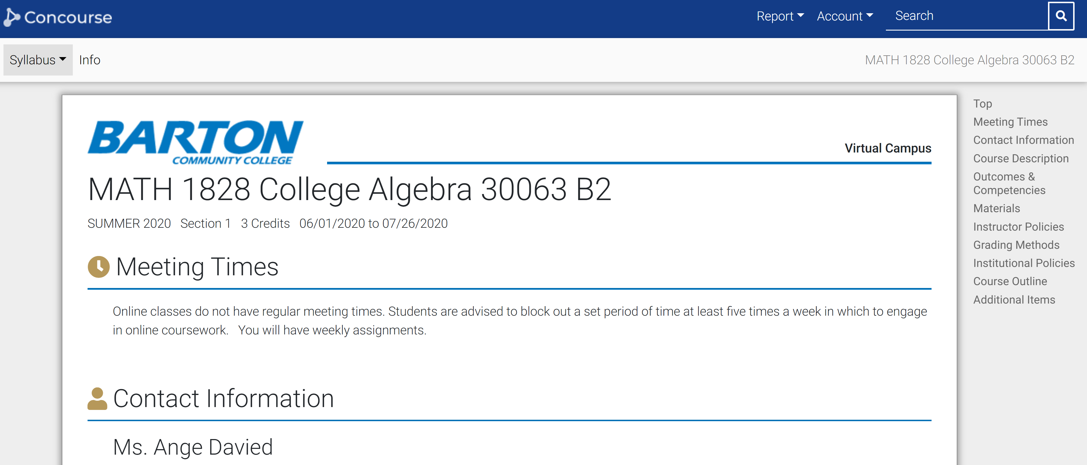
Concourse – Easy & Intuitive

Slide 11
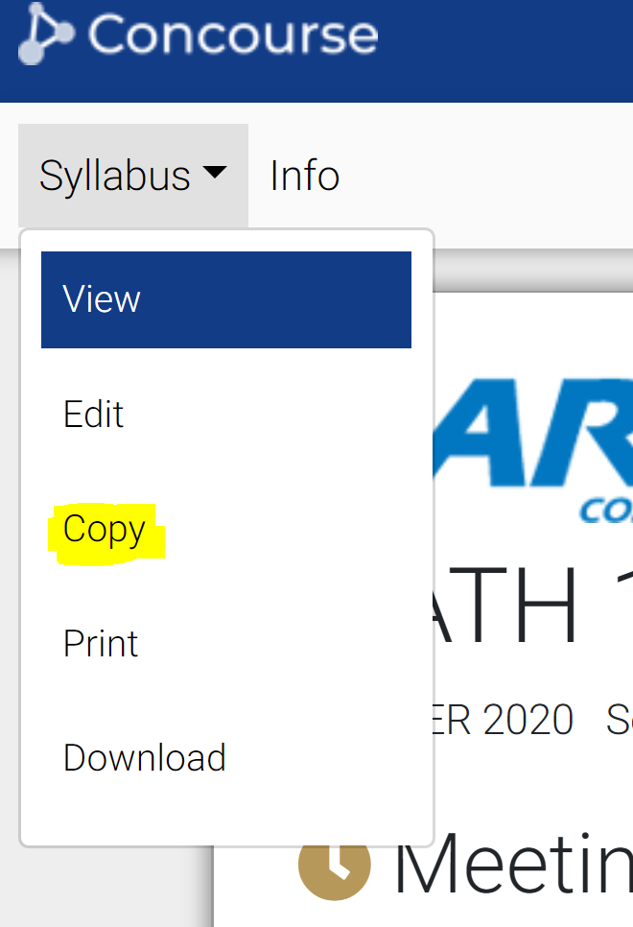
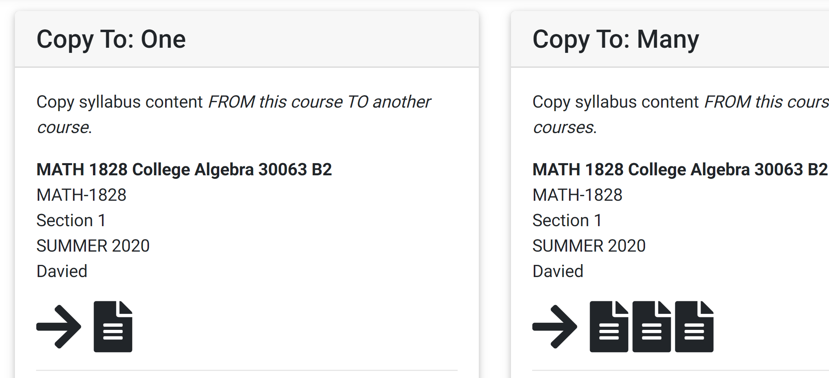
New Features

Slide 12
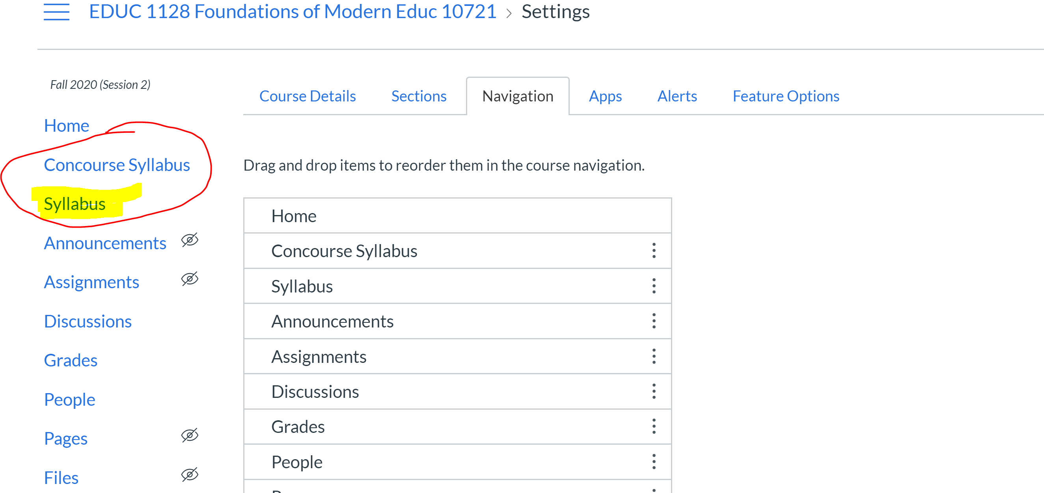
Changes - Coming Soon

Slide 13
Information
Online training available at https://internal.bartonccc.edu/faculty/licc
Training Handout
Watch recorded zoom session
Watch short video clips on concourse topics
Contact concourse@bartonccc.edu for assistance
Upcoming training
August 4th at 7pm
August 6th at 2:30 & 6:30

Slide 14
OER Update
OER vs Barton OER Initiative (Clarifying Opportunities)

Slide 15
What is OER?
“Open Educational Resources are teaching, learning, and research resources that reside in the creative commons and/or public domain or have been released under an intellectual property license that permits their use and repurposing by others. OER may include full courses, course materials, modules, text-books, streaming videos, tests…used to support access to knowledge.”
Based around the 5Rs –
Retain, Remix, Reuse, Revise, and Redistribute
"OER Defined" by Larry Kramer, William & Flora Hewlett Foundation / A derivative from the original work

Slide 16
Updated OER Definition - UNESCO
“Open Educational Resources (OER) are teaching, learning and research materials in any medium – digital or otherwise – that reside in the public domain or have been released under an open license that permits no-cost access, use, adaptation and redistribution by others with no or limited restrictions.”
“OER form part of ‘Open Solutions’, alongside Free and Open Source software (FOSS), Open Access (OA), Open Data (OD) and crowdsourcing platforms.”
United Nations Educational, Scientific, and Cultural Organization – Nov 2019 – https://en.unesco.org/themes/building-knowledge-societies/oer/recommendation

Slide 17
Barton OER Initiative
Terms
No-Cost – no cost to the student
Low-Cost – below $50 student cost
Use of OER is one option to achieve the goal of transitioning to OER. By using these terms we open opportunity for faculty chose appropriate and diversify resources.
Resource options:
OER (Creative Commons including BY, SA, NC, & ND); Public Domain; Open Solutions (Open Data, Open Source, Open Access, etc.); Library Resources; Access to content with permissions; Educational Purpose content; “Free” content; low-cost resources; and Fair Use.

Slide 19
Academic integrity campaign
More information coming soon!

Slide 20
Q & A
A copy of the presentation will be available under the Distance Education tab on The Center website.
internal.bartonccc.edu/center

