Slide 1
Teams, Flow, and SharePoint, Oh My!
Using Advanced Office 365 Tools for Student Success
Dr. John Rice Instructional Technology
Notes:
My name is John Rice, and I head the Instructional Technology Department at Blinn College District.
Blinn College District operates across five Texas campuses, in Brenham, Bryan-College Station, Schulenberg and Sealy. Current enrollment stands at about 18,000 students.
As with so many other campuses across the country, Blinn shifted to an online format after Spring Break this year. This transition was facilitated in part due to the prior adoption of Microsoft Office 365. Every employee full and part time, and every enrolled student has a subscription through Blinn for Office 365. Every student and employee can access installed applications on work and home computers, and has access to the full online suite of products as well.

Slide 2
Notes:
Since Blinn is an Office 365 institution, this suits our workforce students particularly well. Microsoft Office remains the dominant platform in the American workforce. Blinn employees and students are licensed to use Office 365 A3. This package includes a variety of online tools, as well as a consistently updated desktop version of the Office suite, with all the familiar programs such as Word, Excel, PowerPoint and much more.

Slide 3
After Covid 19 . . .
Notes:
This presentation was originally slated to be a roundtable discussion about some of the advanced features of Office beyond Word and Excel. In light of the current work-at-home status for employees and students, we shifted to more of a showcase for how Blinn is using this technology in the current crisis, and hopefully provide some ideas for other educational personnel of what the Office 365 Suite can do in their own school settings. We’ll take some time to look at some additional items, tools like Microsoft Bookings and Yammer, that are increasing in importance as communications solutions for Blinn College as well.

Slide 4
Notes:
To start off, the primary focus of the main apps for this presentation will revolve around Microsoft Teams, Flow, and SharePoint. All of these apps are interrelated and work with one another seamlessly. Our conversation will include examples of how one app integrates with the others. By examining the apps and how they are used in Blinn College District, you will gain a basis for understanding their functions, and see how they are being used by different departments in our college to help students succeed.

Slide 5
Teams
Notes:
We’ll begin with Teams because in many ways it’s the most important app on our roster. Microsoft Teams is the Swiss Army Knife of applications within Office 365. It can do many things.
Teams serves as an online communication tool, providing text, voice, and video chat functions between employees and students.
It offers full integration with Outlook, so meetings scheduled in Teams show up in Outlook. Likewise, meetings in Outlook can be scheduled in Teams.
Teams can also serve as a virtual meeting spot for employees working at home or at a distance to gather and chat. Also, these teams can be private and used as a central repository for online documents via seamless integration with SharePoint.

Slide 6
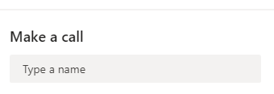
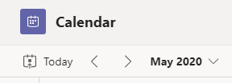
Notes:
The main selling point of Teams is that it provides a single location for a department, class, group, or committee to meet, store documents, and collate contacts and material. Teams can be linked to a SharePoint internal website, and can store data inputted via forms or emails. Everything is secure, meaning no one outside the Team can access the data. Teams is the primary communications platform outside of our LMS in Blinn.

Slide 7
Notes:
Departments serving students have turned to Teams as a way to cross-communicate between employees working from home. We’ll look at some examples.
Like many colleges, we have a Writing Center staffed by tutors with English degrees who work with students on their papers.
Since 2017, we have offered an online option for students who cannot easily get to one of our campuses. With the virus shutdown, we simply moved all Writing Center tutors online to use this option.

Slide 8
Notes:
Within this Team, Writing Center tutors can interact with one another throughout the day while working from home. They discuss papers submitted online, double checking with one another over questions of style or grammar, etc. It also serves a group-building function where they can offer one another moral support.
Even while working from home and never seeing one another in person, through this Team our tutors are able to stay in touch with one another and lift each other up throughout the day.

Slide 9
Notes:
This Team makes use of both SharePoint and Flow. Let’s take a look at how SharePoint is used by the tutors.
The Writing Center has an internal web page that can only be accessed by someone logged into Blinn. This is otherwise known as a SharePoint page. It looks and feels just like a regular web page, only access is restricted to those logged on to the Blinn system. SharePoint is ideal for setting up sites like this to share internal information and store files. Both the website and the Team can be joined together, linked to identical data. In our case, the SharePoint site is the “public” face for the tutors. Students access the site to fill out information, and the tutors access it via Teams.

Slide 10
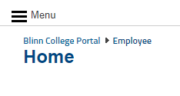
Notes:
Let’s talk for a minute about how a student or an employee would access these internal sites from home.
For all online Office 365 apps and features, students and employees must use the Blinn portal page to enter their username and then login. From there, through the use of something called “Single Sign-on,” which essentially lets them access anything in the system during their session without having to enter their credentials again, they have access to all of our online offerings. This includes the online features for Office 365, some of which are shown here.
This is what the Office 365 app page looks like for students and employees. From the link to SharePoint, students can navigate to the Writing Center Help Desk page. They can also click the URL for that page directly once they are logged into Blinn.

Slide 11
Notes:
So again, this is what the internal page looks like to students once they have logged into Blinn and navigated their way here. At this point, students click on the typewriter graphic to be taken to a submission form.

Slide 12
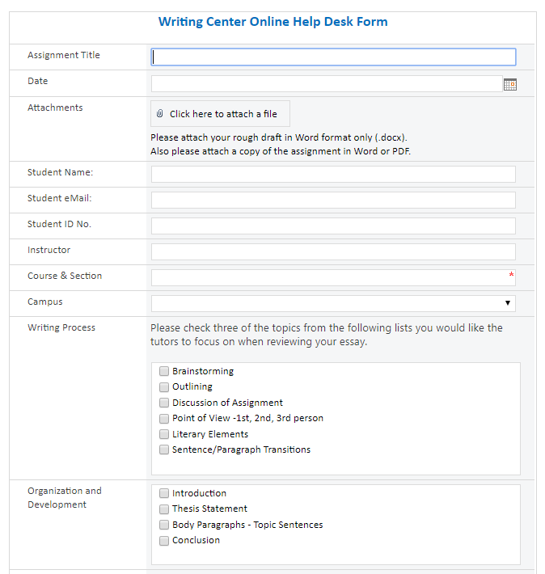
Notes:
At this point, we’ll take a slight digression and discuss the Writing Center’s online form posted on SharePoint.
Note that this particular submission form was built using InfoPath. That is because it was created a few years ago before InfoPath was discontinued. Back then, there was a desire to have the online form look identical to the paper form used on campus. These days, if it were to be built now, the online form would look different by using something like PowerApps or more likely Microsoft Forms, which we’ll look at later. The benefit of using one of those two applications is that it scales easily on phones and other small screens. Older InfoPath forms do not scale easily on phones.
Students fill out what they need on the form, then use the submission buttons to attach a file which is then uploaded to a SharePoint list.

Slide 13
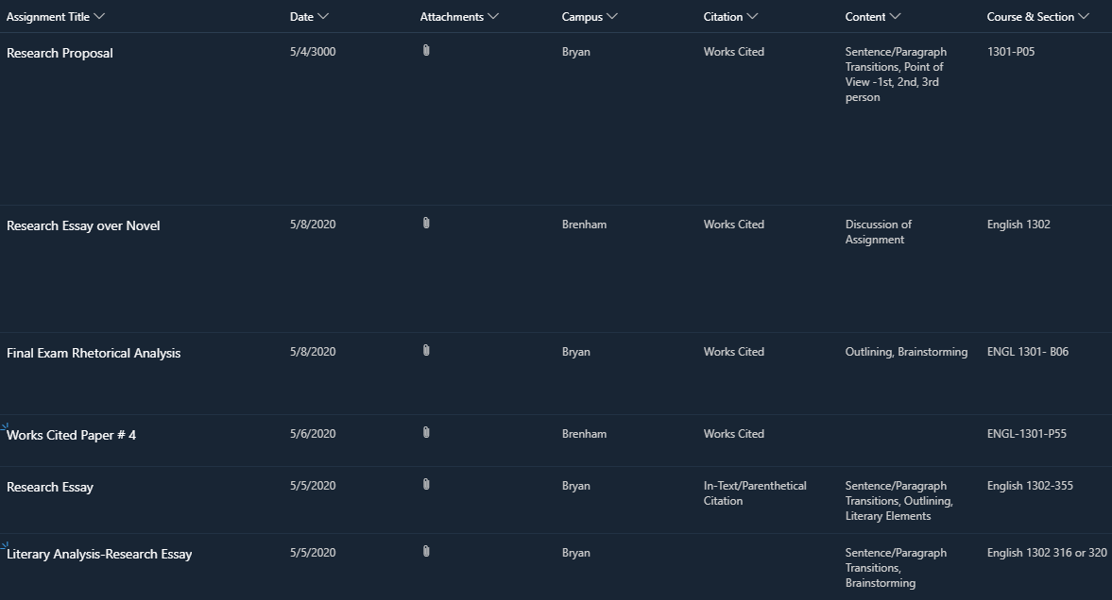
Notes:
Here is what the tutors see when they go to look at the list.
This is a SharePoint list. It’s kind of like an online spreadsheet. It can be sorted by columns, like a spreadsheet, and its data can be accessed by other programs and reported elsewhere. Lists are an important part of SharePoint, especially for sites that involve data collection like this one.
What you are looking at is the “public” view of the list for tutors. The tutors have full access privileges to the entire list, and they can see all the submissions much like we are looking at here.
Students, on the other hand, can only see the information from forms they personally have submitted. So, they won’t see this much when they look at the list. This feature prevents a student from cheating by, for instance, downloading another student’s paper.
From this list view, Tutors download the papers and mark them up with comments via Microsoft Word. Then they return here and upload the marked papers. Students can go back to the list to access the papers and submit new ones for the tutors if needed.

Slide 14
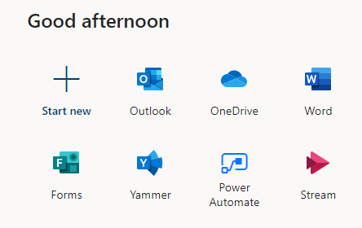
Notes:
So, how do tutors find out there’s a paper waiting for them? How do they get notifications letting them know students have filled out the form and uploaded a paper? This is where additional features in Microsoft Office 365 work their magic.
Tutors find out there is a new paper ready for them back over in Microsoft Teams. Remember, that’s where they’re hanging out all day online during their shifts.
Each time a student fills out the form and submits a paper, a notification appears within their General Channel. All the tutors see the notification and decide which one of them will claim the paper to offer the student assistance.
To get the notification to appear in Teams, we use a program called Microsoft Flow, which now resides under “Power Automate” in Office 365.

Slide 15
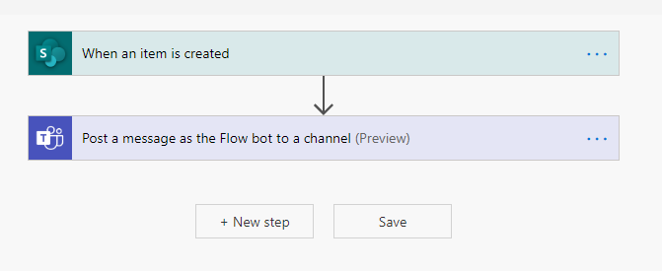
Notes:
This is what a basic Flow looks like. It does the programing for you, and serves as simple building blocks to do more complex functions. Think of it as digital Legos, allowing you to build programs to do things for you.
Jumping briefly into programming-speak, Flow uses “if/then” statements to make things happen. Flow can get incredibly complex if you desire a lot of things to happen. But in this case, we just wanted the tutors to get a notification that a student has filled out the form. And this is what our Flow looks like.

Slide 16
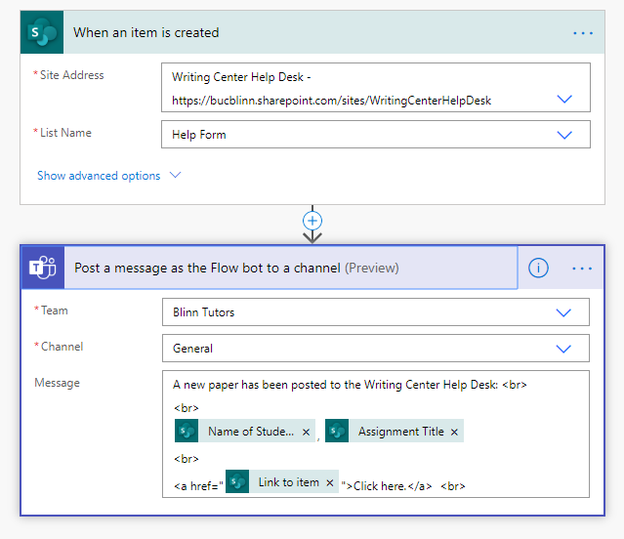
Notes:
So let’s take a closer look.
We used for our trigger, “When an item is created in SharePoint.” That can be considered the “If” statement. We pointed to the list in the SharePoint page as our site address and chose the appropriate list, which in this case is entitled “Help Form.”
The “then” statement is “Post a message as the Flow bot to a channel” in Teams. The Team is “Blinn Tutors,” and the channel is the General Channel over there, where the tutors convene during the day.
As you can see it’s very simple. Left alone, it does exactly what it says it will do. A student posts a paper in the list via the form, and the channel is notified.
But, we wanted a little more to it. In particular, we wanted to indicate the student’s name and the title of their paper. This helps the tutors because they can respond to the automated messages in Teams and claim dibs on the submissions. The tutors also asked for a direct link back to the list in SharePoint, so we asked the Flow bot to give them that, too.
So, for all this we made things a little more complex, and called upon the dynamic content features in Flow. It’s called dynamic because the information changes with each submission. It will be a different student name and email, a different paper title, etc.

Slide 17
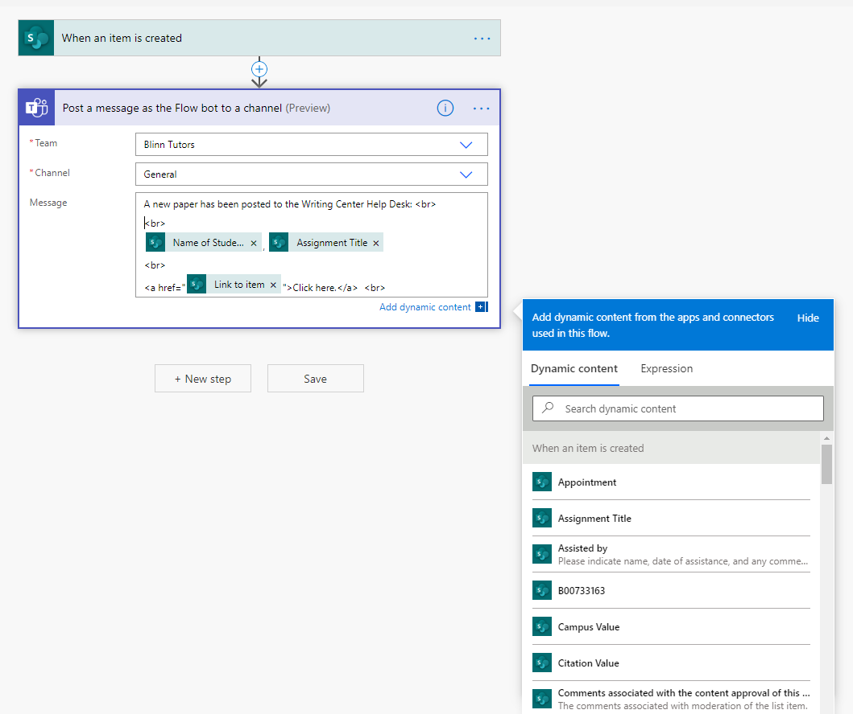
Notes:
Let’s take a closer look at the dynamic content.
On this screen, you can see the three dynamic items we chose to display in the channel through the Flow bot.
We chose “Name of Student,” “Assignment Title,” and then we also included a direct URL to the List item so that tutors could simply click on it and go directly to SharePoint.
We also have some simple HTML code here. This I added in order to make the output from the Flow bot more readable in Teams.
The angle brackets with “BR” simply stand for the HTML code for “break right” and provide spacing. Likewise, the angle bracket and “a href…” simply makes the dynamic content for the submission’s URL a live link for the Flowbot to display.

Slide 18
Notes:
So how does this work out for our tutors? A student fills out the form and submits it, the information goes into the SharePoint List, similar to an online spreadsheet. Flow then posts a notification of the submission back in the tutor’s team.

Slide 19
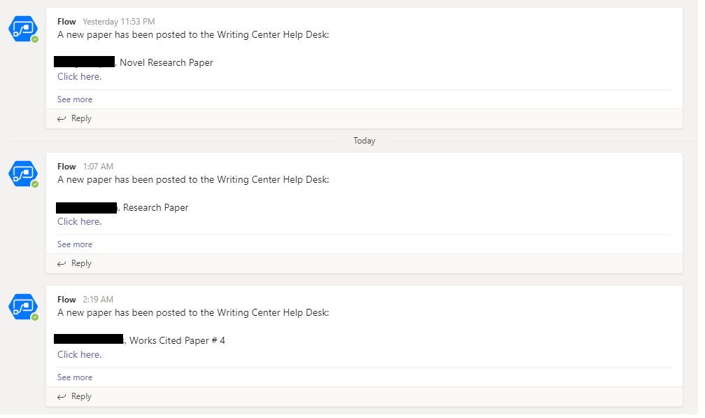
Notes:
For the tutors in the Team, in the General Chat, the notification they get looks like this.
As you can see by the time stamps, sometimes students submit papers at all hours of the night. These remain until the tutors come online in the morning, then they claim dibs on the papers they wish to evaluate by replying to the Flow bot. Papers submitted during work hours are claimed on a rotating basis by whichever tutors are on call at the moment.

Slide 20
Notes:
The Flowbot can be commented on in the General chat. Typically, the tutors will click reply and indicate to the others if they are calling dibs on a paper.
With SharePoint and online storage, the papers are kept online for two years in case they’re needed for grade disputes or anything else. They can be accessed through Teams or tutors can perform searches on this list.

Slide 21
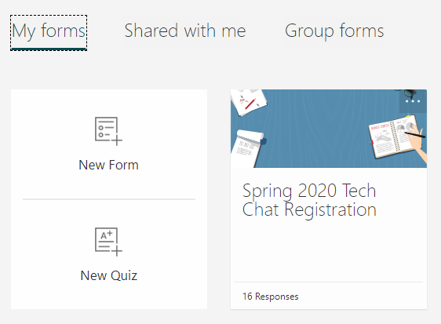
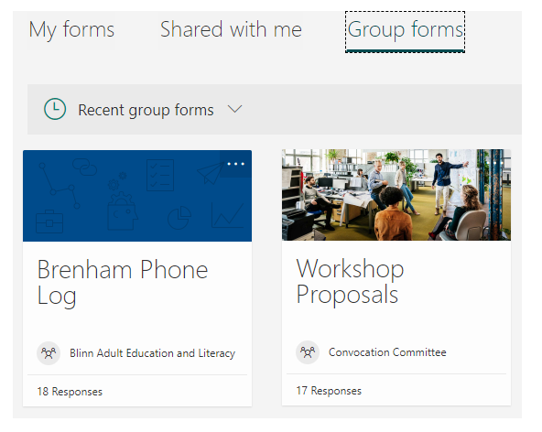
Notes:
I want to discuss some other ways Office 365 tools are being used at Blinn. Microsoft Forms is a powerful tool for data gathering. It’s similar to other products such as Google Forms, but it stores the input in an Excel spreadsheet online. If it’s a personal Form, the spreadsheet is stored in the user’s OneDrive cloud storage account. But if it’s a Group Form, the spreadsheet is stored in the shared Files section of a Team via SharePoint.

Slide 22
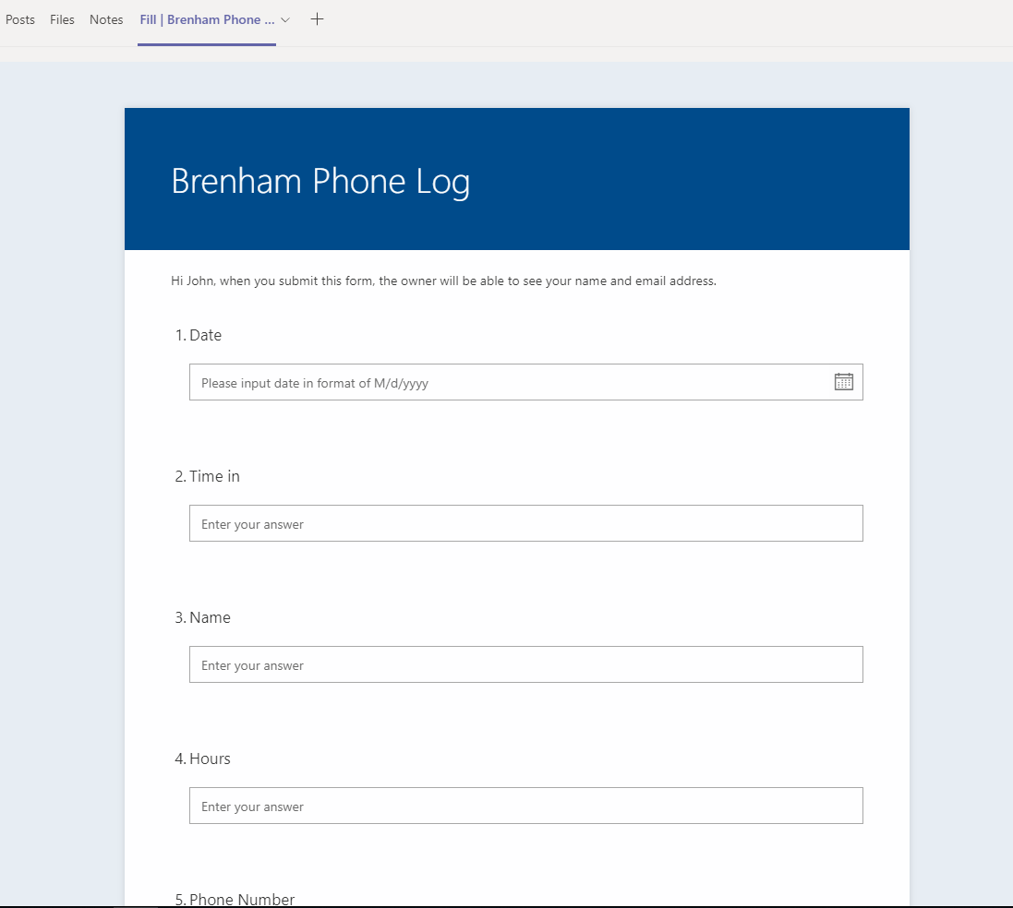
Notes:
Along the top navigation bar in the selected channel, Team owners can place a “Fill” button for the form. From there, Team members can click and begin filling out the form. In this instance, paper phone logs used to record contact with students are transitioned to digital format. Now, employees simply fill out the information in Teams using Forms, and the data is stored and shared directly within the Team.
Forms can also be accessed outside Teams via a public or private URL, if desired.

Slide 23
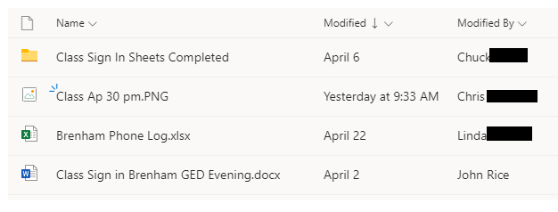
Notes:
The digital records from the Form are stored in an Excel spreadsheet, and placed in the Channel files to be accessible by everyone in the Team as shown here. This allows a simple, one spot solution for records retention. Note that if the Form is a Group Form, as this one is, the Spreadsheet is stored in SharePoint. But, if it were a personal Form, the spreadsheet would be stored on the individual creator’s OneDrive. It goes without saying, Group Forms are shared by everyone in the Group, in this case everyone in the Team.

Slide 24
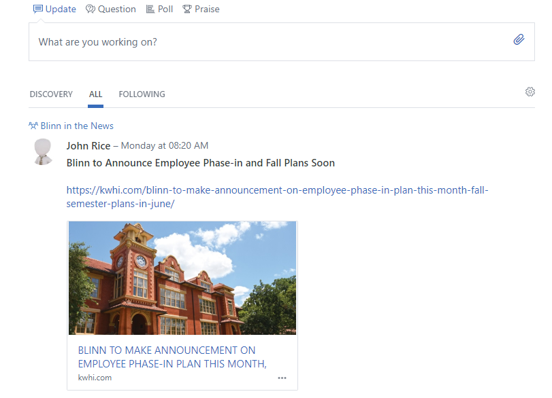
Notes:
I want to briefly touch on Yammer, which is also a part of Office 365. Yammer is a private social media area open only to members of an organization. So in our case, Blinn’s Yammer is only available to our students, faculty and staff. This makes it ideal for several online activities, both in the classroom and for staff. If professors wish to create an assignment using social media, they can use Yammer without having to worry about privacy issues since it is closed to the outside world. It also allows communication with students and employees in a more relaxed setting.

Slide 25
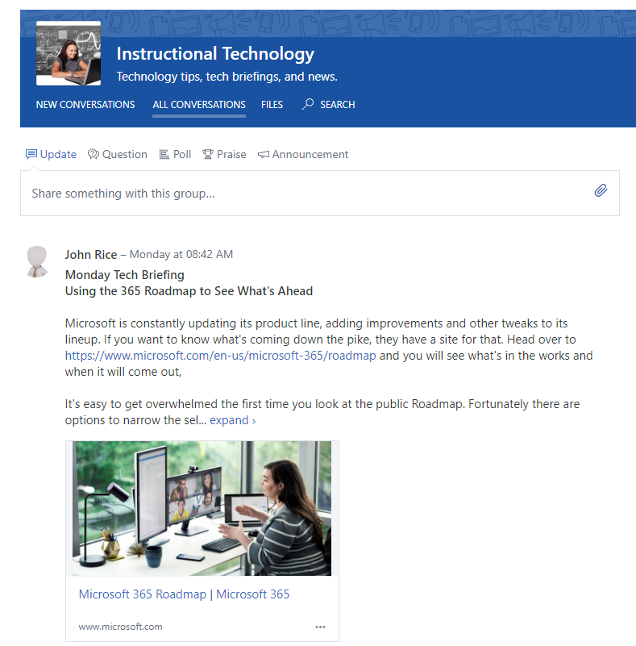
Notes:
Yammer offers a way to communicate through a voluntary setting. In other words, people have to opt in to go there and engage. In that way, it’s not good for broad announcements that everyone should read. But, it is great for engaging people who want to be there, or need to be there. Some professors use it with classes. Some committees and informal groups use it to for discussion. I use it as a blog to keep people informed of technology issues. Yammer also integrates with Teams during Teams Live events, in which presentations can be broadcast to thousands of people instead of being limited to 250. Finally, Yammer is a good place for class presentations to be stored. Then, when students go up to the podium, it’s easy to find their presentation and begin since it’s already there.

Slide 26
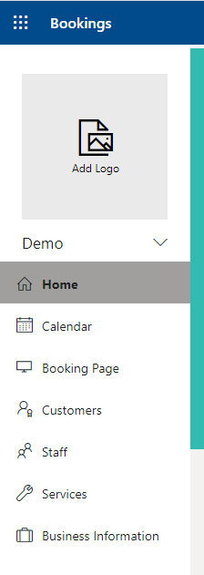
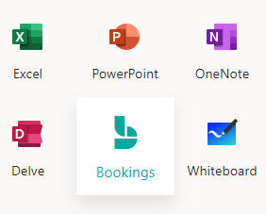
Notes:
I want to also touch on Microsoft Bookings, which is a new tool for us this semester. Bookings allows professors and departments to create a public appointment page with a calendar. This is ideal when you want to allow students to schedule their own date and time for an appointment. It also allows a professor or department to post a public calendar showing dates and times in which they are available for appointments.

Slide 27
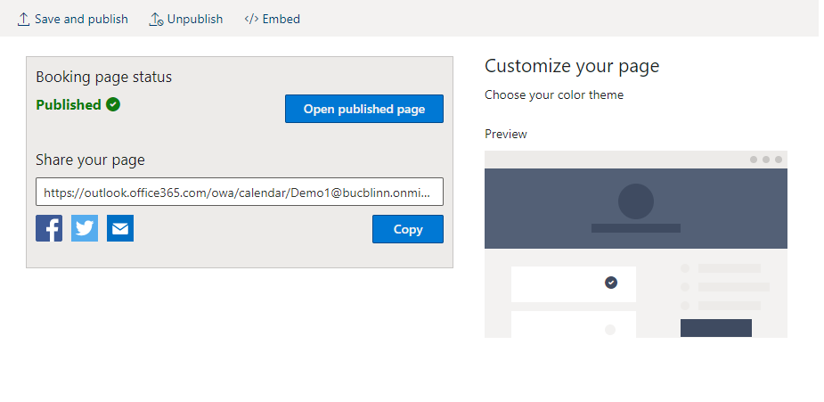
Notes:
The pages that are produced in Bookings are publicly available, and the program assigns you a unique URL. Some limited adjustments can be made to the look and feel of the page, but it does follow a simple format that offers somewhat limited customization. You can change the colors used in a page, for instance, but the main template remains the same.

Slide 28
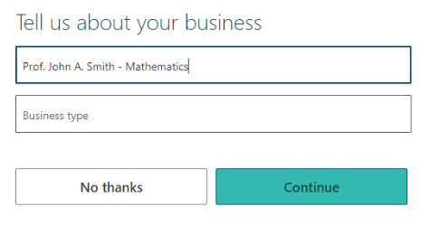
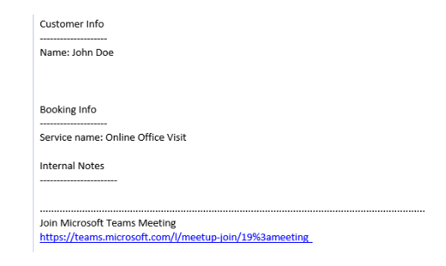
Notes:
When setting up the Bookings page, you will note that as with most things, Office 365 is geared toward the business world first. So, education customers will ignore things like “Business Name” and simply use whatever verbiage is appropriate. If a professor is setting up office hours, they will give their quote unquote business an appropriate name such as “Professor John/Jane Doe.” If a department is setting up a page, they will give it the department name at Blinn, and so on.

Slide 29
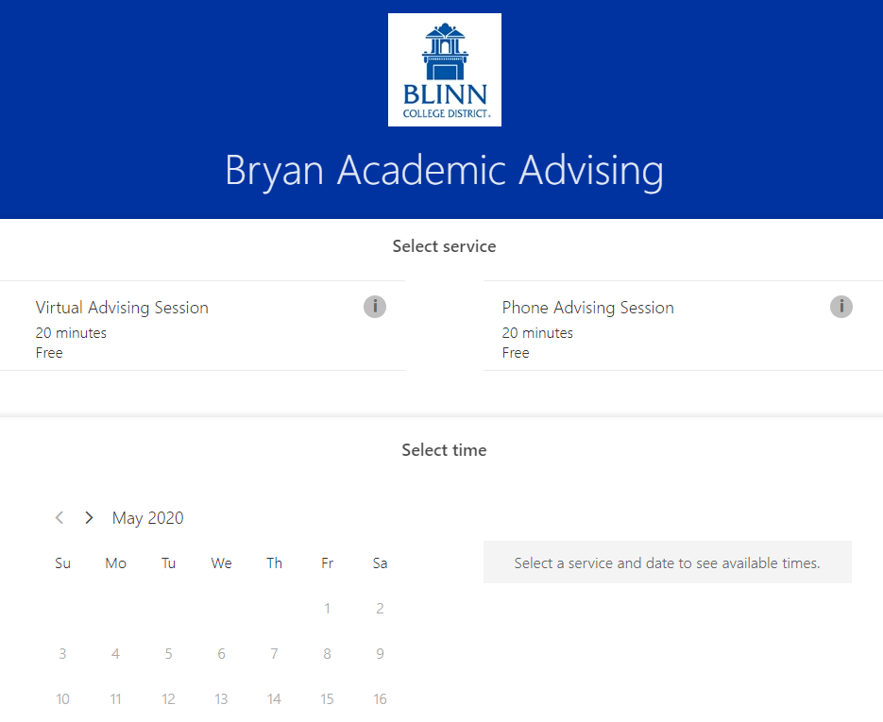
Notes:
This is what an actual Bookings page looks like when it’s live. During this current stay-at-home period, many online sessions occur in Teams. Students can access a Teams meeting through their web browser and do not necessarily have to install the app. From there, if they wish to facetime with the faculty or staff member, they can do so. They also have voice only or text options.
Should the student not wish to engage via Teams, they can always schedule appointments over the phone, in which they would just call in.

Slide 30
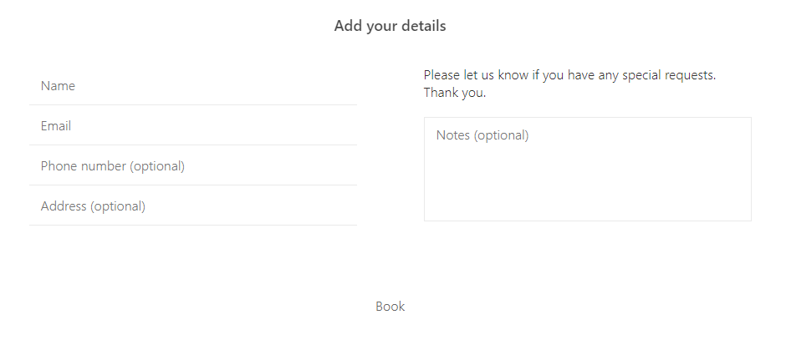
Notes:
The student would input details such as their name and contact information, then click the Book button to submit. Once the student books the appointment, both the professor or staff member and the student receive Outlook meeting notifications on their calendar. The default reminder is 15 minutes before the meeting starts.

Slide 31
Notes:
Let’s briefly discuss Microsoft Stream because that is where recordings made in Teams meetings are stored. Streams serves as a kind of private YouTube for an organization. People can upload videos they have made elsewhere and choose who gets to see them. Within Teams, Streams is the default sharing spot when a meeting is recorded. The owner can decide who has the appropriate privileges to view the video.

Slide 32
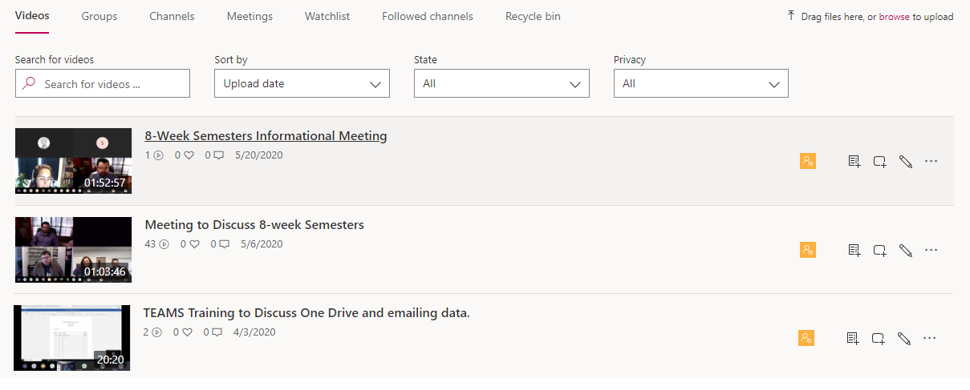
Notes:
Some professors also use Stream to place their own videos online and control access, however we use a product called YuJa for lecture capturing and it is much more commonly used within our Learning Management System. Stream is more common outside of the LMS, and its most common application is for recording group meetings in Teams.

Slide 33
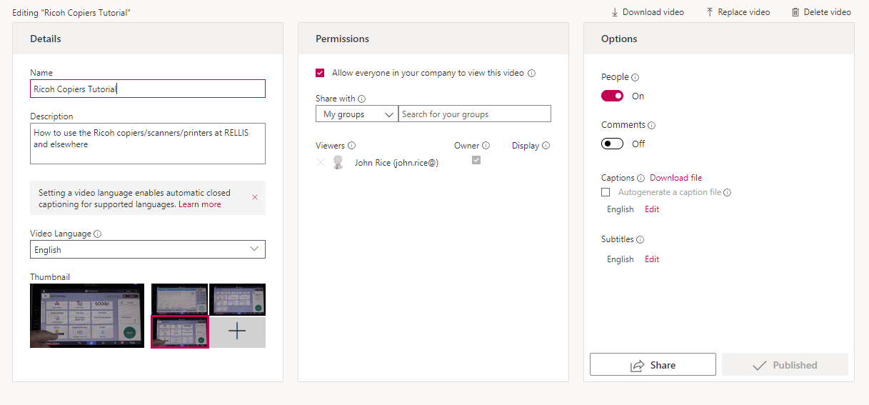
Notes:
Owners of videos placed in Stream can decide who gets to see the videos. In a Team, everyone in the Team is allowed to view by default. Within a classroom setting, or outside of a Team, professors or employees can set up groups and add or delete group members. Owners can also add individual people as those with privilege settings to view the video. Or, by clicking the “Allow everyone in your company to view this video” check box, all employees and students will have access. This is useful for training videos and other items you wish to universally share.

Slide 34
Notes:
Whiteboard is a powerful tool that can be used as a standalone or within Teams meetings. Users can save their Whiteboards and modify them later, share them with others, and collaborate with others in real time, making Whiteboard a very powerful and versatile tool.

Slide 35
Notes:
Whiteboard can operate as a standalone online product, accessible via the Office 365 apps page. From here you can access previously saved Whiteboards in order to show them to a class or modify them on the fly. The interface is simple when accessing via your web browser, but many more features are available when using the app.

Slide 36
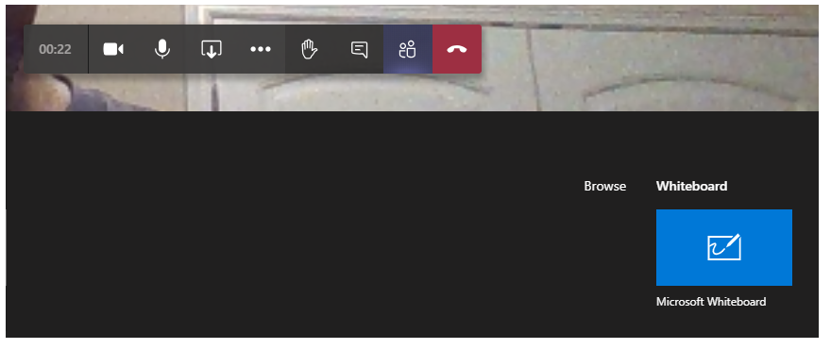
Notes:
Whiteboard is integrated into Teams, and is available during conference calls or Teams meetings when the presenter chooses the share button. In this way, everybody in the meeting can see the graphical presentations created on the Whiteboard, then access it later after the meeting is over.

Slide 37
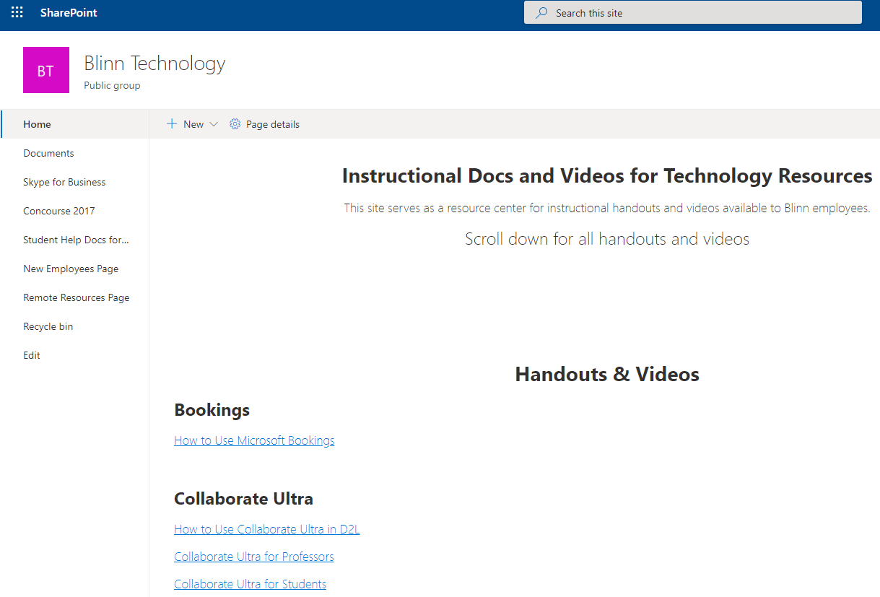
Notes:
I want to go back and take a look at some of our SharePoint sites. Let’s look at some that are used to share information and files with faculty and staff.
We have generated a wide variety of help documents and videos over the years, so we store these on SharePoint. Our Blinn Technology page lists by product in alphabetical order everything we have to offer.
In addition, when face to face training sessions are available, we use a link to Microsoft Forms on this page so that interested parties can sign up for the sessions.

Slide 38
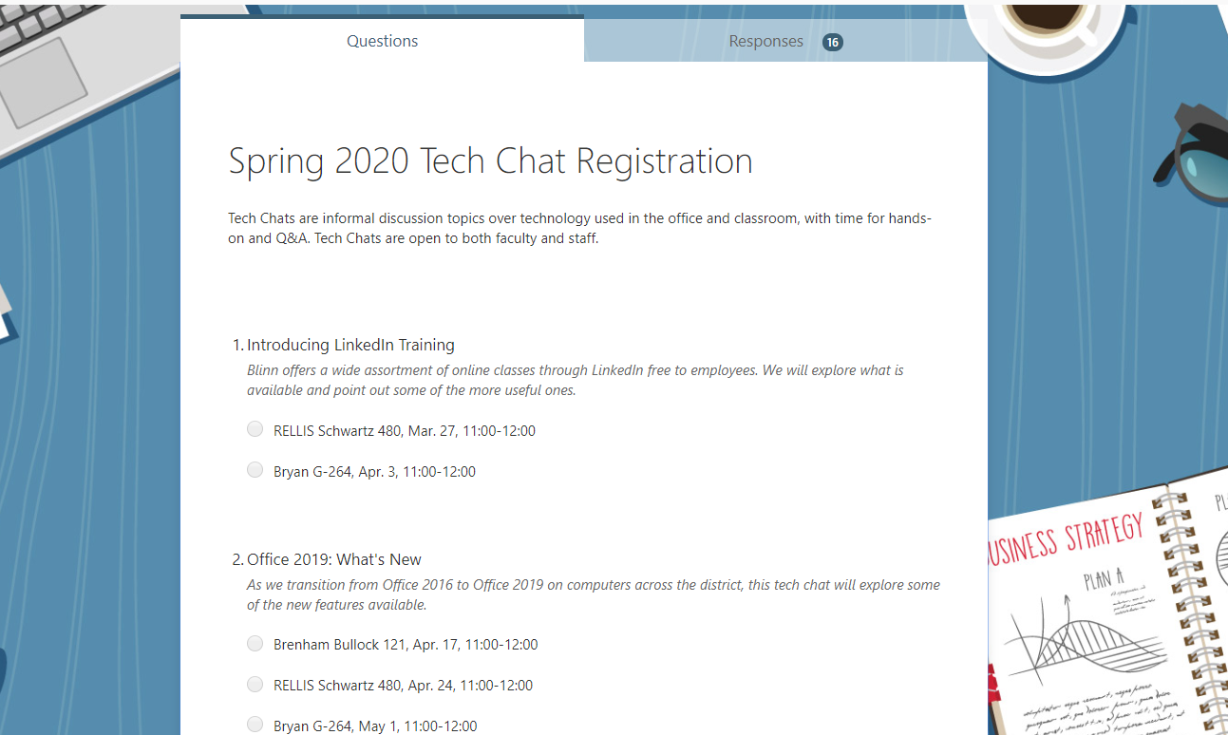
Notes:
This gives you an idea of what the self-registration form looked like before Spring Break. Essentially, faculty or staff would click to this Microsoft Form and choose which face to face trainings they wanted to attend. Note that when a Form is set to internal users only, like this one, it automatically captures their name and email, so that is not needed to be filled out by the person using the form. However, Forms open to external users do not automatically capture name and email, so if you want that info for an external form available to people outside the organization, for instance prospective students, you would need to include as one of your questions on the form a space for them to enter their name and email.

Slide 39
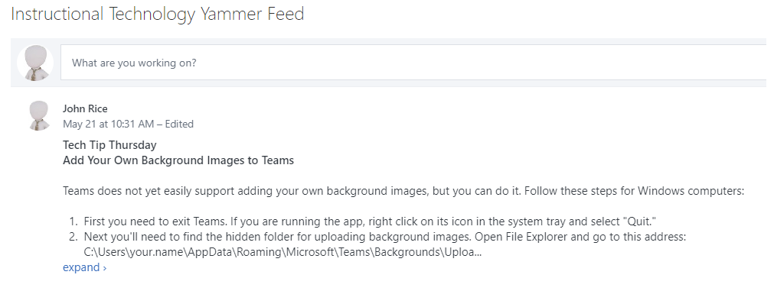
Notes:
At the bottom of the Blinn Technology page, I also include an embedded window to my Yammer feed, in particular the blog type postings I make sharing tech tips every week. This way, anybody visiting the site can easily skim the latest tips and/or discussion.

Slide 40
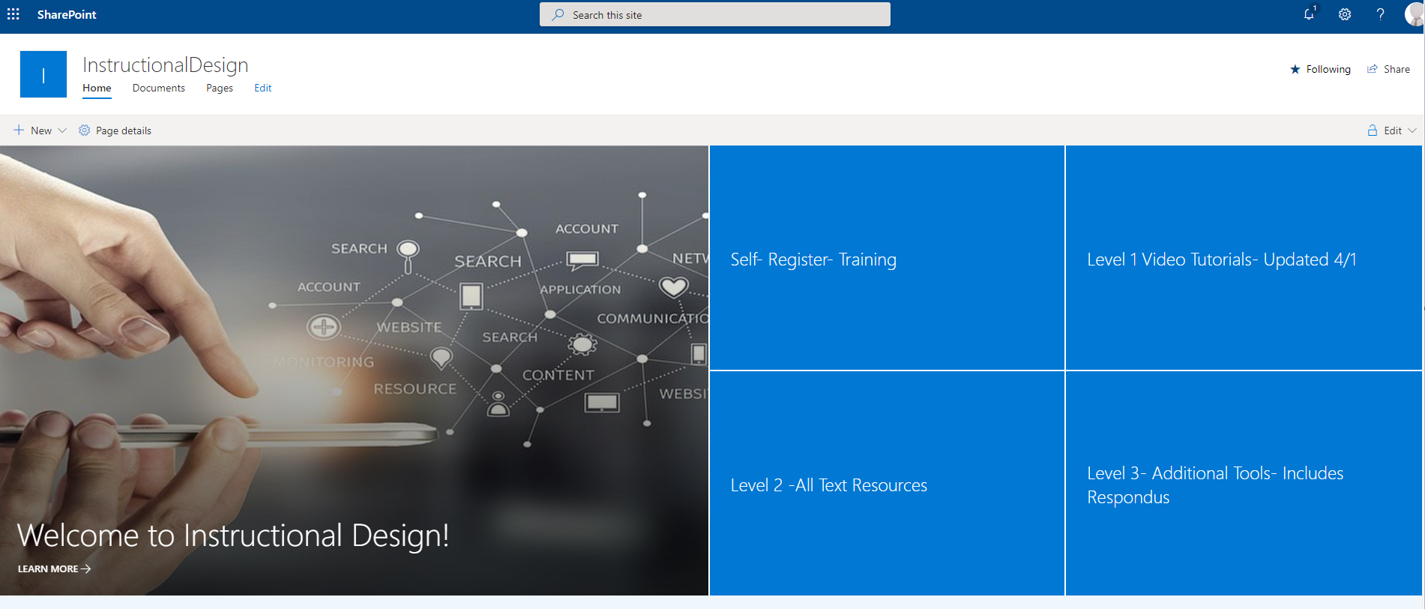
Notes:
We have two excellent Instructional Designers at Blinn who work with professors on setting up and administering their online courses. With the onset of the virus, much of their work transitioned over to online support. Last year I set up a SharePoint site for them which now sees considerable use.
This one is a little fancier, using one of the built-in templates for internal web pages that comes with Teams. The graphics are from a royalty free graphics site loaded with images that anyone can use without worrying about copyright. That site is called pixabay.com.

Slide 41
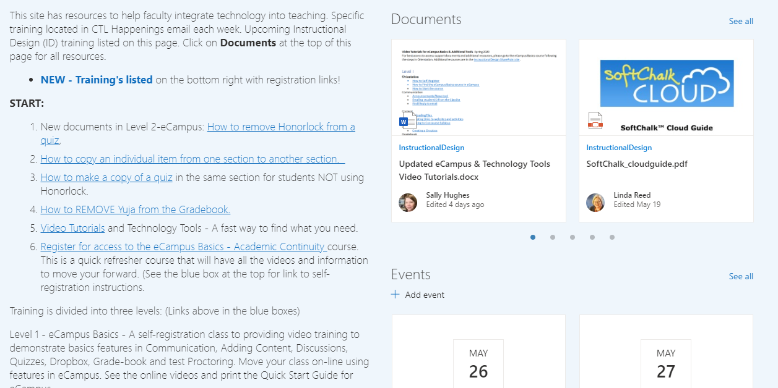
Notes:
Documents and their training events are listed as you scroll down. This serves as an excellent way to distribute material as well as important information, and it serves as a one stop solution when telling professors where to click.

Slide 42
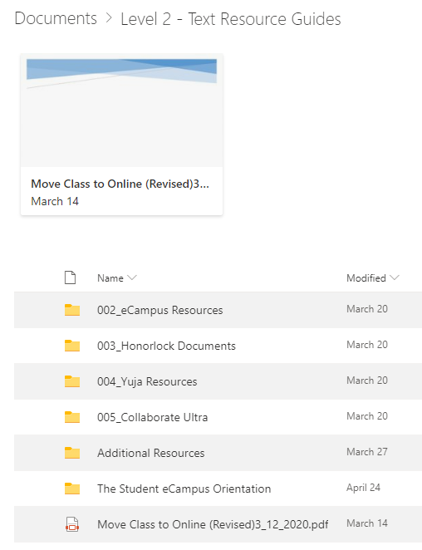
Notes:
At the bottom of the page they have listed their contact info, and in the graphics they have links to other pages with handouts. So, both of these pages give you an idea of how we distribute training material and schedule face to face training when it was offered.

Slide 43
Conclusion
Notes:
Blinn College District makes extensive use of some of the more advanced features in Office 365, as well as the ones with which we are more familiar. If you or your organization are interested in any aspects of Office 365 and what it can do for you, or if you would like to discuss other things such as instructional worksheets we use for faculty and staff, please do not hesitate to contact me.
Thank you.

