Slide 1

Attention
=
Retention
Christian Garrett, EdS
Training Coordinator-
Bossier Parish Community College

Slide 2


Today’s Agenda
Who are our students and where do they come from?
Why does Retention matter?
What does Paying Attention to Students have to do with Retention?
What tools do we have at our disposal to aid in Retention?
What else can you do to aid in Retention?
What does the Research say?
2

Slide 3



Who are our Students?
“Online College Students 2017,” Learning House, 2017, https://learninghouse.com/ocs2017/; Corey Seemiller and Meghan Grace, Generation Z
The Non-Traditional Student
17.6 million undergraduates
38% are over 25 years old
25% are over 30 years old
Students ages 25-34 are projected to increase another 21% by 2022
  6x greater enrolment growth in certificate programs compared to Master’s programs
The New Normal
74% of undergraduates have at least one non-traditional characteristic
  66% transfer students
  62% work full or part time
  43% part time students
  28% have one dependent
  35% enrolled in 2 year program
  63% first gen student
3

Slide 4
From where do online students come?
Compete, Inc U.S. Custom Education H2011; EAB Interviews and Analysis

Slide 5
How do potential students find us?
Compete, Inc. U.S. Custom Education H2011; EAB Interviews and Analysis

Slide 6

Why does retention matter?

Slide 7


What does paying attention to students have to do with retention?
7

Slide 8




A Changing of the Guard
THE OLD REGIME
Teacher = Lecturer
Student = Note-taker
THE NEW REGIME
Teacher = Facilitator of Student-led Discussions
Teacher: Asks a leading question and then guides students through the discussion
Call students by name
Invite fringe-dwellers into the conversation
Utilize the pregnant pause
IDEAS?
SUGGESTIONS?
8

Slide 9

Participation
Noun
An act or instance of participation
The fact of taking part, as in some action or attempt: participation in a celebration
A sharing, as in benefits or profits: participation in a pension plan
Adjective
Of or relating to a venture characterized by more than one person, bank, or company participating in a risk or profit: a participation loan
Pahr-tis-uh-pey-shuh n

Slide 10

Interaction
In-ter-ak-shuh n
Noun
Reciprocal action, effect, or influence
Physics
  The direct effect that one kind of particle has on another, in particular, in inducing the emission or absorption of one particle by another
  The mathematical expression that specifies the nature and strength of this effect

Slide 11
Large image
Is Interaction really that important?
By offering a variety of topics that are relevant to current issues in the field and allowing students to connect the practical, in this case their professional experience, to the theoretical, the course content, the learners become more invested in the course discussions and assignments, as well as their colleagues (Shearer, 2003).
The Course’s level of interpersonal interaction was the most important factor in predicting student grades; students in low-interaction courses earned nearly one letter grade lower than students in high-interaction courses (Jaggars, Edgecombe, & Stacey, 2013, p.2)
By evaluating the level of student engagement and considering these affective aspects, instructors can more effectively plan lessons and activities that will encourage students to be more active participants in their learning and coursework (Jennings & Angelo, 2006; Mandernach et al., 2011).
Instructors can make connections with students by providing constructive feedback that affirms how they are performing well and details ways to improve (Muirhead, 2004).
Teachers need the expertise to develop a class structure that stimulates social interaction and affirms rigorous academic standards while fostering independent learning skills (Muirhead, 2004, p. 50).

Slide 12
What Can Students Gain From Discussions?
Discussions require students to articulate what they are learning.
Source: Thomas, Mike. "Cognitive Learning Theories." In Key Concepts in Healthcare Education, edited by Annette McIntosh Janice Gidman and Elizabeth Mason-Whitehead, 23-27, SAGE Key Concepts. London: SAGE Publications Ltd, 2011. doi: 10.4135/9781446251744.n5.
Discussions create active participation in meaning-making.
Source: Brookfield, Stephen, and Stephen Preskill. 2005. Discussion As a Way of Teaching: Tools and Techniques for Democratic Classrooms. 2nd ed. San Francisco: Jossey-Bass, 22.
Discussions generate social interaction.
Source: Okita S.Y. (2012) Social Interactions and Learning. In: Seel N.M. (eds) Encyclopedia of the Sciences of Learning. Springer, Boston, MA

Slide 13

Students Want to Interact with Other Students

Slide 14
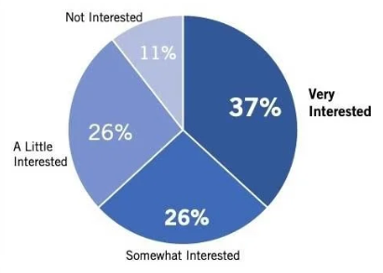
Moravian College
Private Liberal Arts College
Bethlehem, PA

Slide 15

What makes a discussion an engaging one ?
Let’s Discuss

Slide 16
Comparison
Taking a Side By Side Look
Participation Questions
Engaging Discussion Questions
Do you feel that the media is biased in its reporting of national issues?
Looking at Maslow’s Heirarchy of Needs, which need is most strongly felt by the average college student?
Why do more people prefer going to the theatre to see a play than to a ballet performance?
Provide one example of media bias and outline reasons that lead you to this conclusion.
Looking at Maslow’s Heirarchy of Needs and based on your research, why do fewer people in our society reach the level of self-actualization?
Based on your experience (either as a performer, stage hand, or audience member), which elements of live theatre do you find the most difficult to cause one to believe the performer has reached a certain level of existentialism?

Slide 17

How Can I Add Variety To My Discussions?
Encourage Media Responses
Discuss Using Role-Playing or Alternative Perspectives
Engage in Debates
Allow Student-Led or Moderated Discussions

Slide 18

Q: How do I clearly communicate my expectations?
A: Rubrics!

Slide 19
Discussion Rubric
Expectations Explained
Frequency and Timeliness
Quality
Students should post on three different days each week with the initial post being no later than Sunday evening by 11:59 pm CST.
  Students should have a total of three posts per discussion.
  Each post should be on a different day. (3 posts/ 3 Different days)
Substantial posts containing well-developed original thoughts, added insight to the topic, outside sources, and follow-up questions. These posts are error-free and grammatically correct. In addition, these posts are a minimum of five (5) sentences and/or 150 words. The posts should demonstrate higher order thinking and critical thinking skills.
Original thoughts, added insight to the topic, and follow-up questions. These posts are near error-free and typically grammatically correct. In addition, these posts are a minimum of three (3) sentences and/or 125 words. The posts should demonstrate higher order thinking and critical thinking skills.
Basic thoughts with little to no insight. The post may simply be a follow-up question. These posts contain mechanical and grammatical errors. These posts are typically one or two sentences and less than 100 words. No higher order thinking or critical thinking skills are demonstrated.
Zero points will be awarded for no posts and could impact student attendance.

Slide 20
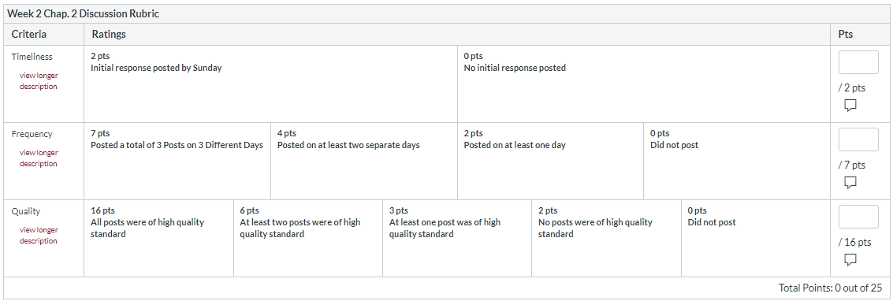
Discussion Rubric
Typical 25 Point Discussion Rubric

Slide 21
What do my students have to say about these types of discussions?

Slide 22
This may mean a change in attitude…

Slide 23


What tools do we have at our disposal to aid in Retention?
CANVAS.
23

Slide 24

Retention Tools Within Canvas
Clearly Outlined Modules
Clearly Arranged Gradebook
Use of Rubrics
Calendar Due Dates/Notifications
Contact Information
Inbox
Gradebook Messenger
24

Slide 25

What else can you do?
Call Students by Name
Send a Welcome Email
Call Fringe Dwellers
Send out Progress Reports
Offer Availability
Make Comments Personal
BE REAL!

Slide 26
What is the quickest way from Point A to Point B?
You have 10 seconds…

Slide 27
Were you correct?

Slide 28
What do you see?
Win?
Lift?
A Man or Liar?

Slide 29

What does the research say?
Let’s have a little look…

Slide 30

A Look at Research
Haynie, D. (2015). Retrieved January 3, 2017, from http://www.usnews.com/education/online-education/articles/2015/01/30/experts-debate-graduation-rates-for-online-students
Most Colleges/Universities offer
Tutoring
Social Media Lounges
Advising
Publications/Outreach
Career Centers
Clubs/Organizations
Counselling Centers
Univ. of Louisiana-Northwestern State Univ.
-2007
69 Bachelor Degree Programs
17% Graduation Rate in 3 years
35% Graduation Rate w/in 6 years
30

Slide 31
Another Look…
Khan, r., & Gogos, A. (2013). Online mentoring for biotechnology graduate students: An industry-academia partnership. Journal of Asychronous Learning networks, 17(1), 89-107.
University of Maryland University College
-2009
19 Mentor/Protégé Pairs
-2011
46 Mentor/Protégé Pairs
76% Retention Rate
Higher Course Completion and Graduation Rates
Bossier Parish Community College
-2018 Fall Semester
COMM 240-975
  86.36% Retention Rate
COMM 240-976
  90.9% Retention Rate
31

Slide 32
Story Time
3 Letters from Teddy
By: Elizabeth Silance Ballard

Slide 33





THANK YOU
Christian Garrett
318-678-6283
cgarrett@bpcc.edu
www.bpcc.edu

