Slide 1


NISOD ONLINE CONVENING
October 26, 2020
Proven Strategies
for Closing Equity Gaps

Slide 2
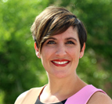
Introductions
Tricia Johnson, EdD
Vice President of Academic Affairs
Community College of Aurora
Charity Peak, PhD
Academic Director
Association of College and University Educators (ACUE)
Notes:
Brief introductions by presenters

Slide 3
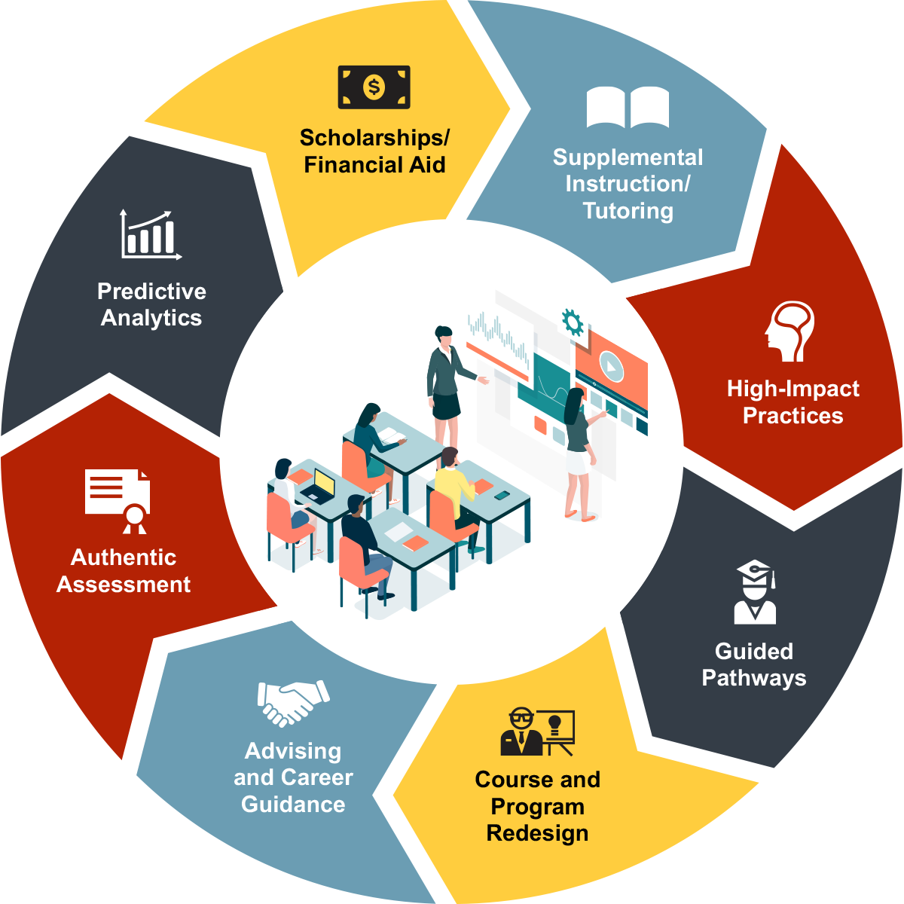
ACUE’s mission:
Student success
through quality instruction
Notes:
CHARITY: Background on ACUE’s mission, many student success initiatives occur outside of the classroom. Faculty spend the most amount of time with students and have the greatest influence on their success. For this reason, ACUE created a Course in Effective Teaching Practices that promotes evidence-based teaching for the benefit of students.

Slide 4








Stronger—More Equitable—Student Outcomes
Economic Equity Achieved
Six-point completion gap eliminated between Pell-eligible and other students; annual 25% increases in completion, in research by CSU LA.
Grades Up in Courses with Achievement Gaps
Students learned more, earning better grades across 150 classes enrolling 4,500 students. Students earned more As and fewer Fs.
Success Rates Improved
Success rates were higher and DFW rates lower across 314 classes, improving odds of graduation for 3% of student body.
F
Diverse Achievement
Students earned more A, B, or C grades at nation’s most diverse campus,
in study of 4,554 students.
A “Gateway” Opened
Improved instruction and course re-design cut DFW rates by 50% in gateway biology,
in research by NAU.
Grades & Engagement Up
GPAs improved 0.19 points to above 3.0 across 100 classes enrolling 6,100 students; Johns Hopkins research found stronger engagement.
4
Notes:
CHARITY: Our data demonstrate that this approach is positively impacting student outcomes – from improving grades to closing equity gaps.

Slide 5
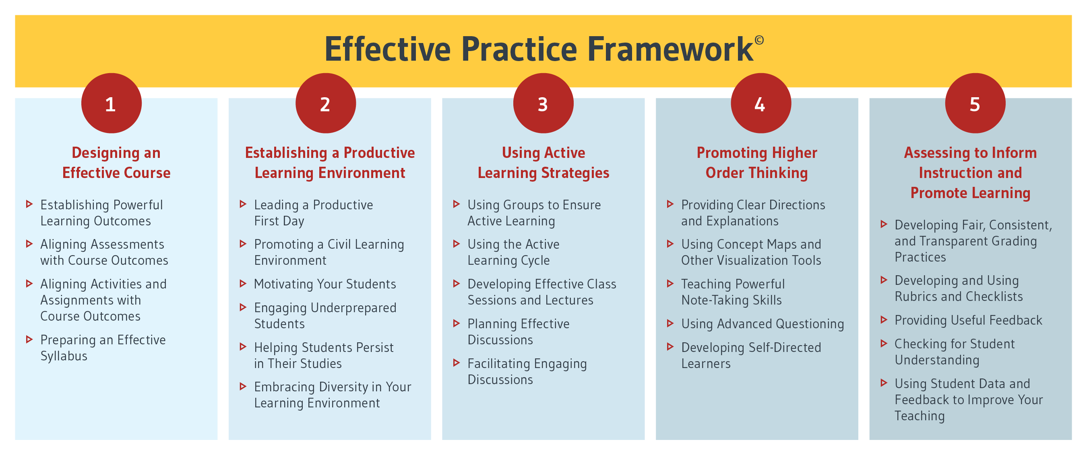

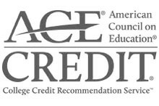
Comprehensive Teaching Competencies
Notes:
CHARITY: ACUE, along with experts in teaching and learning in higher education, developed its Effective Practice Framework which outlines a set of comprehensive teaching competencies.

Slide 6

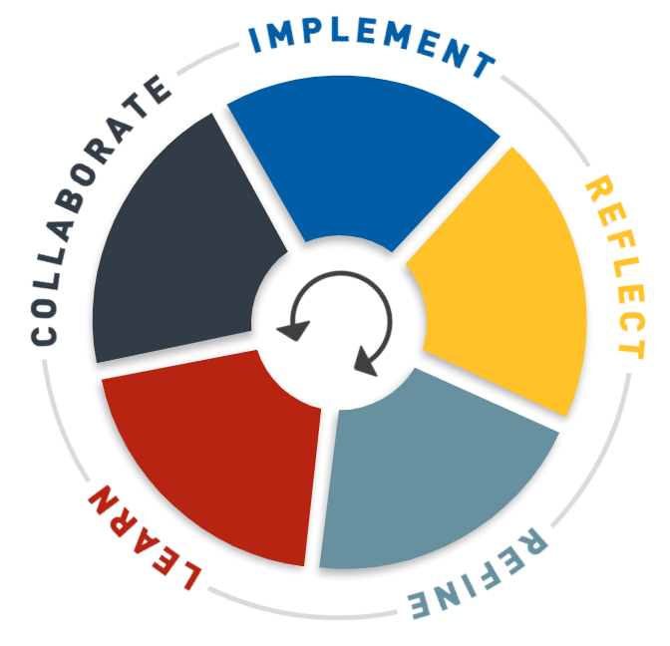
Learning Design
  25 modules build to Certificate
  High-quality, video-rich content
  Collaborative cohort
  Facilitated with campus context
  Implementation and reflection required for each module
  Evaluated by ACUE national readers
6
Notes:
CHARITY: [more about learning design]
25 modules build to full certificate
High-quality user experience
Video-rich; over 180 demonstration lessons
Collaborative; faculty engage in cohorts
Facilitated, by a teaching expert
Implementation is required
Assignments and reflections are required
Evaluated by ACUE national readers

Slide 7

How does differentiating faculty development
help to close student
equity gaps?
Notes:
CHARITY: I now want to turn it over to one of our partners, Community College of Aurora, to share how this course can be used as the foundation of a much broader approach to faculty development.
TRICIA:
Holistic approach – multi-prong approach to faculty development
Meet folks where they are as opposed to cookie-cutter approach
Professional development series, tiered approach – beginning to advanced training

Slide 8
A Common Understanding
Equality…
in education is about providing the same instruction, opportunity, experience and resources for everyone with a focus on sameness (Association of American College and Universities, 2015).
Equity…
in education provides each individual with instruction, opportunities, experiences, and support that meets their needs (Association of American College and Universities, 2015).
Equity‐mindedness…
is a demonstration of awareness and willingness to address equity issues within the institution, structures, practices, policies, and instruction (Center for Urban Education, University of Southern California).
Notes:
TRICIA:
I’m glad you mentioned equity gaps. Before we begin, I want to make sure we are all on the same page regarding commonly used terms in this area. Distinguish between student achievement and equity.

Slide 9
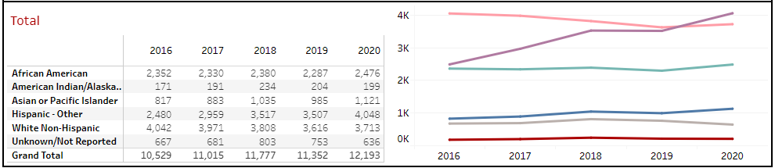


Community College of Aurora
Notes:
Tricia – Who are you? Share some basic info about CC of Aurora (e.g., 61% students of color, urban school, etc.)

Slide 10
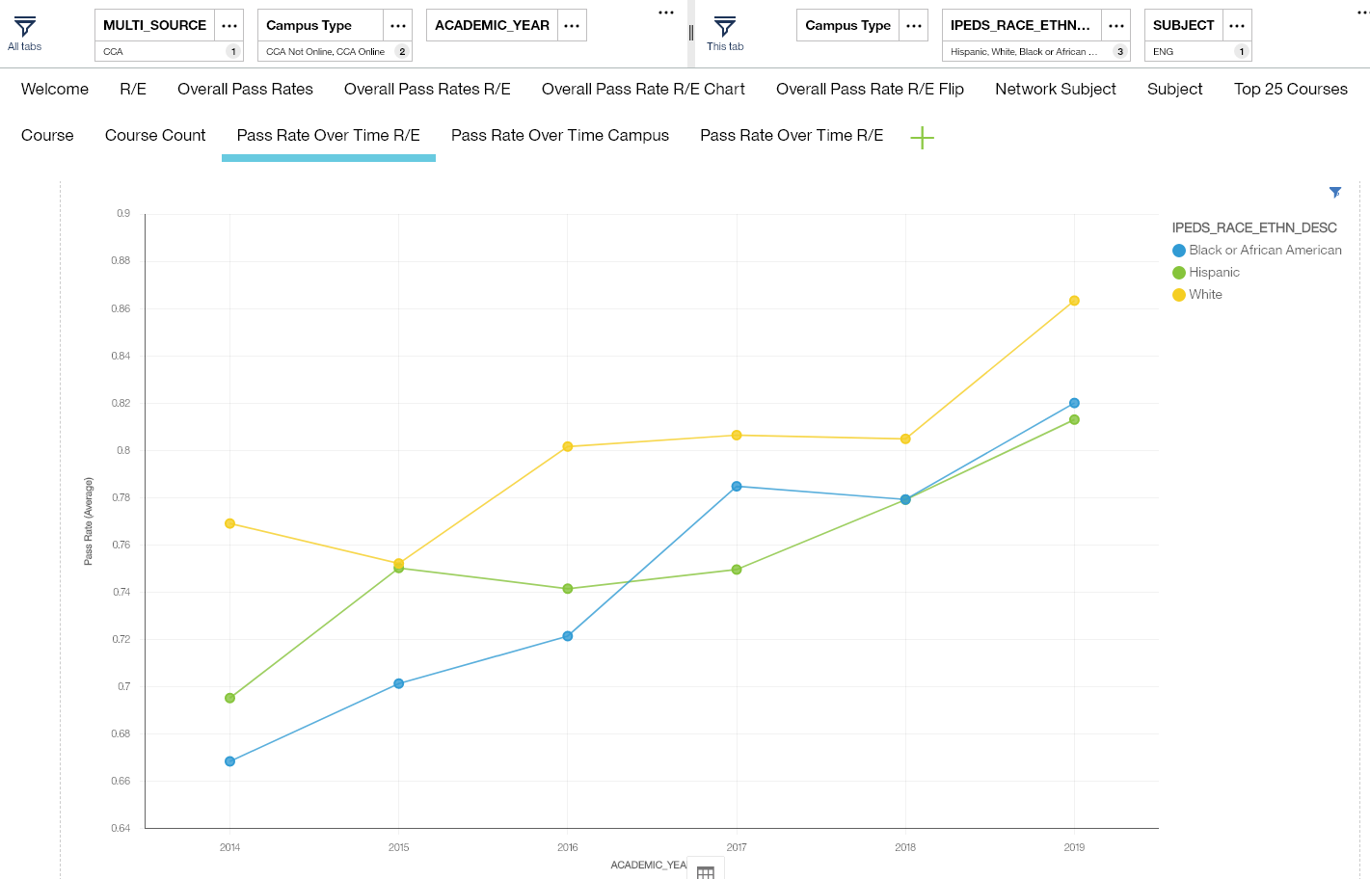
Equity Gap Progress – English Classes
Notes:
Tricia

Slide 11
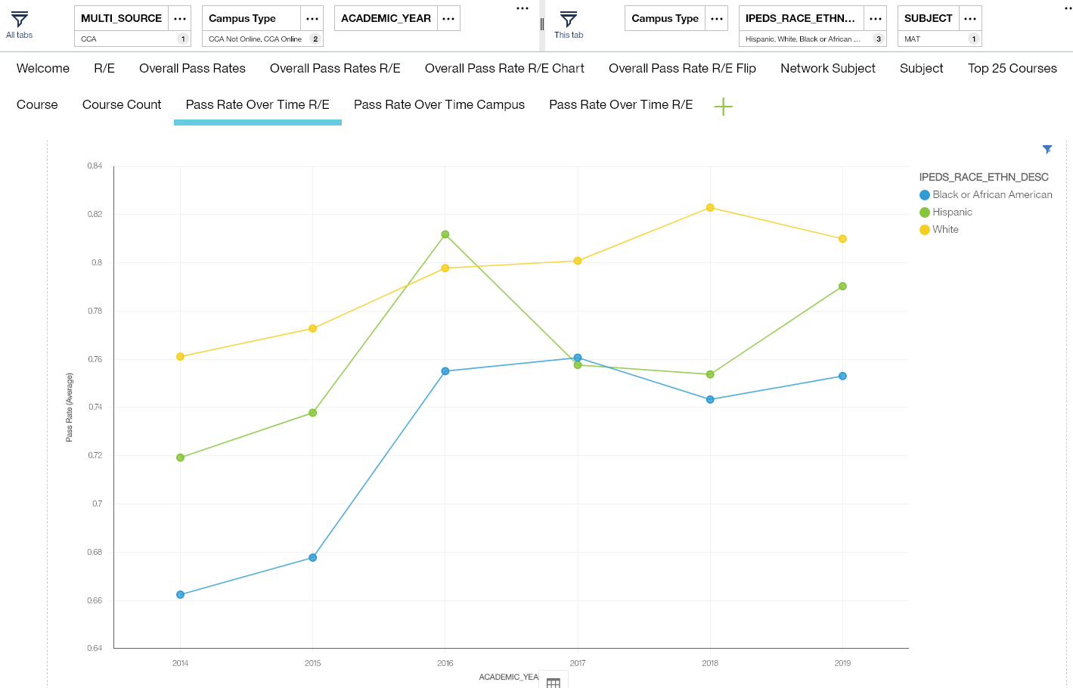
Equity Gap Progress – Math Classes
Notes:
Tricia

Slide 12
Equity and Faculty/Instructor Development Journey
2013-14
2015-16
2017-20
Implementing equity scorecard
Intentionally supporting faculty and instructors
Differentiating supports
Building momentum
Early adopters
Empowering teacher leaders
Investing in the commitment
Institutional buy-in
Expanding instructional innovations
Notes:
TRICIA:
The Equity and Faculty Development Journey

Slide 13
Faculty/Instructor Development
Department of Instructional Intervention and Support
Instructional Support Initiative
Instructional Coach
Equity in Instruction Leadership Academy (EILA)
Instructional Professional Development Workshop Series
Inclusive Pedagogy Training
American College and University Educators (ACUE) Effective Teaching Practices Course
Center for Teaching and Learning
Notes:
Tricia - Share the holistic approach of CC of Aurora

Slide 14
Faculty/Instructor Development Outcomes
Professional Development
Workshop Series
462 participants
46 unique workshops developed and facilitated by faculty and instructors
Faculty surveys administered
Focus groups conducted
Equity in Instruction
Leadership Academy (EILA)
75% faculty members completed EILA
39 instructors completed EILA
Association of College and University Educators (ACUE)
      34 instructors completed ACUE
      10 faculty completed ACUE
Notes:
Tricia

Slide 15
ACUE Courses: 2018-19 & 2019-20
  44 participants – 80% full-time faculty, many adjunct instructors
  Each course taught over entire academic year (2 semesters)
  25 asynchronous online modules
  Cohort learning community sessions (face-to-face/synchronous)
    Peer-to-peer learning
    Inclusive pedagogy infused in sessions
    Peer observations
      One within discipline & one outside discipline
      Identify inclusive teaching practices in action
      Provide feedback to peers
Notes:
CHARITY? Describe two courses and details of program, particularly learning community sessions to emphasize inclusive teaching practices.

Slide 16
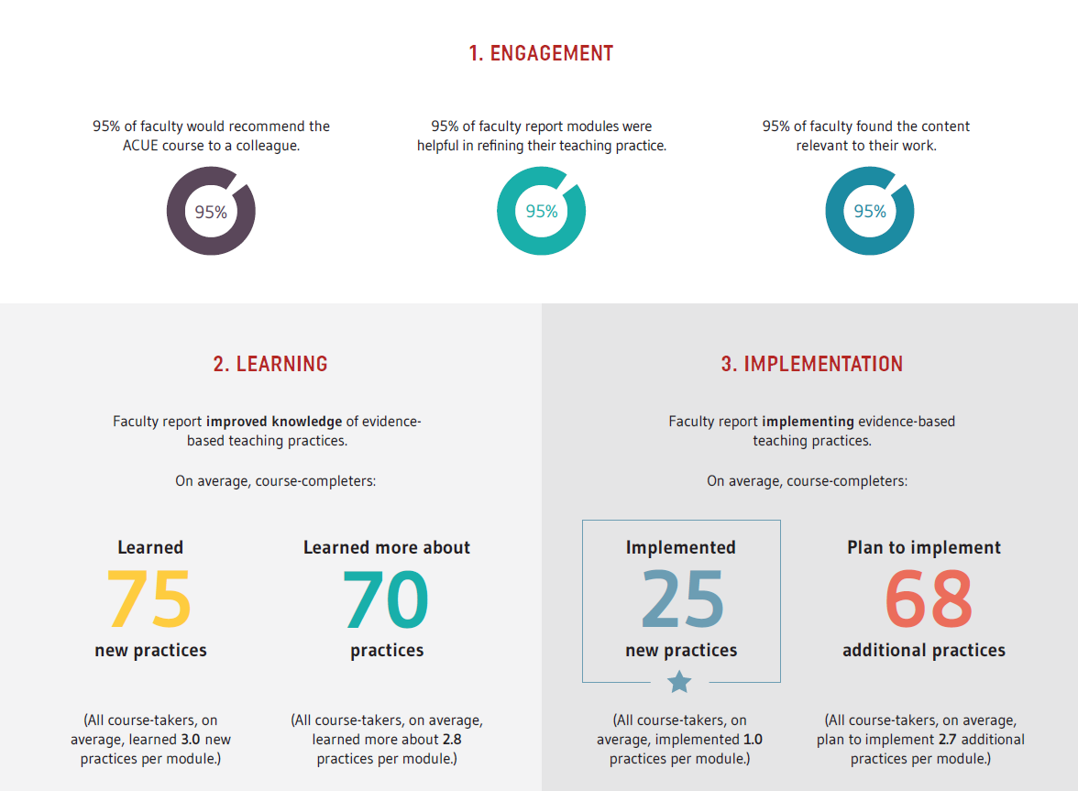
Relevance and Engagement
Notes:
Charity - Faculty found the course relevant for refining their teaching practice and ALL of them would recommend it to a colleague.

Slide 17
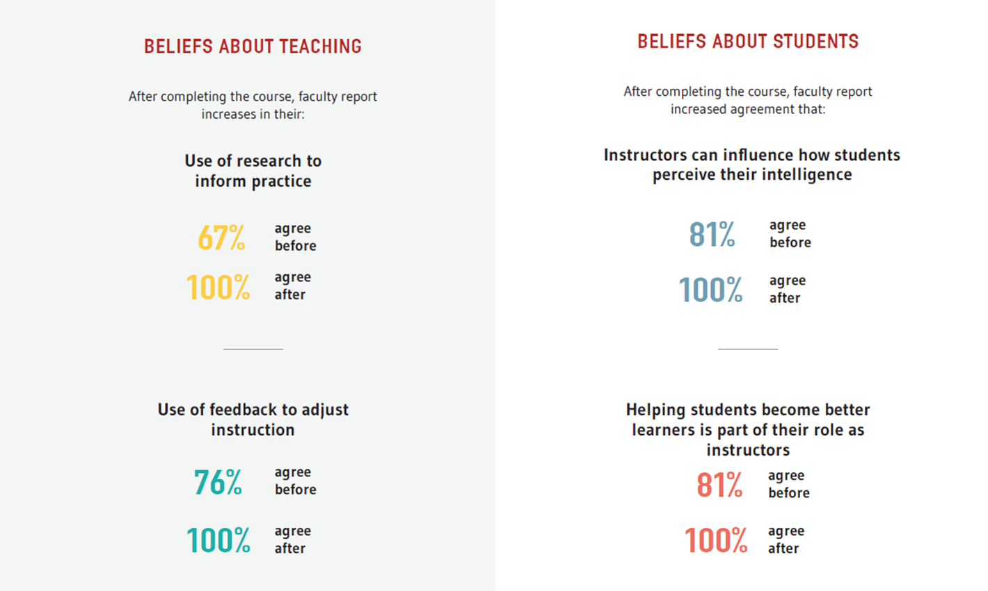
Transformative Experiences
Notes:
Charity

Slide 18
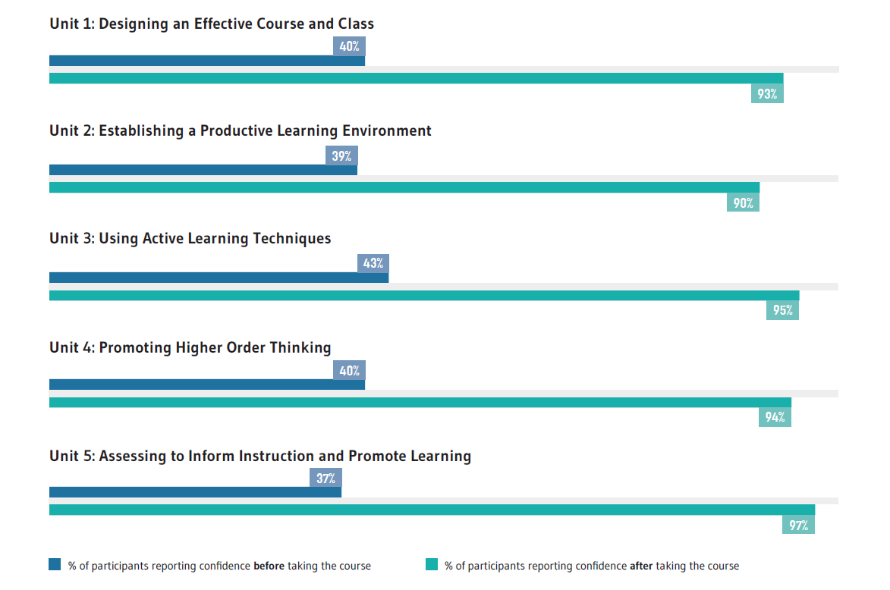
Changes in faculty confidence before and after ACUE
Notes:
Charity

Slide 19
Faculty reflect on their success
“The biggest challenge that I found was being patient with myself and not just answering my own questions. I think I need to become more patient.”
5D: CHECKING FOR STUDENT UNDERSTANDING
“I saw the students’ confidence build as we went through the earlier questions, and by the time we got to the higher-level questions, they were prepared to tackle them and provided much better analysis than in classes during previous semesters. The discussions went longer, more students were involved, and they were even talking/debating amongst themselves instead of just going through me with their answers.”
4D: USING ADVANCED QUESTIONING TECHNIQUES
“This is my second semester teaching and, well, almost everything on here is new to me. Before I would ask a question and then within seconds answer it, but now, I pause and wait for my class to answer and I’ve had much better results.”
3E: FACILITATING ENGAGING CLASS DISCUSSIONS
Notes:
Charity

Slide 20

Criticality in the
Face of COVID-19
  Enrollment shifts
  Inequitable impact on Black and Latinx community
  Necessity for teaching with care, compassion, and creativity
  Application of classroom strategies learned in the ACUE-facilitated course
Notes:
Tricia

Slide 21

Next Evolution
Impact for students
Digging into the data more deeply
Emphasis on quality teaching, inclusive learning spaces, and positive learning
ACUE.org/impact
Photo by Keith Birmingham,Pasadena Star-News/SCNG
Notes:
Tricia

Slide 22
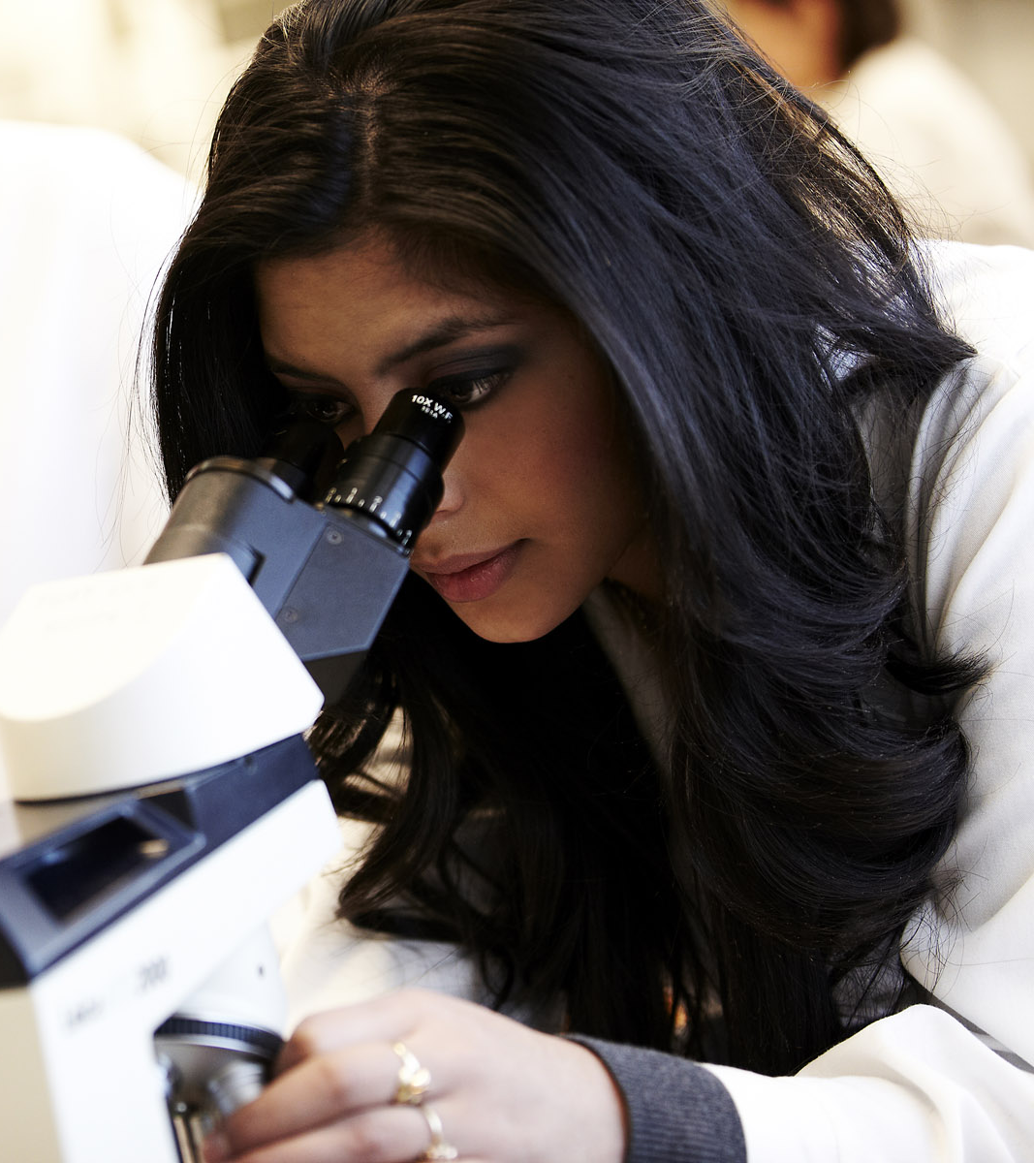
Call to Action
For administrators:
What is my role in supporting this work?
For faculty:
What resources
are available for me?
FREE ACUE Teaching Toolkits
Notes:
TRICIA – Call to action for administrators
Charity – Call to action for faculty (reference toolkit)

Slide 23
Instructional Excellence
for Student Success
Notes:
CHARITY: Summarize the conversation by focusing on the impact faculty can have on students, NOW MORE THAN EVER.

Slide 24
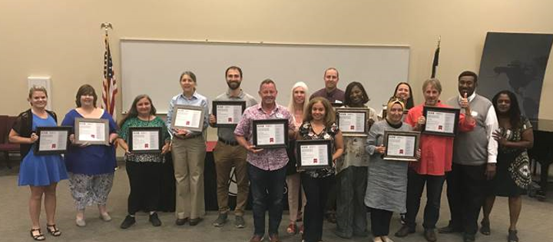
Thank you!

