Slide 1
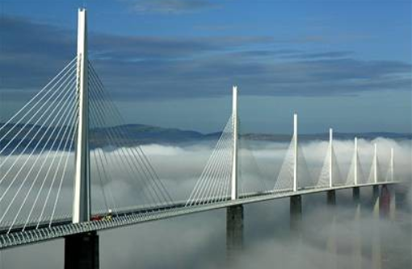
Making “haves” out of “have-nots”: Digital inclusivity to dissipate a divide

Slide 2
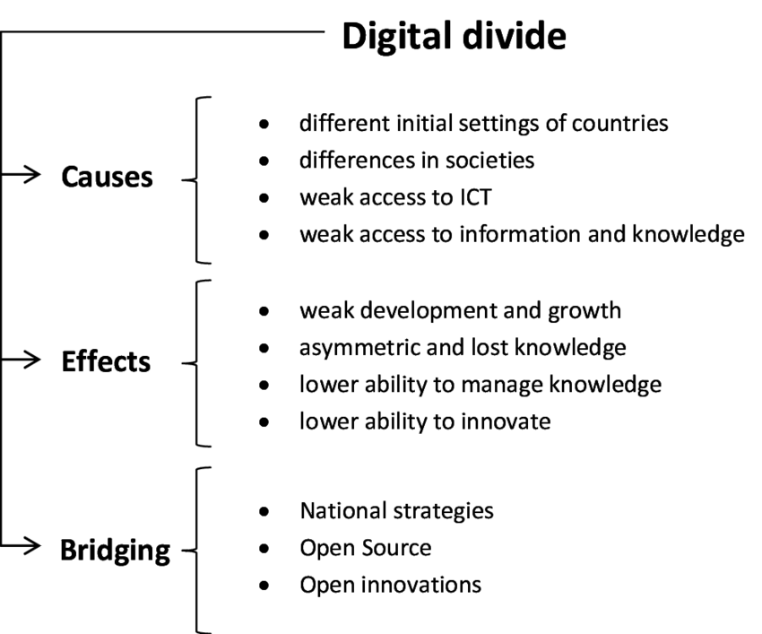
What is it? What causes it? What are its effects? And…

Slide 3
A digital divide: What is it? It’s “illectronisme”!
Tongia’s “ICT Challenges” that lead to “illectronisme”:
Thorny usability
Erratic security
Problematic robustness
Irregular, undependable availability
Lack of basic digital skills, competencies
…and then frustration leading to surrender

Slide 4
Lectronisme: A need of 8 basic digital competencies
Eight necessities must be met, according to Euro Union:
1. Competent communication in the mother tongue
2. Competent communication in at least one foreign language
3. Basic competencies in mathematics, science, and technology
4. Digital competence (confident, critical, creative use of tech)
5. Knowing how to learn to learn (ability to search, research)
6. Social and citizenship competence
7. Entrepreneurship and entrepreneurship approach
8. Cultural consciousness and expression.

Slide 5
Lectronisme: More than just keystroke skill
Technical skills, yes
Competencies embracing task & outcome achievement
Analytical skills, ability to evaluate
Critical thinking, logical thought
…and?

Slide 6
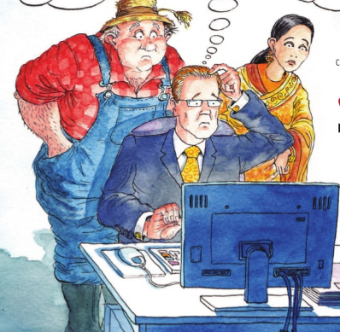
Illectronisme: Who is affected?
Young and old
Men and women
Rural and urban
“Third-world” and “first-”
All of us, haves and have-nots

Slide 7
Illectronisme: When is it apparent?
At school: When students have smartphones but no Internet savvy
At home: When one can call up a recipe or a Netflix show but…
At work: When one can communicate intra-office but not beyond
Wherever: When one is ready to pay, order, etc., and things stop

Slide 8
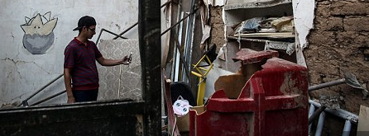
Illectronisme: Where?
Geographically: In remote areas, poor & diseased, war-torn
Intellectually: In educational dead zones…
Demographically: Among the elderly, the disadvantaged….

Slide 9
Illectronisme: Why
Why does it occur? Access & usage
Why may it be worsening? Economic inequities
Why should it be addressed? (Why should we care?)

Slide 10
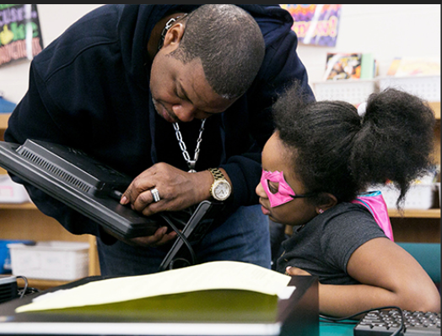
Illectronisme: How will the problem be solved?
Governmental participation
Institutional participation
Popular participation
Stakeholder participation

Slide 11
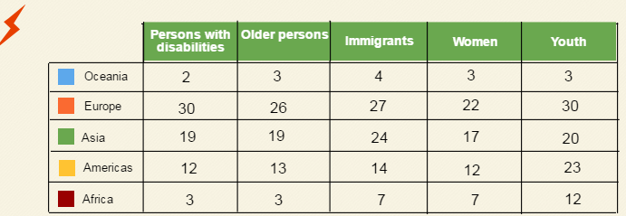
Governmental participation…examples
UK: Office of Communications, OFCOM, is charged with media literacy
Connecting California: “So Cal Grantmakers” fund efforts “to close divide”
China: China Education Television 14hr/day broadcasts for literacy
France: Ministries of Culture and Education develop national plans

Slide 12
Institutional participation: Examples
UNESCO
Global Alliance to Monitor Learning (GAML)
World Bank & the World Economic Forum
American Library Association

Slide 13
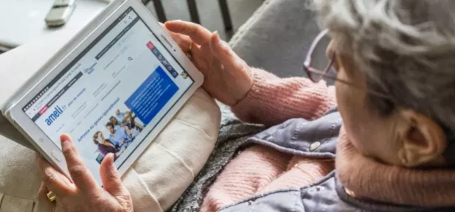
Popular participation: Examples
ISTE (Int’l Society for Technology in Education): Be an agent & interactor
Parents & friends: Help one another to integrate & embed the digital
Individuals: Collect strategies & maintain a toolkit for instant use
Communities: Note how digital literacy helps effective communication

Slide 14
Stakeholder participation: Who?
Governments
Educators
Technology & equipment companies
Service providers
Extra-governmental overseers: e.g., Digital Divide Council, UNESCO

Slide 15
Measuring lacunae that define the divide < GAML

Slide 16
What to hope for: Lectronisme, with citizens who…
Possess skills, tech and cognitive, for finding, understanding, evaluating,
creating, & communicating in varying digital formats;
Can use diverse technologies effectively to retrieve info, evaluate &
interpret results, & judge information quality;
Can understand the relationship between tech, lifelong learning,
personal privacy, & info stewardship
Can use skills & select the best tech for collaboration & communication

