Slide 1
Open Education Instructional
Journal

Slide 2
Table of Contents 1of 4
Purpose Statement
Introduction
Foundational
  Instructional Goals
    Instructional Reflections
    Instructional Course Goals
  Course Design
    Bloom’s Revised Taxonomy
    Understanding by Design/Backward Design
    Differentiated Instruction
    Mind Mapping
    Outcomes and Competencies
    Instructional Support
  Open Education (Content)
    OER Basics
    Resources
  Student Outcomes
    Student Experience
    Reflection
  Value Added

Slide 3
Table of Contents 2 of 4
Understanding & Applying
  Instructor Goals
    Multiple Submission Options
    Feedback
  Course Design
    Pedagogy/Andragogy/Heutagogy
    Pedagogy & Teaching Methods
    Universal Design for Learning (UDL)
    Rubrics
    Scaffolding
  Open Education
    Open Pedagogy
  Student Outcomes
    Student Self-Assessment
    Student Peer Review
    Reflecting on Student Feedback
  Value Added
    Essential Skills

Slide 4
Table of Contents 3 of 4
Innovation & Connections
  Instructor Goals
    Review Philosophy/Teaching Goals
    Evaluate Course Goals
    Assessment & Redesign
    Open to New Ideas – Stay Curious
    Innovation
  Course Design
    UDL and Open Pedagogy
    UDL, Open Pedagogy, Essential Skills, and Workforce
    UDL & Differentiated Instruction
    Differentiated Instruction & Scaffolding
    Interdisciplinary Collaborations
  Open Education
    Student Agency
    Digital Literacy
    Student and Faculty Advocacy
    Student as a Creator/Co-Author
  Student Outcomes
    Diversity, Equity, and Inclusion (DEI)
    Accessibility
    Authentic Assessment
    Dealing with Success/Failure
  Value Added
    Open Pedagogy and Academic Integrity
    Proctoring
    Reminder

Slide 5
Table of Contents 4 of 4
Additional Resources
Acknowledgements
To All Adopters & Adapters
Author/Citation

Slide 6
Purpose Statement
Through my own experience as a faculty member and working with faculty over the last 8 years, it occurred to me that I was only one of many instructors who started their careers with ample field/discipline experience or education, but not necessarily much or any instructional experience. Outside of what has been modeled throughout one’s own education, faculty are often asked to build a class without assistance or training in instructional design or pedagogy. In light of this recognition, I wanted to find a way to bridge the gap between faculty’s personal experiences, education, and expertise with information and options around course design, pedagogy, and resources that they can utilize during the process of course construction. Additionally, faculty are already busy and sometimes have tight deadlines to develop a class. Therefore, I created a resource that would accomplish three aspects: provide introductory information for course design and pedagogical options, introduce faculty to open education, and be usable during the process of course construction.

Slide 7
Introduction

Slide 8
Hello Instructor,
My goal is for you to use this resource as you see fit with the hope you find it helpful and informative. Feel free to jump around to personalize your own experience. Worksheets are provided for each section, as listed below, to assist instructors through self-exploration both as an instructor and as an option for course creation. This journal is broken down into three sections:
Foundational: Introductory information around course design, pedagogy, and open education.
Understanding & Applying: Further exploration of course design, pedagogy, and open education to move toward a deeper understanding and additional instructional application options.
Innovation & Connections: Discussing different connections among items discussed and encouraging continued instructional exploration and innovation, specifically within open education.

Slide 9
Foundational

Slide 10
Instructional Goals
Outline:
Introduction
Instructional Reflections
Instructional Course Goals

Slide 11
Instructional Goals
Identifying how you want to teach, interact with your students, and engage your students in the classroom can be a good foundational starting point to clarify how you want to structure your classes. This provides you the opportunity to show up in your class and provide an authentic student experience that only you can provide. It is a good practice for instructors to take time to reflect and identify goals that they want their students leaving with once they have completed their courses or programs. Consider the questions on the next slide. If you would like to fill out these questions, download the ”Foundational Packet” to be able to start writing.

Slide 12


Instructional Reflections
Why have you chosen teaching as your profession? What were motivating factors? (Motivation)
What is your teaching philosophy?
  Caukin, Nancy G. and Brinthaupt, Thomas M. (2017) "Using a Teaching Philosophy Statement as a Professional Development Tool for Teacher Candidates," International Journal for the Scholarship of Teaching and Learning: Vol. 11: No. 2, Article 18.
  “Exploring Your Teaching Philosophy: Sample Exercises.” Centre for Teaching Excellence, University of Waterloo.
What skills do you encourage students to learn for success in your field?
How do you want to identify as an instructor? (ex. approachable, strict, open, knowledgeable, etc.)
What methods do you use to create engagement with the student and the subject matter?
What three teaching goals would you like to accomplish within an academic year?

Slide 13
Instructional Course Goals
Reflect on your current methods/course design.
  Does this presentation of your class reflect what you stated in your Instructional Reflections?
  Are there skills or experiences that you encourage in class that are not a part of the core outcomes or competencies? Does that affect assessment? If so, is this expectation communicated and understood by students?
    Example: In Instructional Technology industries your clients are coming to you for problem resolution whether that would be for a product or for a technology issue. Communication, both written and verbal, are essential skills needed to provide high quality customer service and get to the root of what the client wants.
Write a one sentence mission statement for your course.

Slide 14
Instructional Course Goals
What is the primary takeaway that you want your students to leave with?
If you had to choose one or two long-term goals to achieve by the end of your class, what would they be?
What short-term goals can you create to help achieve your long-term goal(s)?
Are exams necessary for class assessment and if not, how could you assess student performance/competency more authentically?
If you taught it last time:
  What worked?
  What didn’t work?
  Where are there learning gaps?

Slide 15
Course Design
Outline:
Bloom’s Revised Taxonomy
Backward Design
Brainstorming
Mind Mapping
Outcomes and Competencies
Instructional Support

Slide 16
Course Design: An Introduction
Designing a course is one way to put your fingerprint on your class.
I do want to be transparent and share that I come to this information from a faculty perspective as I have developed and taught online and in person courses and am currently work with faculty on open education as a part of an instructional support team. I highly encourage all to reach out to institutional resources such as instructional designers and librarians for assistance and clarifications around your institutional course policies.
The following pages will explore a few options that I hope you will find useful as you start designing your class, deciding on how you want that to demonstrate your instructional goals, and the engage with your students. This is not an exhaustive list, so I always encourage all to explore and stay curious!

Slide 17
Bloom’s Revised Taxonomy
The new terminology used for Bloom’s Revised Taxonomy for both categories and subcategories here switched to verbs and gerunds to be more action oriented. These are the types of words that you will likely find used when reviewing outcomes and competencies. The categories for the revised taxonomy include Remember, Understand, Apply, Analyze, Evaluate, and Create. For the list of sub-categories visit the resource below.
Armstrong, P. (2010). Bloom’s Taxonomy. Vanderbilt University Center for Teaching. Retrieved [3/22/21] from https://cft.vanderbilt.edu/guides-sub-pages/blooms-taxonomy/.

Slide 18
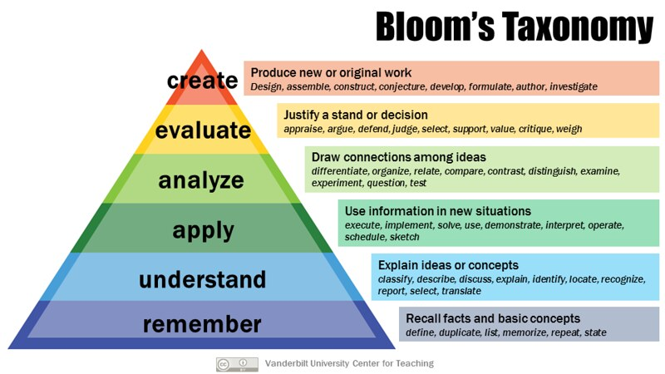
Bloom’s Revised Taxonomy Chart
Armstrong, P. (2010). Bloom’s Taxonomy. Vanderbilt University Center for Teaching. Retrieved 10 Mar. 2021 from https://cft.vanderbilt.edu/guides-sub-pages/blooms-taxonomy/.

Slide 19
Bloom’s Revised
Taxonomy Matrix
Structurally a new taxonomy level is added for ”Knowledge” - one of the original categories - creating a two-dimensional framework. These knowledge categories are Factual, Conceptual, Procedural, and Metacognitive.
Armstrong, P. (2010). Bloom’s Taxonomy. Vanderbilt University Center for Teaching. Retrieved [3/22/21] from https://cft.vanderbilt.edu/guides-sub-pages/blooms-taxonomy/.

Slide 20

Why Use Bloom’s?
“Objectives (learning goals) are important to establish in a pedagogical interchange so that teachers and students alike understand the purpose of that interchange.”
“Organizing objectives helps to clarify objectives for themselves and for students.”
“Having an organized set of objectives helps teachers to:
  ‘plan and deliver appropriate instruction”;
  ‘design valid assessment tasks and strategies’; and
  ‘ensure that instruction and assessment are aligned with the objects.’”
Armstrong, P. (2010). Bloom’s Taxonomy. Vanderbilt University Center for Teaching. Retrieved [3/22/21] from https://cft.vanderbilt.edu/guides-sub-pages/blooms-taxonomy/.
“The revised version of the taxonomy is intended for a much broader audience. Emphasis is placed upon its use as a ‘more authentic tool for curriculum planning, instructional delivery and assessment.’”
Forehand, M. (2005). Bloom’s taxonomy: Original and revised. In M. Orey (Ed.) Emerging perspectives on learning, teaching, and technology. Retrieved 3/22/21, https://cft.vanderbilt.edu/wp-content/uploads/sites/59/BloomsTaxonomy-mary-forehand.pdf

Slide 21
    First – A Story
In his book Start with Why Simon Sinek tells a story about how American car executives went over to Japan to tour their assembly lines. Line workers in America, at this time, would have a rubber mallet to tap on the doors as they attached the car doors to make sure they would fit perfectly. In Japan there were no mallets and no person doing this job. The Americans asked why this was the case and their Japanese guide said, “We make sure it fits when we design it” (Sinek, 14).
Similarly, we too need to follow suit as instructors and plan what we want to be achieved at the end of our course at the beginning.
  “Our lessons, units, and courses should be logically inferred from the results sought, not derived from the methods, books, and activities with which we are most comfortable. Curriculum should lay out the most effective ways of achieving specific results… in short, the best designs derive backward from the learnings sought” (Bowen).
Bowen, R. S. (2017). Understanding by Design. Vanderbilt University Center for Teaching. Retrieved [3/22/21] from https://cft.vanderbilt.edu/understanding-by-design/.
Simon Sinek: How Great Leaders Inspire Everyone to Take Action. (September 2009) TedX. Retrieved [3/22/21] from https://www.ted.com/talks/simon_sinek_how_great_leaders_inspire_action
Sinek, S. (2009) Start with Why: How Great Leaders Inspire Everyone to Take Action. Penguin Group.

Slide 22
    Understanding by Design
Introduction:
Grant Wiggins and Jay McTighe present a framework for course design called ‘Backward Design’ in the book called Understanding by Design.
      “Instructors typically approach course design in a ‘forward design’ manner, meaning they consider the learning activities (how to teach the content), develop assessments around their learning activities, then attempt to draw connections to the learning goals of the course. In contrast, the backward design approach has instructors consider the learning goals of the course first. These learning goals embody the knowledge and skills instructors want their students to have learned when they leave the course.”
Bowen, R. S. (2017). Understanding by Design. Vanderbilt University Center for Teaching. Retrieved [3/22/21] from https://cft.vanderbilt.edu/understanding-by-design/.

Slide 23
    Backward Design
Stages of Backward Design:
1. Identify Desired Results
  Consider the learning goals for the course, unit, and/or lesson.
  What are the long-term goals for the class and what short-term goals can you set to help get you there?
2. Determine Acceptable Evidence
  Consider assessment and performance activities that students can complete to demonstrate understanding.
  “How will I know if students have achieved the desired results?”
  “What will I accept as evidence of student understanding and proficiency?”
  It is important to consider multiple assessment methods and to make sure that the assessments match the learning goals.
3. Plan Learning Experiences and Instruction
  Consider how you will teach.
  Here you can decide the structure of the class, what activities will be used, and how students will engage with the material or experience and practice skills.
Bowen, R. S. (2017). Understanding by Design. Vanderbilt University Center for Teaching. Retrieved [3/22/21] from https://cft.vanderbilt.edu/understanding-by-design/.

Slide 24
    Backward Design
Remember that Backward Design is a way to determine your goals – both long-term and short-term – not to fully outline how the class is going to run. Leave space to be flexible and be able to respond to the needs of the students. This is where class or learning assessments (also called formative assessments) come into play.
“In teaching students for understanding, we must grasp the key idea that we are coaches of their ability to play the ‘game’ of performing with understanding, not tellers of our understanding to them on the sidelines.” Bowen, R. S. (2017). Understanding by Design. Vanderbilt University Center for Teaching. Retrieved [3/22/21] from https://cft.vanderbilt.edu/understanding-by-design/.
Bowen, R. S. (2017). Understanding by Design. Vanderbilt University Center for Teaching. Retrieved [3/22/21] from https://cft.vanderbilt.edu/understanding-by-design/.

Slide 25
    Differentiated Instruction
This is a student-centered approach and looks at students individually who are at various levels of readiness and interest as well as differences among their learning preferences. This is not a personalized plan for every student, but rather the opportunity to adjust in class as observations and assessments may indicate. By making an adjustment for one student it may help assist other students.
This is one way to create change according to data collected from classroom assessment techniques (also called learning assessment techniques.)

Slide 26

    Differentiated Instruction
Differentiated Instruction provides four options where the instructor can make changes to the classroom as needed: content, process, product, or environment.
  Content – (What) Ex. Providing different ways of engaging with content.
  Process – (How) Ex. Some students may need more hands-on approaches to learning vs visional, etc.
  Product – Ex. Provide options for students to demonstrate their understanding of the concepts.
  Environment – (Where) Ex. Opportunity to work alone or as a group.
For more information on this topic go to Ch. 12 in Paula Lombardi’s work “Instructional Methods, Strategies and Technologies to Meet the Needs of All Learners”

Slide 27
Mind Mapping
“Our brains are wired to rapidly make sense of and remember visual input. Visualizations in the form of diagrams, charts, drawings, pictures, and a variety of other ways can help students understand complex information. A well-designed visual image can yield a much more powerful and memorable learning experience than a mere verbal or textual description.” (Maria Ebner & Derek Bruff)
This can also help instructors in their construction and layout of their class. The link below provides several options and resources to explore and try. Other resource options include Canva and Mind Meister as well as many other free options.
Ebner, M. & Bruff, D. (2010). Visual Thinking. Vanderbilt University Center for Teaching. Retrieved 17 Apr. 2021 from https://cft.vanderbilt.edu/guides-sub-pages/visual-thinking/.

Slide 28
Outcomes and Competencies
There has been a lot of discussion around outcomes and competencies thus for so exactly what are these?
Competency: “A general statement that describes the desired knowledge, skills, and behaviors of a student graduating from a program (or completing a course). Competencies commonly define the applied skills and knowledge that enable people to successfully perform in professional, educational, and other life contexts.”
Outcome: “A very specific statement that describes exactly what a student will be able to do in some measurable way. There may be more than one measurable outcome defined for a given competency.”
Gosselin, D (2020) Competencies and Learning Outcomes, InTeGrate. Retrieved 17 Apr. 2021 from https://serc.carleton.edu/integrate/programs/workforceprep/competencies_and_LO.html

Slide 29
Outcomes and Competencies: Key Distinctions
“A true learning outcome is written so that it can be measured or assessed. It focuses on what the student is able to do at end of a program (or course). Thus, learning outcomes are the basis for an assessment program that focuses on what a student can or should be able to do either upon completion of a course or upon graduation from a program. The term learning outcome is used more commonly in the context of a program or course of instruction. The term competency is more commonly used in relation to professional fields (i.e. dentistry, nursing).”
Gosselin, D (2020) Competencies and Learning Outcomes, InTeGrate. Retrieved 17 Apr. 2021 from https://serc.carleton.edu/integrate/programs/workforceprep/competencies_and_LO.html

Slide 30
Instructional Support
Most institutions have instructional support. If your institution supports these roles, I highly encourage you to reach out to your librarians and instructional designers. They have a wealth of knowledge to share with you and your students. These collaborations may open options for:
Technology and other resources
New ways of presenting information
New opportunities to engage students
Alternative for how you can construct your class
Don’t forget your faculty colleagues are great resources and there may be other opportunities for additional collaboration within your discipline or interdisciplinary.

Slide 31
Open Education
Outline:
OER Basics
Why OER? (Brief Problem/Solution Discussion)
Definition and 5Rs
Introduction to Creative Commons
Basic Open Education Terminology
‘OER First’ Approach
Resources

Slide 32
Why OER?
Problem:
Increase in Higher Education cost
Increase in textbook costs - affordability
Student Issues: Hunger, Homelessness, etc.
Lack of access to course materials
Recognition of a digital divide
COVID exacerbated these issues
Where do we start to address these barriers to student success?
A Solution:
Open Educational Resources
  Reduce/Remove cost of textbooks
  Provide immediate/first-day access to course content
  Provide more instructional control over content
  Opens pedagogical opportunities for instructor and student engagement.
  Able to contextualize content for the needs and representation of the student.

Slide 33

Definition and 5Rs
“Open Educational Resources (OER) are teaching, learning, and research materials that are either (a) in the public domain or (b) licensed in a manner that provides everyone with free and perpetual permission to engage in the 5R activities.”
The 5Rs:
Retain – make, own, and control a copy of the resource
Reuse – use your original, revised, or remixed copy of the resource publicly
Revise – edit, adapt, and modify your copy of the resource
Remix – combine your original or revised copy of the resource with other existing material to create something new
Redistribute – share copies of your original, revised, or remixed copy of the resource with others
"OER” – Creative Commons – https://creativecommons.org/about/program-areas/education-oer/

Slide 34
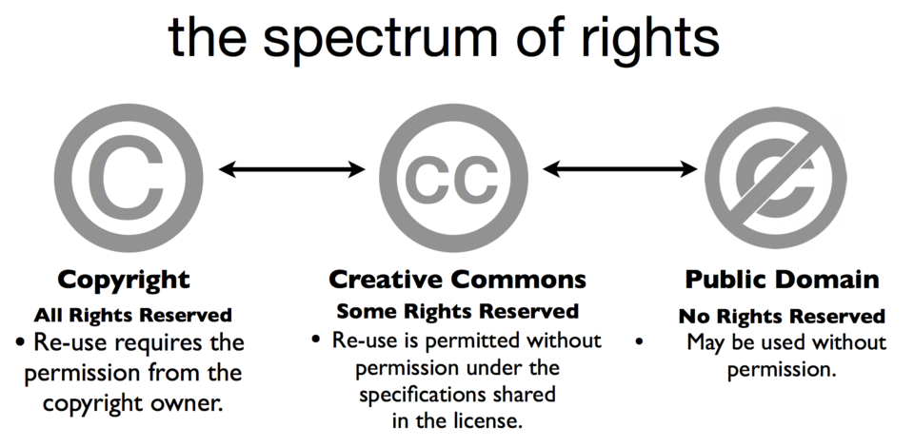

Introduction to Creative Commons
Creative Commons (CC) is a layer on top of copyright that grants irrevocable and perpetual permissions. These rights are recognized using six different combinations of four different symbols.
Graphic from http://tlinnovations.populr.me/copyright

Slide 35
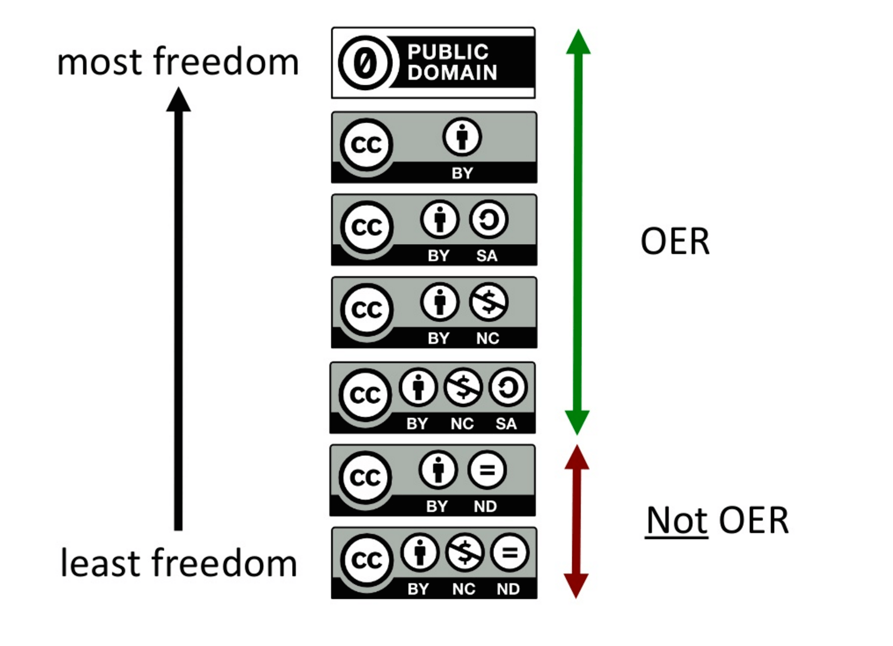
Creative Commons
Creative Commons Rights:
BY – Attribution – Give credit
SA – ShareAlike – Must redistribute derivatives under the same license
NC – Non-Commercial – No for-profit use
ND – Non-Derivative – Cannot produce a derivative of work
Note in the image to the right that ND is outside of what is considered OER because users may not engage with the ’remix’ and ‘revise’ features of the 5Rs.
Cable Green – University of Hawaii – Taken from: https://oer.hawaii.edu/getting-started/copyright-for-oer/ [Retrieved 3/22/21]

Slide 36
Basic Open Education Terminology
Adopt: Use OER in the place of or in conjunction with traditional materials
Adapt: (Revise/Remix) Customizing, updating, contextualizing, revising OER content
Create: Authoring and openly licensing new content
Public Domain: “The term ‘public domain’ refers to creative materials that are not protected by intellectual property laws such as copyright, trademark, or patent laws.” – Stafford Libraries – Public Domain
Fair Use: “A copyright principle that excuses unauthorized uses of a work when used for a transformative purpose such as research, scholarship, parody, criticism, or journalism.” – Cornell Law School – Fair Use
‘Free’ – Available on the internet for educational OR personal use, but under ’all rights reserved’ - copyrighted
‘Digital’ – Available through library resources or publisher – “somebody pays”- copyrighted – “Free to student”
‘Open’ – Accessible with no cost (free + permissions) 5Rs – OER

Slide 37
‘OER First’ Approach
As you say in Differentiated Instruction, ’content’ is one area where you can make adjustments to address the needs in the classroom. With that mentality in mind, consider taking an ‘OER First’ approach when choosing your course materials. This is one area where faculty can make an impact within their students’ lives that immediately extends past the classroom.
Currently, there may not be OER available for every discipline or level. There is much work to still be done, however, it is a first step. Remember you are the expert, and this is not a sales pitch for you to adopt OER. This is a solution to address different student/educational issues, but you have the academic freedom to chose the materials and texts that work best for your class.
Please consider OER first.

Slide 38
Learn More About OER - Resources
Fair Use
  Best Practices in Fair Use for OER – (American University – Washington College of Law)
The OER Starter Kite Workbook (Abbey Elder and Stacy Katz)
Keep in mind and ask about any institutional or state OER policies or procedures.
SPARC State Policy Tracker
Places to start looking for OER:
OpenStax
Open Textbook Library
Libretexts
BCCampus
Galileo
SkillsCommons

Slide 39
Student Outcomes
Outline:
Student Experience
Reflections

Slide 40
Student Experience
Thus far, we have reflected on your instructional goals, explored course design, and content options. Now let’s explore how the student engages with the learning experience you have designed:
What experience will they have in the class with what you have outlined thus far?
Do they have different opportunities to engage with content?
Do you communicate your course goals and outcomes clearly?
Do students have any opportunity for choice?
Is there space for them to provide input on the structure of the course?

Slide 41
Reflection
It’s good practice to pause and reflect on where you are at and where you want to go early in the process of designing a course. Assessment is a primary driver for student learning and without it you cannot determine if learning is happening.
Bloom’s/Backward Design Assessment:
  If you have chosen to implement one or more instructional strategies to improve your course design, how has it/have they improved the class outline?
  How do you anticipate they will improve student learning?
Course Goals Reflection:
  Does the structure; activities, assignments, and assessments; and choice of content move you toward achieving your instructional goals? If so, how? If not, why not and what changes do you need to make?
Instructional Goals Reflection:
  How does the previous answers reflect when compared to your teaching philosophy?
  Does this help you achieve any of your teaching goals you articulated earlier?

Slide 42
Value Added
Define ’Value Added’
’Value Added’ is a term that I am using to indicate something more is provided than just the outcomes and competencies being covered. Other skills, knowledge, or information that students and young professionals need to know and practice early to be successful in this field or industry.
Additional Student Need-To-Knows
What is the ultimate student learning outcome they need to understand/execute after this course?
Are there aspects students need to be successful in this field that are not listed in the outcomes and competencies?
  How could you start including one or more of these aspects into your class?
  Could this element drive how assessments or assignments are completed?
  Do you articulate why students are executing these assessments/assignments in the manner you are requiring? (Tell them/explain why.)

Slide 43
Understanding & Applying

Slide 44
Instructional Goals
Outline:
Multiple Submission Options
Feedback
Students Providing Peer Review & Constructive Feedback
Students Receiving Instructional Feedback
Students Providing Instructional Feedback – End of Course
If you would like to fill these questions out download the “Understanding & Applying Packet” to be able to start writing.

Slide 45
Multiple Submission Options
Just as students’ learning preferences are different and faculty are encouraged if not required to provide a variety of ways to present information (visual, auditory, kinesthetic, verbal, etc.) so too is that a way to approach how students may want to present their information. Providing a few choices for students to present their information during assignments or assessments can improve motivation, engagement, as well as overall understand.
Here is an instructional example:
https://www.nisod.org/archive_files/abstracts/pdf/XLIII_1.pdf

Slide 46
Feedback
“In a nutshell, feedback is information provided on the performance or understanding of a task which can then be used to improve this performance or understanding. Feedback helps to close the gap between actual performance and intended performance.” (Lombardi, P.)
“The use of feedback is regarded as one of the most powerful strategies to improve student achievement and you may or may not be aware of just how much attention it receives in education policy and practice.” (Brooks, C.)
“Research suggests that much of feedback that is given is in fact rarely used by students. For this reason, we need to focus upon how feedback is being received rather than just how feedback is given.” (Brooks, C.)
UQx LEARNx Team. (2019) Instructional Methods, Strategies and Technologies to Meet the Needs of All Learners. “Ch. 10 – Feedback” Retrieved 17 Apr. 2021 https://granite.pressbooks.pub/teachingdiverselearners/chapter/feedback-2/

Slide 47
Feedback
With the knowledge that feedback can have a significant impact in a classroom how can we increase the effectiveness of this practice? Do students have the skills to interpret instructional feedback or provide constructive feedback during peer review? Feedback – both given and received – will be something all students will experience throughout their education and into their careers. How they understand, reflect, and respond to feedback will have an overall impact on their future success.
Students Providing Peer Review & Constructive Feedback
  Have you given them the tools to understand their role as a peer reviewer and how to give constructive feedback?
Students Receiving Instructional Feedback
  Have you given your students the tools to work through your feedback on their work?
  Do you have options in place to address questions on feedback?
Students Providing Instructional Feedback – End of Course
  How can students provide effective feedback at the end of class to express their experience and assist you in providing information that can be turned into actionable changes to improve the course?
***The resource below provides good introductory information on feedback for all learners.
UQx LEARNx Team. (2019) Instructional Methods, Strategies and Technologies to Meet the Needs of All Learners. “Ch. 10 – Feedback” Retrieved 17 Apr. 2021 https://granite.pressbooks.pub/teachingdiverselearners/chapter/feedback-2/

Slide 48
Course Design
Outline:
Pedagogy/Andragogy/Heutagogy
Pedagogy and Teaching Methods
Universal Design for Learning (UDL)
Rubrics
Scaffolding

Slide 49
Pedagogy/Andragogy/Heutagogy
How instructors teach continues to a topic of discussion and research. There are a vast number of components to research and discover, but here are some nuts and bolts to get started.
Pedagogy has been a ’default’ term for ‘how to teach’ in some cases as ‘pedagogy’ is defined by Merriam-Webster Dictionary as “the art, science, or profession of teaching” even though the etymology references children.
However, other terms you may hear in higher education include:
‘Andragogy’: “the art or science of teaching adults” (Merriam-Webster Dictionary) also referred to as ’self-directed learning”
‘Heutagogy’: “self-determined learning”
Differences: Pedagogy/Andragogy/Heutagogy

Slide 50
Pedagogy and Teaching Methods
Types of Pedagogy (Example List)
Critical
Collaborative
Connectivist
Constructivist
Creative
Digital
Inquiry-Based
Integrative
Reflective
Teaching Methods (Resources)
There are a variety of teaching methods. Here are a few resources so you may investigate options for yourself.
https://granite.pressbooks.pub/teachingdiverselearners/chapter/feedback-2/
https://cft.vanderbilt.edu/teaching-guides/pedagogies-and-strategies/
https://facultyinnovate.utexas.edu/instructional-strategies

Slide 51
Universal Design for Learning (UDL)
What is Universal Design for Learning?
“a framework to improve and optimize teaching and learning for all people based on scientific insights into how humans learn.”
Here is a video that provides a good brief overview of UDL
  https://youtu.be/bDvKnY0g6e4
“These guidelines offer a set of concrete suggestions that can be applied to any discipline or domain to ensure that all learners can access and participate in meaningful, challenging learning opportunities.”
For more information and interactivity with the Guidelines Graphic Organizer for UDL that is on the next slide, visit the Cast website.
Faculty Perspective Example: Video
CAST (2018). Universal Design for Learning Guidelines version 2.2. Retrieved on 18 Apr 2021 from http://udlguidelines.cast.org

Slide 52
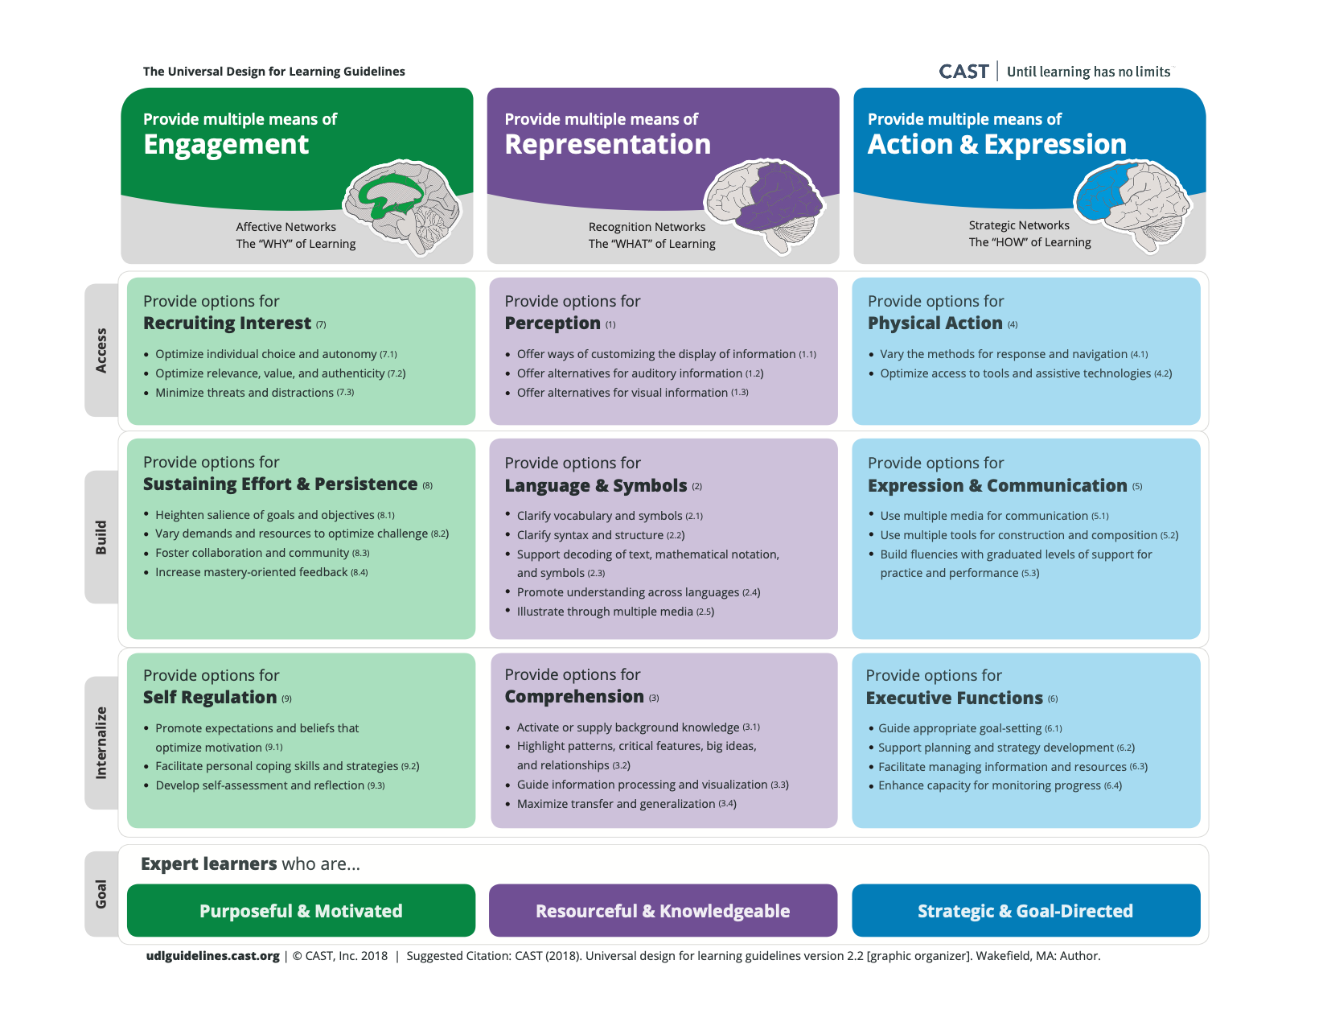
Universal Design for Learning (UDL)
Video: https://youtu.be/wVTm8vQRvNc - please note that the chart is in a different order than on the previous slide. Colors due match, but for clarification the previous slide and video puts the columns in the following order:
  Engagement/Representation/Action & Expression (Previous Slide)
  VS
  Representation/Action & Expression/Engagement (Video link demonstration)

Slide 53
Rubrics
A UDL tactic is to use rubrics to provide student choice and self-regulation. Rubrics are one way to provide guidance for students as well as help ensure grading consistency.
Some Student Benefits:
Clearly articulated expectation of standards
Easy to understand instructional feedback
Some Faculty Benefits:
Reduce time grading
Provide more consistency over time and throughout students
Clarify/Identify gaps or competency across a class
Resources
Creating Rubrics by Tom Lombardo –
Creating Rubrics in Canvas by Tom Gibbons –
Creating and Using Rubrics by Yale University –
For open education, rubrics are vital for consistency of grading while being able to open assignments to more choice.

Slide 54
Scaffolding
What is Scaffolding?
“The term ‘scaffolding’ was developed as a metaphor to describe the type of assistance offered by a teacher or peer to support learning. In the process of scaffolding, the teacher helps the student master a task or concept that the student is initially unable to grasp independently. The teacher offers assistance with only those skills that are beyond the student’s capability.”
  “Of great importance is allowing the student to complete as much of the task as possible, unassisted.”
Larkin (2002) states, “Scaffolding is one of the principles of effective instruction that enables teachers to accommodate individual student needs.”
“The scaffolding should be removed gradually and then removed completely when mastery of the task is demonstrated.”
West, A. et al. (2019) Instructional Methods, Strategies and Technologies to Meet the Needs of All Learners. “Ch. 11 - Scaffolding” Retrieved 17 Apr. 2021- https://granite.pressbooks.pub/teachingdiverselearners/chapter/scaffolding-2/

Slide 55
Scaffolding
Characteristics and Critical Features:
“In an appropriate scaffolding process, there will be specific identifiable features that are in place to allow facilitation of assisting the learner in internalizing the knowledge until mastery occurs. Applebee and Langer (1983), as cited by Zhao and Orey (1999), identify these five features as:”
  Intentionality: “The task has a clear overall purpose driving any separate activity that may contribute to the whole.”
  Appropriateness: “Instructional tasks pose problems that can be solved with help but which students could not successfully complete on their own.”
  Structure: ”Modeling and questioning activities are structured around a model of appropriate approaches to the task and lead to a natural sequence of thought and language.”
  Collaboration: “The teacher’s response to student work recasts and expands upon the students’ efforts without rejecting what they have accomplished on their own. The teacher’s primary role is collaborative rather than evaluative.”
  Internalization: “External scaffolding for the activity is gradually withdrawn as the patterns are internalized by the students (p. 6).”
West, A. et al. (2019) Instructional Methods, Strategies and Technologies to Meet the Needs of All Learners. “Ch. 11 - Scaffolding” Retrieved 17 Apr. 2021- https://granite.pressbooks.pub/teachingdiverselearners/chapter/scaffolding-2/

Slide 56
Scaffolding
Another Perspective – This is simply another perspective. Find what works for you and your class.
Jesse Stommel – “The Human Work of Higher Education Pedagogy." Academe Vol. 106.1 (2020)
“Rubrics, backward design, learning objects, Bloom’s taxonomy, instructional design, outcomes. Too much of what we do breaks learning down into neat chunks, discrete linear steps, carefully “scaffolded” to control for anxiety and distraction— without being responsive to the specific contexts, backgrounds, and experiences of students.
Instructional scaffolding is a pedagogical method that emphasizes a structured framework of support for students as they proceed through deeper and deeper levels of learning. In practice, though, too much of this framework is built in advance, during the design phase of a course, before teachers have even met the students. In “Subversion and Instructional Design,” Sean Michael Morris, director of Digital Pedagogy Lab, writes, “Any effort on my part to scaffold . . . would be colonial, patriarchal, and disempowering. Instead, I wish to lay upon the table before you the works which can—do, should, maybe will—inform what each of us also brings.” Scaffolding can create points of entry and access but can also reduce the complexity of learning to its detriment. As a metaphor, scaffolding hasn’t been adequately interrogated. It is too often a mechanism of control that operates under the guise of care—with much of the work done presumptively, sometimes patronizingly, in advance of students arriving upon the scene.”
What will work for you, your discipline, and your students? Don’t be afraid to step back, rethink, and assess what may need to change even if it seems a little scary with less initial structure. Will it be better for the students? You are a resource, not just a provider of information.

Slide 57
Open Education
Open Pedagogy:
Characteristics:
  Innovation and Creativity
  Sharing Ideas and Resources
  Centered on People/Openness/Trust
  Collaboration
  Community and Connection
  Student-Centered/Choice
  Experiential Learning
  Reflective Practice and Peer Review
  Equity and Access
  Social Justice
  Student as Creator
These characteristics summarize the thoughts and practices within open pedagogy, but there is still much debate about how it is fully defined.
As you will also see from previous information, open pedagogy coordinates with and/or overlaps with many of the other pedagogies or other teaching methods mentioned.
Explore these characteristics, pedagogies, and teaching methods for what may work for your vision, discipline, and course.

Slide 58
Student Outcomes
Outline:
Student Self-Assessment
Student Peer Review
Reflecting on Student Feedback

Slide 59
Student Self-Assessment
Five Attributes of Self-Assessment
#1 Self-assessment is explicitly taught and modeled by the teacher.
  Five strategies support teaching self-assessment skills to students:
    Develop Success Criteria with student to clarify how they learning will be assessed;
    Model how the criteria are applied to student work;
    Provide opportunities for students to apply the criteria to their own work;
    Discuss with students how well they are assessing their own learning; and
    Help students use feedback (from teacher, peer feedback, and self-assessment) to develop individual Learning Goals and clarify next steps in their learning.
#2 – Self-assessment involves students applying all the elements of the Feedback Loop to their own work.
#3 – Self-assessment involves students in generating internal feedback to guide their learning.
#4 – Self-assessment is an essential element in support of student agency and self-regulation.
#5 – Self-assessment requires student to hold an understanding of quality work that is similar to that of the teacher.
This resource also provides options to promote metacognition as well which aligns with practices associated with Universal Design for Learning.
Student Agency in Learning (SAIL) “Five Attributes of Self-Assessment.” Retrieved 4 May 2021. https://www.azed.gov/sites/default/files/2019/02/5_Attributes_SelfAssessment_v3_FINAL.pdf?id=5c5cb1af1dcb250c34e8a4d5

Slide 60
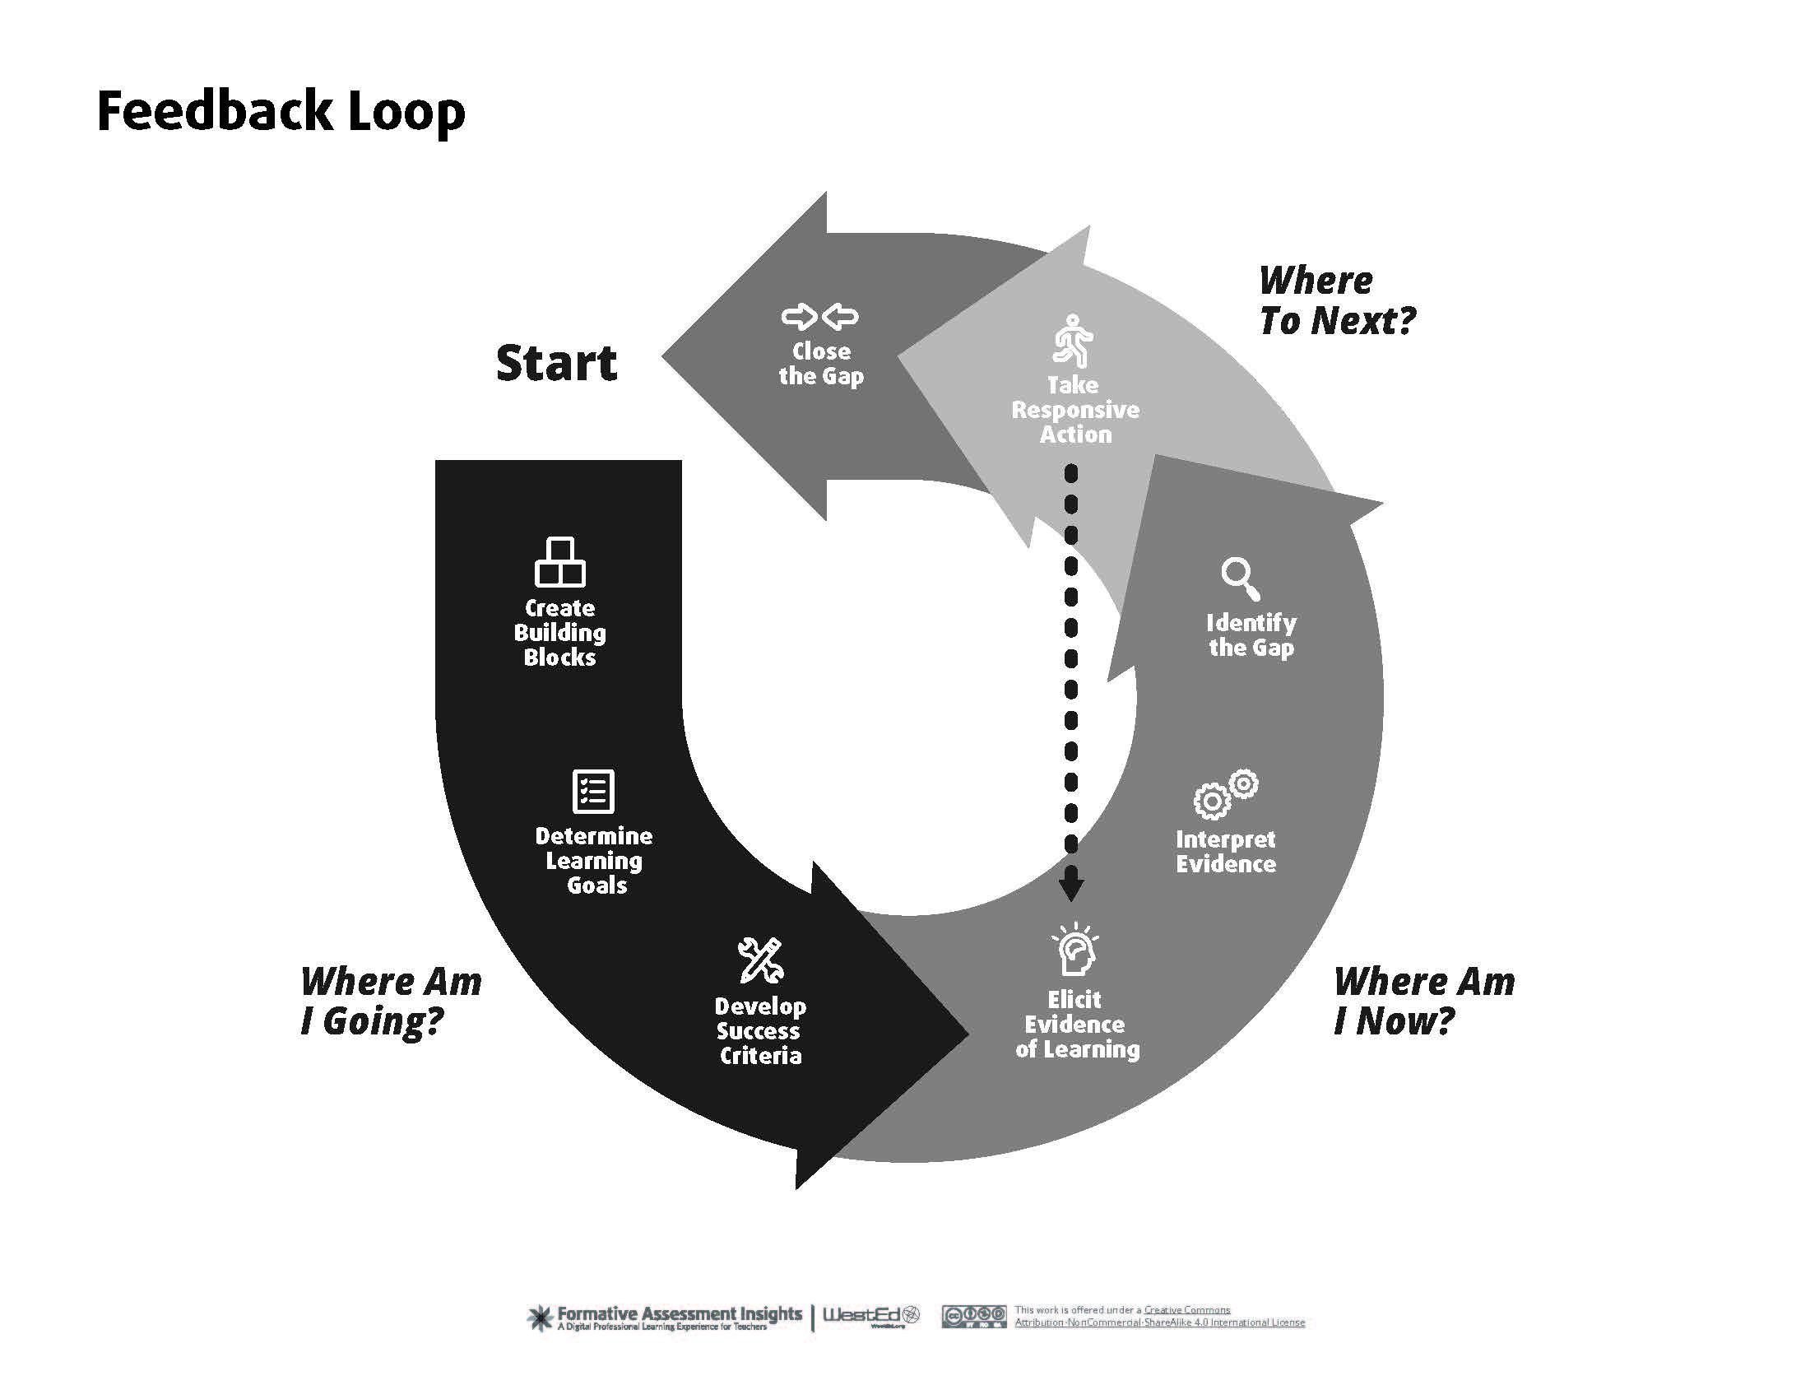
Student Self-Assessment
Feedback Loop
“Self-assessment involves many of the same learning opportunities, while also engaging students in critical self-reflection and regulation, enhancing student ownership of learning and outcomes, and challenging students to create action plans related to their work.” – “The Idea Book” by iDesign – University of Saskatchewan
Self-Assessment Tool for Students –
Self Assessment Tool for Faculty -

Slide 61
Student Peer Review
Why do student peer review?
“Peer Review is the process of handing your own draft of an assignment to a classmate to read and review, while your classmate hands over his or her own paper for you to read and review.”
“In general, we accept feedback best from people we trust because we believe they have our best interests at heart. In a college class where the faces around you change frequently, it’s hard to develop that level of trust. So in peer review, we have to create credibility — that’s trustworthiness — through a process of Restating, Praising, and Criticizing.”
Research indicates that peer assessment offers the following pedagogical benefits:
Diversifies feedback
Provides practice in formal assessment and receiving feedback
Deepens learning, since it requires a second consideration of the assignment
Enhances motivation related to team performance
– “The Idea Book” by iDesign – University of Saskatchewan

Slide 62
Student Peer Review
Receiving Feedback – Thoughts to share with your students.
“Yes, handing over your paper makes you vulnerable — but the student you trade with is having exactly that same experience. Learning comes from vulnerability, from admitting that we don’t know everything, that we might — on occasion — need some help.”
“Peer Review relies on collaboration — the art of working together to create something. When you collaborate with someone else, you share ideas — you don’t compete to see who’s got the better idea (or paper). Instead, your goal is to make the best end product — paper, project, presentation — that you can.”
“Go into Peer Review with this mindset, and you’ll have a successful session no matter with whom you’re paired.” – Better Writing From the Beginning “Part 3: Peer Review and Collaboration” – Jenn Kepka
Peer Review Resource – “Peer Assessment” – Iowa State University –

Slide 63
Reflecting on Student Feedback
Reflective Teaching:
“When instructors engage in reflective teaching, they are dedicating time to evaluate their own teaching practice, examine their curricular choices, consider student feedback, and make revisions to improve student belonging and learning. This self-assessment process requires information gathering, data interpretation, and planning for the future. Reflective teaching involves examining one’s underlying beliefs about teaching and learning and one’s alignment with actual classroom practice before, during and after a course is taught.”
Yale University. Poorvu Center for Teaching and Learning. “Reflective Teaching.” Retrieved 4 May 2021- https://poorvucenter.yale.edu/ReflectiveTeaching
Visit link for more resources and information.

Slide 64

Value Added
Essential Skills
“Essential Skills are the skills that people need for learning, work, and life. They are used in the community and the workplace, in different forms and at different levels of complexity.” – Human Resources and Skills Development Canada - https://www.nwtliteracy.ca/sites/default/files/pdf/2018-06-20/gcs_9_essential_skills_0.pdf
This is a basic definition that can encompass many different elements. Here are a few resources to gauge the different types of essential skills.
University of Kentucky – National Center for Innovation in Education (2015) – Essential Skills and Dispositions: Developmental Frameworks for Collaboration, Communication, Creativity, and Self-Direction -
Skills Builder Partnership (Apr. 2020) – Universal Framework for Essential Skills –
  Document is under but the Framework itself is under
Association of American Colleges & Universities – VALUE assessment approach

Slide 65
Essential Skills
Examples of Essential Skills Include:
Communication
Creativity
Self-Direction
Teamwork
Ethics
Organization
Dependable
Critical Thinking
Problem Solving
Emotional Intelligence
Self-Awareness
Decision-Making
Adaptability
Tolerating Ambiguity
Goal-Setting
Time Management
Leadership

Slide 66
Innovation & Connections

Slide 67
Instructional Goals
Outline:
Review Philosophy/Teaching Goals
Evaluate Course Goals
Assessment & Redesign
Open to New Ideas – Staying Curious
Innovation
If you would like to fill these questions out download the “Innovation & Connections Packet” to be able to start writing.

Slide 68
Review Philosophy/Teaching Goals
Review Philosophy:
Throughout the journey through this journal, I hope that you have learned/investigated some new options, have re-evaluated a couple of old assumptions, and have been able to apply some innovative strategies into your class. (Review on Slide 12 or Foundation Packet Notes)
When looking back at the Teaching Philosophy, would you make revisions now?
  Example/Resource to add to your review: University of Waterloo – Centre for Teaching Excellence
Review Teaching Goals:
Either after finishing your course or working through this journal, are your teaching goals the same that you want to achieve now? Did you complete/achieve any goals?
(Review on Slide 12 or Foundation Packet Notes)
  If so, how and would you add?
  If not, why and what would you change?

Slide 69
Evaluate Course Goals
Reflect on the methods and strategies that you have identified useful inside of your class.
Are these methods/strategies more aligned with your teaching philosophy?
Does it connect to your one sentence mission statement and fulfill that mission for the course?
Do you establish and assess students’ understanding of the primary takeaway your want them leaving your class with?
How did the short-term goals you establish work for you and your students?
  What changes would you make to improve?
How did the long-term goals you set work for your and your students?
  What changes would you make to improve?
Did your assessments authentically gauge your student competency for the class?
  What changes would you make to improve?
(Review on Slides 13 & 14 or Foundation Packet Notes)

Slide 70
Assessment & Redesign
What is assessment?
Assessment has been mentioned throughout this journal. Here are definitions for two major forms of assessment:
  “Formative assessment refers to tools that identify misconceptions, struggles, and learning gaps along the way and assess how to close those gaps.”
  “[S]ummative assessments evaluate student learning, knowledge, proficiency, or success at the conclusion of an instructional period, like a unit, course, or program.”
    Yale’s Poorvu Center for Teaching and Learning. “Formative and Summative Assessment.” Retrieved 8 May 2021. https://poorvucenter.yale.edu/Formative-Summative-Assessments -
    This resource also provides additional examples and information.

Slide 71
Assessment & Redesign
What does assessment do?
Essentially it is a way to collect student data during or at the end of a class to gauge the level of understanding so that adjustments can be made to improve student learning.
  Assessments during a class or CATS provide information to make immediate adjustments to fill learning gaps that may have been identified. The link below has specific examples and more information about CATs.
    Yale’s Poorvu Center for Teaching and Learning. “Class Assessment Techniques” Retrieved 8 May 2021. https://poorvucenter.yale.edu/Classroom-Assessment-Techniques -
Redesign
  Course assessment looks at what you can learn from the class that just ended and how you can take that data and feedback to improve on the class for the next set of students – options to redesign the class.
    Are there patterns that highlights specific outcomes/competencies?
    Choose one outcome/competency that you recognized as an option for improvement. How can you improve that outcome/competency?

Slide 72
Open To New Ideas – Stay Curious
Staying Open to New Ideas
In the following article, Greg Satell starts with a story about solving a problem that focused on detecting pollutants in very small concentrations. The team was diverse comprised of microchip designers and a marine biologist.
  Satell, G. (2017) “The 4 Types of Innovation and the Problems They Solve.” Harvard Business Review. Retrieved 8 May 2021. https://hbr.org/2017/06/the-4-types-of-innovation-and-the-problems-they-solve
Remember:
  The power of a story.
  The importance of building a diverse team.
  Building the right team for the job.
  Being willing to keep an open mind about all possibilities.
Many of the best innovations are the solutions that solve everyday problems and not all solutions have to be complex. Sometimes the simplest solution is the best option. The goal is to keep an open mind where all options are possible. Stay Curious!

Slide 73
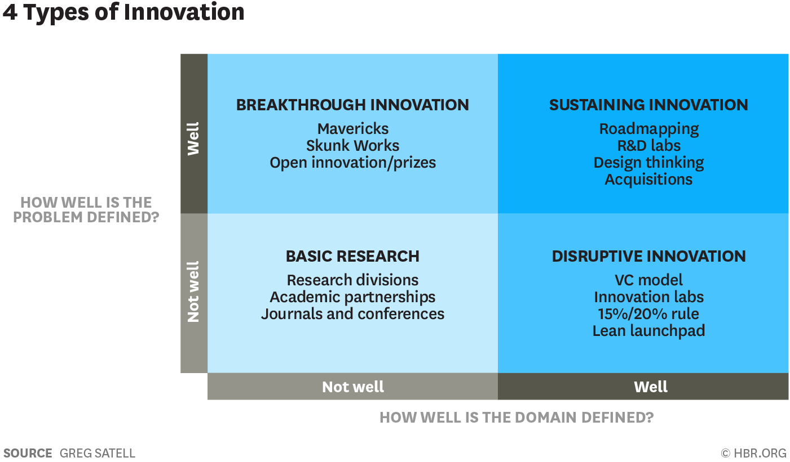
Innovation
What does “Innovation” mean?
At the core of “innovation” is the idea of solving a problem. There are a variety of ways, and the Harvard Business Review outlines 4 types in the chart below as follows:
Satell, G. (2017) “The 4 Types of Innovation and the Problems They Solve.” Harvard Business Review. Retrieved 8 May 2021. https://hbr.org/2017/06/the-4-types-of-innovation-and-the-problems-they-solve

Slide 74
Course Design
Outline:
UDL and Open Pedagogy
UDL, Open Pedagogy, Essential Skills, and Workforce
UDL and Differentiated Instruction
Differentiated Instruction and Scaffolding
Interdisciplinary Collaborations

Slide 75
Making Connection
I encourage you to take the opportunity to start exploring how you can make connection between different teaching methods, pedagogies, and strategies as well as your field/discipline and the world at large to fine tune your teaching craft. The remaining portion of this journal will be providing some insights on current connections between some of these elements. Please take or leave what connects with you, your class, and your students and expand wherever you can.

Slide 76
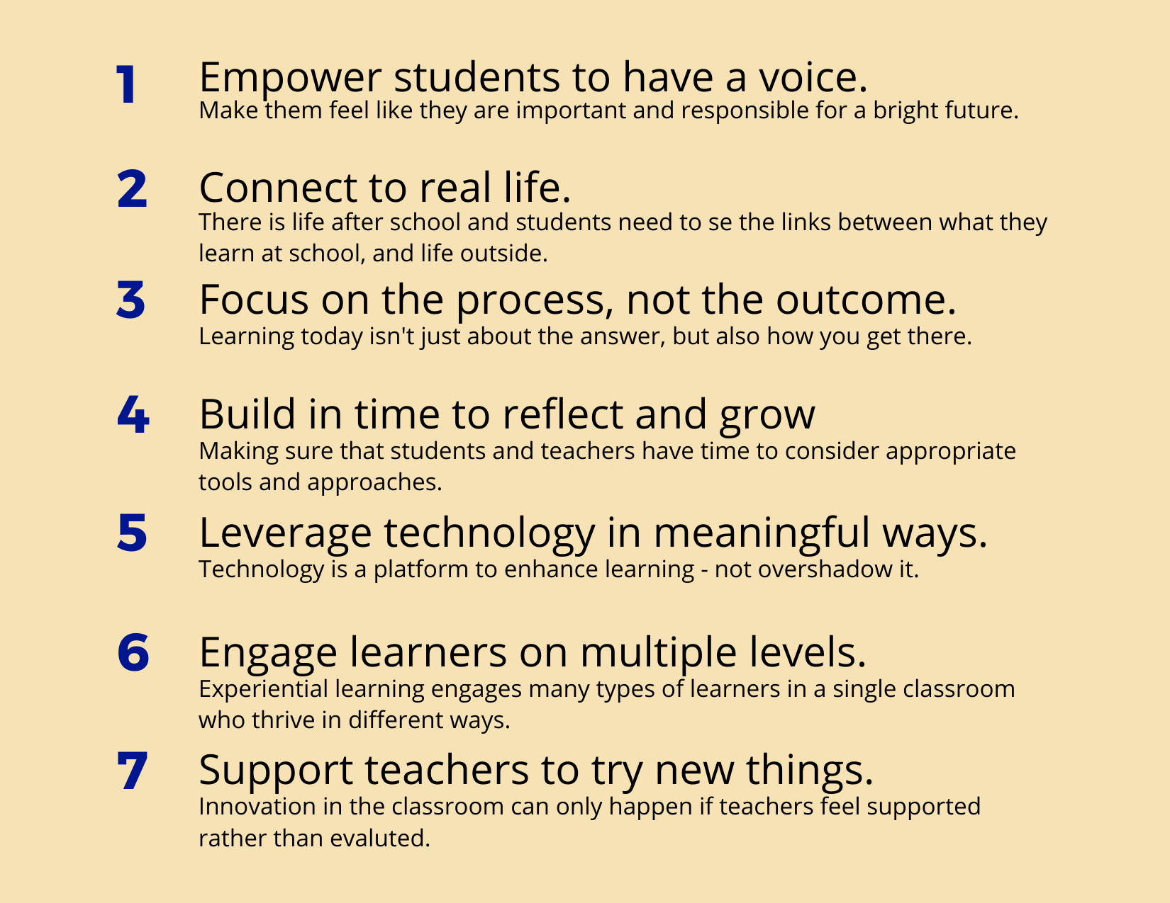
UDL and Open Pedagogy
If you note between the UDL guide and the characteristics of open pedagogy, there are several overlapping characteristics:
  (You may note that there are several overlapping characteristics between the UDL framework and Open Pedagogy.)
Student Center and Student Empowerment
Experiential Learning
Metacognition and Self-Awareness/Growth
Innovation and Creativity for Faculty and Student
Equity and Access
  CAST is currently starting an UDL Equity Initiative
Student Choice and Agency
Universal Design for Learning in HCPSS. “Guiding Principles and UDL Connections.” Retrieved 7 May 2021. https://udlhcpss.wordpress.com/guiding-principles-and-udl-connections/

Slide 77
UDL, Open Pedagogy, Essential Skills, and the Workforce
Likewise, when comparing UDL, Open Pedagogy and Essential Skills, we can find an overarching pattern.
UDL –
  Self Regulation (self-directed motivation, self-assessment and reflection)
  Comprehension (synthesize current knowledge, identify patterns & relationships, critical/creative thinking)
  Executive Functions (goal setting, plan and strategize, mange information, review progress)
Essential Skills – Overlapping areas with UDL
  Self-Direction
  Organization
  Critical Thinking
  Problem Solving
  Emotional Intelligence
  Creativity
  Communication
  Leadership

Slide 78
UDL, Open Pedagogy, Essential Skills, and the Workforce
Additionally, many of the essential skills that you see on the list and that you may recognize as areas of growth for your students are the same strengths the workforce is requiring in their new employees.
A recent study published by Georgetown University Center on Education and Workforce notes the following 5 top cognitive categories:
  Georgetown University Center on Education and the Workforce, Workplace Basics: The Competencies Employers Want, 2020. (Review data use in source.)
Communication
Teamwork
Sales and Customer Service
Leadership
Problem Solving and Complex Thinking
This is only one example of several workforce reports that you can review.
Identifying the needs of the workforce that your students will be walking into is another way to help and support them for future success.

Slide 79
UDL and Differentiated Instruction
The Dinner Party Analogy – Katie Novak – Novak Education
Summary - In the Dinner Party Analogy Katie uses the following metaphor:
  Differentiated Instruction: Making individual meals for everyone dining according to their preferences and needs.
  Universal Design for Learning: A buffet style dinner offered with everyone’s preferences and needs in mind.
These are both educational frameworks around providing student options, but the emphasis shifts between an individual student’s needs and a collection of needs being addressed by the offering of different instructional options.
Both have their uses, but when is the important question here.
Here is another resource: Inclusive Education Planning

Slide 80
Differentiated Instruction and Scaffolding
These two methods can be used together, but there is a distinct different:
Scaffolding is the breaking up of concepts or skills to make them more accessible to students. This same framework can be used for all students as needed. It can also be combined with UDL practices.
Differentiated Instruction considers the needs of an individual student or group of students and identifies options specifically for them based on their needs.
West, A. et al. (2019) Instructional Methods, Strategies and Technologies to Meet the Needs of All Learners. “Ch. 11 - Scaffolding” Retrieved 17 Apr. 2021- https://granite.pressbooks.pub/teachingdiverselearners/chapter/scaffolding-2/

Slide 81
Interdisciplinary Collaboration
Nothing is an island unto itself. Using interdisciplinary approaches to different concepts can provide different perspectives and a holistic view to concepts.
Here are a couple of examples of how art impacts medical students:
Museum Studies: Art Unleashes Emotions and Discussion Among New Doctors
An Artful Approach to Medicine
How can you connect your field/discipline with other areas of study?
How could that impact your students?

Slide 82
Open Education
Outline:
Student Agency
Digital and Information Literacy
Student and Faculty Advocacy
Student as a Creator/Co-Author

Slide 83
Student Agency
“A primary goal in formative assessment is to promote students’ agency in their learning. Being active agents in learning and assessment is important for students’ self-regulation abilities. Self-regulated learners:
set academic and personal goals;
make plans to accomplish the goals;
monitor their learning process; and
self-direct their actions to achieve the goals.”
Note: This aligns with terminology with Universal Design for Learning.
How can student agency be used to help students practice self-regulate?
The link below uses practices discussed earlier (Peer review/feedback and self-assessment. How can these items be used to help with this type of essential skill and course work?
Student Affairs Assessment Leaders (SAAL)(2019) “SAAL Continua: Peer Feedback and Self-Assessment” Retrieved 24 Apr. 2021- https://www.azed.gov/sites/default/files/2018/06/SAAL_Continuums_FINAL.pdf?id=5b2d3c1f1dcb250ec4c1d6bd

Slide 84
Student Agency with Open Education
Student agency in open education helps student
understand copyright and creative commons licensing;
ability to have control over their work;
strength knowledge around digital literacy;
be empowered to set boundaries; etc.
  Is it posted on the open web or only submitted through the LMS?
  If the choice is made to post on the open web, is it openly licensed or not?
  If an open license is chosen, which license is the student comfortable with?

Slide 85
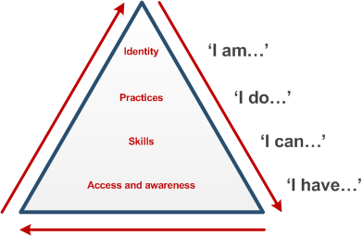
Digital and Information Literacy
When discussing student agency, it is important that students understand digital and information literacy.
“Digital literacy includes the ability to find and use information (otherwise known as information literacy) but goes beyond this to encompass communication, collaboration and teamwork, social awareness in the digital environment, understanding of e-safety and creation of new information. Both digital and information literacy are underpinned by critical thinking and evaluation.” – The Open University. (2016) ”Digital and Information Literacy Framework” Retrieved 8 May 2021.
Beetham and Sharpe ’pyramid model’ of digital literacy development model (2010) All rights reserved
Digital and information literacy framework, Copyright © 2012 The Open University, http://www.open.ac.uk/libraryservices/subsites/dilframework/. Attribution-NonCommercial-ShareAlike 3.0 Unported (CC BY-NC-SA 3.0)

Slide 86
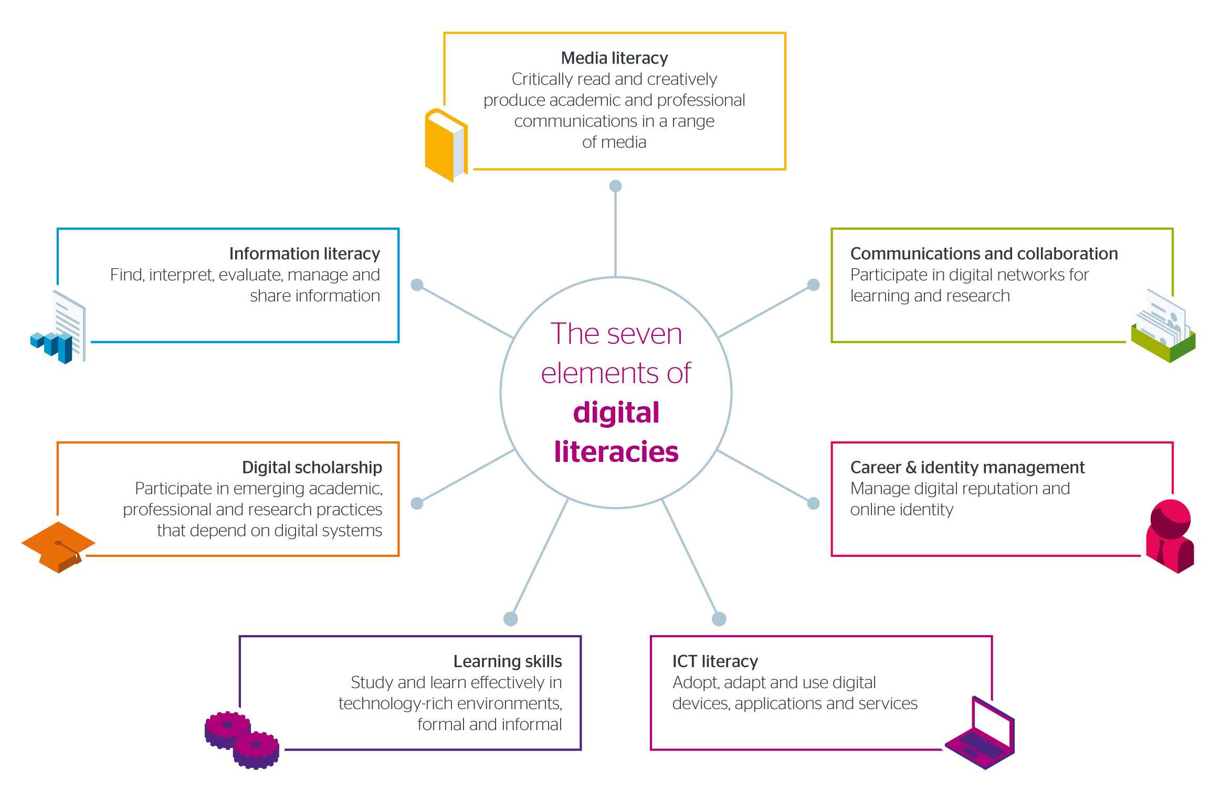
Digital
Literacy
JISC. (2018) ”Seven Elements of Digital Literacy”

Slide 87
Student and Faculty Advocacy
Student Advocacy Resources:
Student PIRGs
Student OER Toolkit
Faculty Advocacy Resources:
DOERS3
  Admin Information – Research group links
  Capacity Building – Legal/Legislator
SPARC
Tenure and Promotion:
DOERS3
  Tenure & Promotion Matrix
    T&P Matrix NEBHE Article

Slide 88
Student as Creator/Co-Author
As the top tier of the Bloom’s Revised Taxonomy (create) and one of the most sought out skills in the workforce (creativity) shifting toward a student as a creator and not just consumer mentality can open the door to multiple opportunities.
Open pedagogy as well as other pedagogies, like constructivist, shift focus to the student as a creator. This provides opportunities for students to engage with material and concepts differently. The Open Pedagogy Notebook is a place where you can go to look at examples.
Incorporating assignments, activities, or assessments that rotate around creation also allow student to have more choice, makes course work more personal, and students can follow their interests.
Note that this also shifts the structure of the class as the instructor is no longer just the giver of information but is also a resource and/or a co-creator. Clear rubrics are needed to fulfill the needed outcome/competency but keep student choice open.
Student agency is also a point here as you can allow them to decide how their projects are licensed and distributed.

Slide 89
Student Outcomes
Outline:
Diversity, Equity, and Inclusion (DEI)
Accessibility
Authentic Assessment
Dealing with Success/Failure

Slide 90
Diversity, Equity, and Inclusion (DEI)
Discussions around diversity, equity, and inclusion are are happening both in and outside of education. It is specifically a focus for many within the open education community.
Sarah Lambert wrote “Changing our (Dis)Course: A Disruptive Social Justice Aligned Definition of Open Education” where she establishes a good working definition of social justice in order to further research: “A process and also a goal to achieve a fairer society which involves actions guided by the principles of redistributive justice, recognitive justice, or representational justice.”
“Redistributive justice is the most long-standing principle of social justice and involves allocation of material or human resources towards those who by circumstance have less.”
“Recognitive justice involves recognition and respect for cultural and gender differences[.]”
“[R]epresentative justice involves equitable representation and political voice.”
Here is another article by Sarah Lambert: "Approaches to Open Education and Social Justice Research”
Lambert, S. R. (2018). “Changing our (Dis)Course: A Distinctive Social Justice Aligned Definition of Open Education.”
Journal of Learning for Development, 5(3), 225-244. https://jl4d.org/index.php/ejl4d/article/view/290/333

Slide 91
Diversity, Equity, and Inclusion (DEI)
How can you learn more and incorporate DEI into your class?
Here are some resources that you can investigate, learn more about DEI issues, and how you can impact change and support students in your classroom? There are a lot of resources offered by colleges and organizations. Here are just few to get started finding what works for you:
  University of Nebraska- Lincoln – Racial Equity Resources – curated list of books, articles, websites, videos, podcasts, etc.
    Antiracism Toolkit for Allies
  DOERS3 – Equity Blueprint – coming soon!
  Northern Illinois University – “Diversity, Equity, and Inclusion Educators Toolkit”
  Association of College and University Educators – “10 Inclusive Teaching Practices”
  UCLA – “Creating a Positive Classroom Climate for Diversity”
  Harvard University – “Community Learning: Resources”
  College Libraries Ontario – “Protecting Indigenous Knowledge”
Note that there are multiple areas of equity all of which many not be covered here. I encourage you research areas of interest.

Slide 92
Accessibility
Accessibility is one of the largest conversations in education and it can shine light on something specific or span several aspects.
In Open Education ‘accessibility’ is largely used in the context of access to content, thus making material more open – OER.
In the United States Accessibility in the broad sense looks at people’s access to goods and services: wheelchair access, elevators, ramps, brail, etc. One that I will highlight that impacts education is web accessibility. (Ask for accessibility options within your institution if you are in a different country.)
Web Content Accessibility Guidelines (WCAG) – a list of recommendations to make web content more accessible to all users.
Examples include, but not limited to:
Alt Text for Images
Color Contrast between text and background
Text Organization is clear – useable for screen reader
Avoid using color to emphasize – use another method as well
Easily readable font
Avoid animations – especially with text
Video quality is clear
Audio is clear and provides closed captioning
BCCampus Open Textbook – Accessibility Toolkit

Slide 93
Authentic Assessment
What is Authentic Assessment?
“A form of assessment in which students are asked to perform real-world tasks that demonstrate meaningful application of essential knowledge and skills.” -- Jon Mueller – Authentic Assessment Toolbox
  In this resource you can find additional examples and alternatives to traditional assessments.
Mueller notes the following comparison as an easy visual:
Traditional Authentic
Selecting a Response - Performing a Task
Contrived - Real-life
Recall/Recognition - Construction/Application
Teacher-structured - Student-structured
Indirect Evidence - Direct Evidence
Note that when these are compared with open pedagogy as well as Bloom’s we can identify opportunities for integrating strategies.
Mueller, J. (2018) “Authentic Assessment Toolkit” North Central College. Retrieved 8 May 2021. http://jfmueller.faculty.noctrl.edu/toolbox/whatisit.htm

Slide 94
Dealing with Success/Failure
There are a ton of quotes relating to success and failure:
“Failure is not the opposite of success; it’s a part of success.” – Arianna Huffington
“Success is not the absence of failure; it’s the persistence through failure.” – Aisha Tyler
“Failure is success in progress.” – Albert Einstein
Success has more to do with trying and putting in the effort. Knowing that what you are doing is valuable and pushing through the challenges and discomfort.
However, what happens after success? Celebration? Close the deal? Start the project? When failure happens there is a process of review and analysis.
What went wrong? What/where could we improve? How can we look at things differently? Etc.
The same thing needs to happen after success.
What went right? Is what we did/created repeatable? What/where can we improve? Etc.
When we (and students) can change our mindset around success and failure we no longer take it personally – it is simply a part of the journey to reach our goal.

Slide 95
Value Added
Outline:
Open Pedagogy and Academic Integrity
Proctoring
Reminders: - Empathy, Kindness, and Compassion

Slide 96
Open Pedagogy and Academic Integrity
There have been more and more conversations around academic integrity and how pedagogy can assist in the efforts to inform students about integrity values and policies as well as reduce the option of cheating or having someone else do a student’s work.
International Center for Academic Integrity – This is a great place to start and learn more about the issues around academic integrity and how you can help students in your classes make good choices.
Maureen O’Brien – Vice President of Evaluation Operations at Western Governors University presented at the 2021 ICAI Mid-Atlantic Conference and discussed at academic integrity will look like in the future. She focused on three different areas:
Verification
Personalization
Protection
Personalization is where pedagogy can have an impact on academic integrity. With options like authentic assessment and other open pedagogy methods as well as opening communication around academic integrity topics faculty can have a lasting impact on students’ academic careers as well as their future in the workforce.

Slide 97
Proctoring
Sarah Elaine Eaton and Ceceilia Parnther presented at the 2021 ICAI Conference discussing “Student Perspectives on the Impact of Race in Educational Surveillance and Proctoring Technologies International Center of Academic Integrity (ICAI) Conference.”
Here I reference the other two areas in the previous slide (verification and protection). Eaton and Parnther bring up issues that exacerbate already existing problems:
  Verification:
    Increased anxiety – especially test anxiety
    Surveillance pedagogy – reflection on social control
    Ability/Inability to be seen
      Reference made to “Lantern Law”
  Protection:
    Security concerns and data usage
    Equity
This is where student engagement through pedagogical practices could help remove some of the needs around proctoring and provide more authentic ways of assessing student learning.
“E-proctoring will not be going away but we need to demand from the companies that provide these services to address these concerns and we need to demonstrate this through our wallets and in legislation.” – Ceceilia Parnther
“If the system is invisible for you, it is because it was made for you. If the system affects you than the system was not designed for you.” – Keeta Gladue (Student)

Slide 98
Reminder:
Student have ever growing responsibilities and the student body in classroom seats, whether online or inside the class, are becoming more and more diverse with different needs.
Remember your students are also people:
Show Empathy
Be Kind
Have Compassion
“Students must
Maslow
before they can
Bloom.”

Slide 99
Additional Resources
Accessibility:
WAVE Web Accessibility Evaluation Tool - https://wave.webaim.org/
The National Center on Disability and Access to Education - https://ncdae.org/resources/cheatsheets/
Authentic Assessment:
"Alternative Assessment Guide for Hybrid/Online Teaching” - https://cte.tamu.edu/getattachment/Instructional-Resources/Teaching/updated-version-2020-09-10-Alternative-Assessments-(1).pdf.aspx?lang=en-US
Bloom’s Revised Taxonomy:
Revised Bloom's Handout - https://www.celt.iastate.edu/wp-content/uploads/2015/09/RevisedBloomsHandout-1.pdf
DEI:
Growth and Justice Equity Blueprint - https://growthandjustice.org/publication/Blueprint-online-Fh.pdf
Learning for Justice - https://www.learningforjustice.org/

Slide 100
Additional Resources
Digital Literacy:
University of Hawai'i OER - https://oer.hawaii.edu/oer-training-digital-literacies/
Student Agency, Peer Feedback, and Self-Assessment:
SAAL Continua: Peer Feedback and Self-Assessment - https://www.azed.gov/sites/default/files/2018/06/SAAL_Continuums_FINAL.pdf?id=5b2d3c1f1dcb250ec4c1d6bd
Teaching and Learning in Higher Education:
Teaching and Learning in Higher Education - https://www.queensu.ca/teachingandlearning/modules/home.html
Teaching Methods:
Instructional Methods, Strategies and Technologies to Meet the Needs of All Learners - https://granite.pressbooks.pub/teachingdiverselearners/
Global Text - https://textbookequity.org/Textbooks/Orey_Emergin_Perspectives_Learning.pdf

Slide 101
Acknowledgments
First, I want to thank Kevin Corcoran (Connecticut State Colleges & Universities) for being willing to be my mentor during the SPARC OER Leadership Fellowship (2020-2021). Thank you for everything! I look forward to future conversations and collaborations!
A huge thank you also goes out to the Fellowship Team:
Nicole Allen - SPARC
Hailey Babb – SPARC
Tanya Spilovoy – WCET/SPARC
Thank you for this amazing opportunity!
I’d also like to thank Barton Community College for their support. Especially my colleagues at The Center of Innovation and Excellence!
Thank
You!

Slide 102
To All Adopters & Adapters:
To any who would like to adopt or adapt this for their own course(s) or institution I would welcome the opportunity to see how this resource is evolving and to receive feedback on how this is working as a resource.
Please take a moment to fill out the google form below and share additional ideas on how this can evolve, new resources that have been released, and other general feedback around how this resource worked to fulfill the stated purpose at the beginning of the journal.
Google Form
Thank you for using and/or adapting this resource.

Slide 103
Lee Miller
Director of Innovation and Compliance
Center of Innovation and Excellence
Barton Community College millerle@bartonccc.edu
@Connect2Innovat
Created by:
Unless otherwise noted, “Open Education Instructional Journal” by Lee Miller from Barton Community College is licensed under the Creative Commons Attribution-Non-Commerical-Sharealike 4.0 International

