Slide 1
Blooms Taxonomy
in the Classroom 10/1/11

Slide 2
Agenda
What is Blooms Taxonomy?
What is the revised Blooms Taxonomy?
A look at the six Blooms Levels
What level are these Outcomes & Competencies?

Slide 3
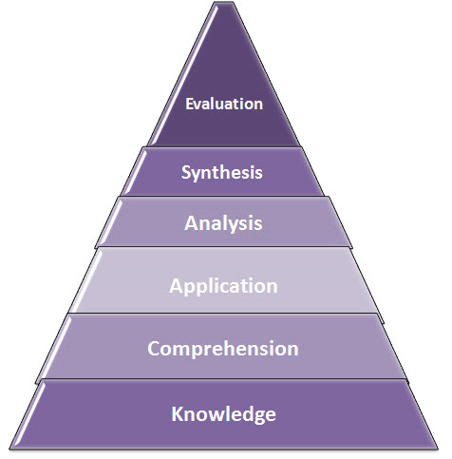
What is Blooms Taxonomy?
Benjamin Bloom’s taxonomy follows the thinking process.
  You cannot understand a concept if you do not first remember it
  You cannot apply knowledge and concepts if you do not understand them.
Notes:
In the 1950's Benjamin Bloom developed his taxonomy of cognitive objectives or critical thinking skills, Bloom's Taxonomy.
His taxonomy follows the thinking process.
You cannot understand a concept if you do not first remember it
You cannot apply knowledge and concepts if you do not understand them.
It is organized from Lower Order Thinking Skills to Higher Order Thinking Skills.

Slide 4
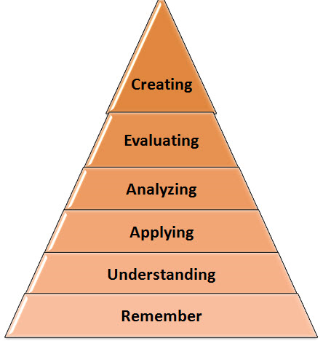
What is the revised Blooms Taxonomy?
Blooms
Revised Blooms
Blooms
Notes:
In the 1990's, a former student of Bloom, Lorin Anderson, revised Bloom's Taxonomy and published Bloom's Revised Taxonomy in 2001.
Uses verbs rather than nouns
She rearranged the sequence within the taxonomy by swapping Evaluation and Synthesis then renamed Synthesis "Creating" as the highest level of thinking skills

Slide 5
Blooms Action Verbs
Knowledge | Comprehension | Application | Analysis | Synthesis | Evaluation
(Remember) | (Understand) | (Apply) | (Analyze) | (Evaluate) | (Create)
Arrange | Associate | Add | Analyze | Appraie | Arrange
Choose | Classify | Apply | Appraise | Argue | Assemble
Count | Computer | Calculate | Arrange | Assess | Categorize
Define | Convert | Change | Breakdown | Attach | Choose
Describe | Defend | Choose | Calculate | Choose | Collect
Draw | Demonstrate | Classify | Categorize | Compare | Combine
Duplicate | Describe | Complete | Classify | Conclude | Compile
Identify | Distinguish | Compute | Combine | Contrast | Comply
Label | Estimate | Demonstrate | Compare | Criticize | Compose
List | Explain | Discover | Contrast | Critique | Construct
Locate | Express | Divide | Criticize | Defend | Create
Match | Extend | Dramatize | Design | Describe | Design
Memorize | Extrapolate | Employ | Detect | Discrimminate | Develop
Name | Generalize | Examine | Develop | Determine | Devise
Omit | Give Examples | Explain | Diagram | Estimate | Do
Order | Identify | Generalize | Differentiate | Evaluate | Drive
Outiline | Illistrate | Graph | Discriminate | Explain | Explain
Point | Indicate | Illustrate | Distinguish | Grade | Formulate
Quote |  | Interpret | Examine | Judge | Generate
Notes:
Take out your Action Verbs handout for reference during the next few slides..

Slide 6

A look at the six Blooms Levels

Slide 7
REMEMBER
Retrieving, recalling or recognizing knowledge from memory. Remembering is when memory is used to produce definitions, facts or lists, or recite or retrieve material.
Key Verbs
Possible Activities
Arrange Count
Define Draw
Duplicate Label
List Match
Memorize Omit
Order Point
Quote Recall
Recite Relate
Recitation
Quiz/Test
Flashcards
Definition
Fact
Worksheet/book
List
Bookmarking

Slide 8
UNDERSTAND
Constructing meaning from different types of function be they written or graphic.
Key Verbs
Possible Activities
Associate Compute
Convert Demonstrate
Describe Distinguish
Estimate Express
Extend Generalize
Give Example Illustrate
Indicate Interpret
Interrelate Locate
Match Predict
Summary
Explanation
Show and tell
Advanced and Boolean searches -
Blog journaling Diary
Tagging, comments & annotating
Subscribing

Slide 9
APPLY
Carrying out or using a procedure through executing or implementing. Applying related and refers to situations where learned material is used through products like models, presentation, interviews and simulations.
Key Verbs
Possible Activities
Add Apply
Change Choose
Complete Demonstrate
Discover Dramatize
Employ Explain
Generalize Illustrate
Interpret Judge
Manipulate Operate
Organize Practice
Illustration
Simulation
Demonstration
Presentation
Interview
Performance
Editing
Playing

Slide 10
ANALYZE
Comparing, Organizing, Deconstructing, Attributing, Outlining, Structuring, Integrating, Mashing,
Linking, Reverse-engineering, Cracking, Media clipping and Mind-mapping.
Key Verbs
Possible Activities
Analyze Arrange
Breakdown Categorize
Classify Compare
Contrast Design
Detect Diagram
Differentiate Distinguish
Examine Identify
Illustrate Model
Outline Question
Survey
Database
Abstract
Relationship mind maps
Report
Graph Spreadsheet
Process
Checklist
Chart

Slide 11
EVALUATE
Making judgments based on criteria and standards through checking and critiquing.
Key Verbs
Possible Activities
Appraise Assess
Attach Compare
Conclude Criticize
Critique Describe
Discriminate Estimate
Evaluate Grade
Judge Interpret
Measure Relate
Rank Select
Debate
Report
Evaluation
Verdict, Judgment or Conclusion
Persuasive speech
Critical Commenting
Moderating
Reviewing
Posting

Slide 12
CREATE
Putting the elements together to form a coherent or functional whole; reorganizing elements into a new pattern or structure through generating, planning or producing.
Key Verbs
Possible Activities
Arrange Categorize
Choose Combine
Compile Compose
Construct Design
Develop Do
Drive Formulate
Generate Hypothesize
Integrate Make
Organize Plan
Film
Presentation
Story
Programming
Project Management
Blogging/Video blogging
Plan
Model
Song

Slide 13
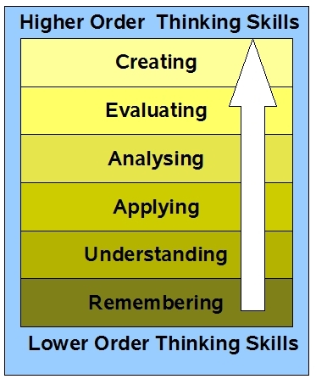
What level are these
Outcomes & Competencies?
Explain the importance of animal health as it relates to profitable animal production.
Comprehension

Slide 14
What level are these
Outcomes & Competencies?
Participate in formal and informal assessments of the infant’s/young child’s social emotional development.
Evaluation

Slide 15
What level are these
Outcomes & Competencies?
Interpret four gas readings, and determine necessary action
Application

Slide 16
What level are these
Outcomes & Competencies?
List indicators of combustible gas
Knowledge

Slide 17
What level are these
Outcomes & Competencies?
Perform a failure investigation
Application

Slide 18
What level are these
Outcomes & Competencies?
Identify conditions based upon customer complaint/description
Analysis

Slide 19
What level are these
Outcomes & Competencies?
Define nutrition and the major nutrients.
Knowledge

Slide 20
What level are these
Outcomes & Competencies?
Discuss the history of child abuse and neglect and cite important legal milestones.
Comprehension

Slide 21
What level are these
Outcomes & Competencies?
Plan routine procedures in child care.
Synthesis

Slide 22
What level are these
Outcomes & Competencies?
Differentiate the developmental stages of young children.
Analysis

Slide 23
What level are these
Outcomes & Competencies?
Compare recommendations of how to communicate parent interaction techniques and development of discipline through positive guidance.
Analysis or Evaluation

Slide 24
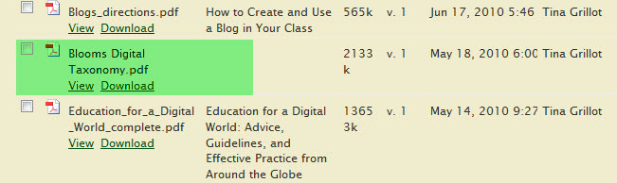
Download
“Blooms Digital Taxonomy”
https://sites.google.com/site/bcccfacultydev/bookshelf

