Slide 1
SALARIED LEAVE REPORT GUIDE

Slide 2
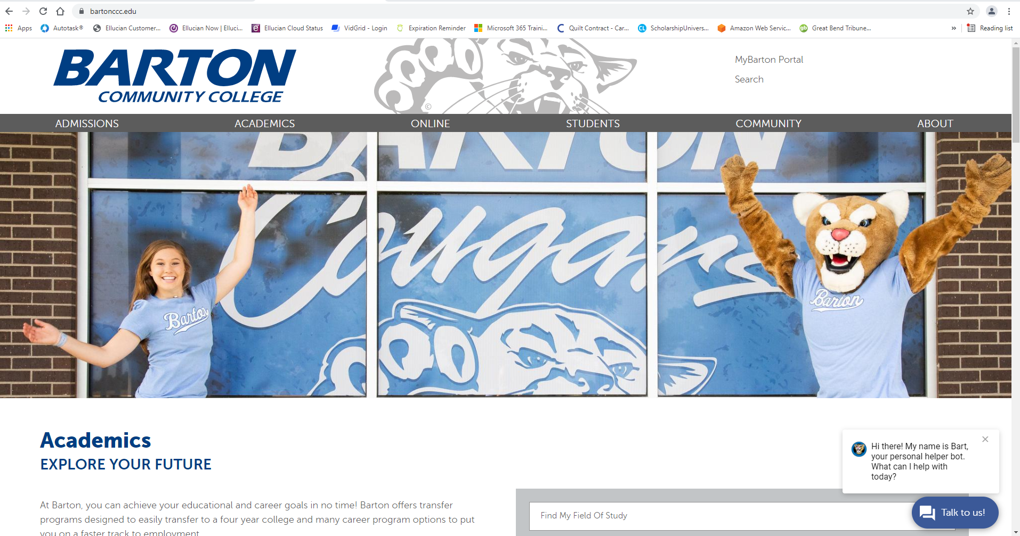
Go to www.bartonccc.edu
MyBarton Portal

Slide 3
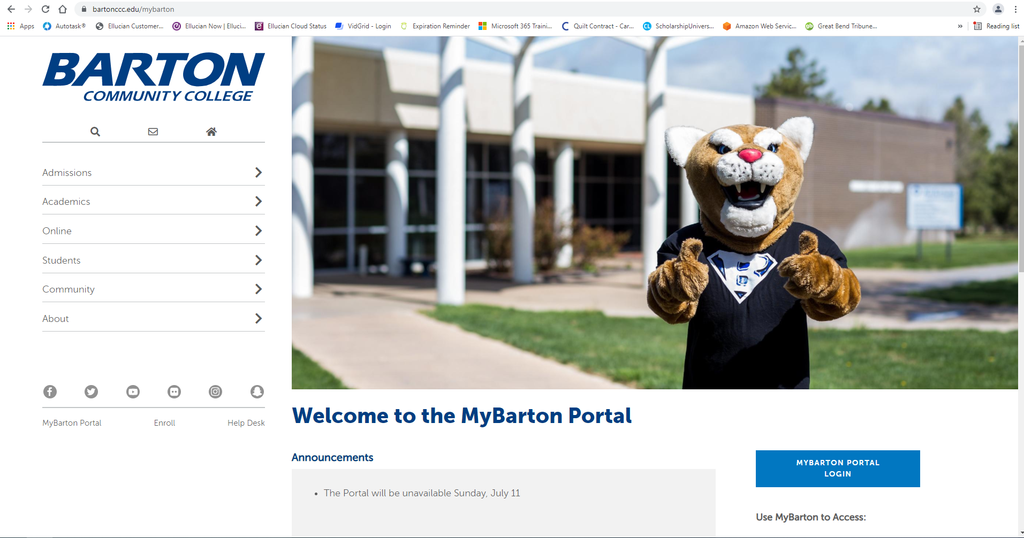
MyBarton Portal Login
Login with your Username and Password

Slide 4
Table of Contents
Accessing Your Leave Report
How to Restart Your Leave Report
Adding Comments
Submit Leave Report
Recalling a Submitted Leave Report
Viewing Leave Report Approver(s)
Viewing Leave Balances
Pay Stub/Direct Deposit Information
Earnings

Slide 5
ACCESSING
YOUR
LEAVE REPORT

Slide 6
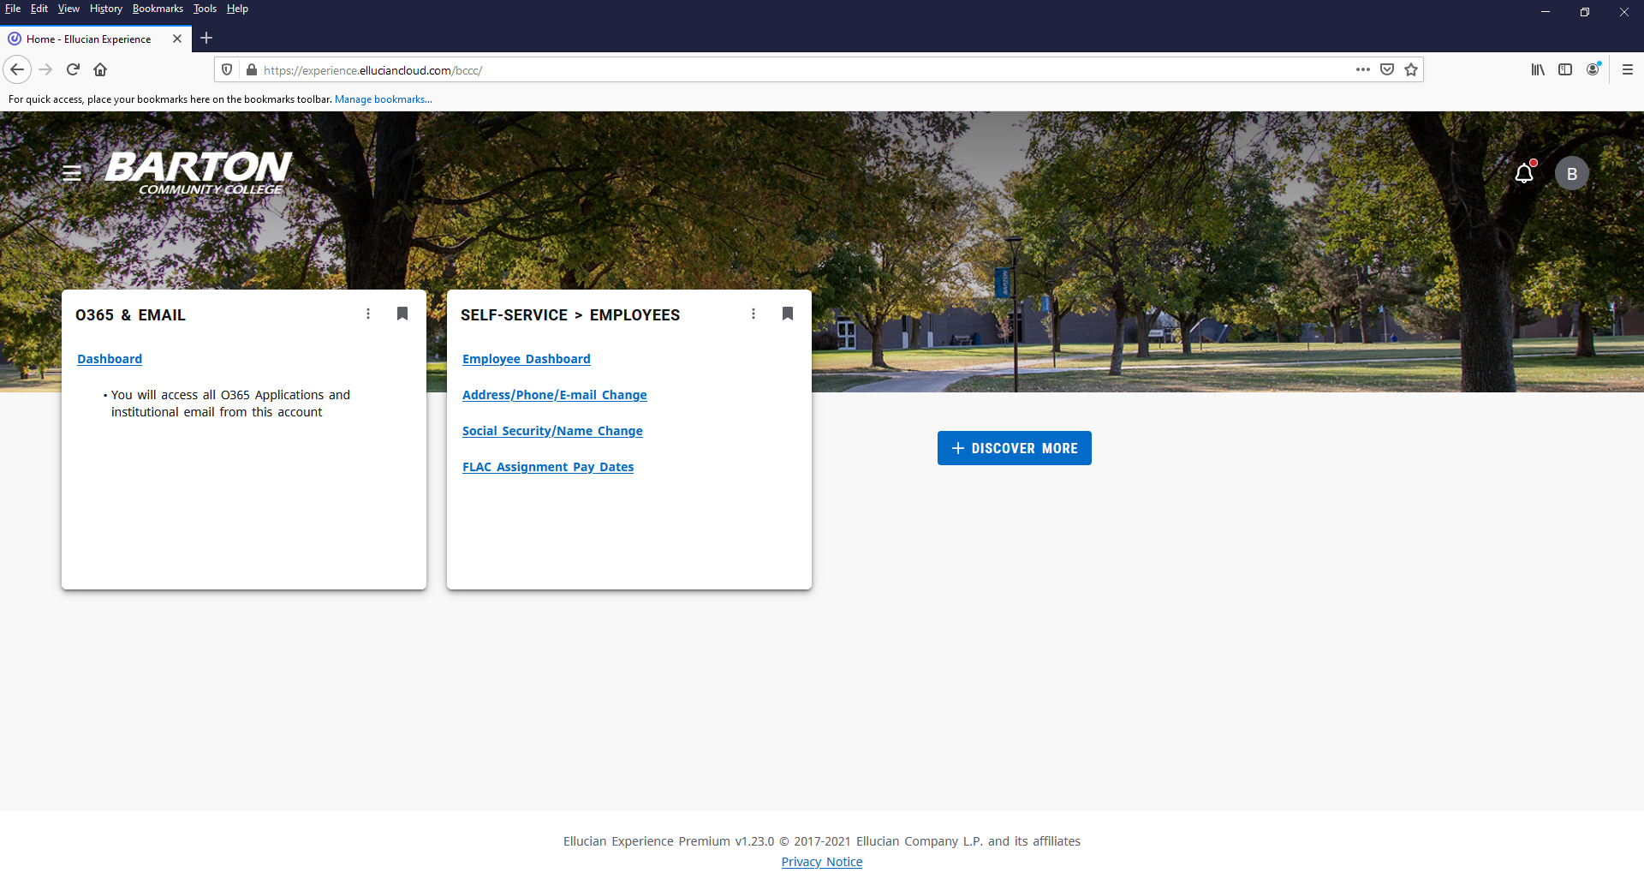
After logging into the MyBarton Portal, click on Employee Dashboard under the Self-Service > Employees Card (If the card isn’t displayed, you may have to click on Discover More at the bottom of the screen to find the card and then save it to your Home Page by clicking on the ribbon in the right-hand corner).

Slide 7
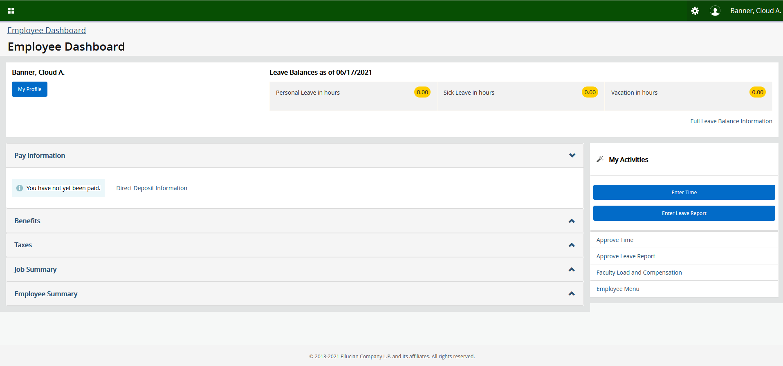
Click on Enter Leave Report on the Employee Dashboard.

Slide 8
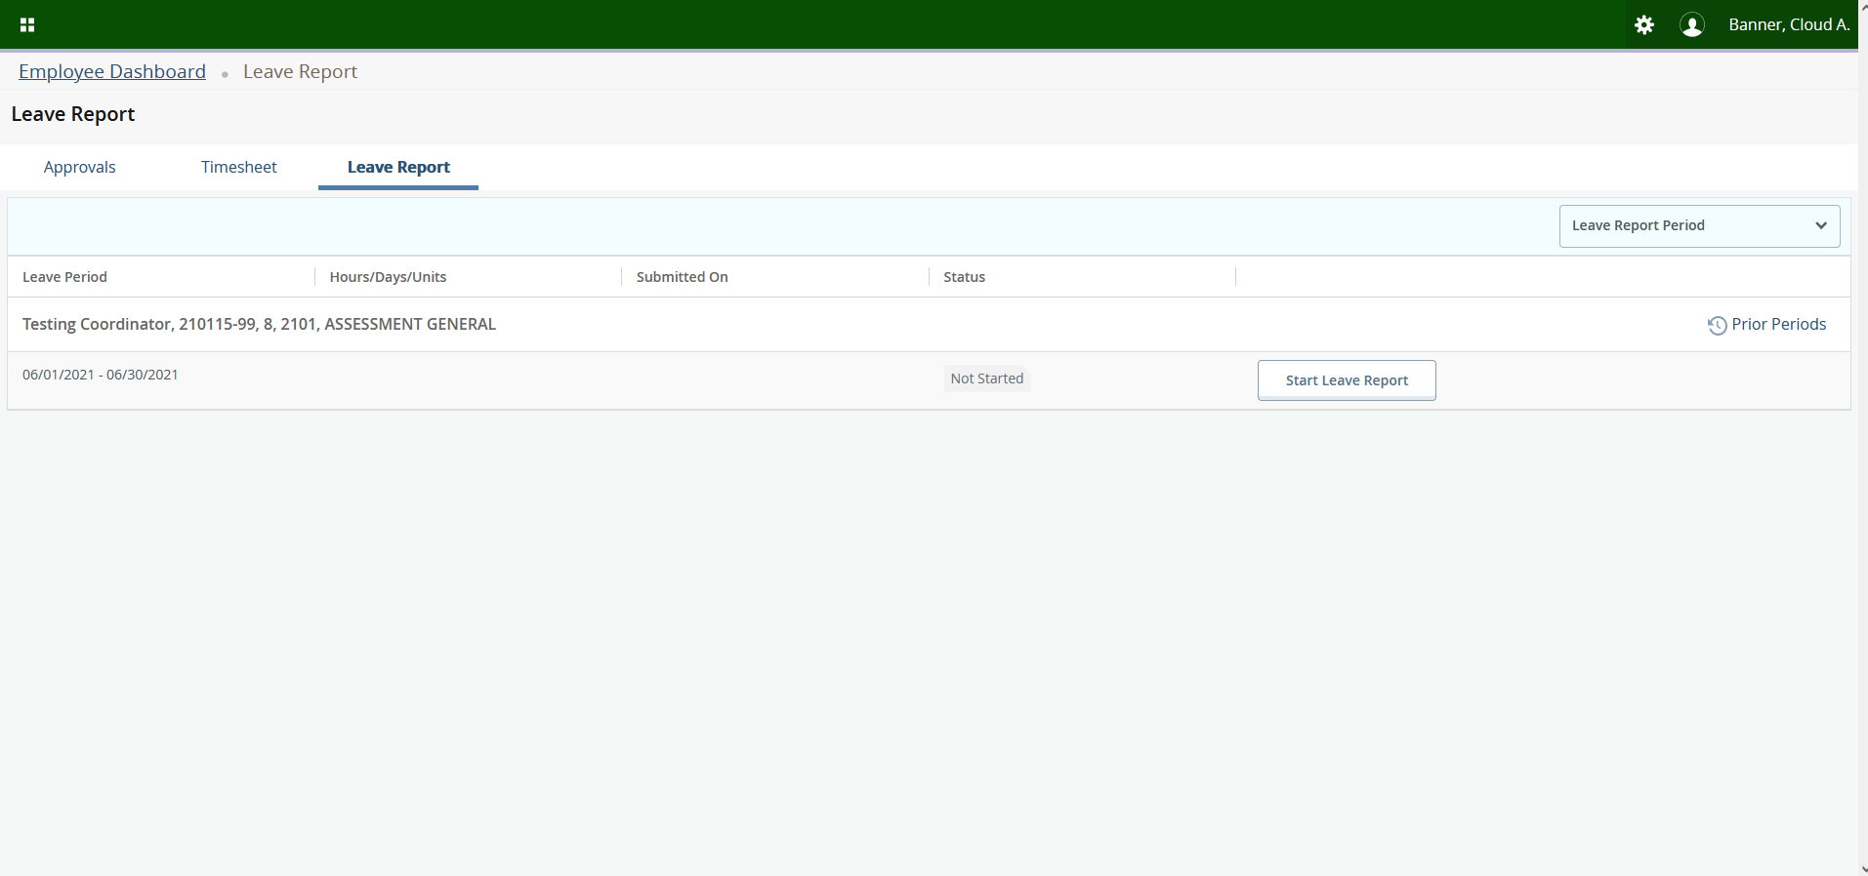
To enter time, click on Start Leave Report for the appropriate pay period. Tip – If you would like to view the whole month at once, click on the Caret under Leave Report Period.

Slide 9
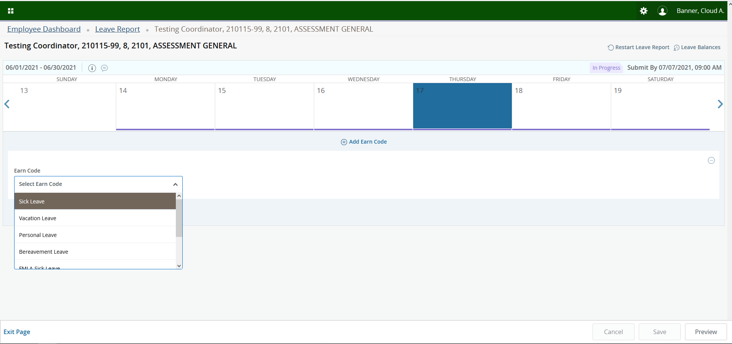
Click on the date you want to Edit. You may need to click on the over arrow located on the right-hand side to get to the correct date if you are not viewing the whole month at once. Then click on the Earn Code Caret and select the correct Earn Code.

Slide 10
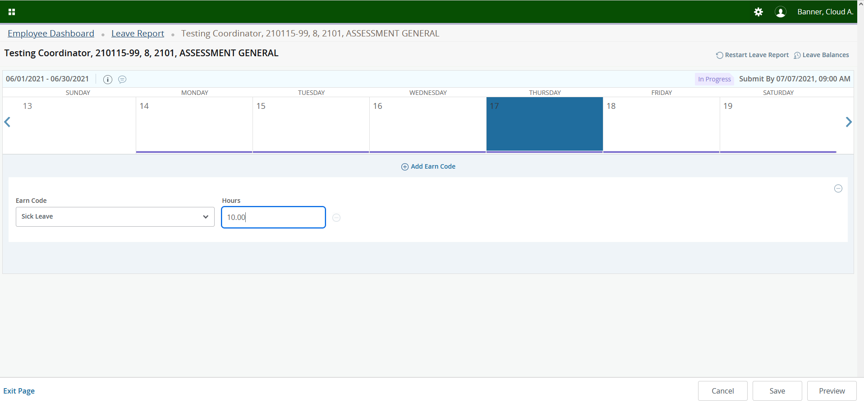
Type in the hours you need to report and click Save located in the bottom right-hand corner.

Slide 11
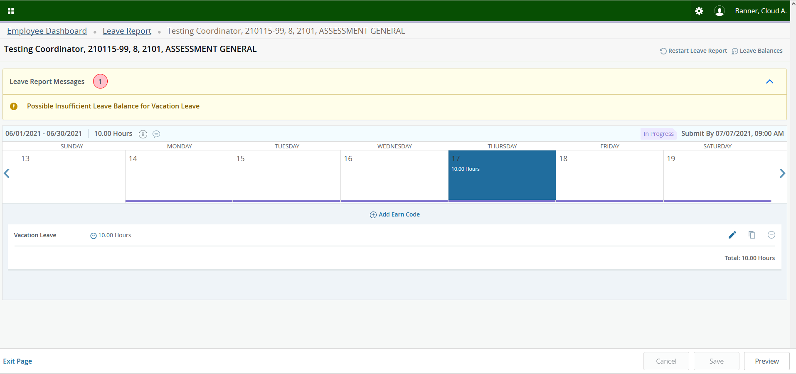
Tip – You must save after each entry otherwise you will lose your changes.

Slide 12
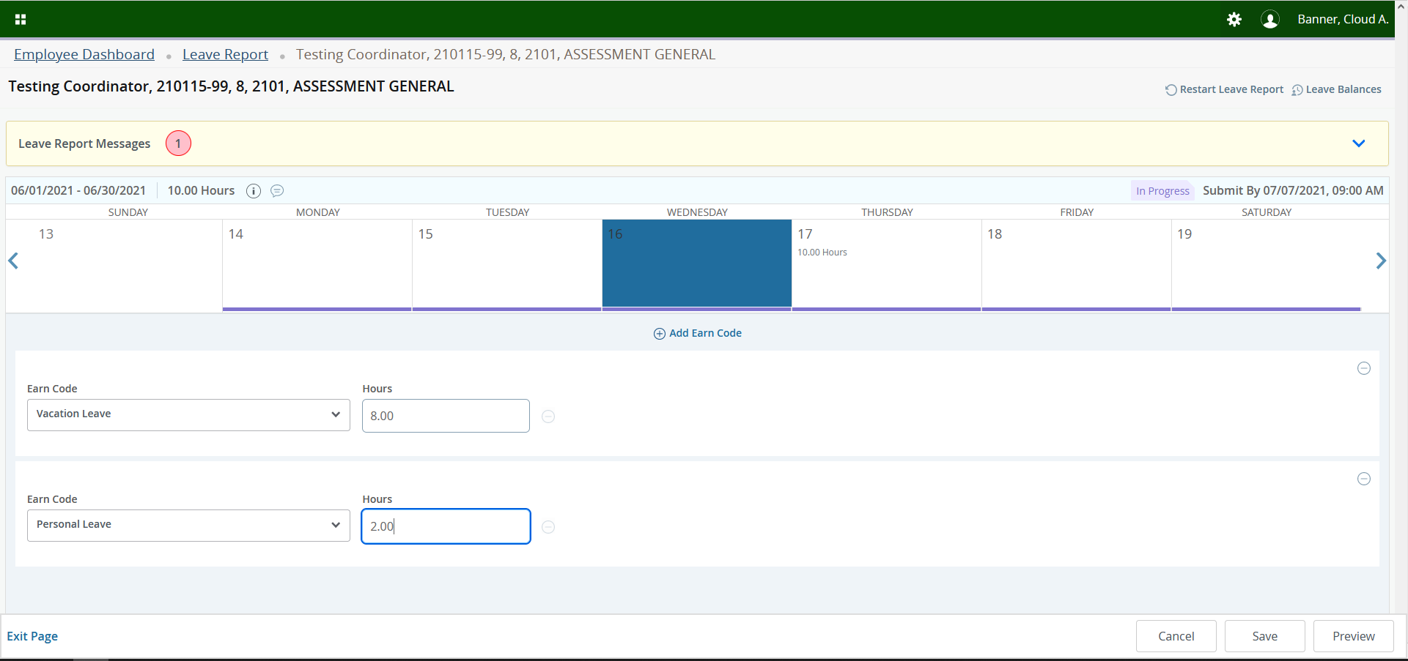
You can select multiple Earn Codes for the same day by clicking on Add Earn Code. Once you have selected all Earn Codes and times, click Save.

Slide 13
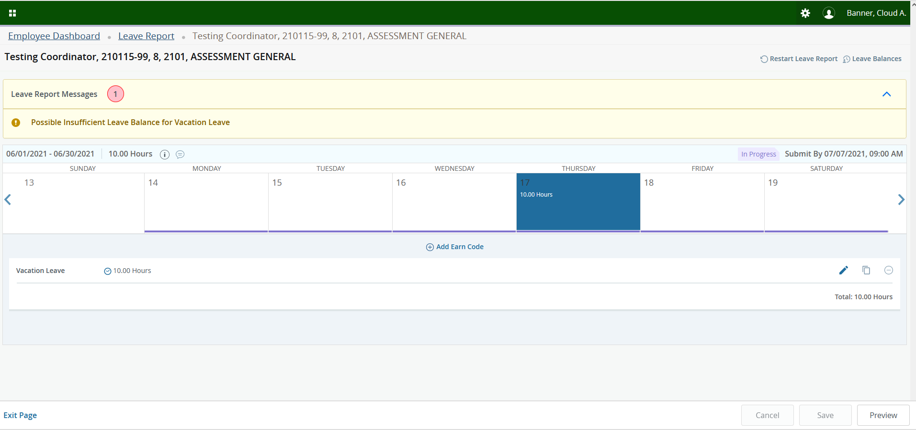
If you get an insufficient leave warning, for example Vacation Leave has been exhausted, click on Leave Balances in the upper right-hand corner to determine if other appropriate leave is available.

Slide 14
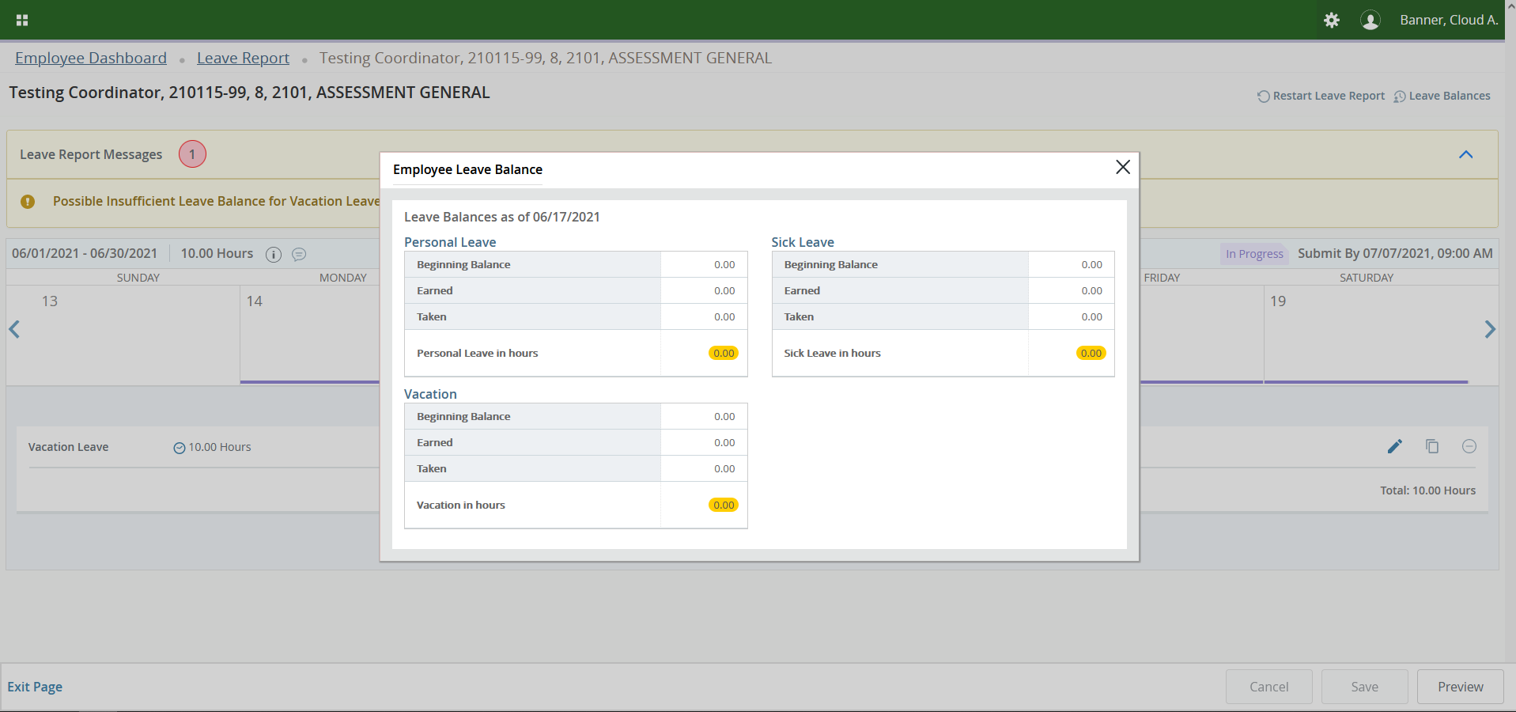
A box will appear with your available Leave Balances. To close the box, click the “X” located in the upper right-hand corner of the box.

Slide 15
If you want to edit or delete time on a specific day, click on the Pencil/Delete button located on the far right, make your edit/delete, and then click Save (The Delete Button is the – button ). If you delete an entry, a warning message will appear. Click Yes and then click Save.

Slide 16
HOW TO
RESTART YOUR LEAVE REPORT

Slide 17
Click on Enter Leave Report on the Employee Dashboard.

Slide 18
If you want to delete your Leave Report and start over, click on Restart Leave Report in the top right-hand corner.

Slide 19
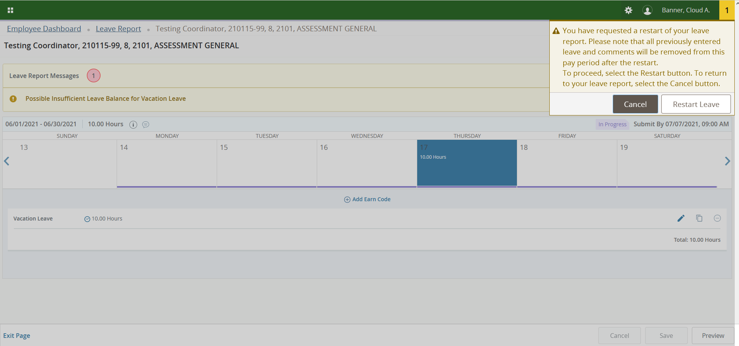
This warning message will appear to confirm you want to restart your Leave Report. If you want to proceed, click on Restart Leave.

Slide 20
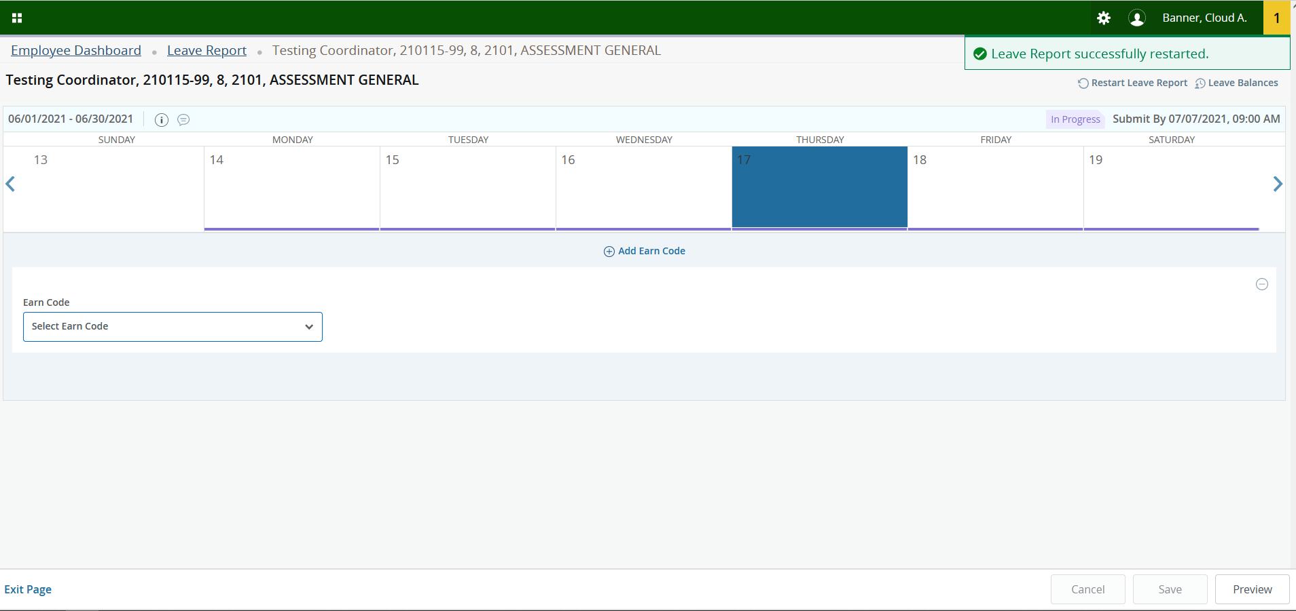
A notification will appear stating your Leave Report has been successfully restarted.

Slide 21
ADDING COMMENTS

Slide 22
Click on Enter Leave Report on the Employee Dashboard.

Slide 23
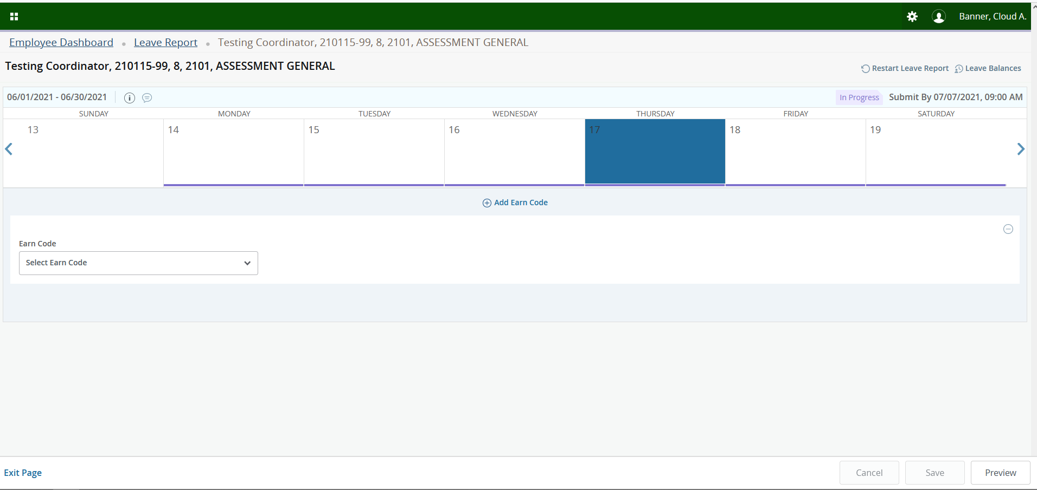
Click on the Conversation Cloud to add a comment.

Slide 24
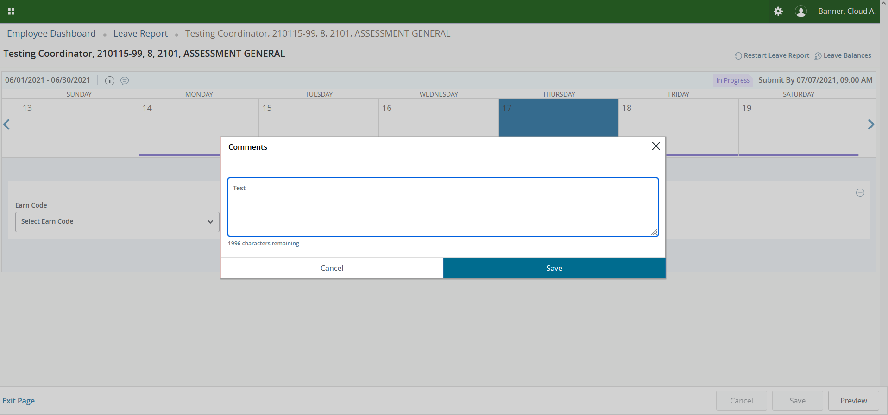
Type your comment and click Save.

Slide 25
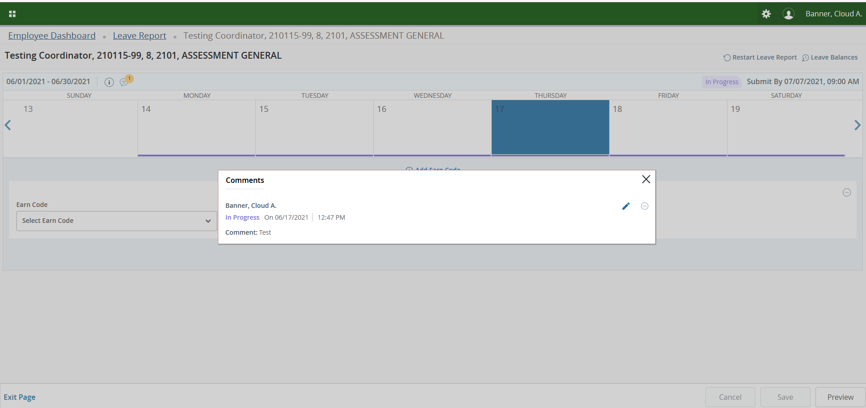
To Edit a comment, click on the Pencil. To Delete a comment click on the - Button.

Slide 26
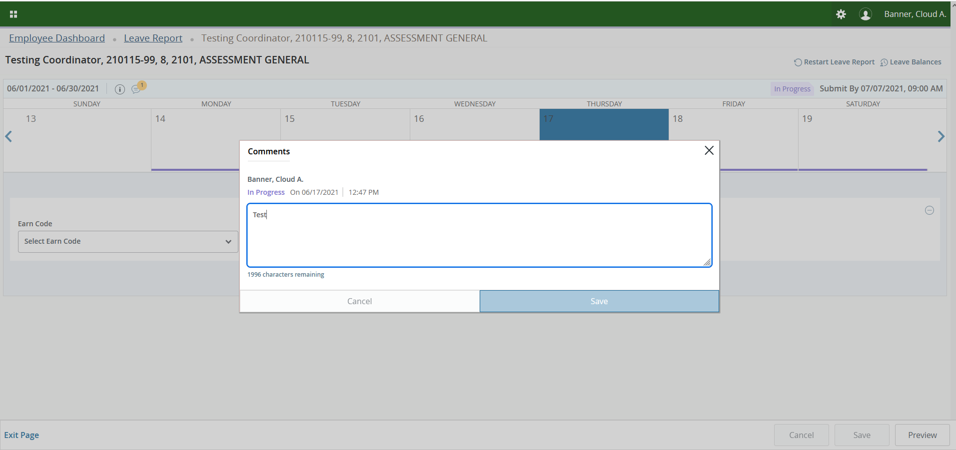
Edit your comment and click on Save. Tip—the Save button will be grayed out until you change the wording.

Slide 27
SUBMIT
LEAVE REPORT

Slide 28
Click on Enter Leave Report on the Employee Dashboard.

Slide 29
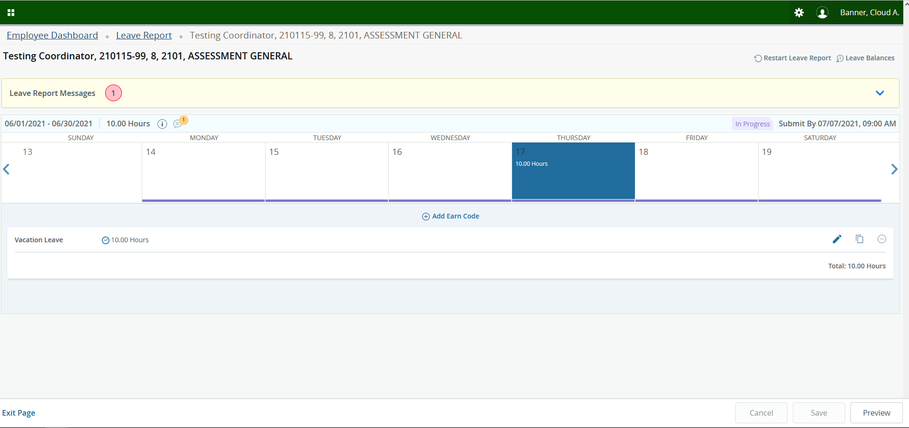
Once your Leave Report is complete, click on Preview in the bottom right-hand corner.

Slide 30
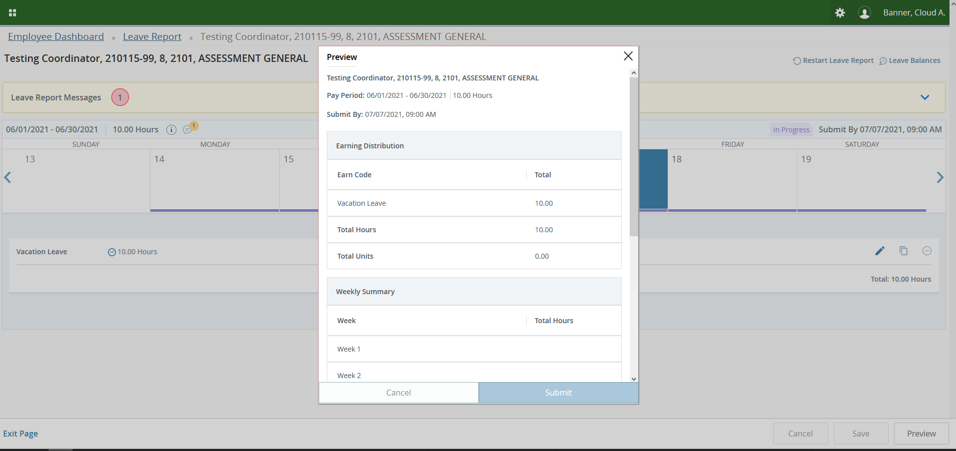
Review your Leave Report for accuracy.

Slide 31
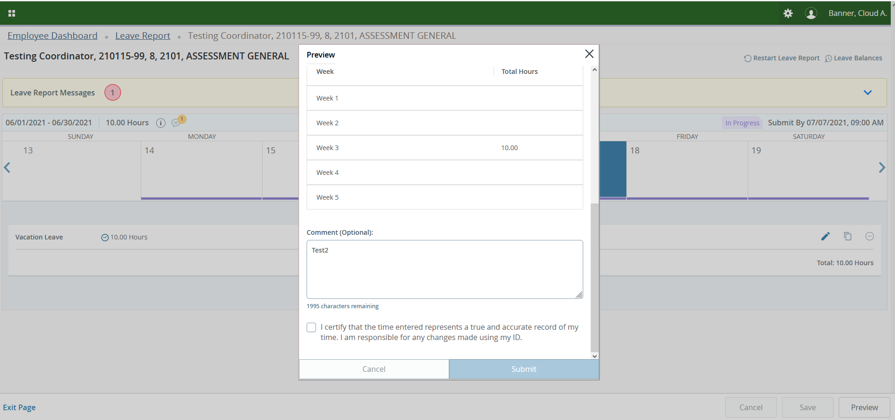
Scroll down and add additional comments if needed. Review the certification statement, check the box and click on Submit. Your Leave Report has now been submitted for approval and processing.

Slide 32
RECALLING A SUBMITTED
LEAVE REPORT

Slide 33
Click on Enter Leave Report on the Employee Dashboard.

Slide 34
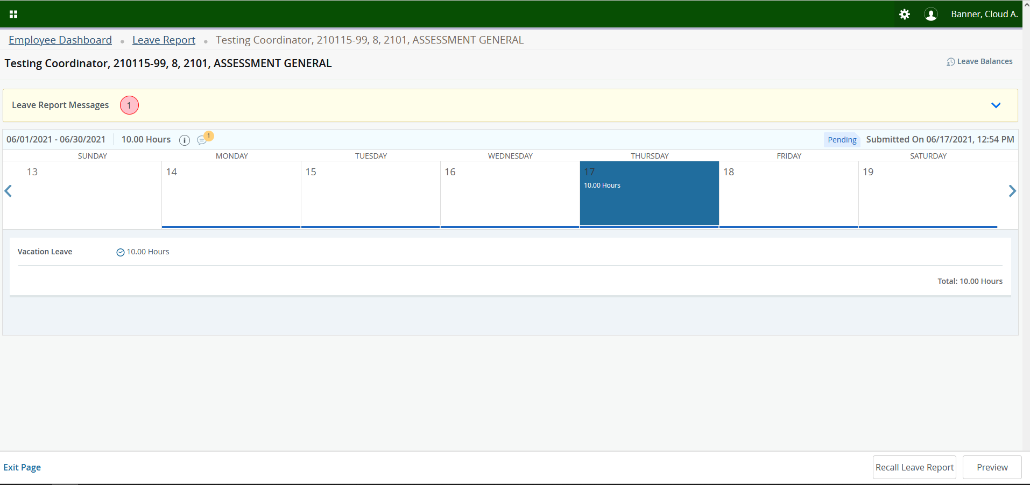
If you submitted your Leave Report and you need to make a change, you can recall it by clicking on Recall Leave Report in the bottom right-hand corner. Your Leave Report will be returned to you for editing.

Slide 35
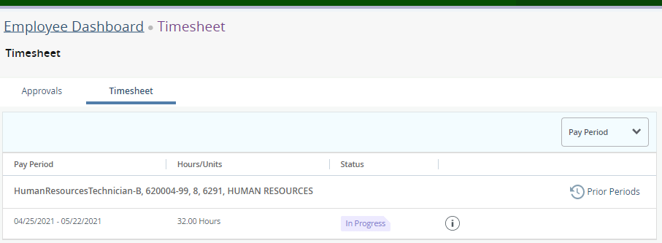
If you realize you need to change your Leave Report prior to your supervisor approving and prior to the pay period closing, you can recall it by clicking Prior Periods in the top right-hand corner. Select the Leave Report that is Pending and select Recall Leave Report. If the pay period is closed, you will not see the Recall Leave Report button and will need to contact HR.

Slide 36
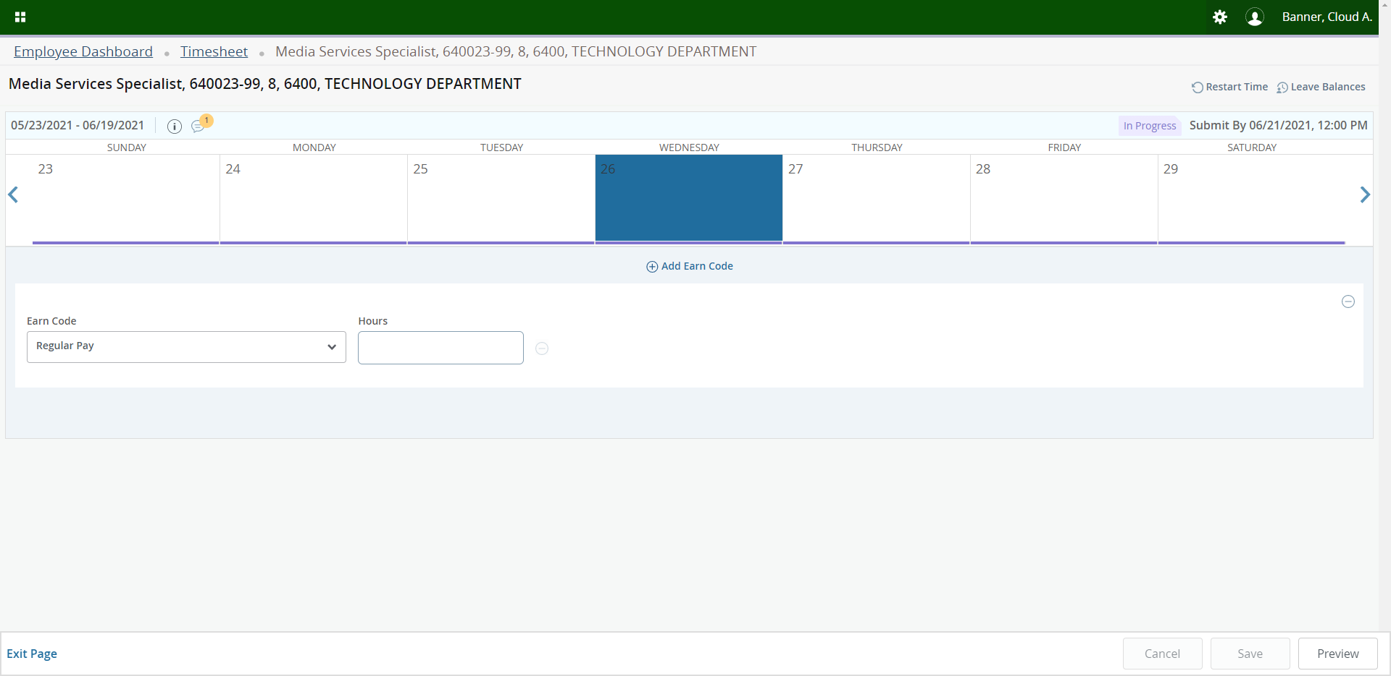
Once your Leave Report is complete, click on Preview in the bottom right-hand corner.

Slide 37
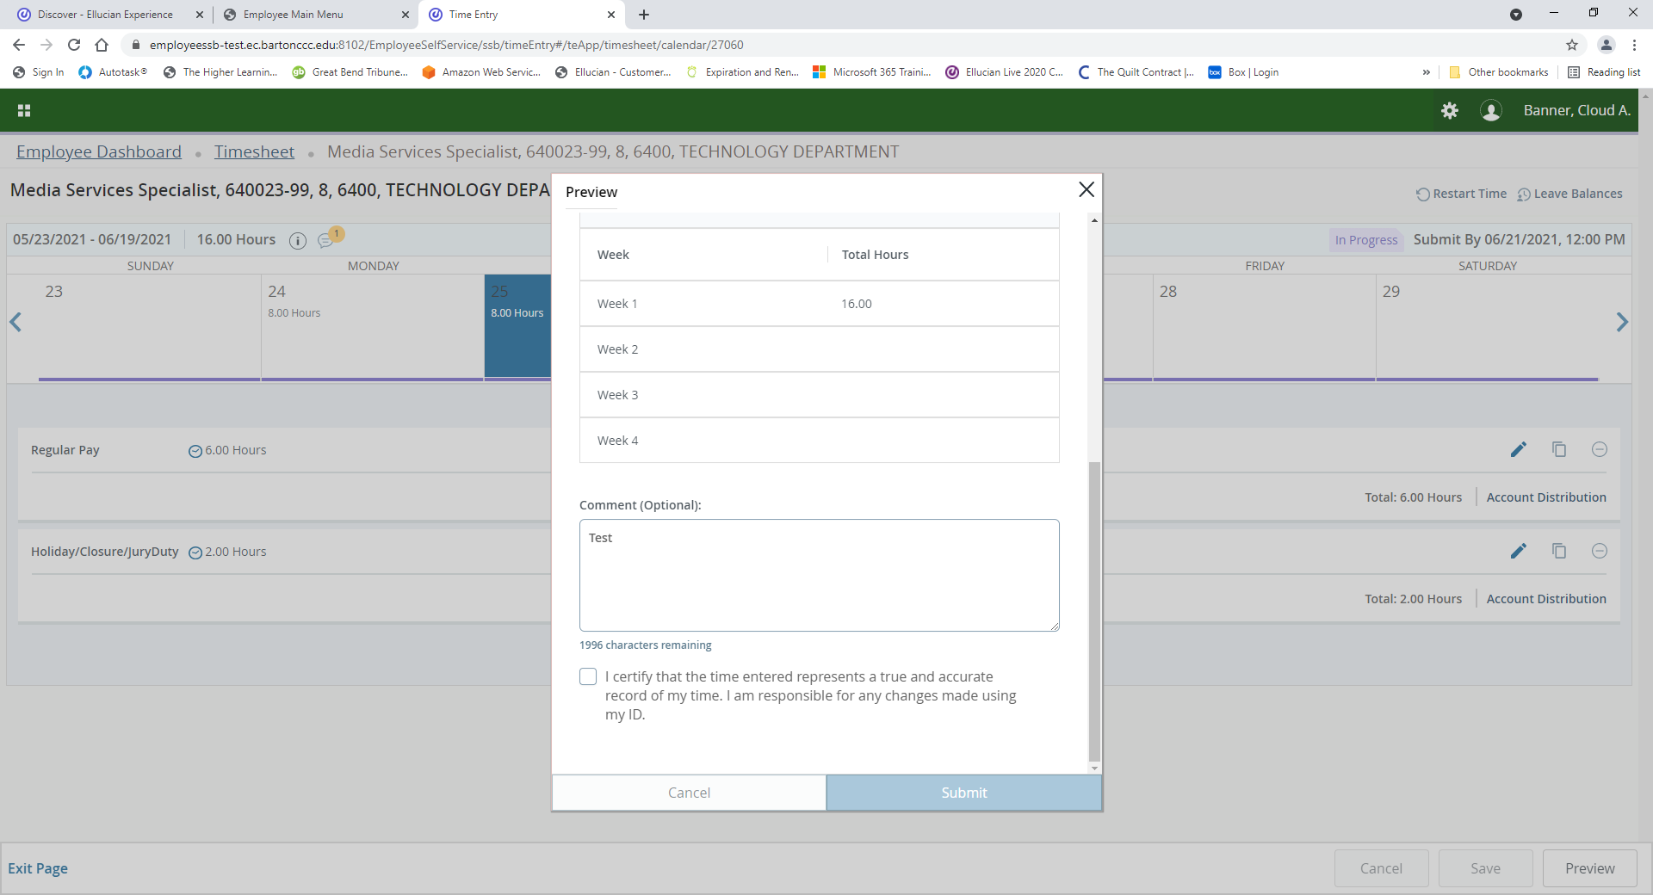
Scroll down and add additional comments if needed. Review the certification statement, check the box and click on Submit. Your Leave Report has now been submitted for approval and processing.

Slide 38
VIEWING LEAVE REPORT APPROVER(S)

Slide 39
Click on Enter Leave Report on the Employee Dashboard.

Slide 40
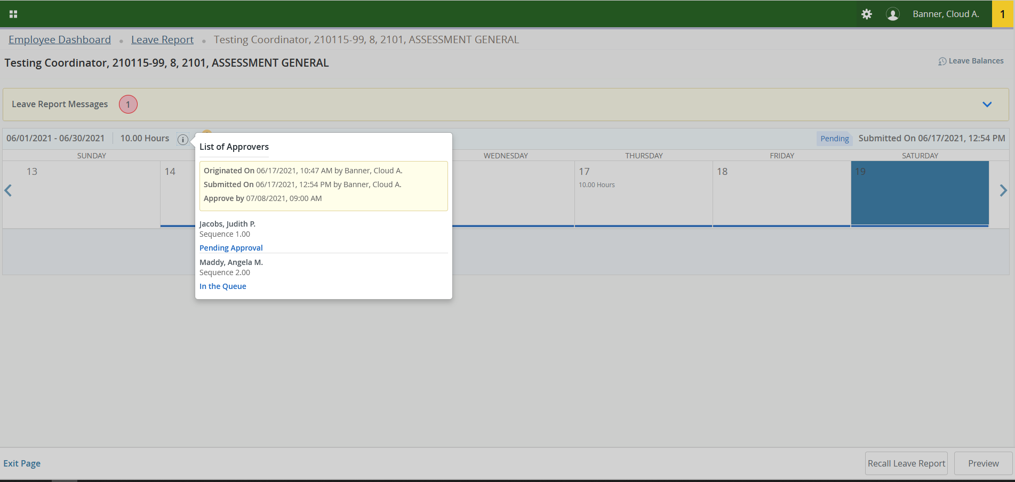
Click on the Information icon and it will display an Approver list.

Slide 41
VIEWING LEAVE BALANCES

Slide 42
Click on Enter Leave Report on the Employee Dashboard.

Slide 43
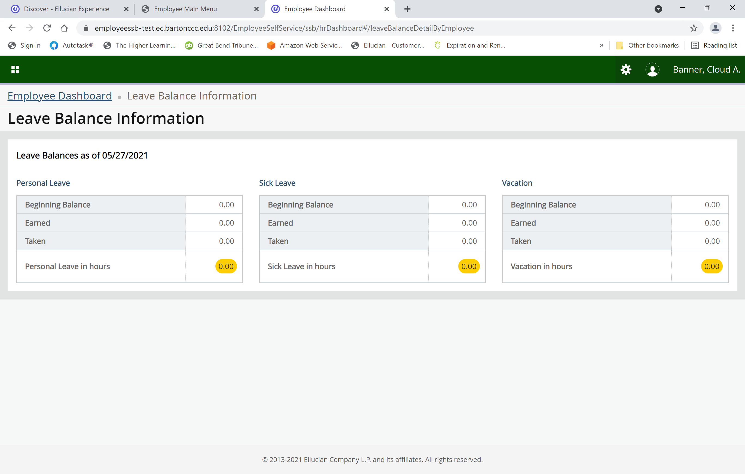
Click on each of the Leave buttons to see more detailed information.

Slide 44
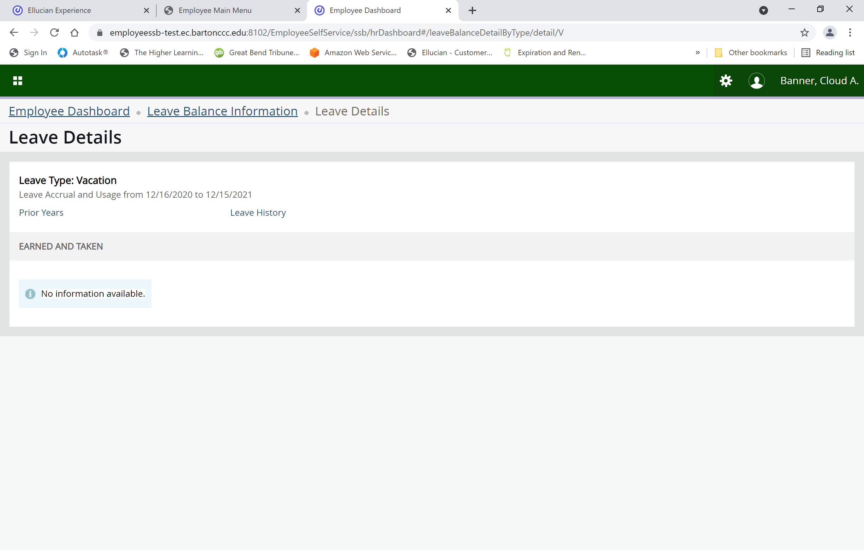
Click on Prior Years to see a history or click on Leave History to see the most recent history.

Slide 45
PAY STUB/DIRECT DEPOSIT INFORMATION

Slide 46
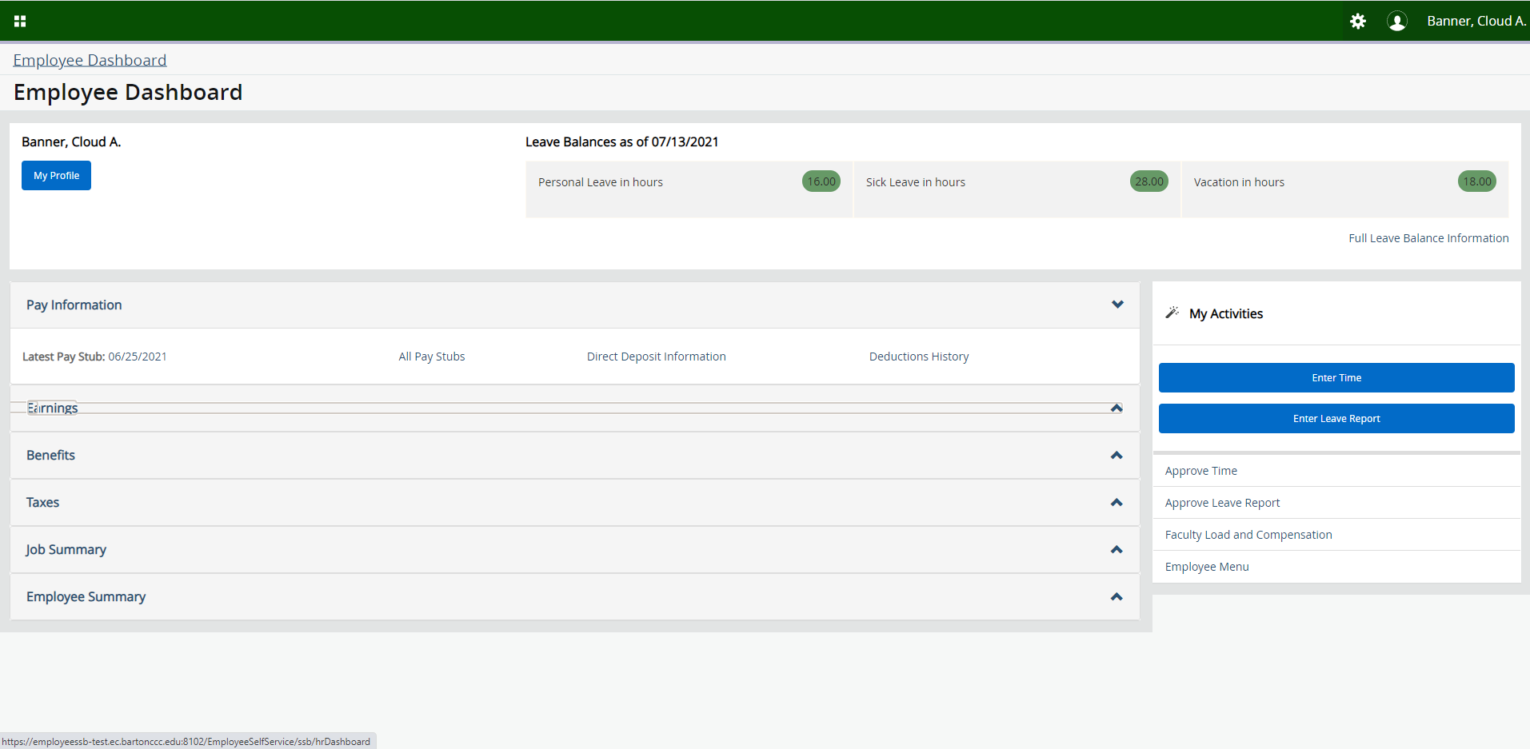
To view your last Pay Stub, click on the Date next to Latest Pay Stub.

Slide 47
To Print, click on the Printer-Friendly button.

Slide 48
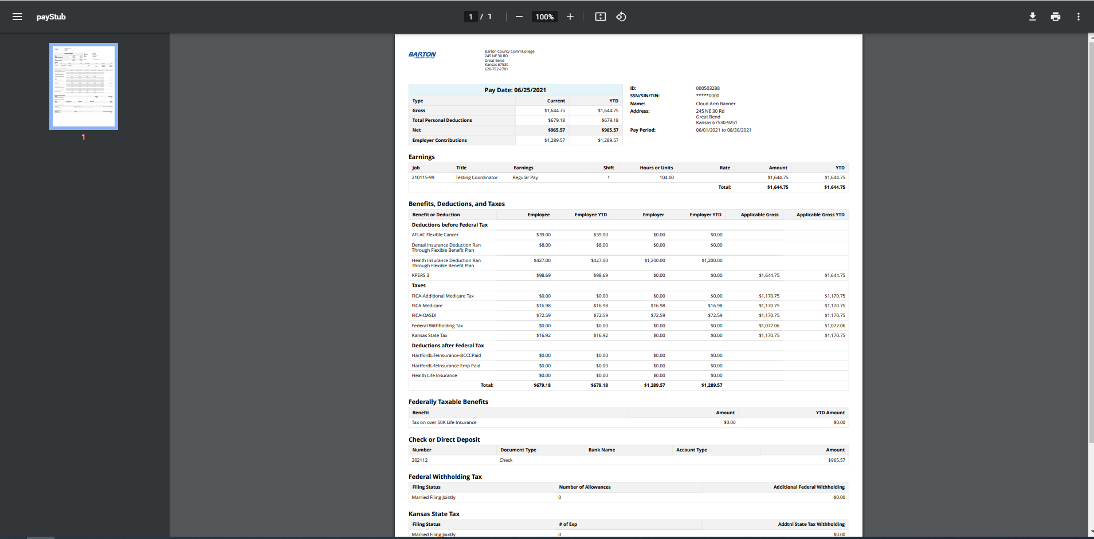
Click on the printer icon on the far right-hand side to print.

Slide 49
To view more Pay Stubs on the employee Dashboard, click on All Pay Stubs.

Slide 50
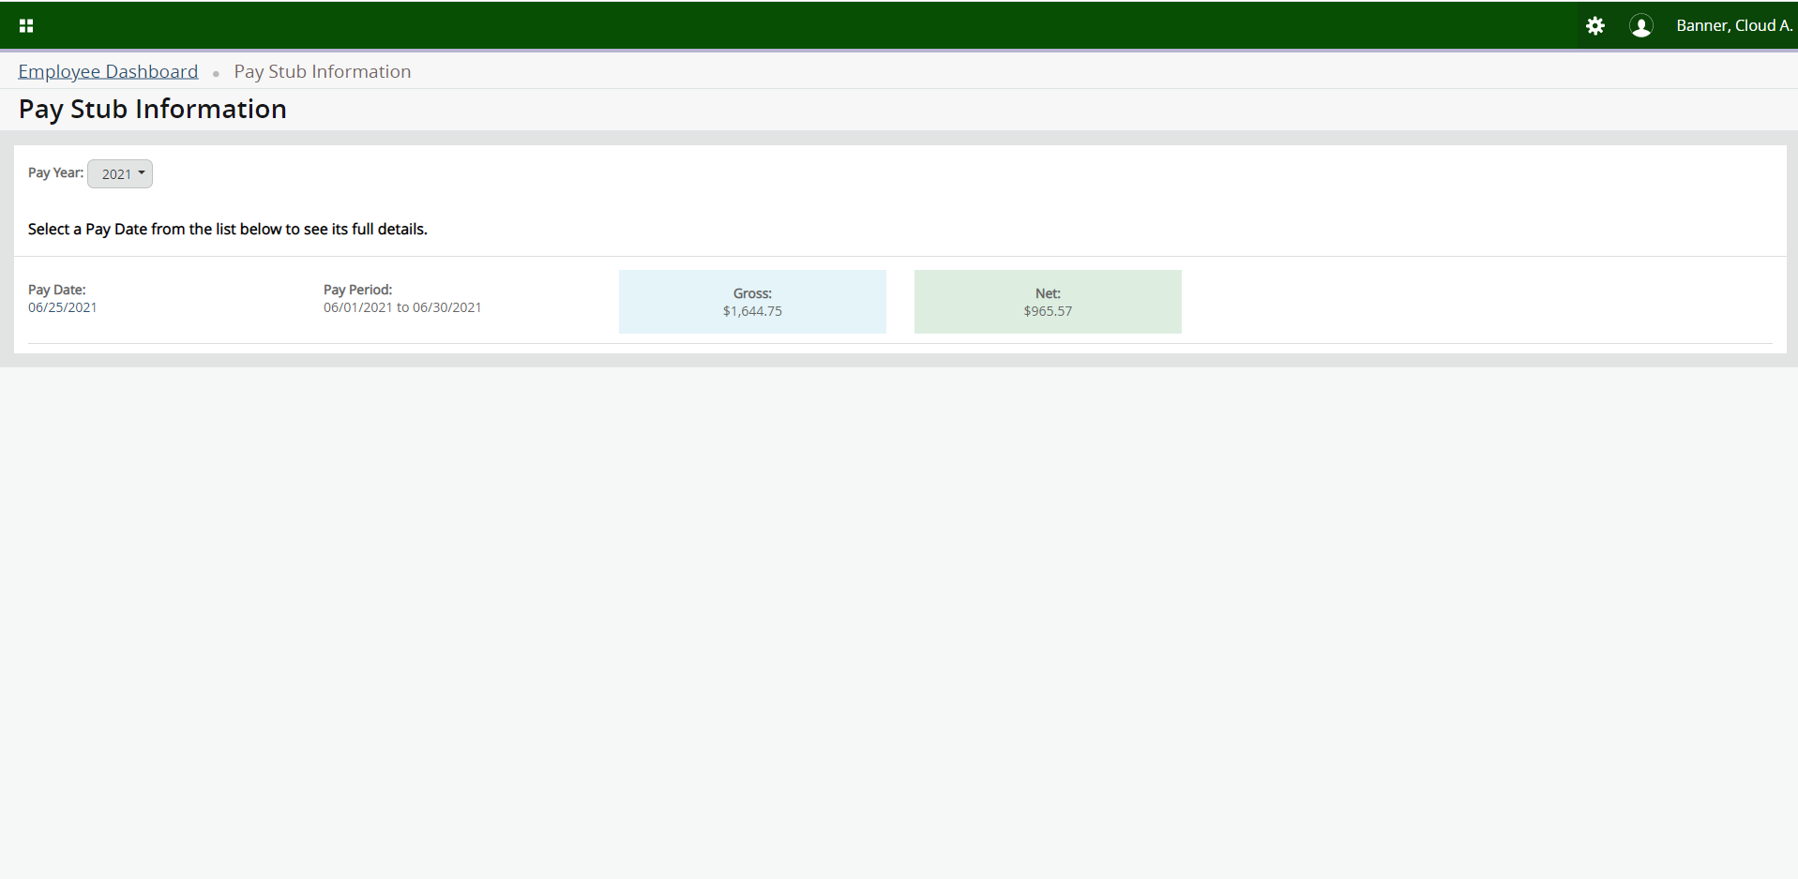
Under Pay Year, choose the year you want to view. Once you have located the pay stub, click on the date in the Pay Date column.

Slide 51
To view your banking information, click on the Direct Deposit Information located under Pay Information.

Slide 52
Click on Deductions History to view your deductions that are broken out into separate sections (Example - FICA-Medicare is separate from Dental).

Slide 53
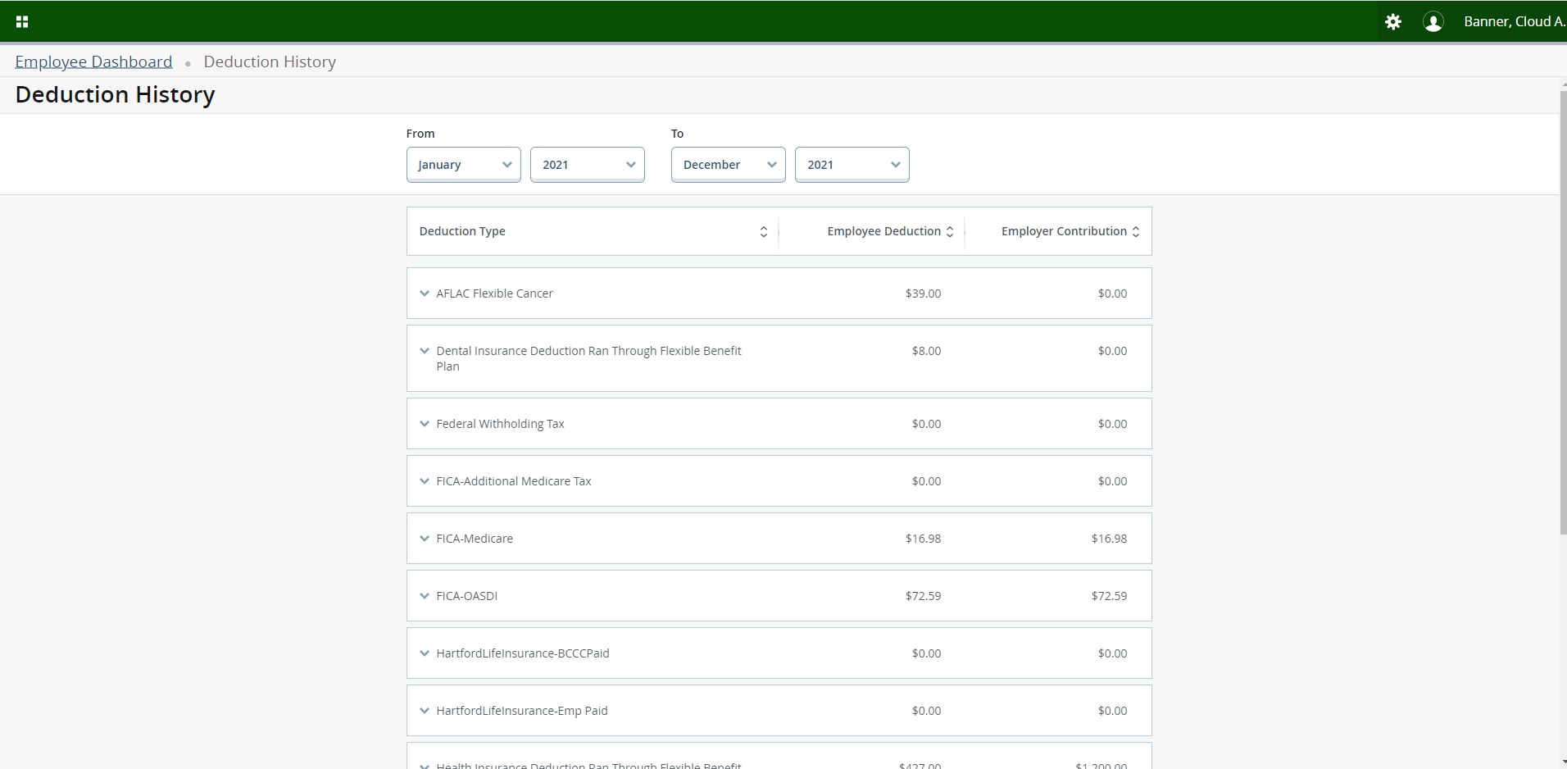
Choose a date range you want to view by clicking on the dates in the From and To columns.

Slide 54
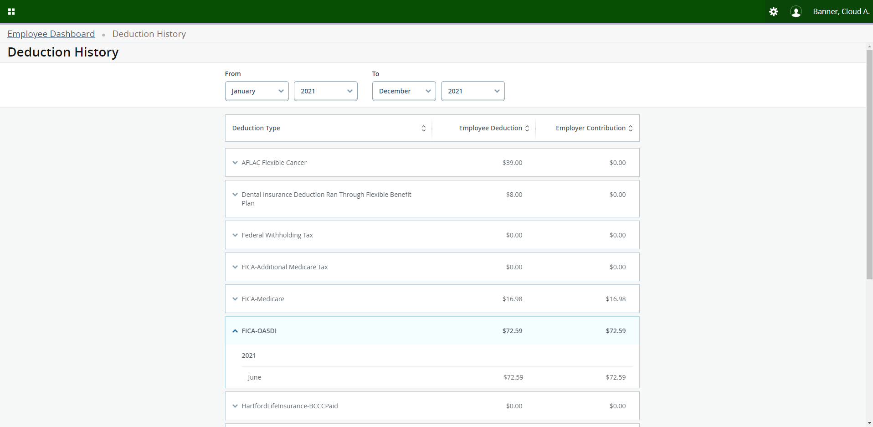
Click on the Caret next to the deduction you want to view to see more information.

Slide 55
EARNINGS

Slide 56
Click on the Caret next to Earnings.

Slide 57
Click on the Earnings by Date Range under the Earning Section.

Slide 58
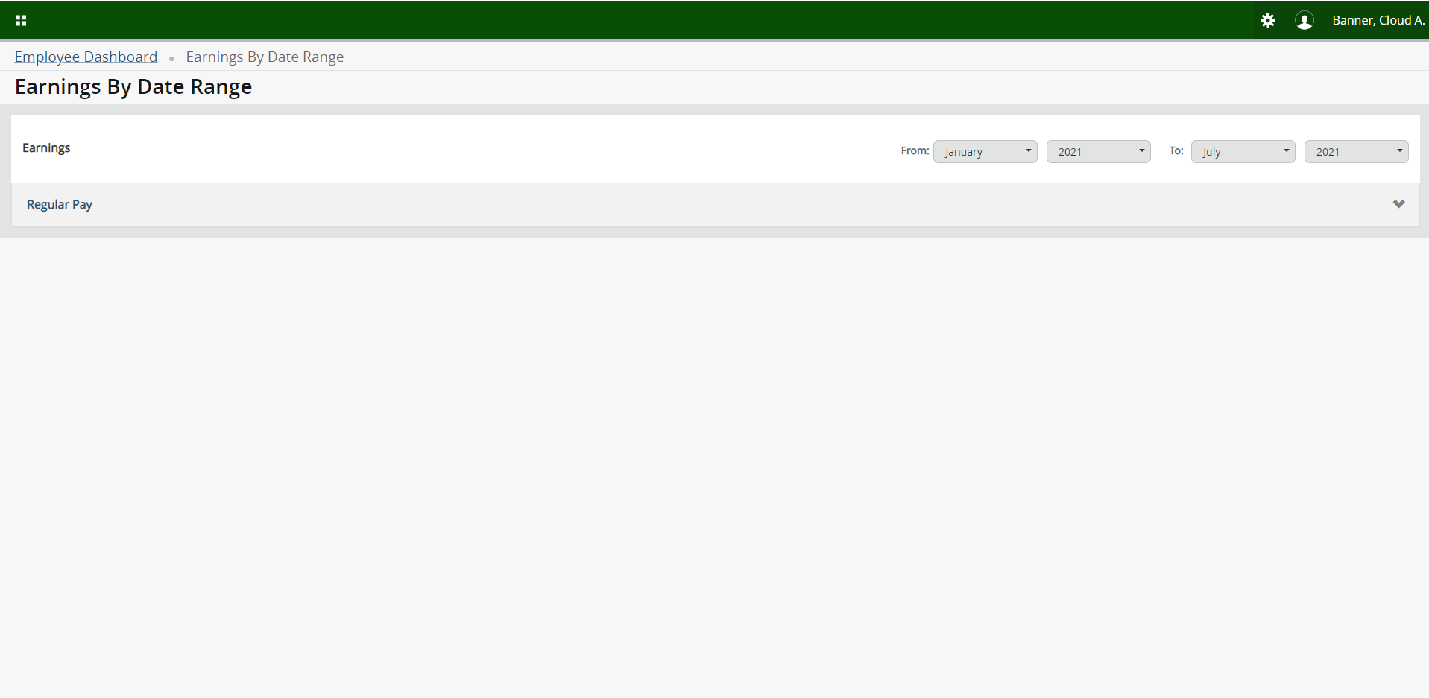
Choose the dates you want to view in the From and To Fields. Next locate the earning you want to view and click on the Caret next to that earning.

Slide 59
Click on the Earnings by Position under the Earning Section.

Slide 60
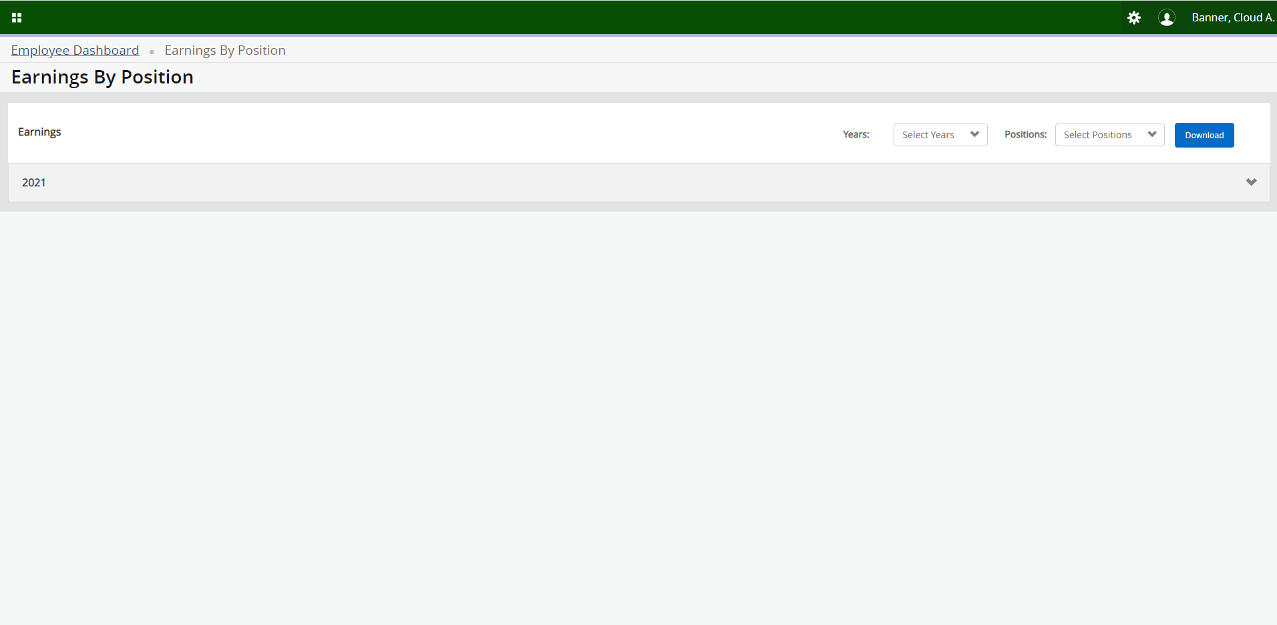
Choose the years/positions you want to view by clicking on the Caret next to these items.

Slide 61
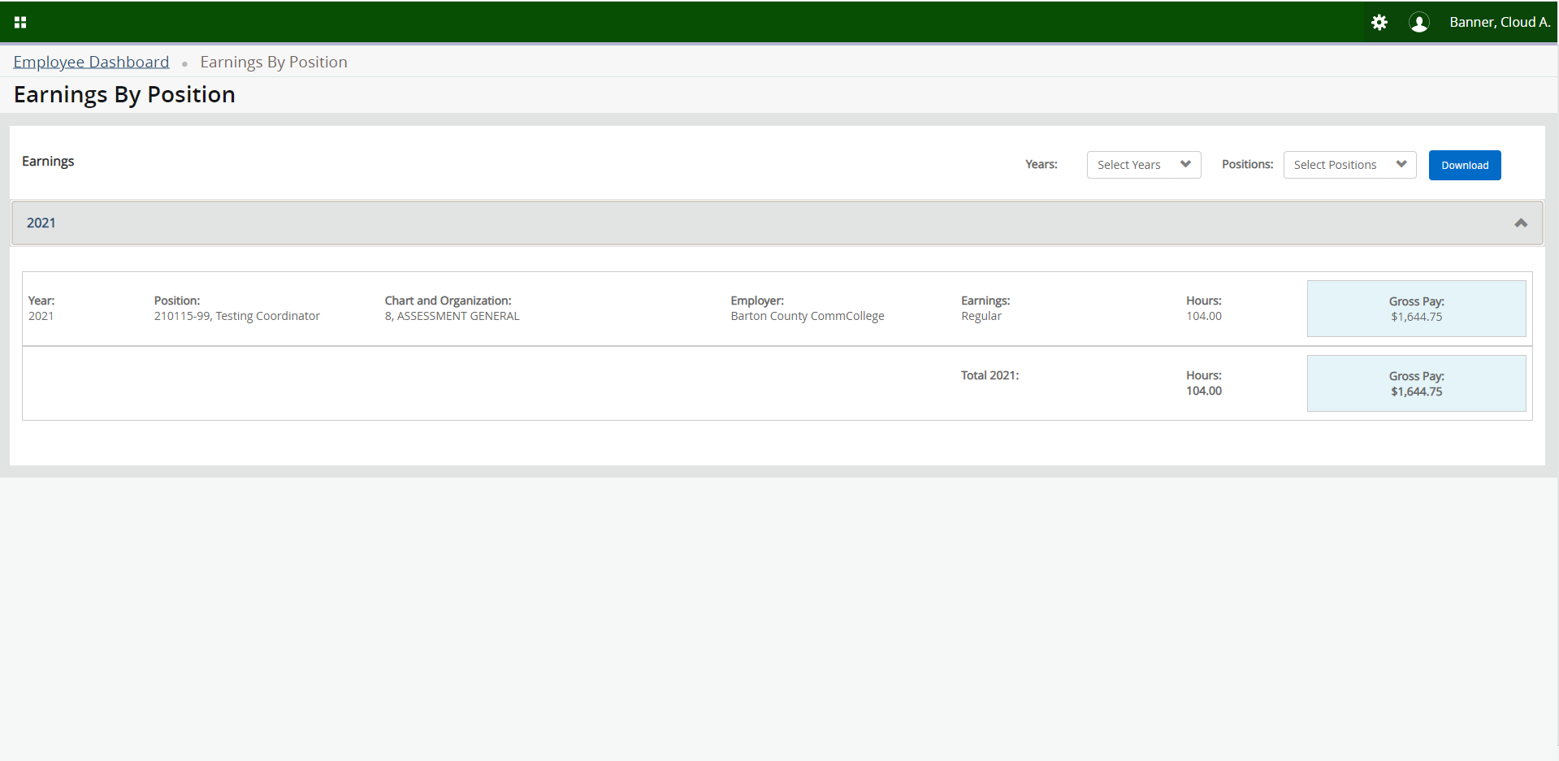
Click on the Caret to view more information next to your search parameters.

Slide 62
Click on Download to view your information in an Excel spreadsheet.

Slide 63
THANK
YOU!

