Slide 1

HOURLY TIMESHEET GUIDE

Slide 2
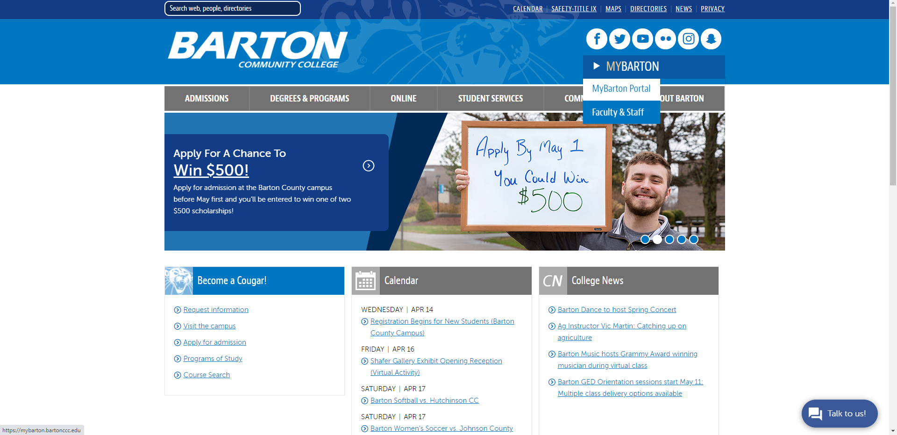
Go to www.bartonccc.edu
MyBarton
MyBarton Portal
Login with your Username and Password

Slide 3
Table of Contents
Accessing Your Timesheet
How to Restart Your Timesheet
Adding Comments
Submit Timesheet
Recalling a Submitted Timesheet
Viewing Timesheet Approver(s)
Viewing Leave Balances
Pay Stub / Direct Deposit Information

Slide 4
ACCESSING
YOUR
TIMESHEET

Slide 5
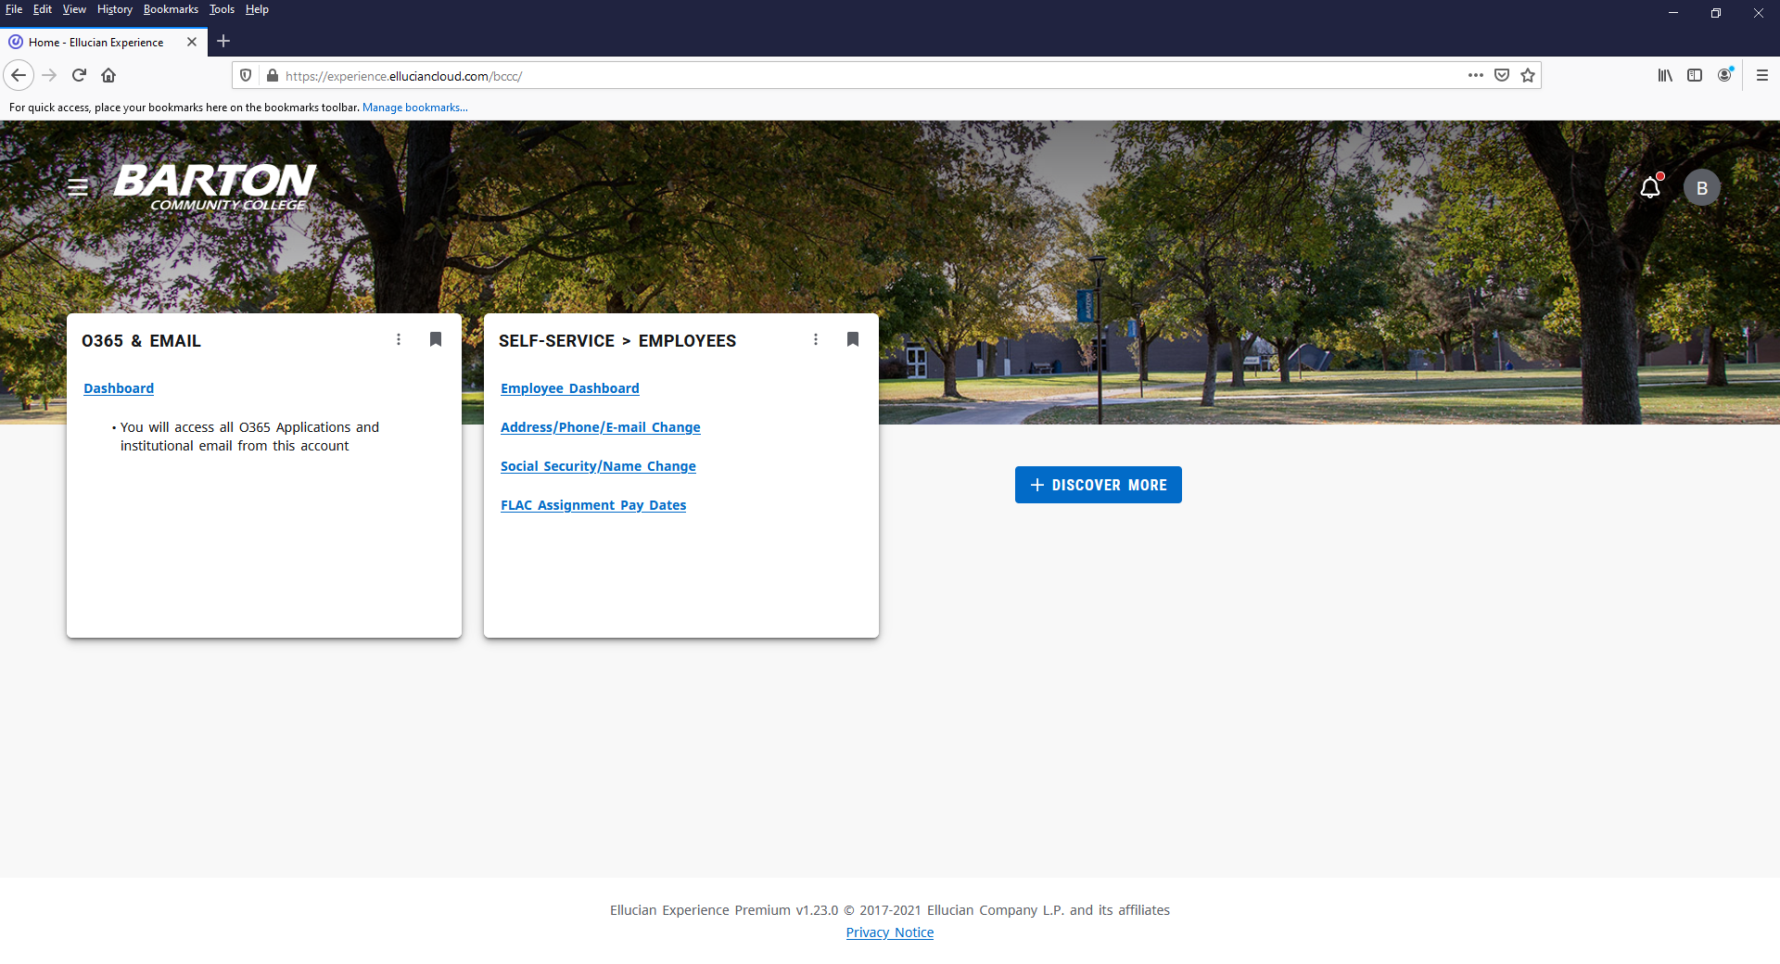
After logging into the MyBarton Portal, click on Employee Dashboard under the Self-Service > Employees Card (If the card isn’t displayed, you may have to click on Discover More at the bottom of the screen to find the card and then save it to your Home Page by clicking on the ribbon in the right-hand corner).

Slide 6
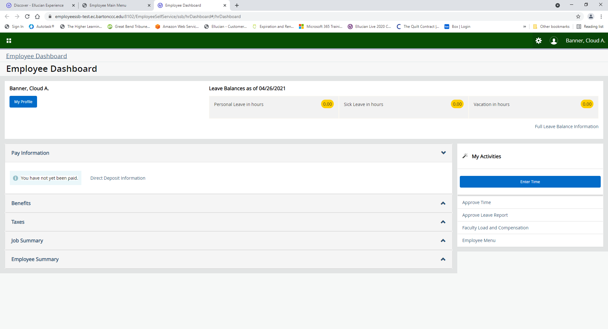
Click on Enter Time on the Employee Dashboard.

Slide 7
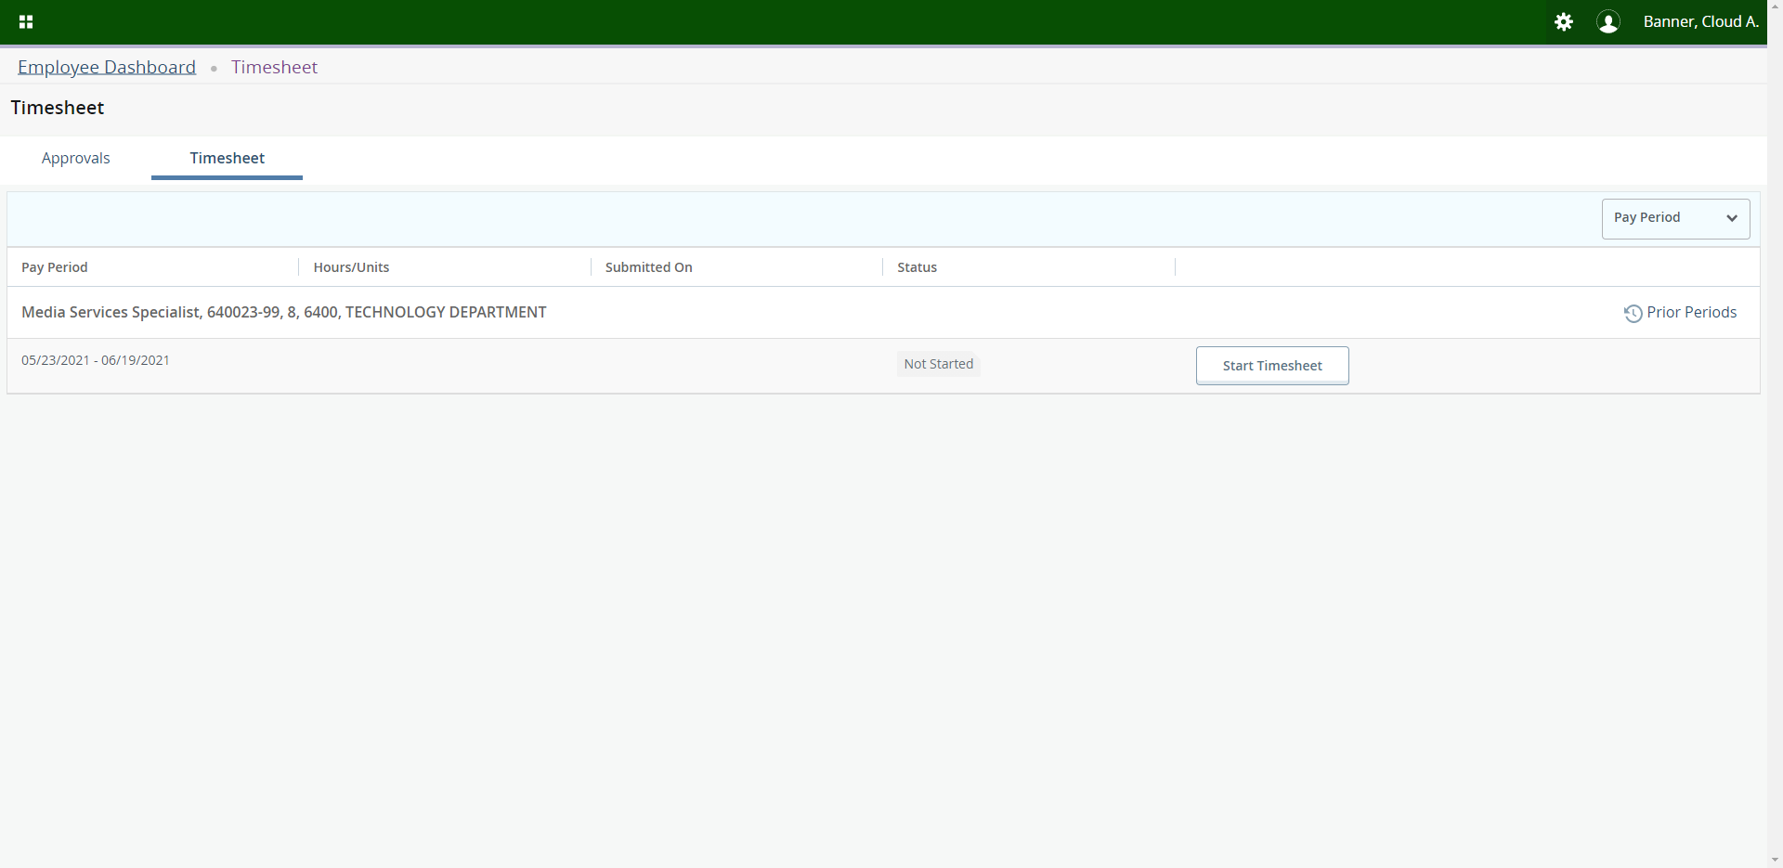
To enter time, click on Start Timesheet for the appropriate pay period.

Slide 8
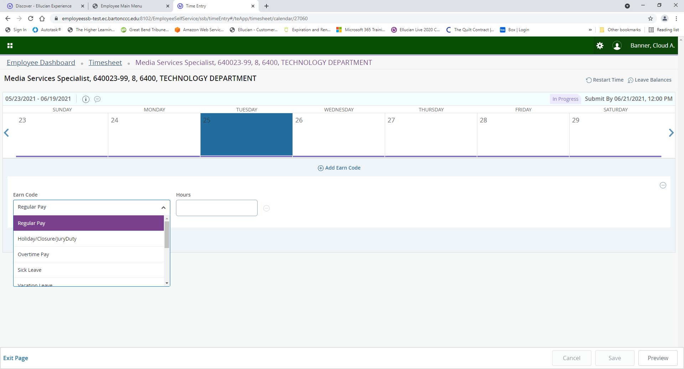
Click on the date you want to Edit. Since you are only able to view one week at a time, you may need to click on the over arrow located on the right-hand side to get to the correct date.

Slide 9
Select the hours you need to report by clicking on the down arrow next to Regular Pay and selecting the appropriate Earn Code.

Slide 10
Type in the hours you need to report and click Save located in the bottom right-hand corner.

Slide 11
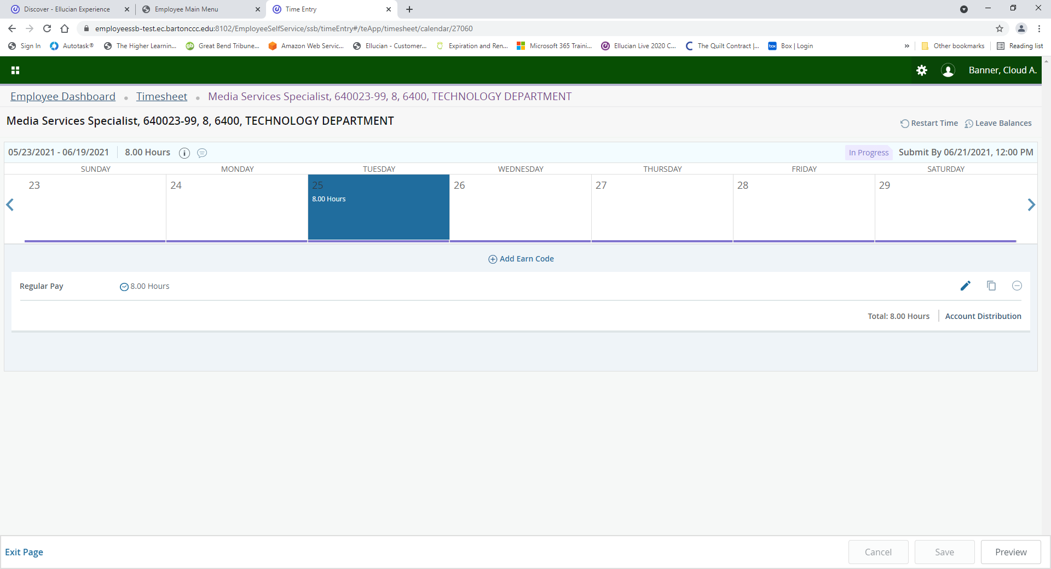
Tip – You must save after each entry otherwise you will lose your changes.

Slide 12
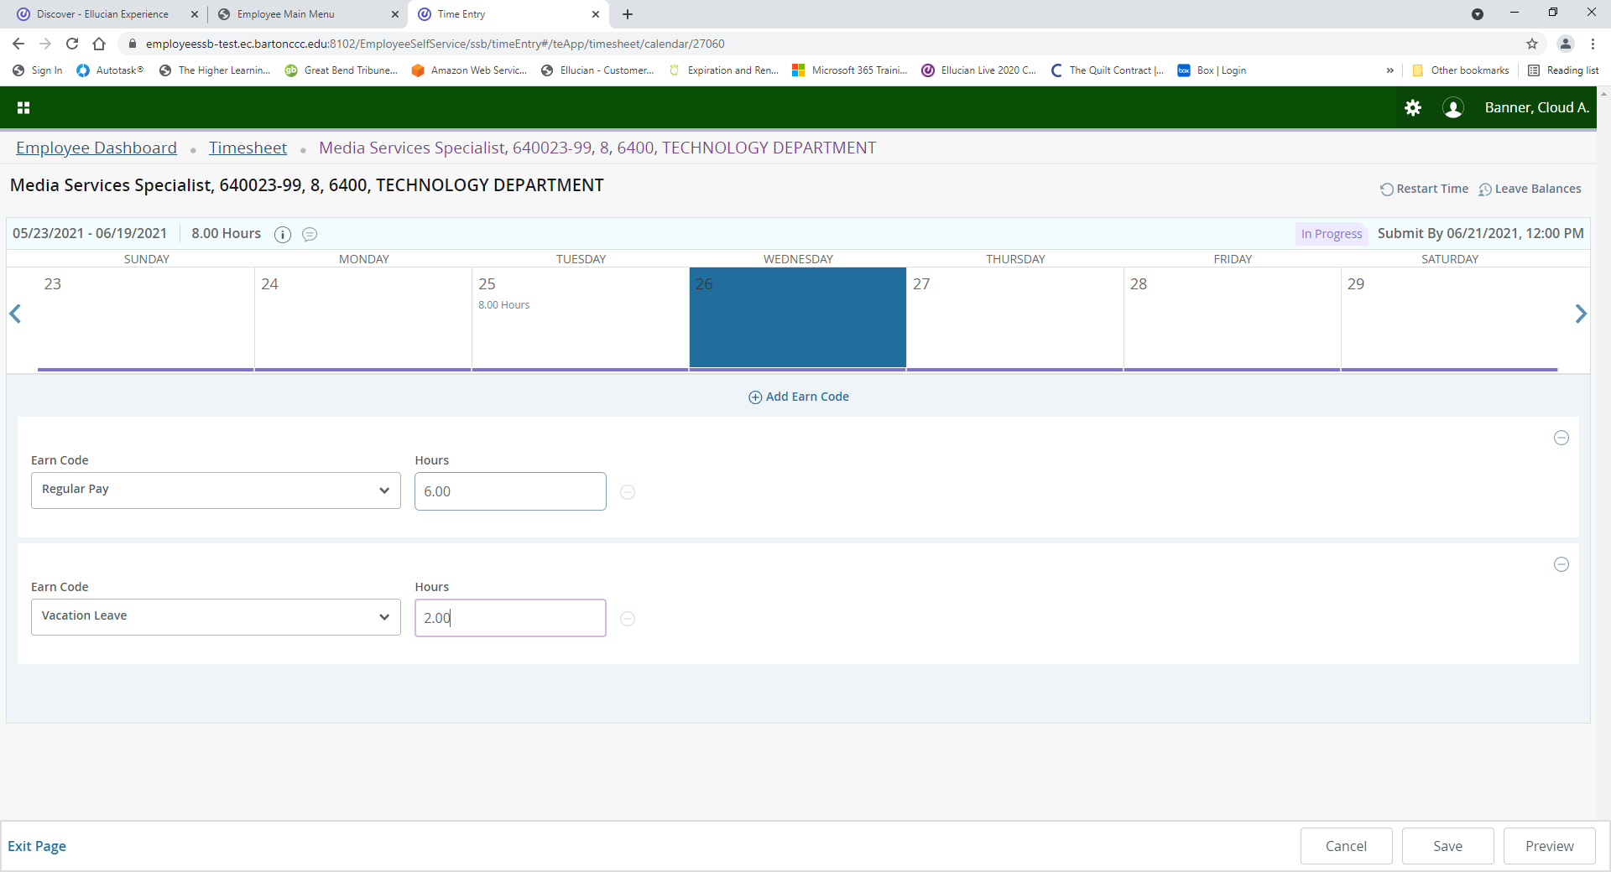
You can select multiple Earn Codes for the same day by clicking on Add Earn Code. Once you have selected all Earn Codes and times, click Save.

Slide 13
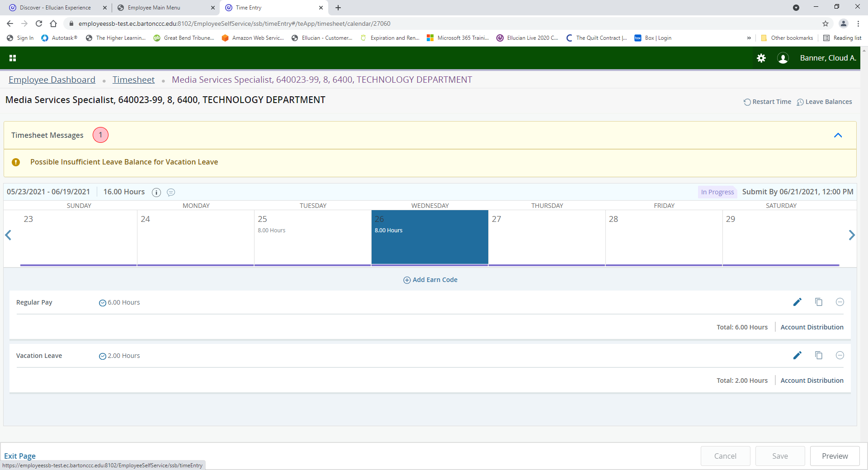
If you get an insufficient leave warning, for example Personal Leave if Vacation Leave has been exhausted, click on Leave Balances in the upper right-hand corner to determine if other appropriate leave is available.

Slide 14
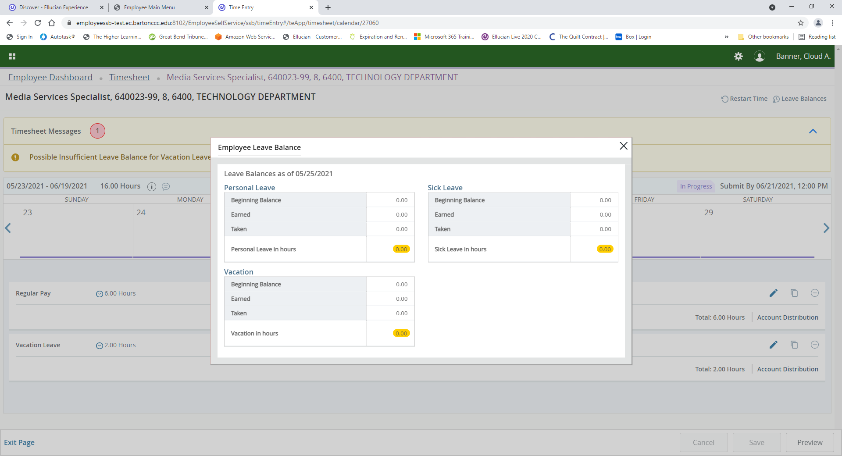
A box will appear with your available Leave Balances. To close the box, click the “X” located in the upper right-hand corner of the box.

Slide 15
If you want to edit or delete time on a specific day, click on the Pencil/Delete button located on the far right, make your edit/delete, and then click Save (The Delete Button is the – button ). If you delete an entry, a warning message will appear. Click Yes and then click Save.

Slide 16
HOW TO
RESTART YOUR TIMESHEET

Slide 17
Click on Enter Time on the Employee Dashboard.

Slide 18
If you want to delete your timesheet and start over, click on Restart Time in the top right-hand corner.

Slide 19
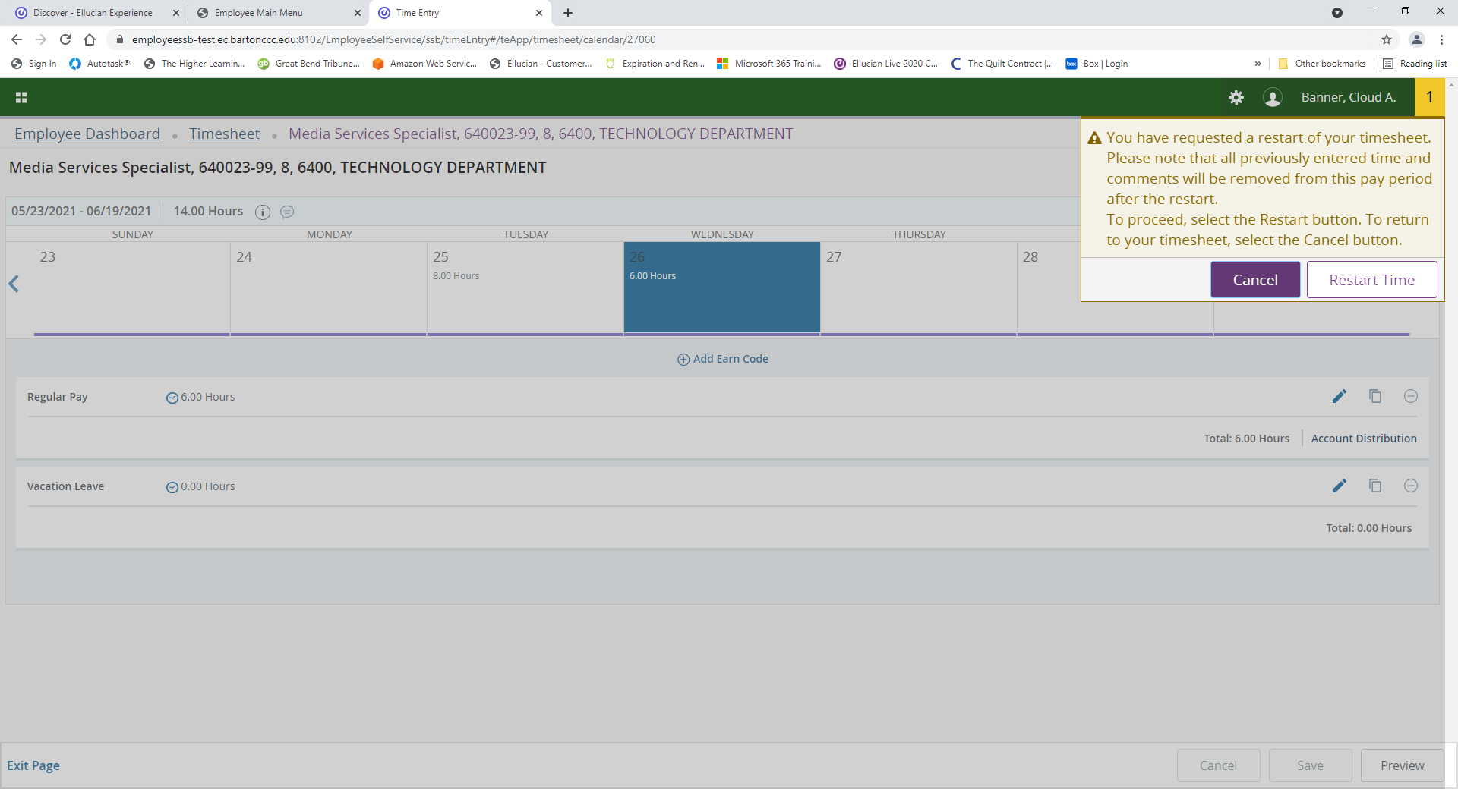
This warning message will appear to confirm you want to restart your time. If you want to proceed, click on Restart Time.

Slide 20
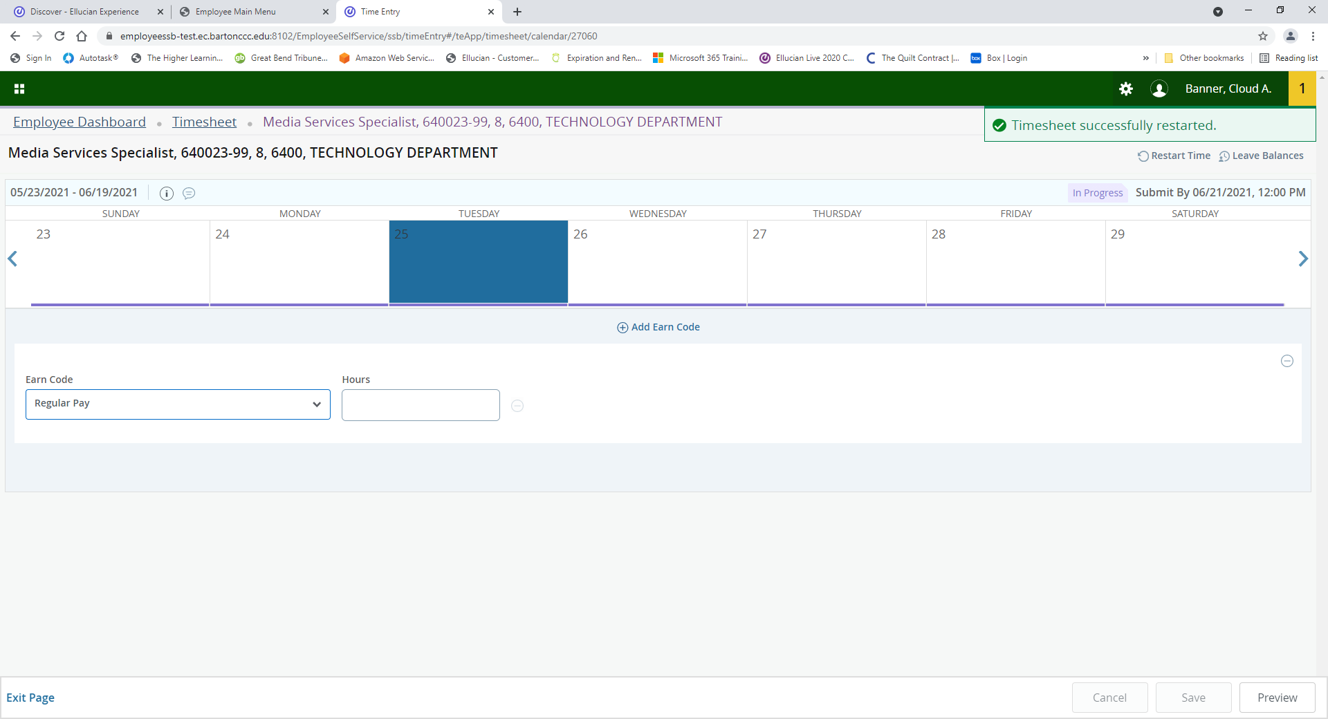
A notification will appear stating your timesheet has been successfully restarted.

Slide 21
ADDING
COMMENTS

Slide 22
Click on Enter Time on the Employee Dashboard.

Slide 23
Click on the Conversation Cloud to add a comment.

Slide 24
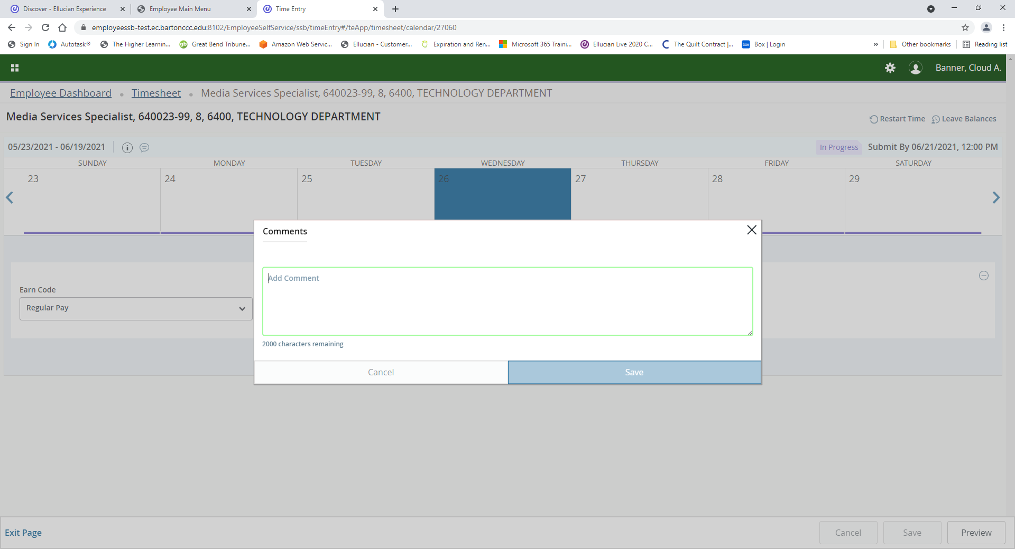
Type your comment and click Save.

Slide 25
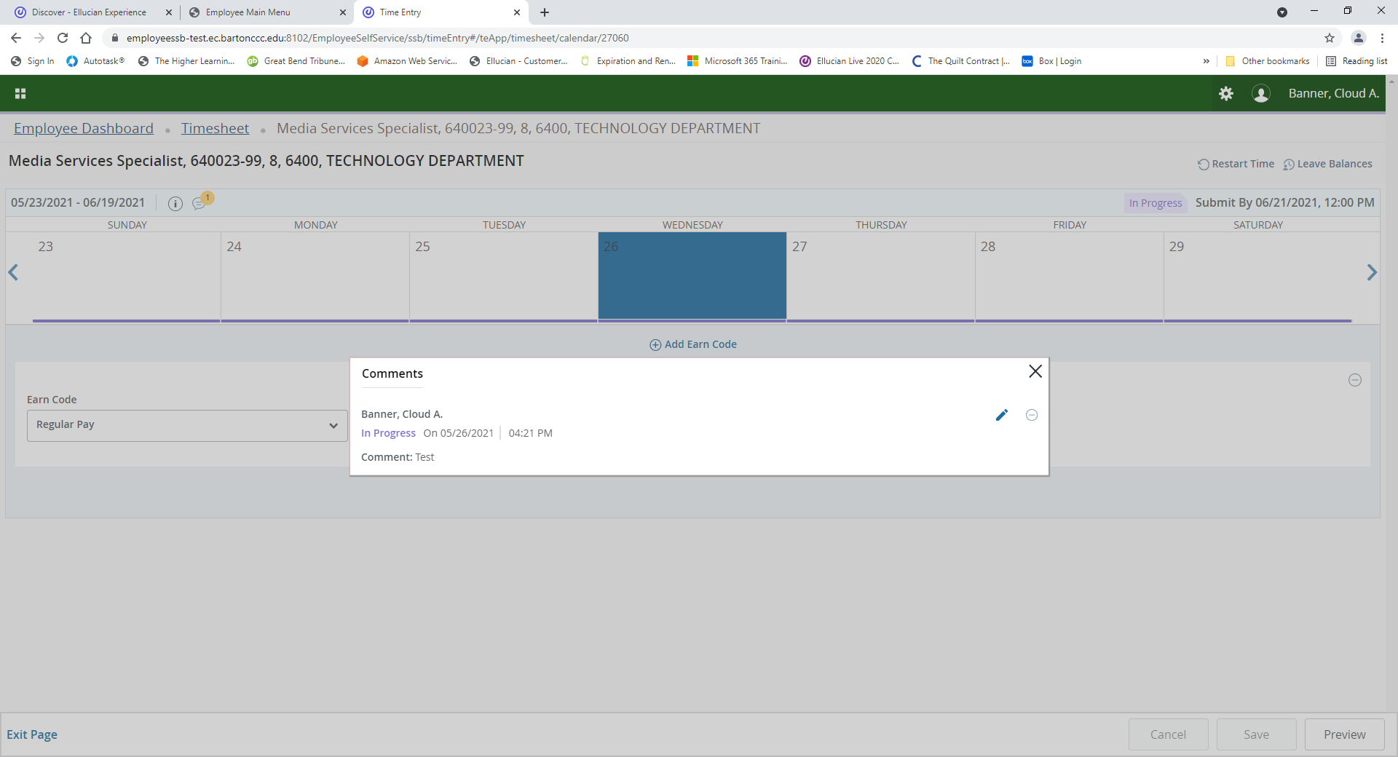
To Delete or Edit a comment, click on the Pencil.

Slide 26
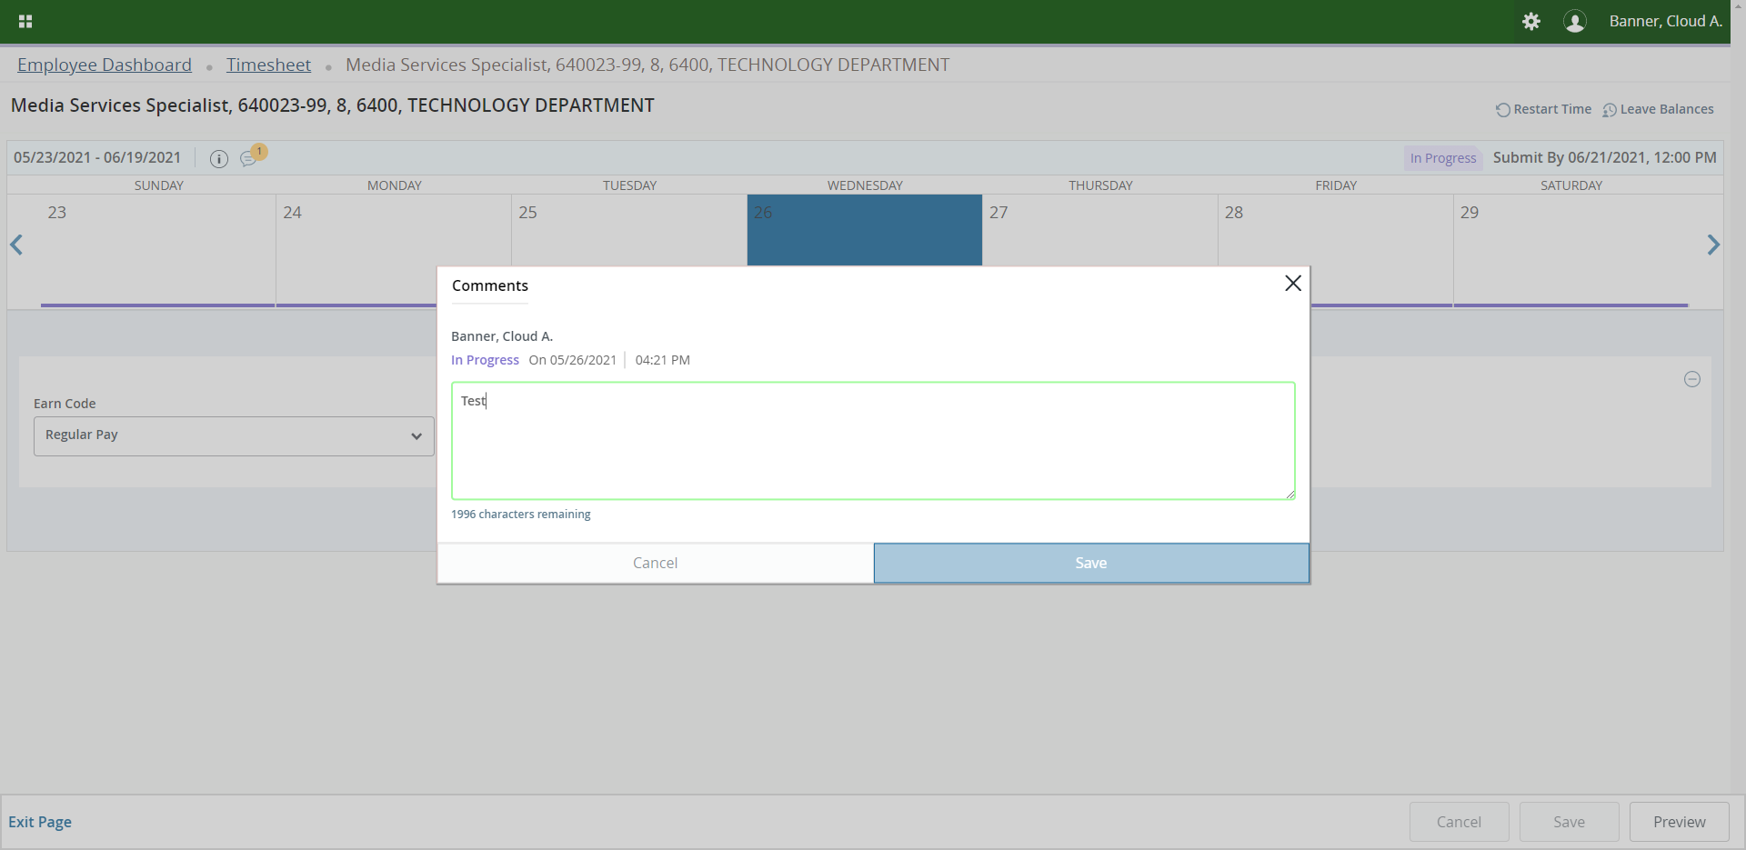
Edit your comment and click on Save. Tip—the Save button will be grayed out until you change the wording.

Slide 27
SUBMIT
TIMESHEET

Slide 28
Click on Enter Time on the Employee Dashboard.

Slide 29
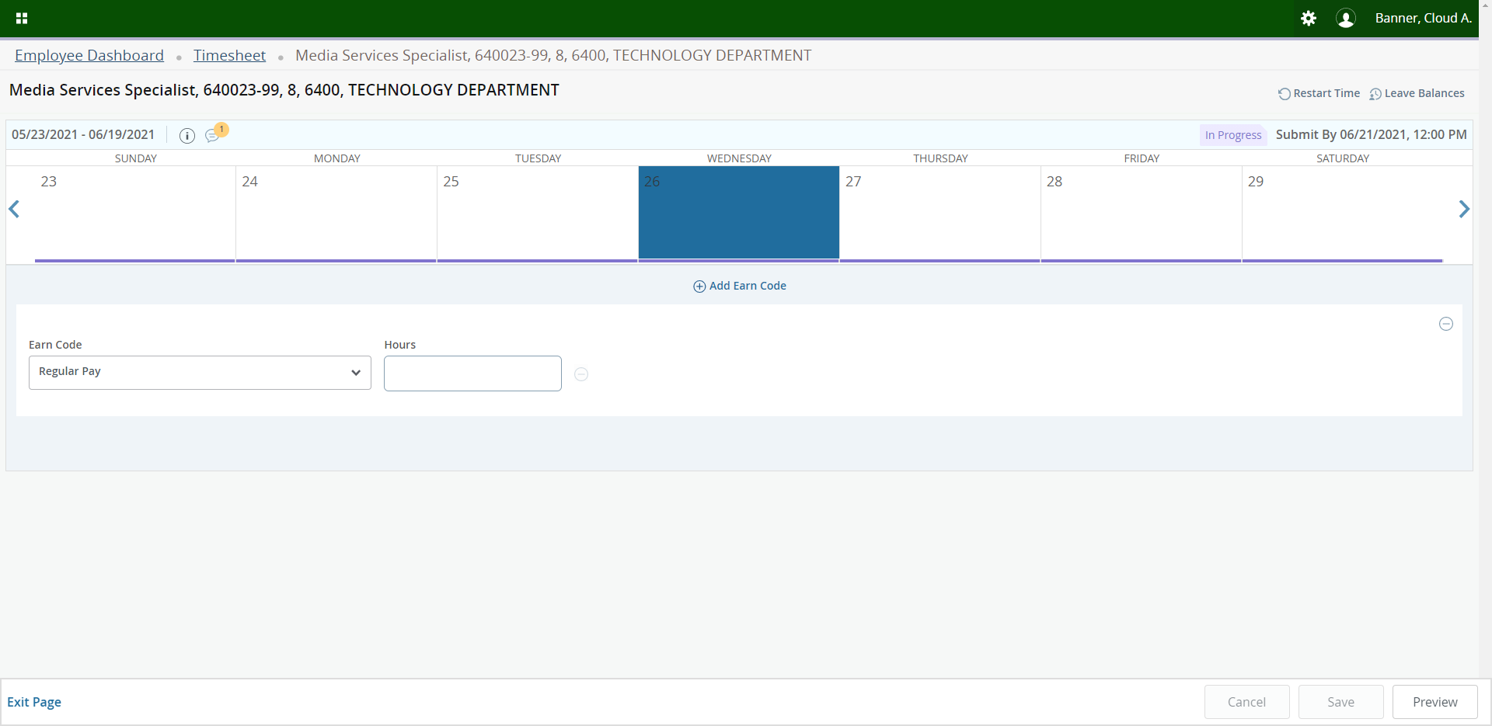
Once your timesheet is complete, click on Preview in the bottom right-hand corner.

Slide 30
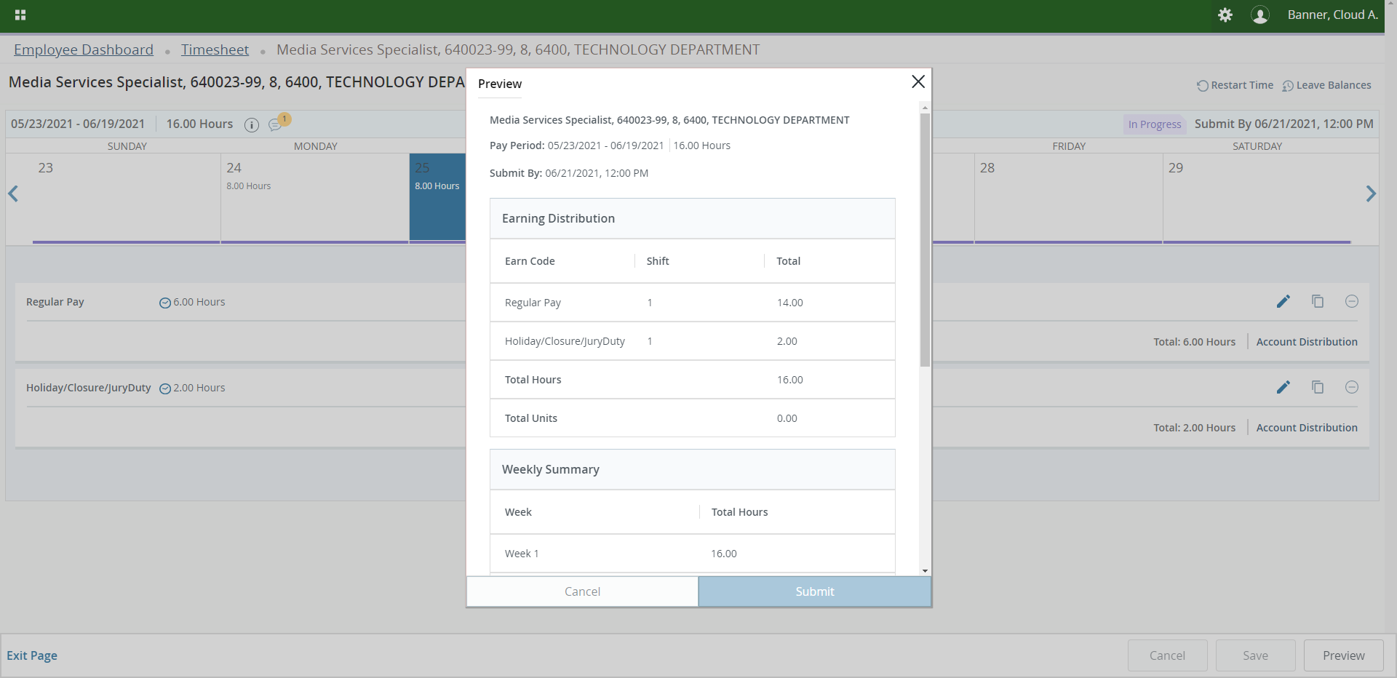
Review your timesheet for accuracy.

Slide 31
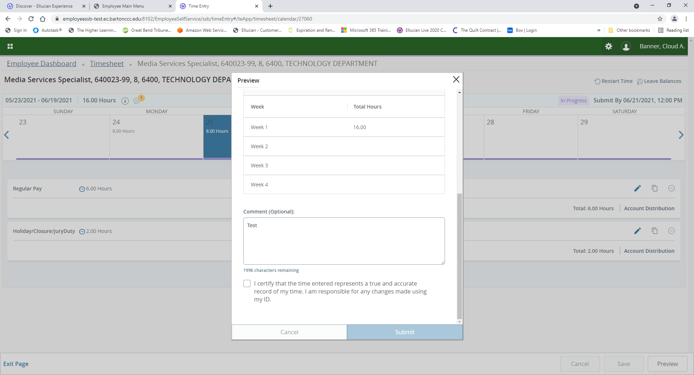
Scroll down and add additional comments if needed. Review the certification statement, check the box and click on Submit. Your timesheet has now been submitted for approval and processing.

Slide 32
RECALLING A SUBMITTED TIMESHEET

Slide 33
Click on Enter Time on the Employee Dashboard.

Slide 34
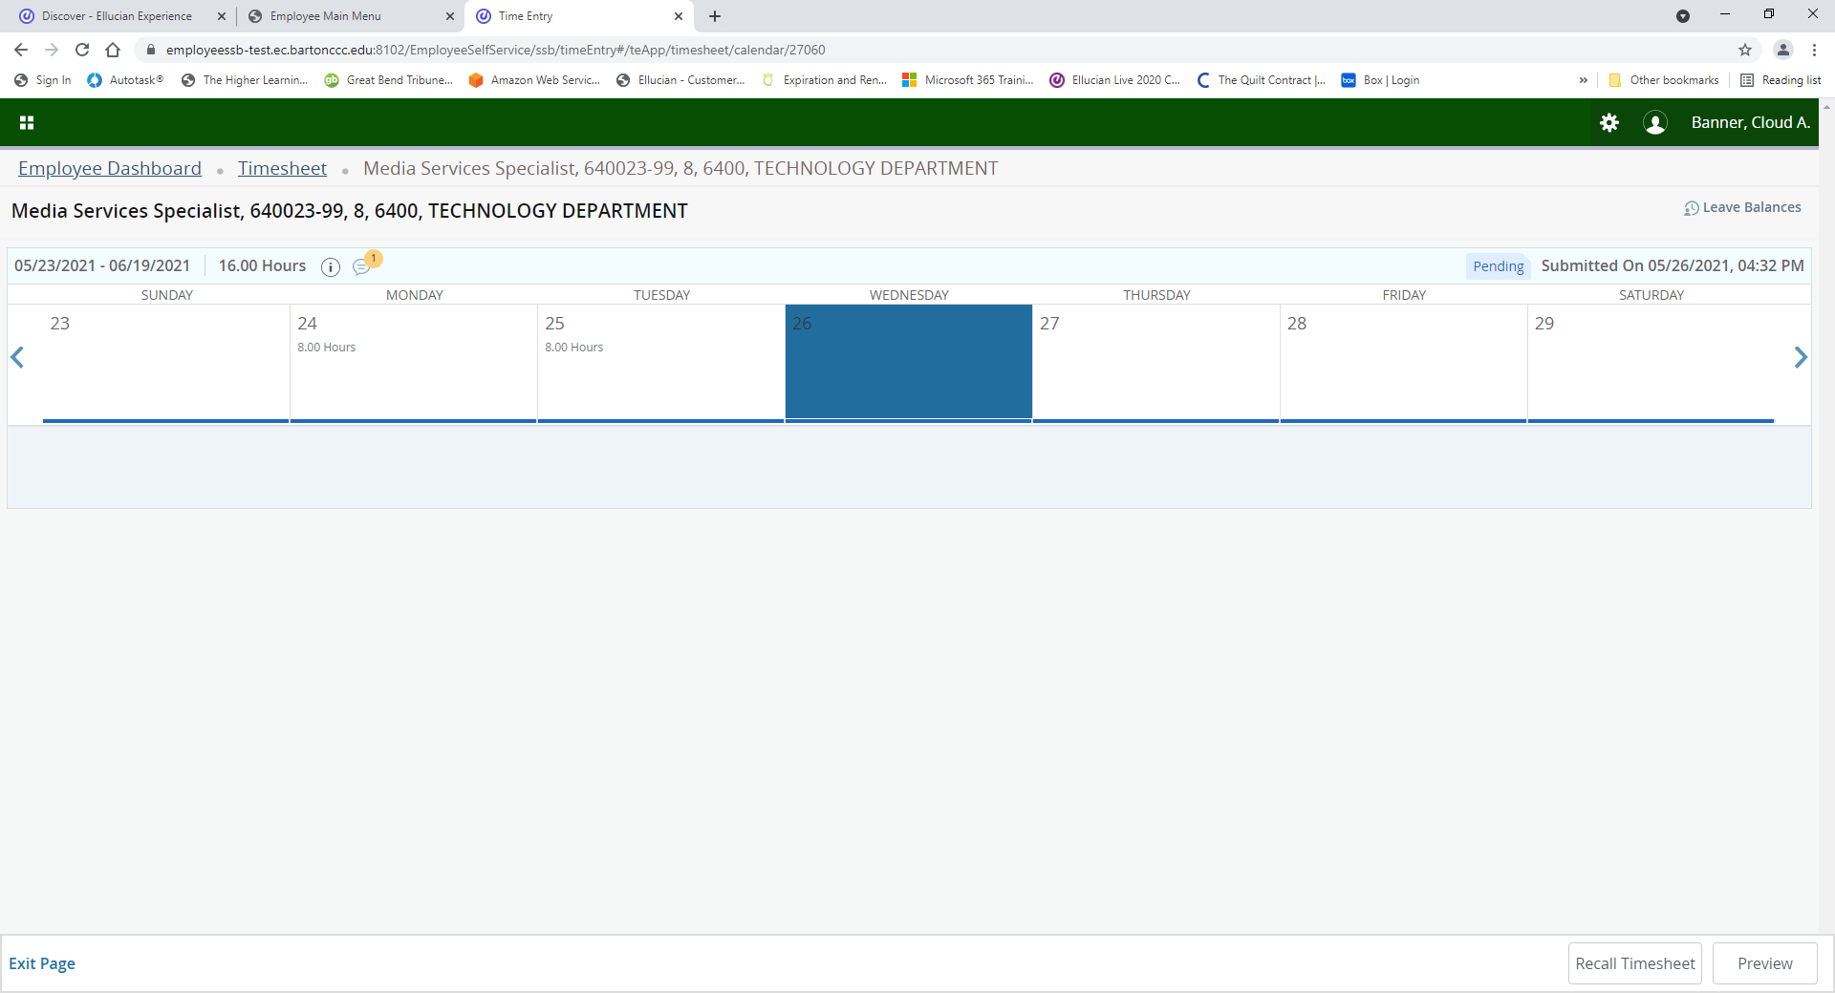
If you submitted your timesheet and you need to make a change, you can recall it by clicking on Recall Timesheet in the bottom right-hand corner. Your timesheet will be returned to you for editing.

Slide 35
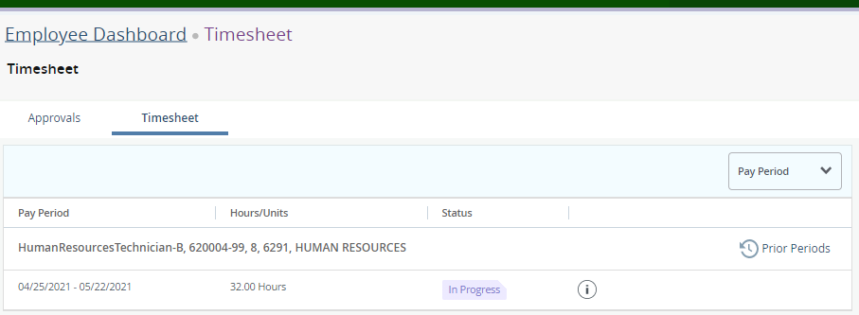
If you realize you need to change your timesheet prior to your supervisor approving and prior to the pay period closing, you can recall it by clicking Prior Periods in the top right-hand corner. Select the timesheet that is Pending and select Recall Timesheet. If the pay period is closed, you will not see the Recall Timesheet button and will need to contact HR.

Slide 36
Once your timesheet is complete, click on Preview in the bottom right-hand corner.

Slide 37
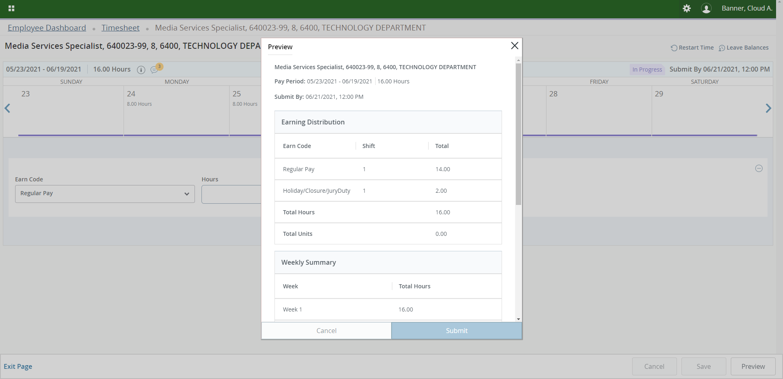
Review your timesheet for accuracy.

Slide 38
Scroll down and add additional comments if needed. Review the certification statement, check the box and click on Submit. Your timesheet has now been submitted for approval and processing.

Slide 39
VIEWING TIMESHEET APPROVER(S)

Slide 40
Click on Enter Time on the Employee Dashboard.

Slide 41
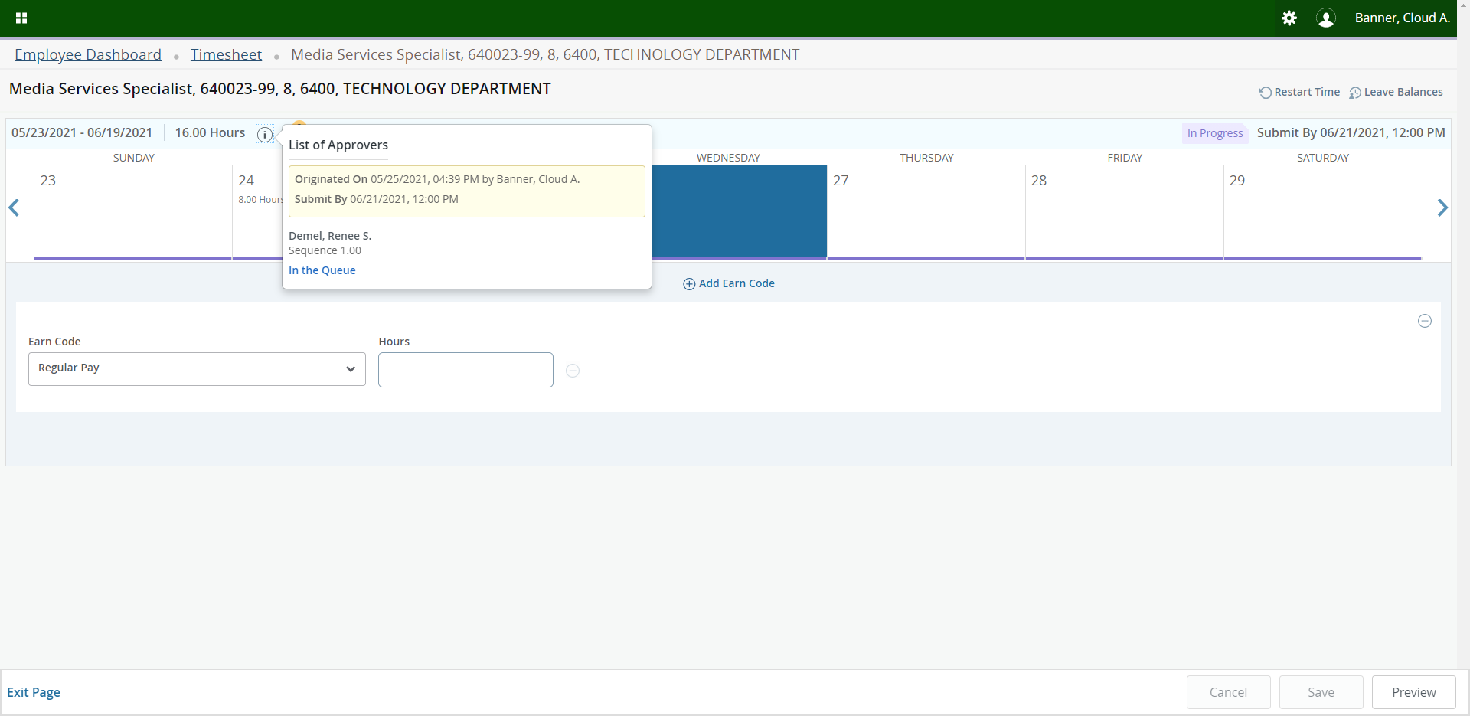
Click on the Information icon and it will display an Approver list.

Slide 42
VIEWING LEAVE BALANCES

Slide 43
Click on Full Leave Balance Information on the Employee Dashboard.

Slide 44
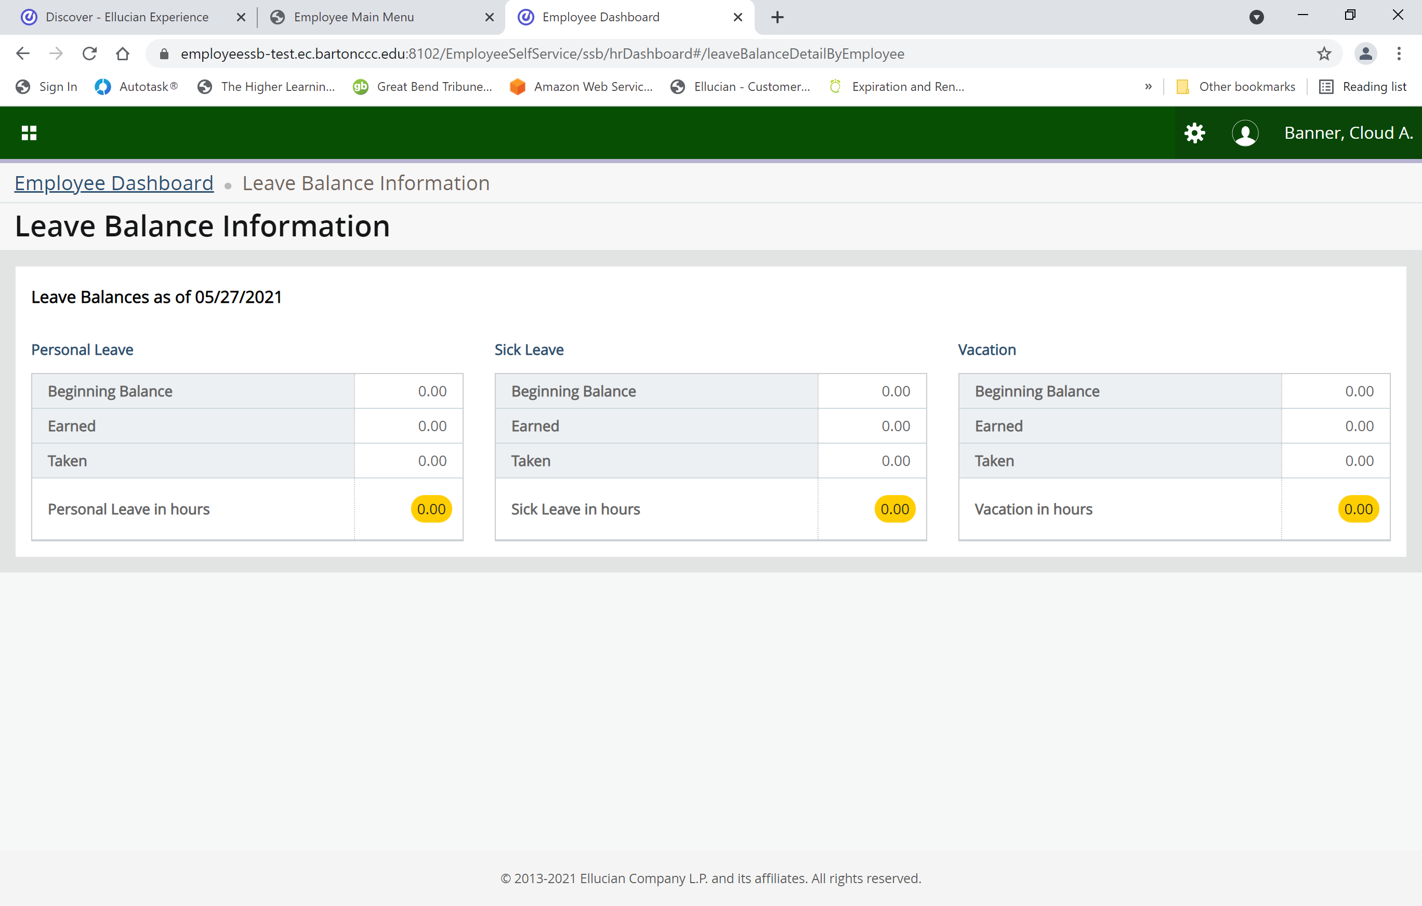
Click on each of the Leave buttons to see more detailed information.

Slide 45
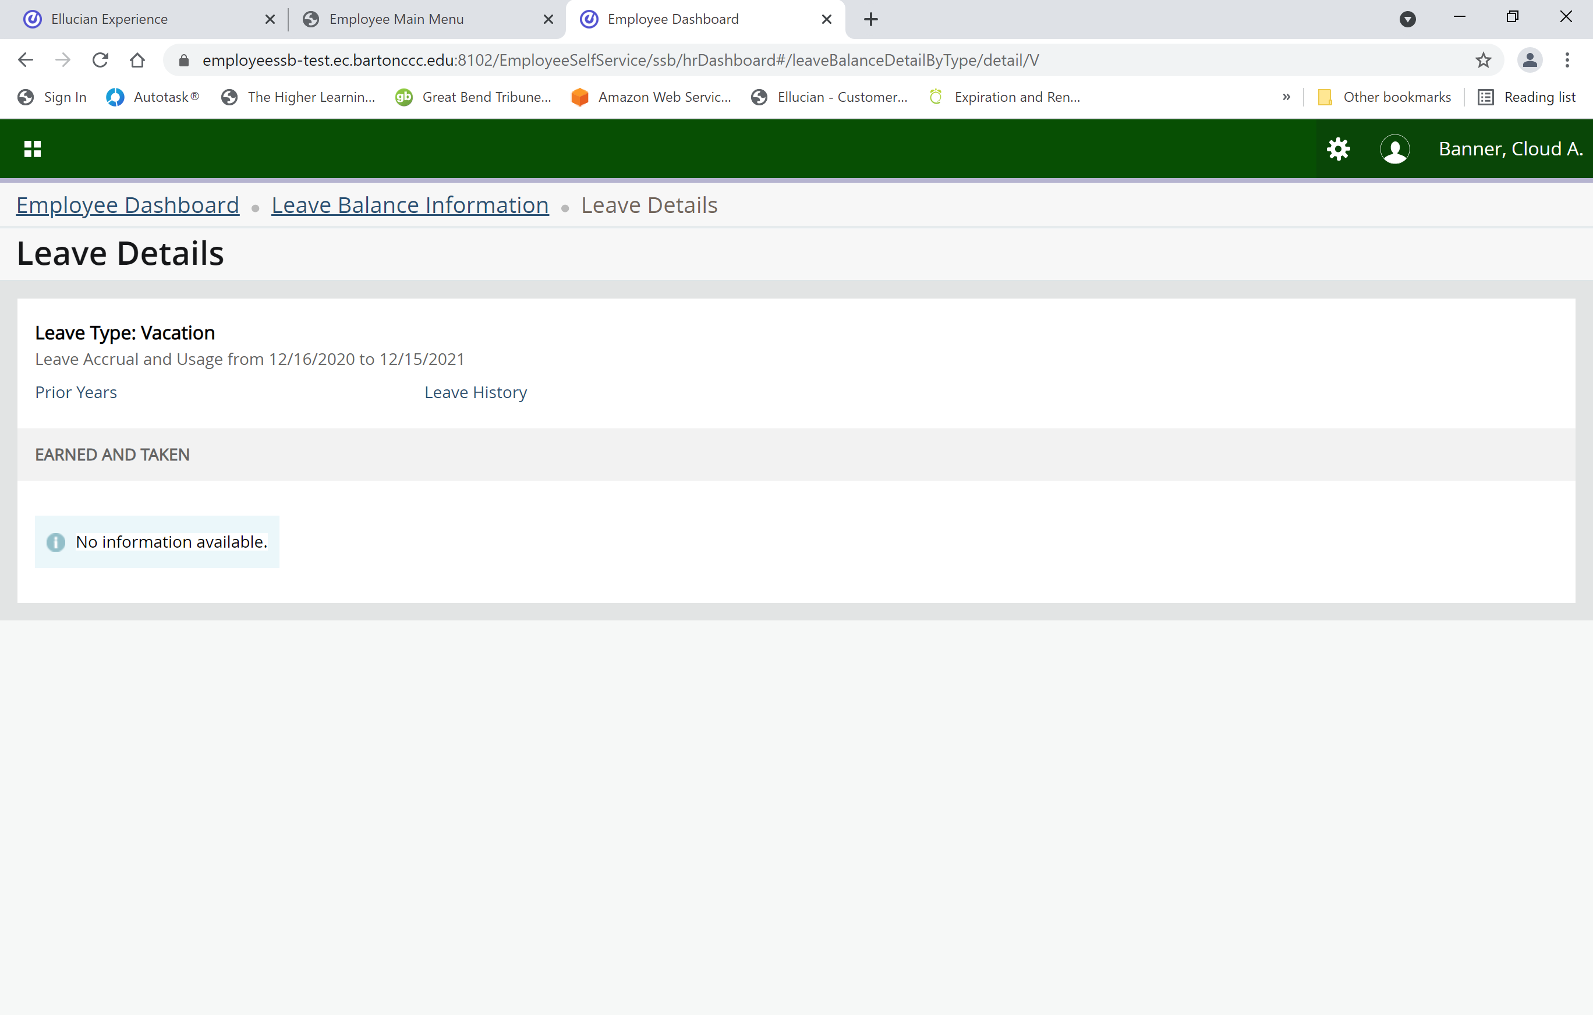
Click on Prior Years to see a history or click on Leave History to see the most recent history.

Slide 46
PAY STUB / DIRECT DEPOSIT INFORMATION

Slide 47
To view your Pay Stub click on the date; and to view your banking information click on Direct Deposit Information.

Slide 48
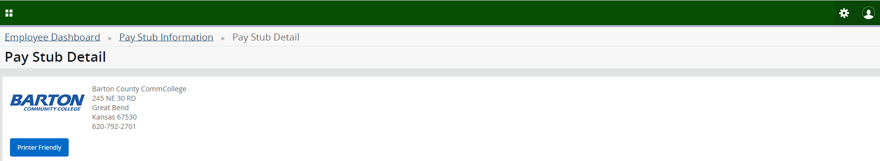
After clicking on the paystub date you are wanting to view, click on Printer Friendly. Then click on the printer icon on the far right-hand side when the next screen comes up.

Slide 49
Click on the All Pay Stubs to see previous Pay Stubs.

Slide 50
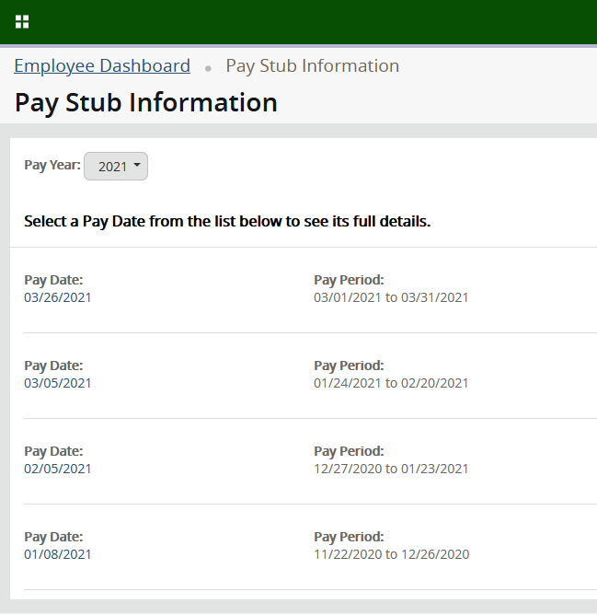
Select the appropriate year by clicking the drop down arrow. Click on Pay Date to view your Pay Stub.

Slide 51
Click on Deductions History to view your deductions that are broken out into separate sections (Example - FICA-Medicare is separate from Dental).

Slide 52
THANK
YOU!

