Slide 1

APPROVER GUIDE FOR LEAVE REPORTS

Slide 2
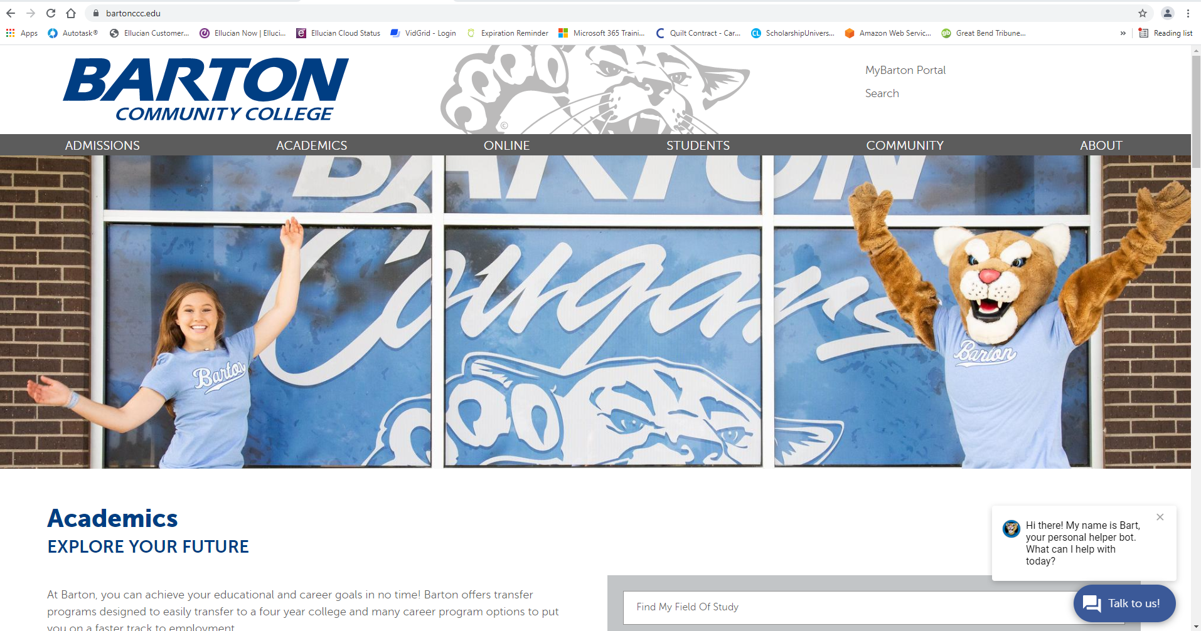
Go to www.bartonccc.edu
MyBarton Portal

Slide 3
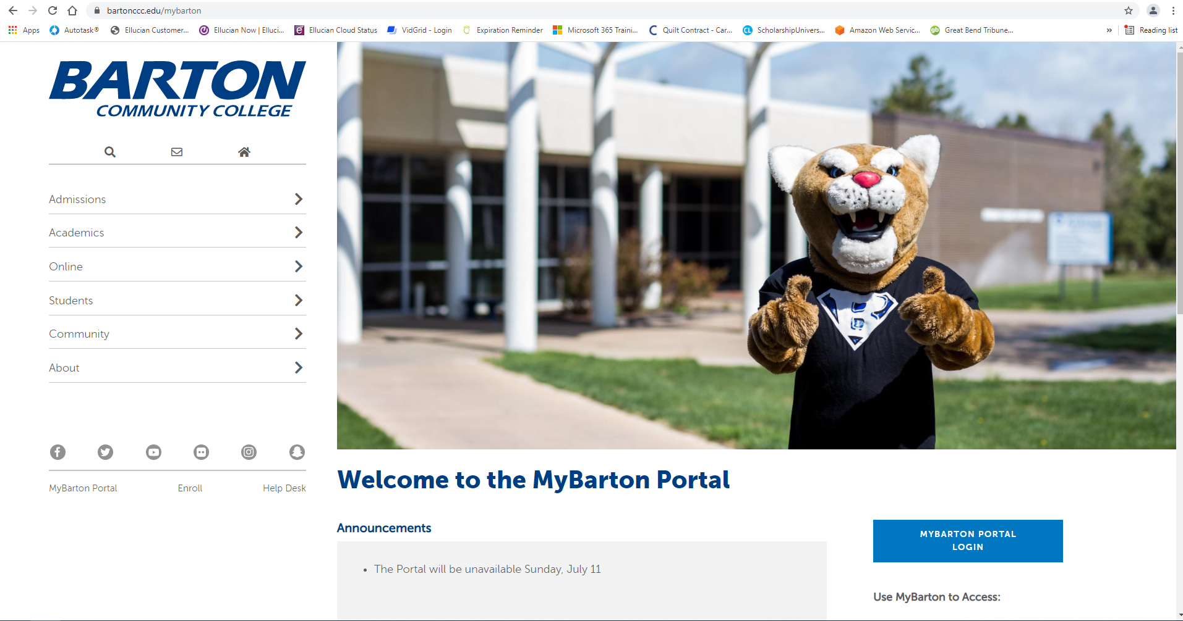
MyBarton Portal Login
Login with your Username and Password

Slide 4
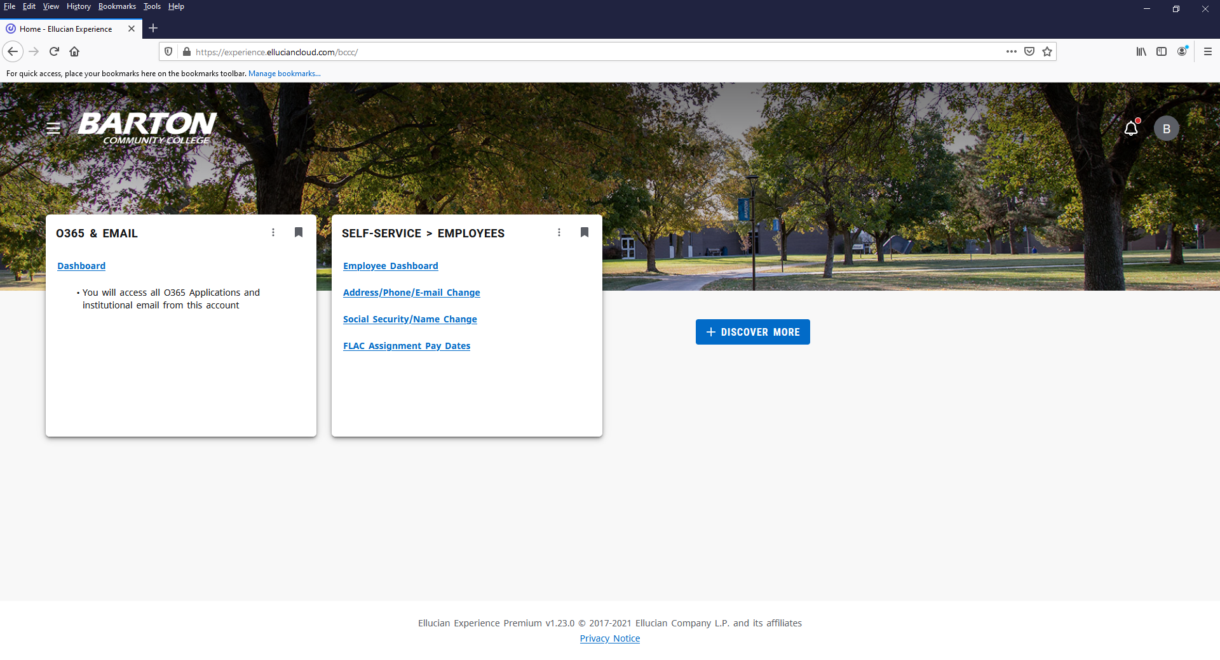
After logging into the MyBarton Portal, click on Employee Dashboard under the Self-Service > Employees Card (If the card isn’t displayed, you may have to click on Discover More at the bottom of the screen to find the card and then save it to your Home Page by clicking on the ribbon in the right-hand corner).

Slide 5
Table of Contents
Approving Leave Report
Returning Leave Report to Employee
Viewing Employee Leave Balances
Error on Leave Report
Viewing Leave Report Approver(s)
Viewing Comments
Reports

Slide 6
APPROVING
LEAVE REPORT

Slide 7
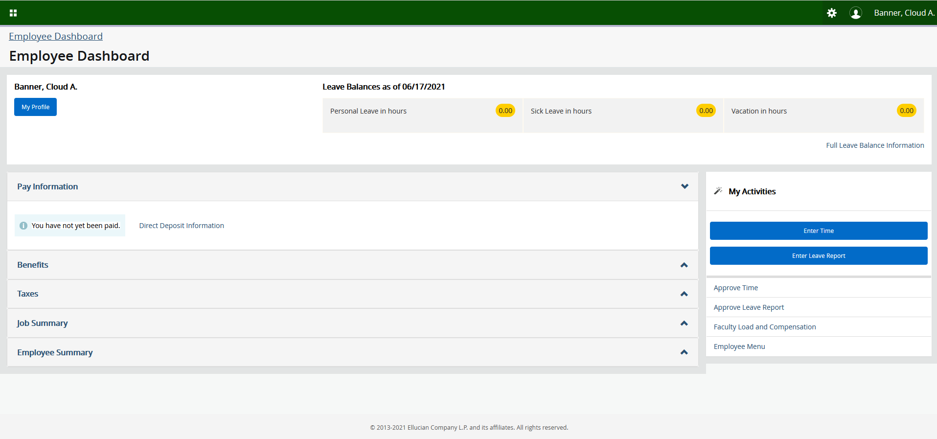
Click on Approve Leave Report on the Employee Dashboard.

Slide 8
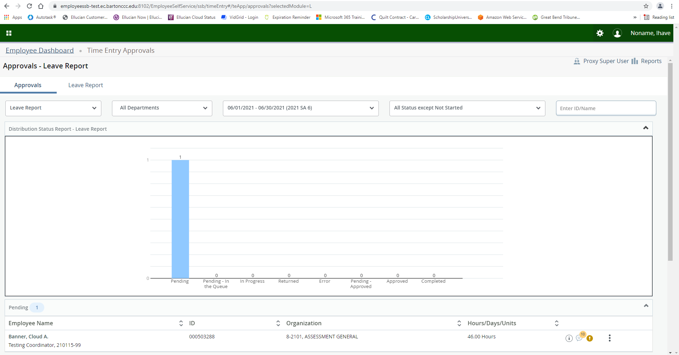
Below is a screenshot of what it will look like.

Slide 9
You can filter using the Caret Buttons or by manually entering information into the “Enter ID/Name field” to select the information you want to view.

Slide 10
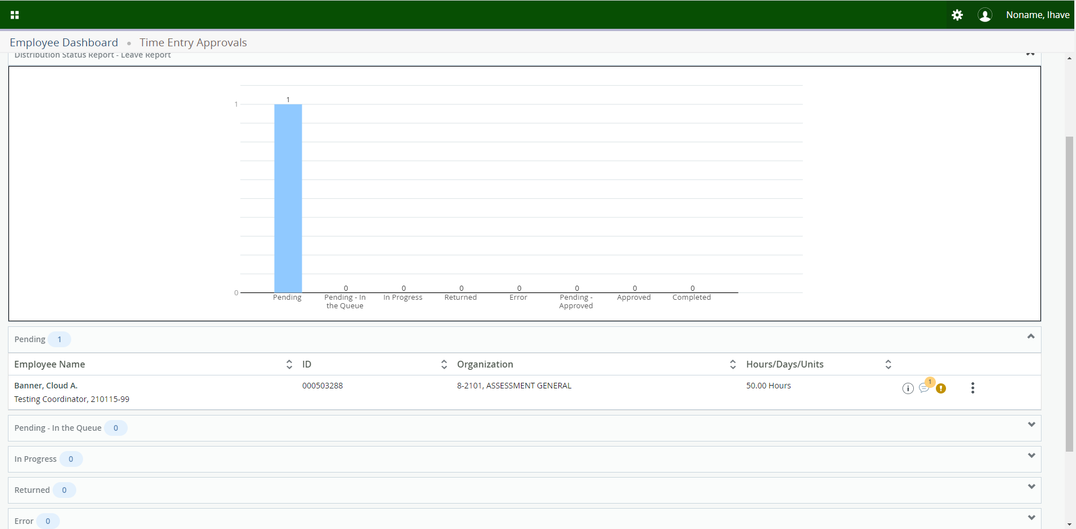
Click on the Action Menu to the right of the employee’s name.

Slide 11
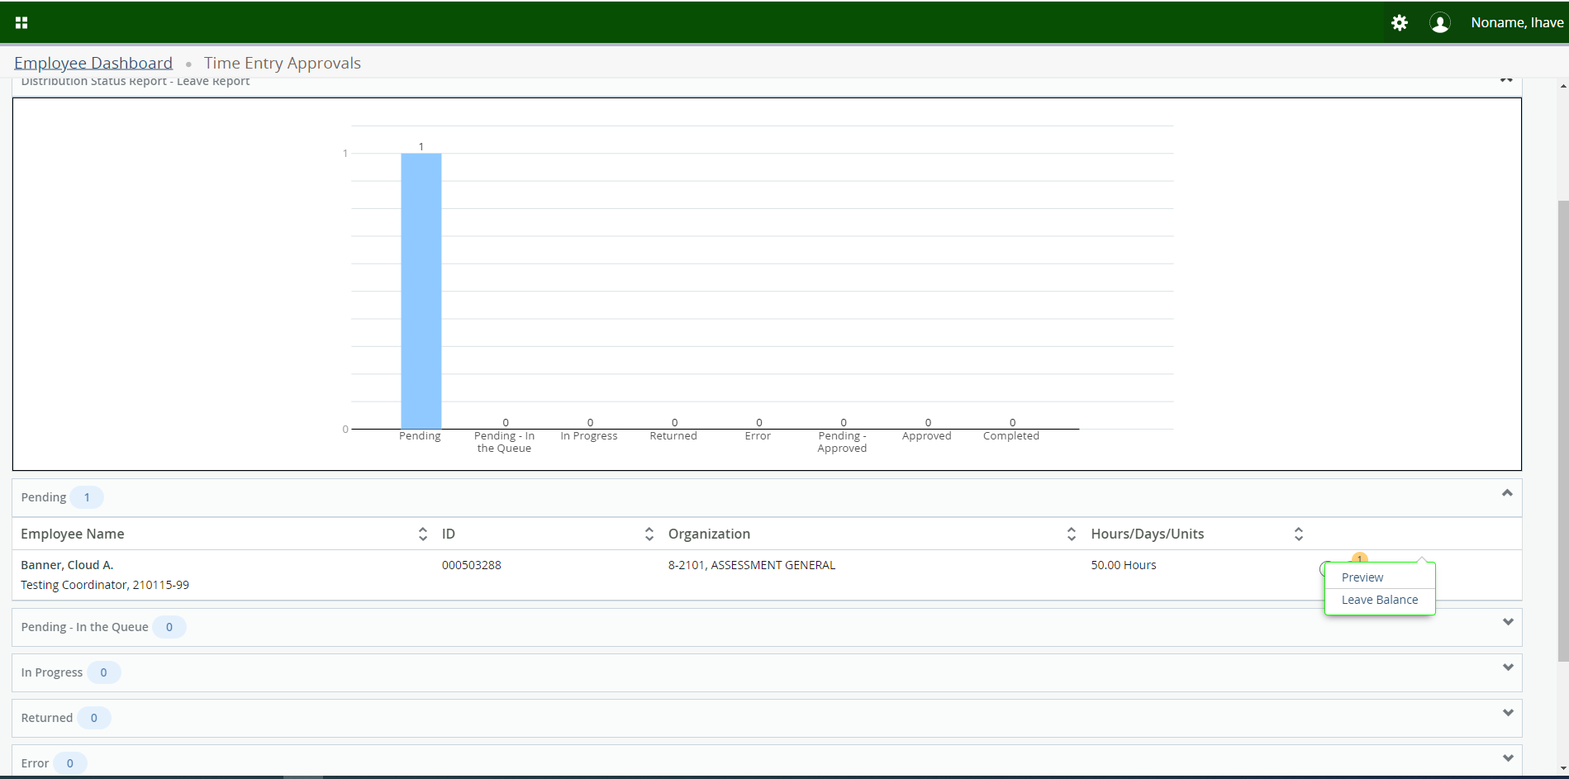
Click on Preview.

Slide 12
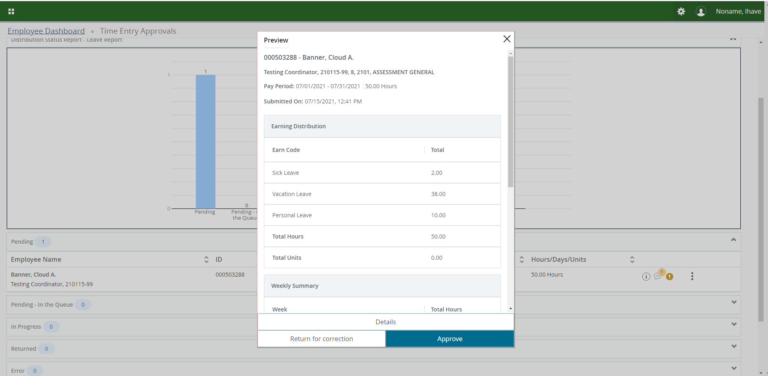
Click on Details to see a more detailed view of the Leave Report.

Slide 13
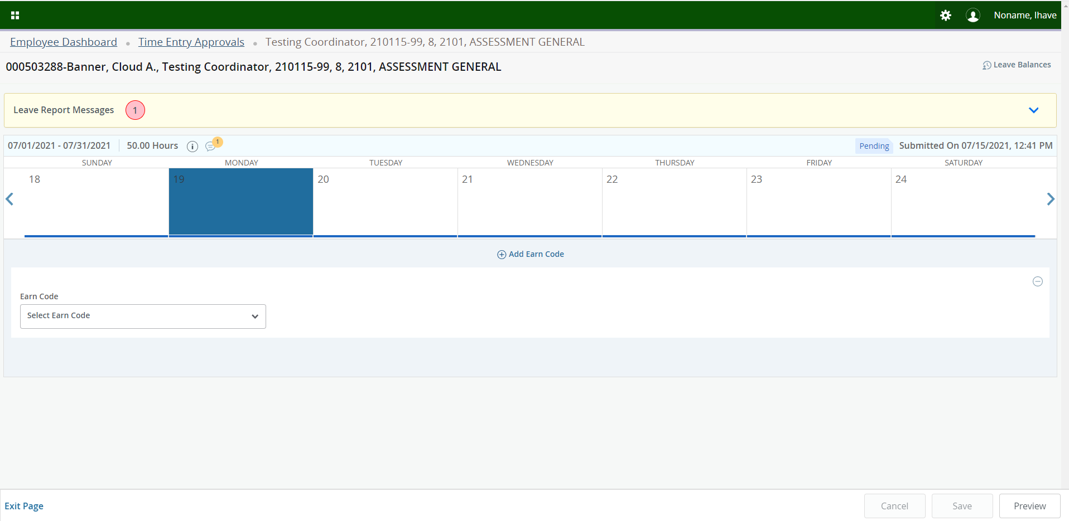
If you wish to see what earn code(s) an employee entered for a particular day, click that date on the calendar and the information will be displayed.

Slide 14
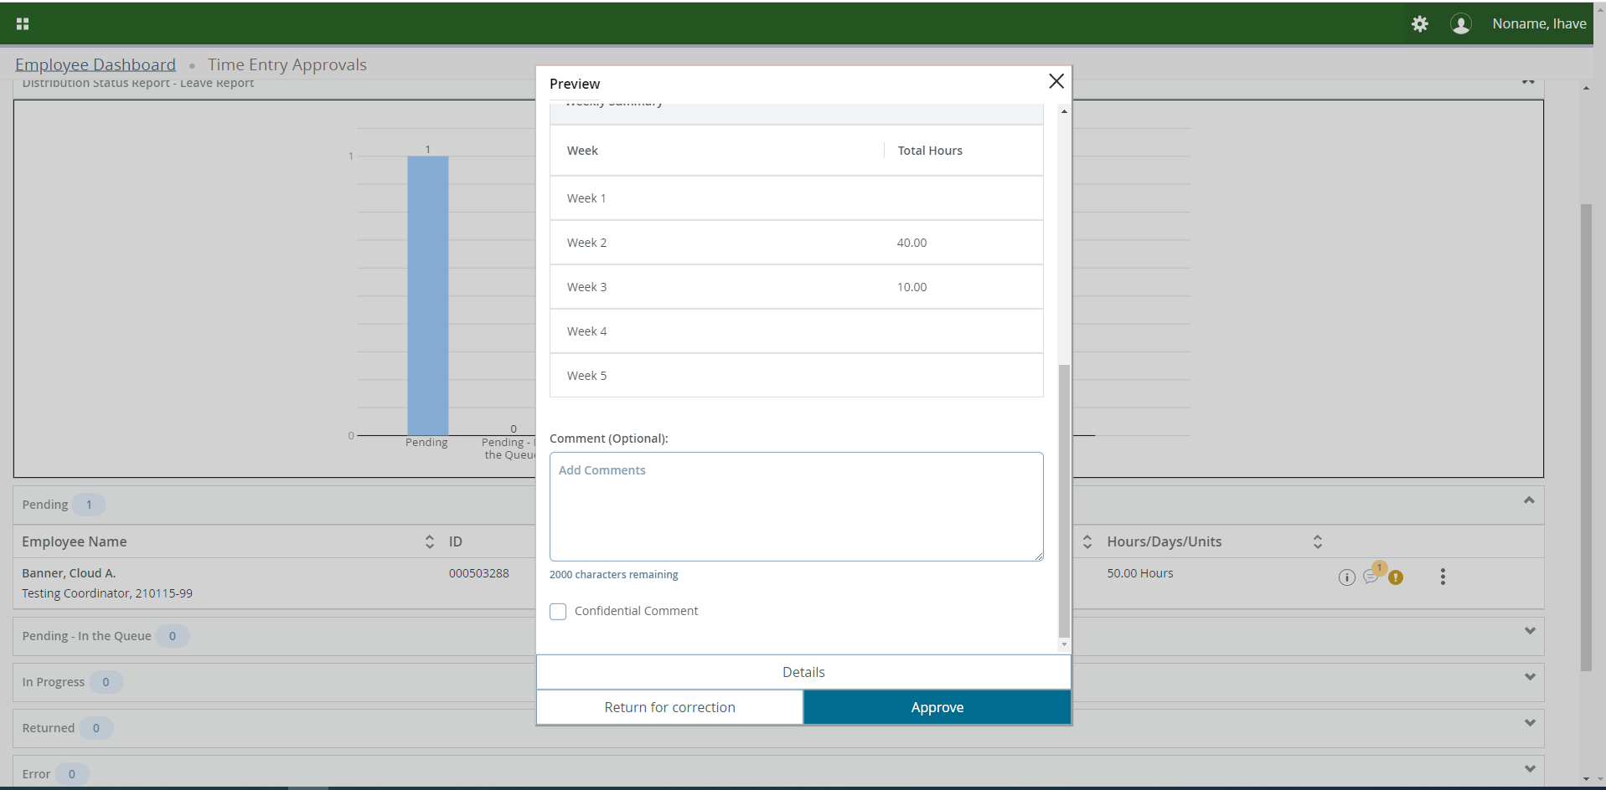
Scroll to the bottom of the box to add a comment and if you wish to mark it confidential, check the box next to Confidential Comment.

Slide 15
Click on Approve once you have certified that everything is correct.

Slide 16
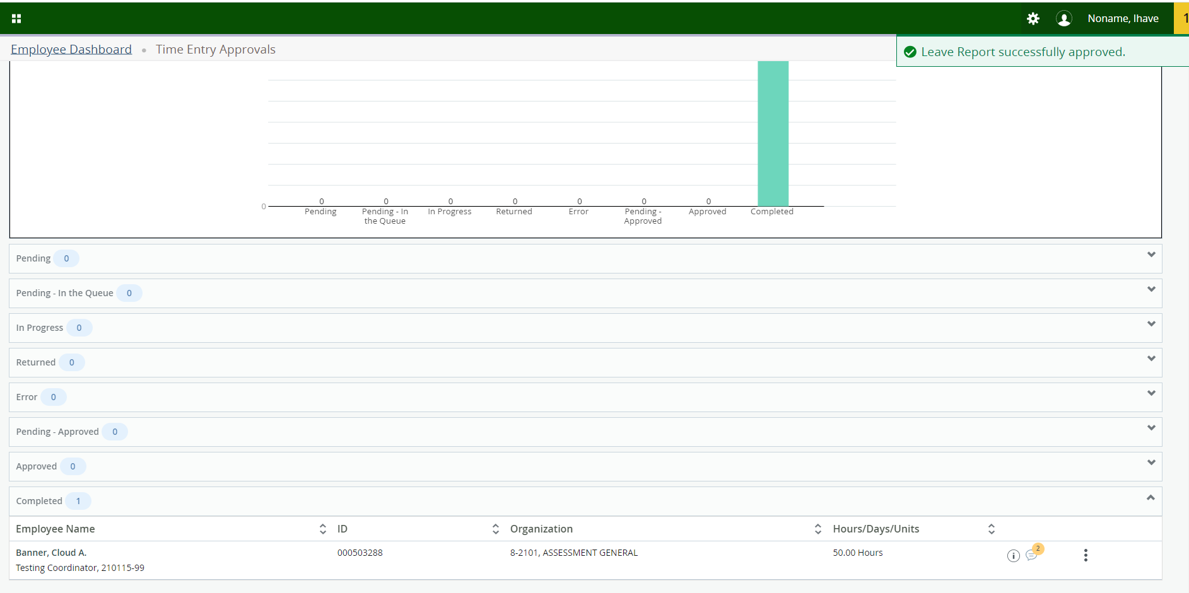
The Employee’s Leave Report will move to Completed status.

Slide 17
RETURNING
LEAVE REPORT
TO EMPLOYEE

Slide 18
Click on Approve Leave Report on the Employee Dashboard.

Slide 19
Click on the Action Menu to the right of the employee’s name.

Slide 20
Click on Preview.

Slide 21
Scroll to the bottom of the box to add a comment then click on Return for Correction. This will return the Leave Report to the employee.

Slide 22
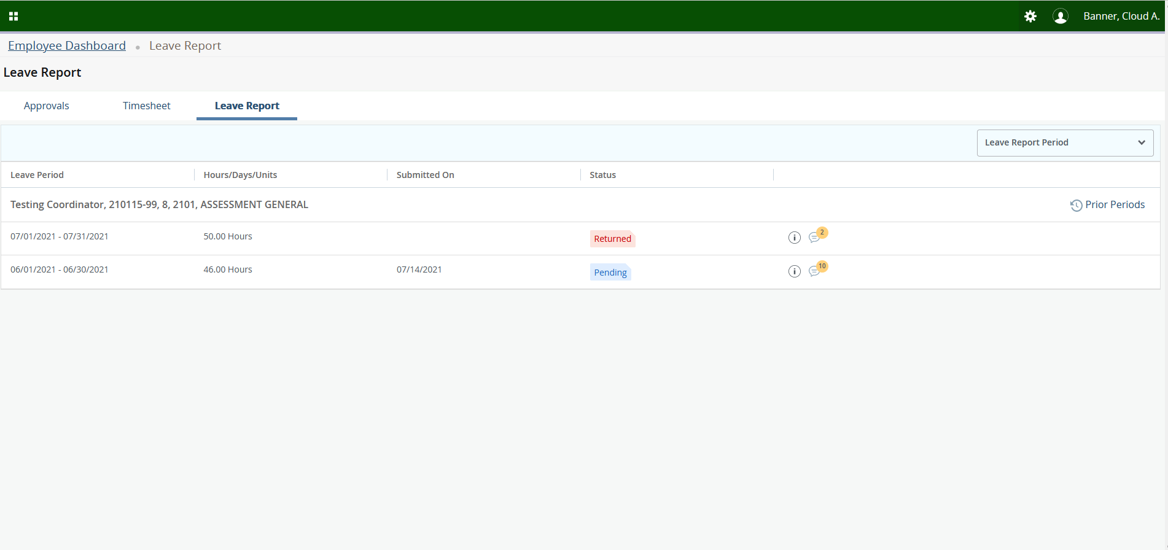
Below is a screen shot of what the employee will see when clicking on Enter Leave Report. The employee’s Leave Report status has changed from Pending to Returned. Tip – the Employee will not get an automatic notification when a Leave Report is Returned so they WILL need to be notified by their supervisor.

Slide 23
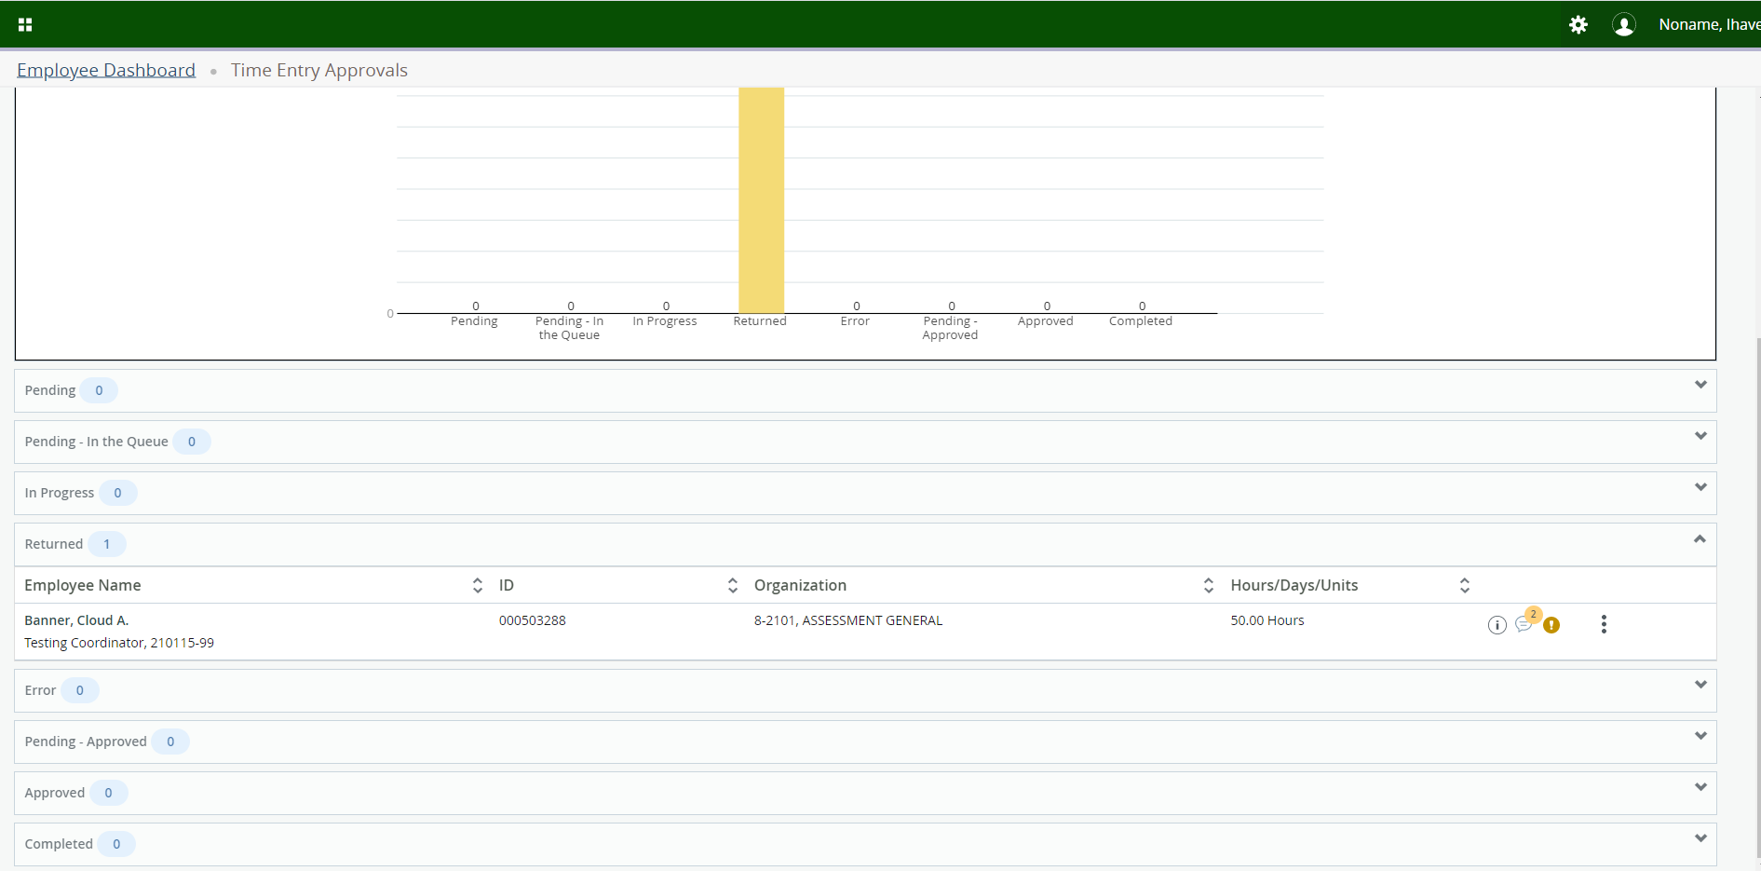
Once the Leave Report is sent back to the employee, the Leave Report will move from the Pending section to the Returned section. Once they submit their Leave Report again for approval, it will move back to the Pending section.

Slide 24
VIEWING
EMPLOYEE
LEAVE BALANCES

Slide 25
Click on Approve Leave Report on the Employee Dashboard.

Slide 26
Click on the Action Menu to the right of the employee’s name.

Slide 27
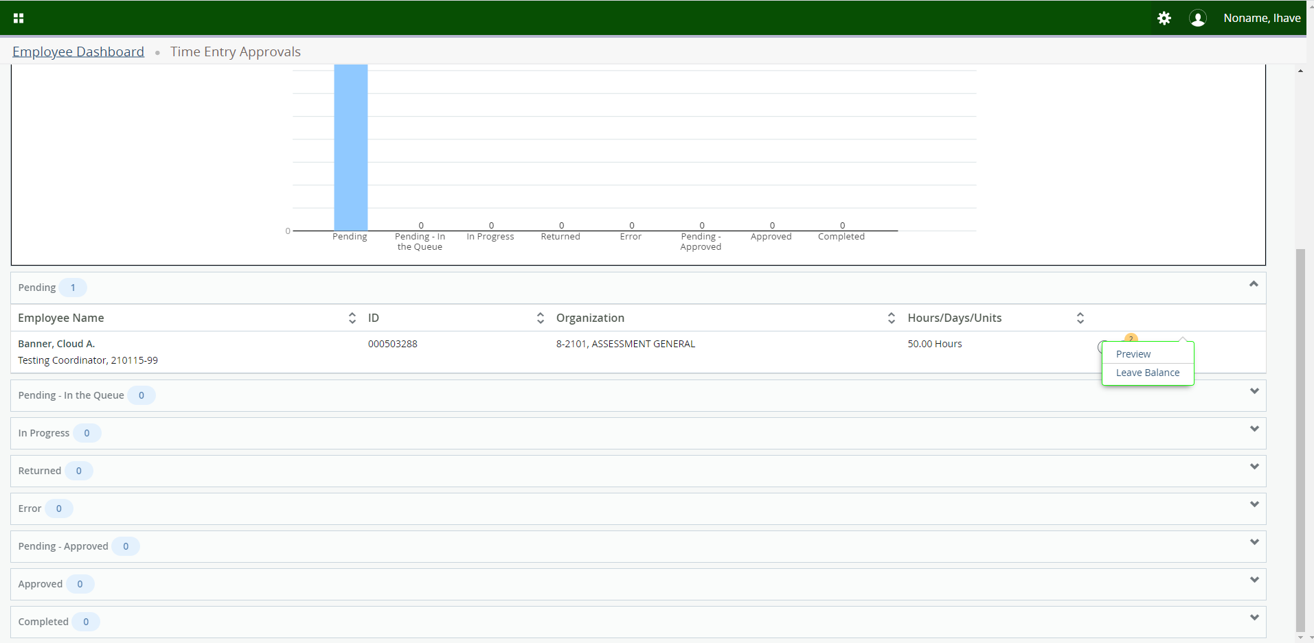
Click on Leave Balance.

Slide 28
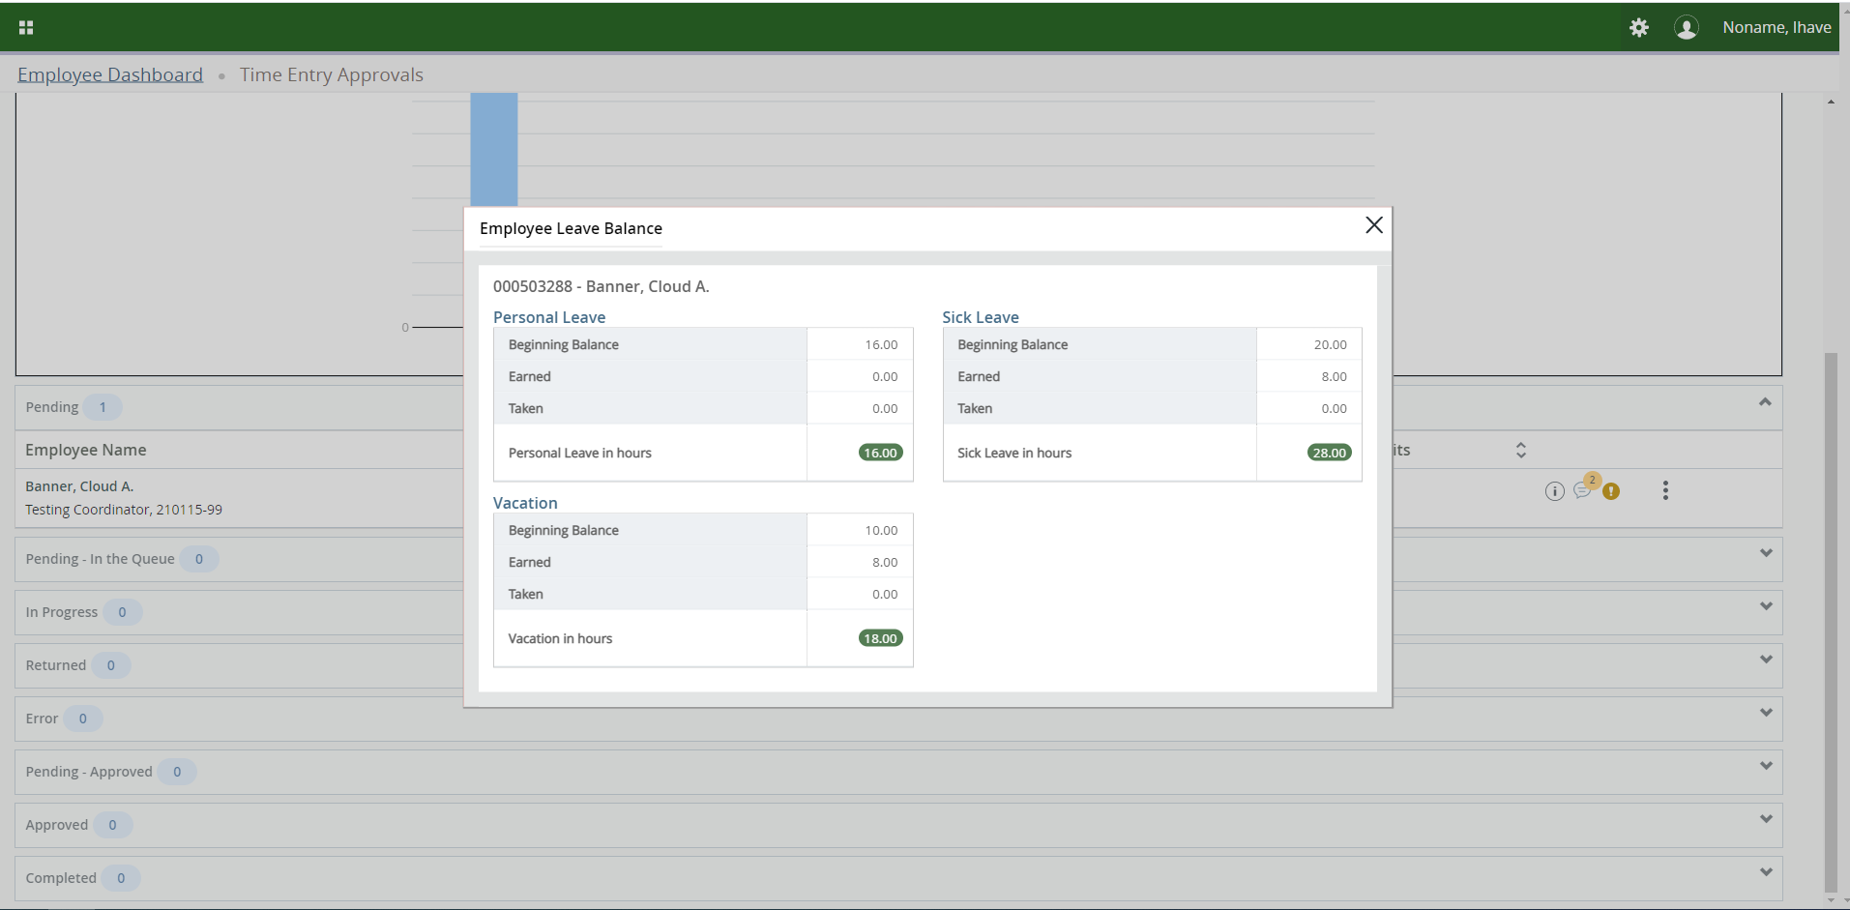
A box will appear with the employee’s current leave balances.

Slide 29
ERROR ON
LEAVE REPORT

Slide 30
Click on Approve Leave Report on the Employee Dashboard.

Slide 31
If there are any errors on the Leave Report, an exclamation mark will appear to the right of the employee’s name. To view the error(s), click on the exclamation mark.

Slide 32
VIEWING
LEAVE REPORT
APPROVER(S)

Slide 33
Click on Approve Leave Report on the Employee Dashboard.

Slide 34
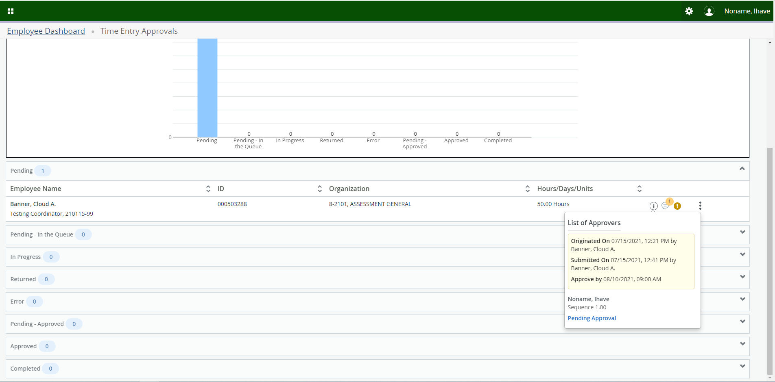
Click on the information icon to the right of the employee’s name to see the List of Approvers.

Slide 35
VIEWING COMMENTS

Slide 36
Click on Approve Leave Report on the Employee Dashboard.

Slide 37
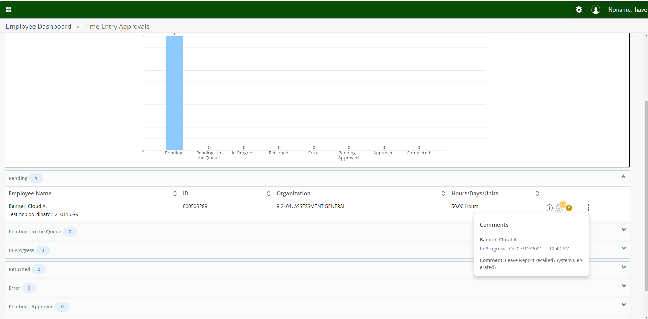
Click on the Conversation Cloud to see any comments that were made.

Slide 38
REPORTS

Slide 39
Click on Approve Leave Report on the Employee Dashboard.

Slide 40
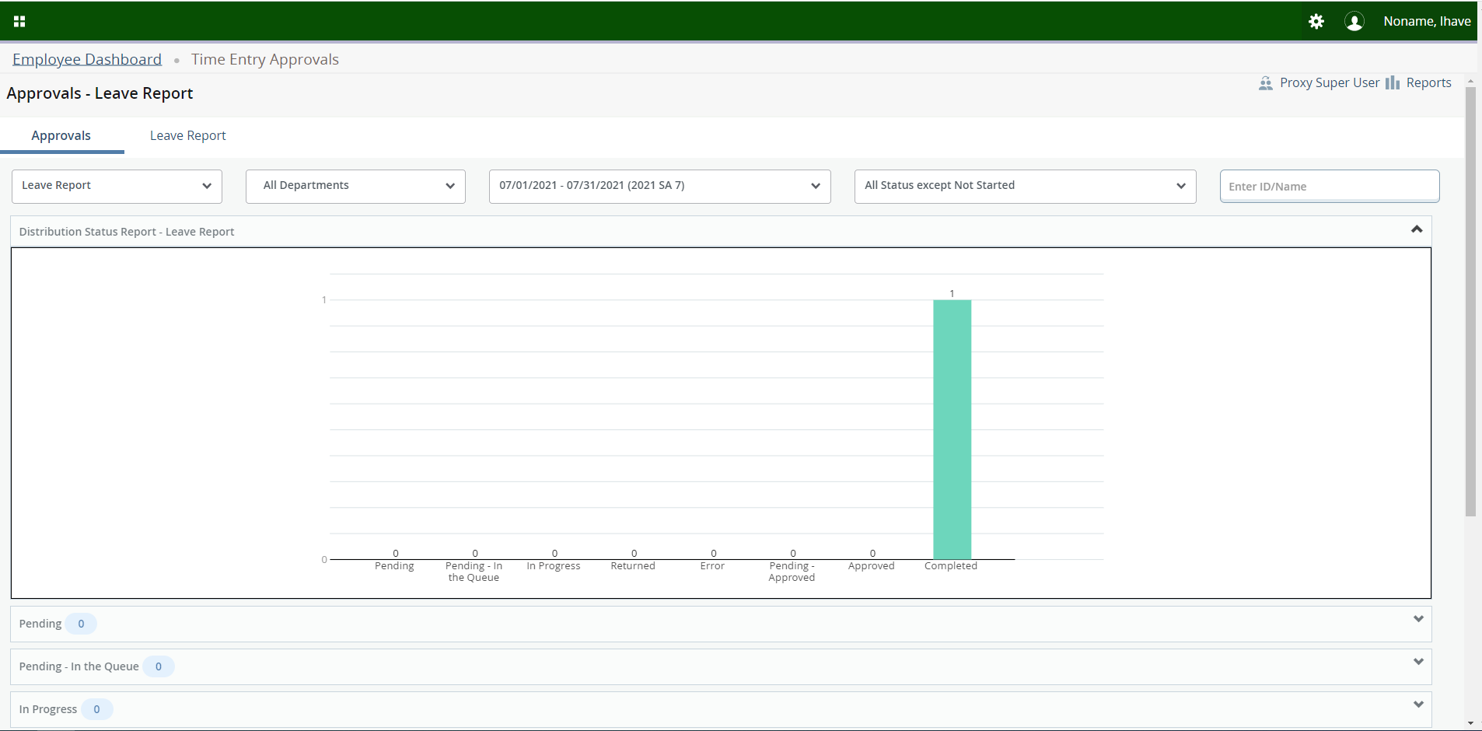
Click on Reports in the far right-hand corner.

Slide 41
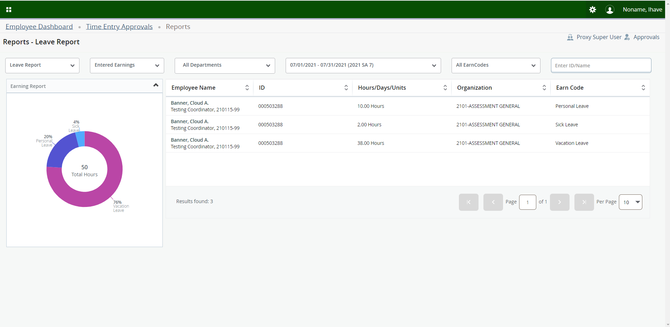
You can filter using the Caret Buttons or by manually entering information into the “Enter ID/Name Field” to select the information you want to view.

Slide 42
THANK
YOU!

