Slide 1
Federal Financial Aid Administrative Burden Translated:
The Impact on Financial Offices
An Awareness for College Presidents and What They Can Do to Help

Slide 2
Policy, Procedure, & Service
Federal Aid Understanding and Interpretation – Support and Encourage Training
Implementation of Federal Aid Requirements – Encourage Institutional Support
Service to Students– Provide Adequate Human Resources

Slide 3
Federal Student Aid – Administrative Burden Study
Increases in enrollment, financial aid awards, and federal regulations are straining financial aid offices who according to Program Participation Agreements with the Department of Education must be administratively capable.
The more time that financial aid administrators spend on trying to comply with federal regulations, the less time is left for counseling and working with federal aid applicants and their families.
In a recent study done by Inceptia entitled Stress in the Financial Aid Office, two of the main stressors for financial aid administrators are 1) workload; and, 2) student service issues. This seems to support the idea that regulatory burden is cutting into time that should be spent counseling students on the complexity of federal aid.
A recent study done by NASFAA entitled Getting it Right: Analyzing Accuracy of Federal Burden Estimates for Title IV Financial Aid Compliance, suggests that federal time estimates for compliance are lower than actual time spent on compliance. The focus of the study was on Gainful Employment and the most recent 150% Limit on Federal Direct Subsidized Student Loans.
Reference:
http://docs.bartonccc.edu/finaid/Resources/Presentations/Reducing%20Stress%20in%20the%20Financial%20Aid%20Office.pdf

Slide 4
Top 10 Audit Findings
(From 2013 FSA Conference Session presented by Effie Barnett & Barbara Wingel)
1. Repeat Finding – Failure to Take Corrective Action
2. Return of Title IV (R2T4) Funds Made Late
3. R2T4 Calculation Errors
4. Student Status – Inaccurate/Untimely Reporting
5. Verification Violations
6. Qualified Auditor’s Opinion Cited in Audit
7. Pell Overpayment/Underpayment
8. Entrance/Exit Counseling Deficiencies
9. Student Credit Balance Deficiencies
10. Information in Student Files Missing/Inconsistent

Slide 5
Top Program Review Findings
1. Verification Violations
2. Student Credit Balance Deficiencies
3. R2T4 Calculation Errors
4. Crime Awareness Requirements Not Met
5. Satisfactory Academic Progress Policy Not Adequately Developed/Monitored
6. Lack of Administrative Capability
6. Information in Student Files
Missing/Inconsistent
7. Inaccurate Recordkeeping
7. Pell Grant Overpayments/Underpayments
8. Account Records Inadequate/Not Reconciled
9. R2T4 Funds Made Late
10. Entrance/Exit Counseling Deficiencies

Slide 6
Top 10 NASFAA Standards of Excellence (SOE) Peer Review Observations
1. Student Consumer Information Incomplete
2. Monthly and/or Year-End Reconciliation Incomplete
3. R2T4 Done Incorrectly
4. Verification Errors
5. Inadequate Technical Support for FA Office
6. Inadequate Communication Between Departments
7. Manual Processes need to be Automated
8. Lack of Written Policies and Procedures
9. Lack of Training Opportunities for Financial Aid Staff
10. Less Than Optimal FA Staff Organization

Slide 7
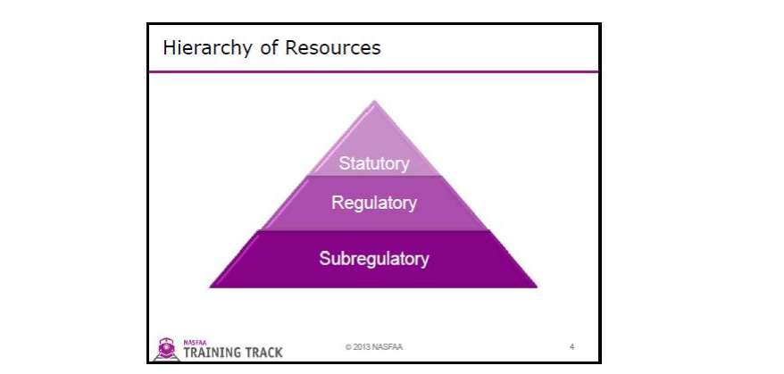
Federal Aid Understanding and Interpretation:
Interpretation Resources and Their Hierarchy
http://docs.bartonccc.edu/finaid/Resources/Presentations/HowToFindAnswersForYourRegulatoryIssues.pdf

Slide 8
Understanding the spirit of the regulation/law:
Available Resources
Federal Student Aid Conference
National, Regional, State Conferences
Other Decentralized and/or Targeted Training
Webinars
IFAP and other ED/Government Websites
Pushed announcements– Listserv, DC Letters, E-announcements
Regional and national ED employees

Slide 9
Federal Aid Requirements– Implementation Steps
Train for Understanding of new regulation
Application to the institution
Writing the policy/procedures
Setting up technical aspects – software/reports
Training staff/Educating other departments
Informing/ Counseling Students

Slide 10
Example: Recent 150% Limit Federal Direct Subsidized Student Loans
Step 1: Understanding the new rules.
Step 2: Applying to our unique institution.
Step 3: Update institutional P&P, SCI
Step 4: Explain to Registrar, Advising, Instruction, etc.
Step 5: Implement software upgrades, write new reports
Step 6: Train FA staff on new procedure
Step 7: Counsel students/families

Slide 11
Service to Students – Getting the right people on the bus and all facing the same direction!
Compliance efforts versus counseling students – compete for time
Correct number of financial aid staff
Right staff configuration
Manual versus automated processes
Federal, State, Institutional, External Aid
Depth and Breadth of Compliance
Level of Service Provided to Students
Assistance from Other Departments
Variation of Instructional Offerings
Staff FA Experience

Slide 12
Three Takeaways to Support Financial Aid at Your College
Encourage Training Efforts
Ensure Support of Financial Aid Operations
Support Appropriate FA Human Resources

Slide 13
Presenter: Myrna Perkins
Associate Dean of Student Services/Director of Financial Aid
Barton Community College perkinsm@bartonccc.edu

