Slide 1
Kansas Council of Instructional Administrators – Leadership Scholarship Outcomes
Presented by: Whitney Asher – Barton Community College

Slide 2
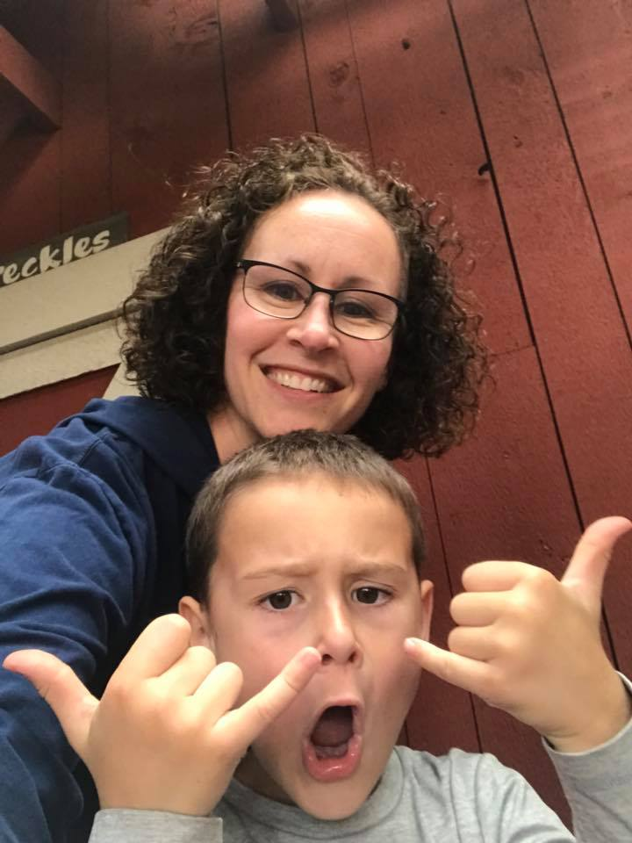
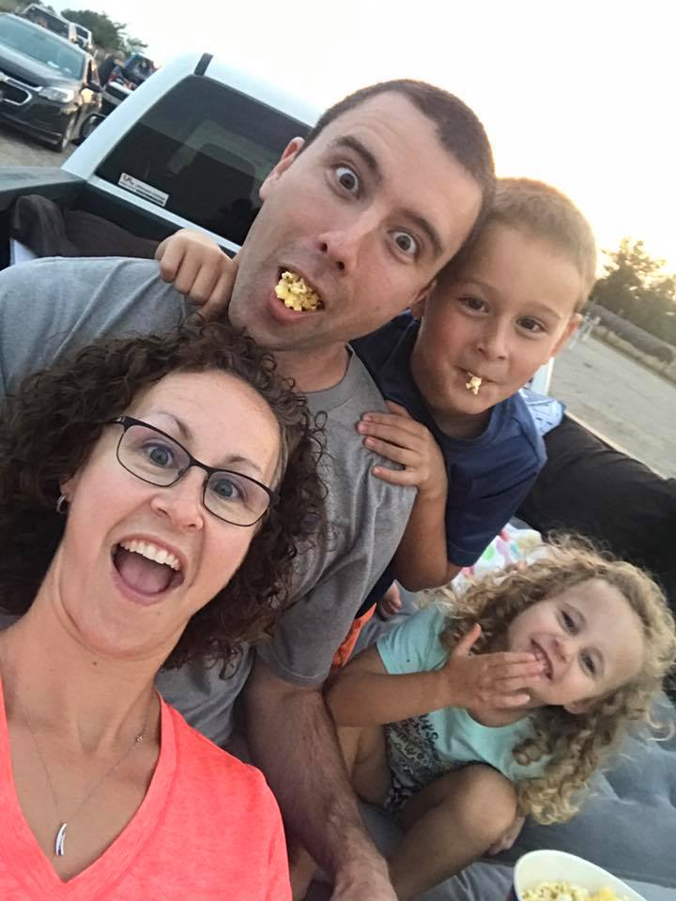
Introduction
Assistant Director of Financial Aid – Barton Community College (10 years)
Let’s Have FUN!!
Family First

Slide 3
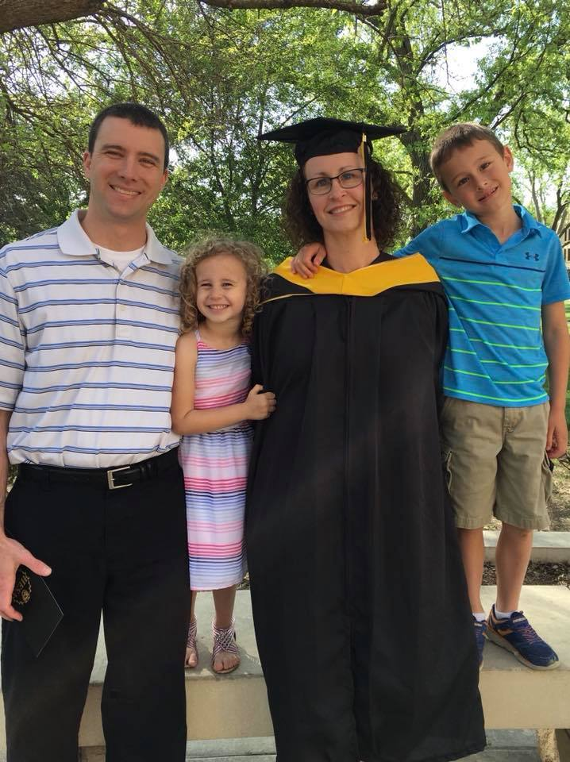
Purpose of Application
Fort Hays State University – Master’s of Science Education – Higher Education Student Affairs
Began working on this during the spring of 2016
Graduated May 11th 2018!!
KACCT’s – Kansas Community College Leadership Institute
Nominated to be the Barton representative in the 3rd class of KCCLI
Graduated May 3rd 2018

Slide 4
Objectives
Preparation for the Future
Awareness
Confidence

Slide 5
About the programs
FHSU - Higher Education and Student Affairs
Kansas Community College Leadership Institute
36 Hour Master of Science in Education
Developed around the NASPA student affairs competencies
Practical in nature
Included two practicums and a final culminating learning demonstration (portfolio and presentation)
Focused on developing leaders from within the Kansas community colleges.
Met monthly at campuses across the state
Listed to speakers on a variety of topics including personal strengths, president and board relations, finance, strategic planning, personal brand, Kansas legislators, etc.
Development of 1 major project for our campus and Kansas community colleges.
Had the opportunity to network and learn from today’s leaders

Slide 6
Outcomes
Preparation | Awareness | Confidence
NASPA Competencies Challenging my though process and how I make decisions | Complexity of Higher Education Impact that I can have on students/campus How to reframe situations | In my decision making process Interactions with peers/faculty Simply accomplishing my goals

Slide 7
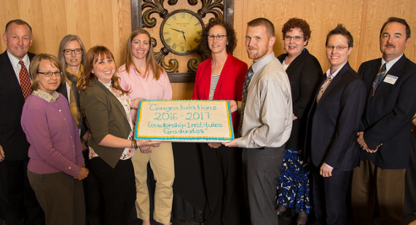
Impact
Experience of Online Learning
Understanding of Operations/Big Picture
Development of Personal Leadership Philosophy
Development of Student Affairs Philosophy Statement
Network of Professionals
Demonstrated Commitment
Self-Reflection, Self-Reflection, Self-Reflection

Slide 8
Thank you!!!

Slide 9
Questions

