Slide 1
Barton Financial Aid Office Business Continuity Plan
Presented by: Whitney Asher
KCCLI 2017-18

Slide 2
Purpose
The implementation of a business continuity plan will prepare Barton’s financial aid office, as well as the institution for any:
Unexpected changes or absences with human resources
Technology Failures
Natural Disasters

Slide 3
Objectives
Human Resources
  This section describes how Barton’s Financial Aid Office ensures continuation of all vital operations and student services with existing staff in the event a staff member has to be out of the office for an extended period of time.
Technology
  This section describes alternative methods of processing and communication in the event Barton’s Financial Aid software and systems are not available.
Natural Disasters
  This section describes how Barton’s Financial Aid Office would continue business operations in the event of a natural disaster.

Slide 4
Strategies
Research existing plans and Identify necessary components
Determine what existing framework exists that can be built upon
Determine how the plan will be stored, accessed and used.

Slide 5
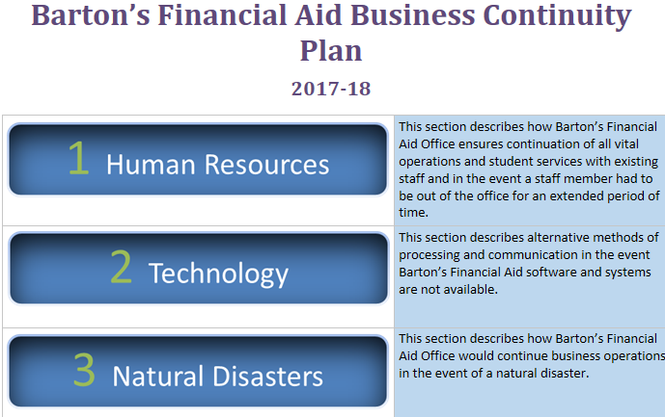
Outcomes

Slide 6
Human Resources Components
Organizational Chart
  Including clear designation of chain of command in the absence of the Director
Position-Specific Responsibilities and Procedures
  Job function, priority, frequency of completion, link to procedure, backup personnel
Critical Office Functions
  Taken from priority level components across all positions
List of External Vendors
  Including contact information and contract lengths/renewal information
List of Professional Contacts and Resources
  FSA Regional Contacts; SAIG, NSLDS, COD.

Slide 7
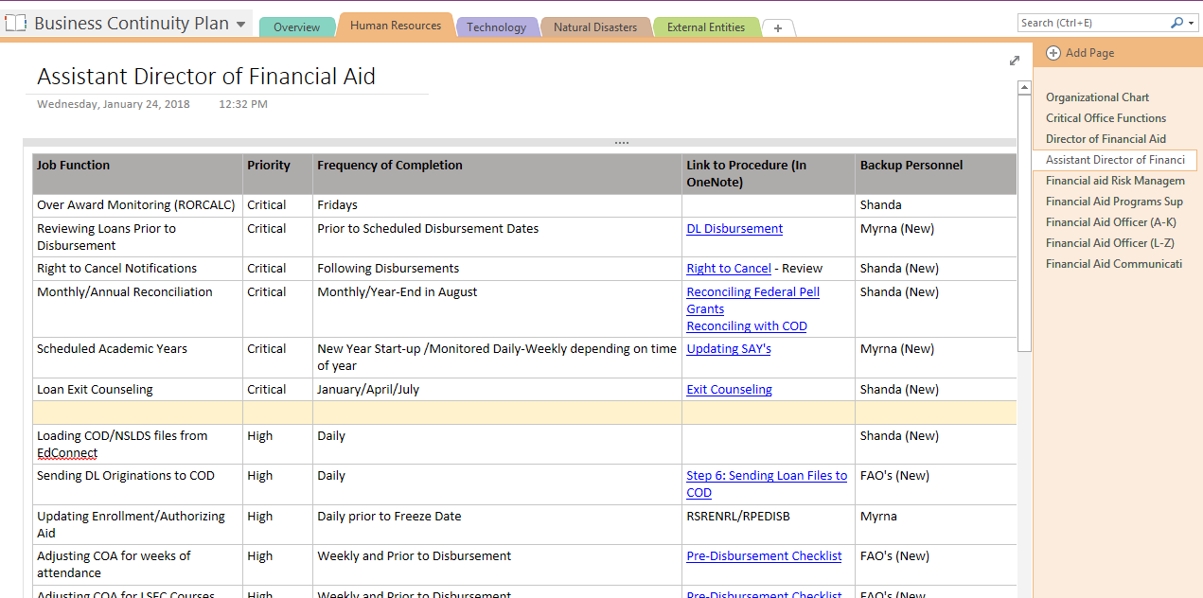

Slide 8
Technology Components
IT Disaster Plan
  Be familiar with IT plans, network backup, availability of systems and order of restoration.
Technology Chart
  Office processes, technology needed for those processes, identify backup technology, detailed instructions for deploying the backup system.
Outsourcing options
  Identify in advance viable options for outsourcing office processes if software will be unavailable for a lengthy period of time.

Slide 9
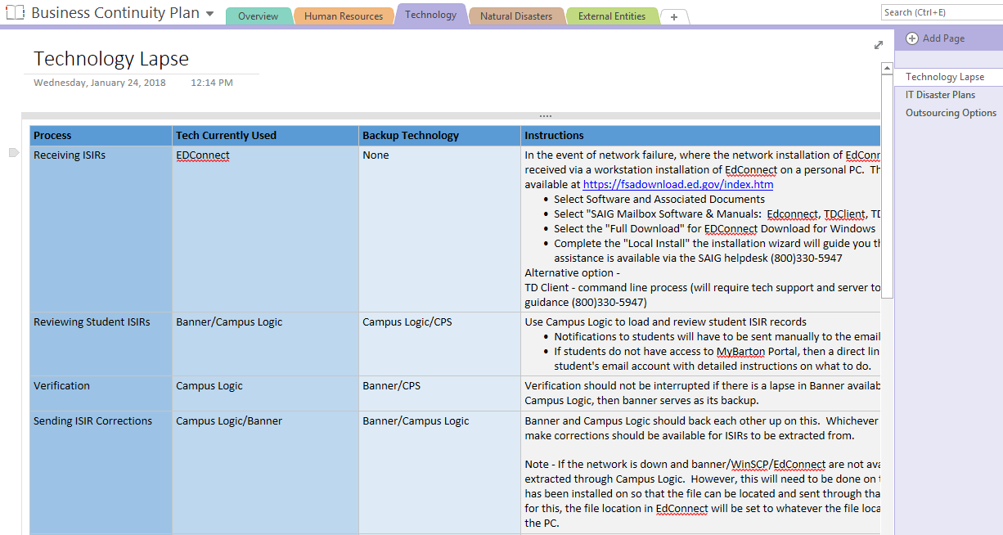

Slide 10
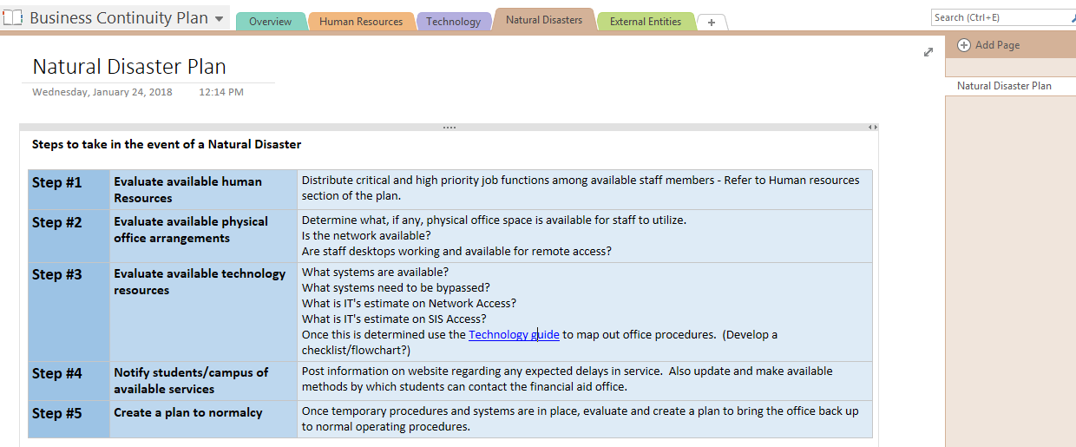
Natural Disaster Components
Outline necessary steps to resume normal operations
  Human resources, physical office arrangements, available technology, communication with students, plan to normalcy

Slide 11
Sharing and Storing the Plan
Completed plan will be shared with campus administration so that they are aware of the plan and where/how it is stored.
Copies will be updated and archived annually on institutional network
Current copy of the plan, in addition to a current copy of our procedure guide will be stored in a shared Drop Box account so that it will be accessible in the event of a network outage or other disaster.

Slide 12
Impact
Clear organization of the financial aid office
Demonstrates stability to administration
Peace of Mind
Awareness and motivation for financial aid staff members and other departments on campus
Provides a template that can be copied and used by other departments and institutions

Slide 13
Recommendations for Others
Don’t work on this alone. Involve all office staff, at minimum in the outlining of job responsibilities.
Spend time talking to IT and other support services for the technology that you use.
Establish a method to keep the plan updated.
Try and help other departments on your campus see the value in building this type of plan. Our plan will be much more successful if other departments have backup procedures in place as well.

Slide 14
QUESTIONS??

