Slide 1
Federal Financial Aid:
Regulatory Burden and
Future Direction – The Impact on Ability for Institutional Responsiveness to State Goals (Foresight 20/20)
Presented by:
Ben Kohl, Assistant Director for the Office of Student Financial Assistance at Kansas State University and President for the Kansas Association of
Student Financial Aid Administrators
Myrna Perkins, Associate Dean of Student Services and Director of Financial Aid at Barton Community College

Slide 2
Today’s Topics
Federal Aid Administrative Burden
Federal Aid Understanding and Interpretation
Federal Financial Aid Focus Points
Financial Aid Trends and Projections

Slide 3
Federal Aid
Administrative Burden
Strain on financial aid offices
Compliance efforts over counseling students
Workload and stress
Federal time estimates compared to actual
Notes:
Increases in enrollment, financial aid awards, and federal regulations are straining financial aid
offices who according to Program Participation Agreements with the Department of Education
must be administratively capable.
The more time that financial aid administrators spend on trying to comply with federal regulations,
the less time is left for counseling and working with federal aid applicants and their families.
In a recent study done by Inceptia entitled Stress in the Financial Aid Office, two of the main
stressors for financial aid administrators are 1) workload; and, 2) student service issues. This seems
to support the idea that regulatory burden is cutting into time that should be spent counseling
students on the complexity of federal aid.
A recent study done by NASFAA entitled Getting it Right: Analyzing Accuracy of Federal Burden
Estimates for Title IV Financial Aid Compliance, suggests that federal time estimates for compliance
are lower than actual time spent on compliance. The focus of the study was on Gainful
Employment and the most recent 150% Limit on Federal Direct Subsidized Student Loans.
Reference:
http://docs.bartonccc.edu/finaid/Resources/Presentations/Reducing%20Stress%20in%20the%20Financi
al%20Aid%20Office.pdf

Slide 4
Federal Aid Understanding,
Interpretation, and Implementation
Interpretation resources and their hierarchy
Training – understanding the spirit of the
regulation/law
Application to the institution
Setting up technical aspects

Slide 5
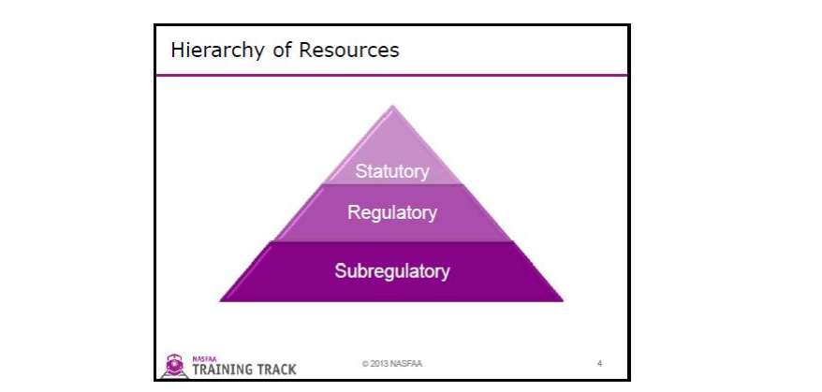
Hierarchy of Regulatory and
LegislativeResources
Reference: http://docs.bartonccc.edu/finaid/Resources/Presentations/HowToFindAnswersForYourRegulatoryIssues.pdf

Slide 6
Federal Financial Aid Focus Points
President Obama’s Higher Education Initiatives:
Paying for performance
Promoting innovation and competition
Ensuring that student debt remains affordable

Slide 7
Federal Aid Trends and Projections
What the focus of U.S. Department of Education:
The complexity of federal financial aid
The rising costs of higher education
Rising student loan debt
The lack of college outcome information

Slide 8
Federal Aid Trends & Projections
HEA Reauthorization
College Ratings System
FAST Proposals*
America’s Promise Announcement
*http://www.nasfaa.org/Main/orig/2013/rtf/Bipartisan_FAST_Act_Officially_Introduced.aspx

Slide 9
References
5 Things Colleges Can Expect -- http://chronicle.com/article/5-Things-Colleges-Can-Expect/151009/
College Ratings System Press Release -- https://www.insidehighered.com/sites/default/server_files/files/ratings%20framework%20draft.pdf
FAST Act -- http://www.nasfaa.org/Main/orig/2013/rtf/Bipartisan_FAST_Act_Officially_Introduced.aspx
Reauthorization Information -- http://www.nasfaa.org/Main/orig/2013/rtf/Senate_HELP_Committee_Introduces_Final_Higher_Education_Affordability_Act_Reauthorization_Bill.aspx
Community College Announcement -- http://www.whitehouse.gov/blog/2015/01/08/president-proposes-make-community-college-free-responsible-students-2-years
Community College Announcement -- https://www.insidehighered.com/news/2015/01/12/white-house-plan-could-change-relationship-between-government-and-higher-education

Slide 10
Presenter Contact Information
Ben Kohl – benkohl@ksu.edu
Myrna Perkins – perkinsm@bartonccc.edu

