Slide 1
Planning for the Unknown: How Creating a Business Continuity Plan Can Help You Sleep at Night
Presented By: Whitney Asher Assistant Director of Financial Aid Barton Community College asherw@bartonccc.edu

Slide 2
Purpose
The implementation of a business continuity plan will prepare your financial aid office, as well as the institution, for any:
Unexpected changes or absences with human resources
Technology Failures
Natural Disasters

Slide 3
Strategies
Research existing plans and Identify necessary components
Determine what existing framework exists that can be built upon
Determine how the plan will be stored, accessed and used.

Slide 4
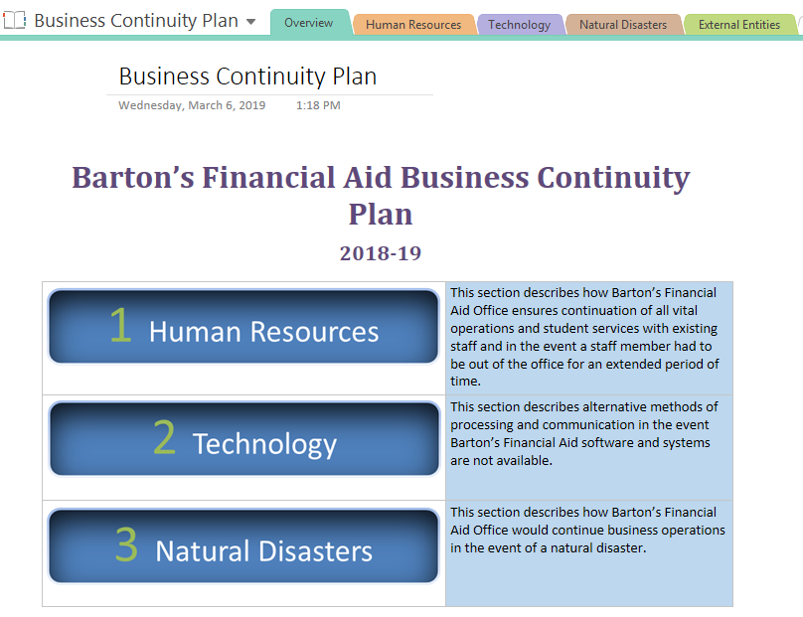
Building the Plan

Slide 5
Human Resources Components
Organizational Chart
Including clear designation of chain of command in the absence of the Director
Position-Specific Responsibilities and Procedures
Job function, priority, frequency of completion, link to procedure, backup personnel
Critical Office Functions
Taken from priority level components across all positions
List of External Vendors
Including contact information and contract lengths/renewal information
List of Professional Contacts and Resources
FSA Regional Contacts; SAIG, NSLDS, COD.

Slide 6
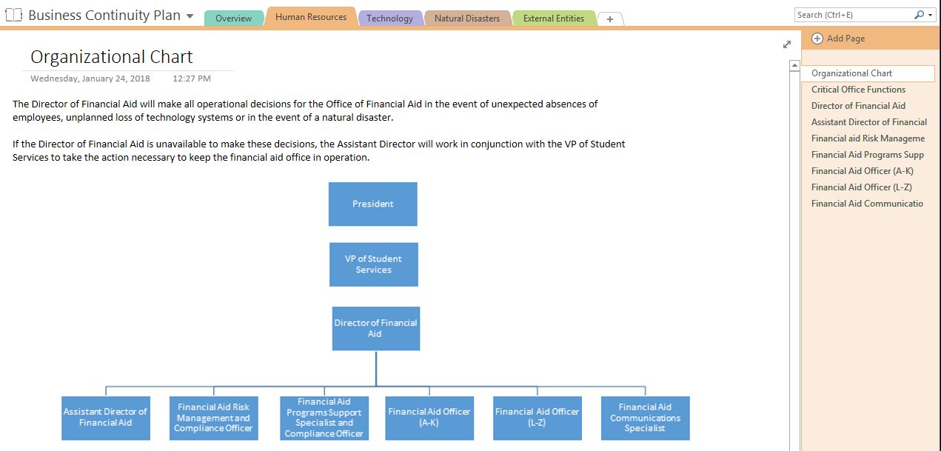
Human Resources Components
Organizational Chart
Including clear designation of chain of command in the absence of the Director

Slide 7
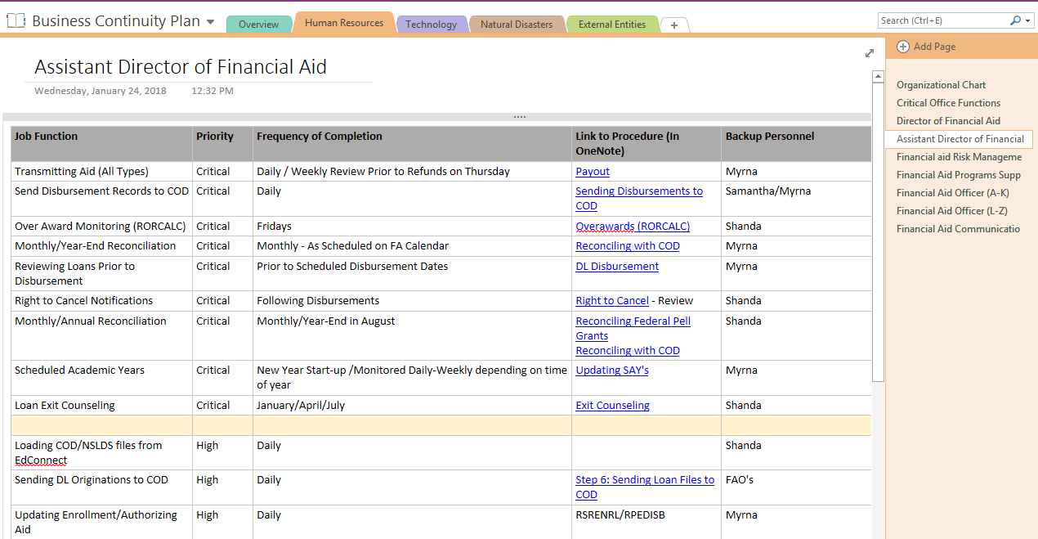
Human Resources Components
Position-Specific Responsibilities and Procedures
Job function, priority, frequency of completion, link to procedure, backup personnel

Slide 8
Human Resources Components
Critical Office Functions
Taken from priority level components across all positions
Priority Level | Description
Critical | Failure to complete in specified timeframe will cause our office to be out of compliance with federal regulations
High | Failure to complete in specified timeframe will create eligibility issues and delays for students.
Low | Failure to complete in specified timeframe may cause delays but will not affect student eligibility or create significant delays for students.

Slide 9
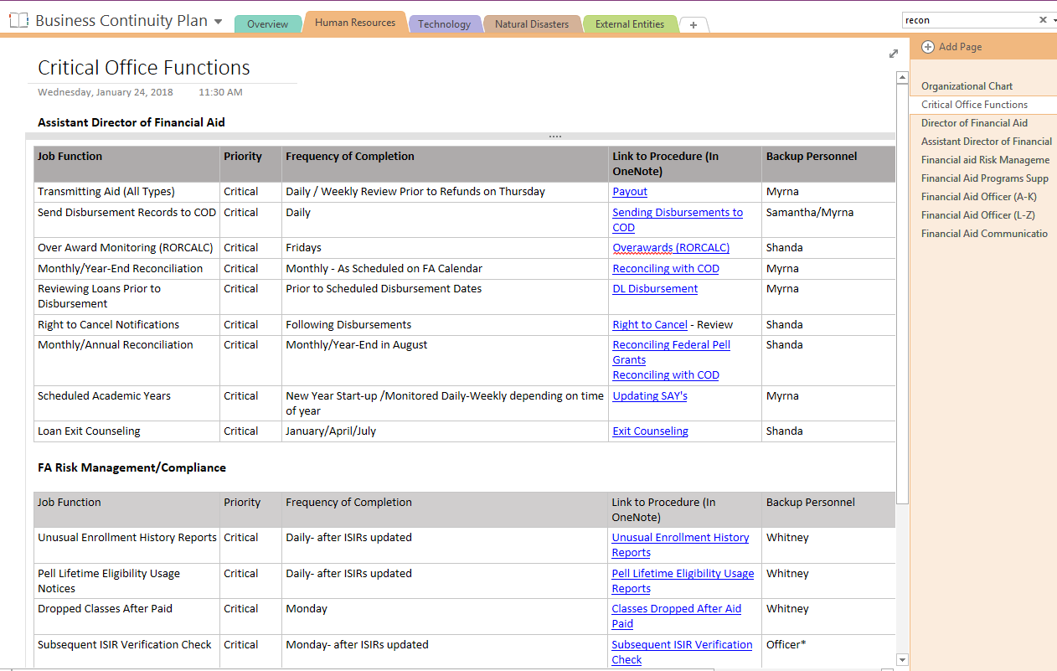

Slide 10
Human Resources Components
List of External Vendors
Including contact information and contract lengths/renewal information

Slide 11
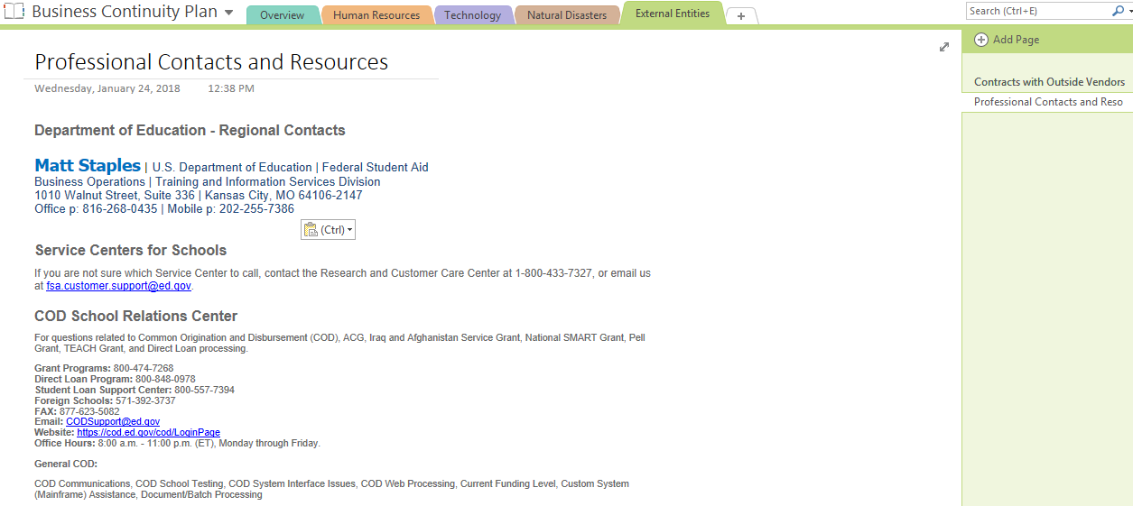
Human Resources Components
List of Professional Contacts and Resources
FSA Regional Contacts; SAIG, NSLDS, COD.

Slide 12
Technology Components
IT Disaster Plan
Be familiar with IT plans, network backup, availability of systems and order of restoration.
Technology Chart
Office processes, technology needed for those processes, identify backup technology, detailed instructions for deploying the backup system.
Outsourcing options
Identify in advance viable options for outsourcing office processes if software will be unavailable for a lengthy period of time.

Slide 13
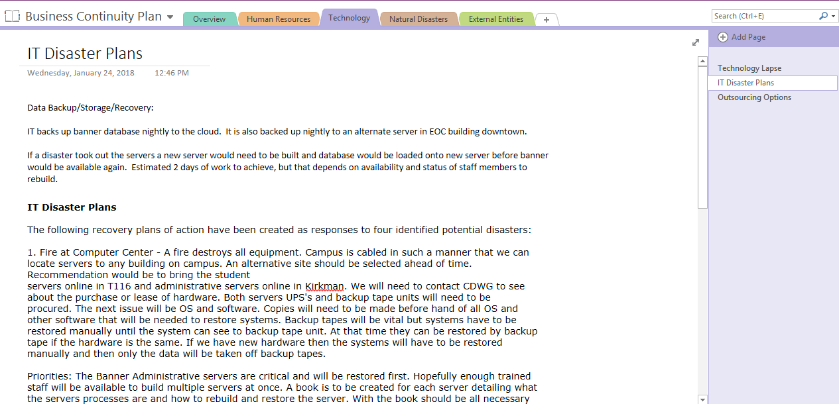
Technology Components
IT Disaster Plan
Be familiar with IT plans, network backup, availability of systems and order of restoration.

Slide 14
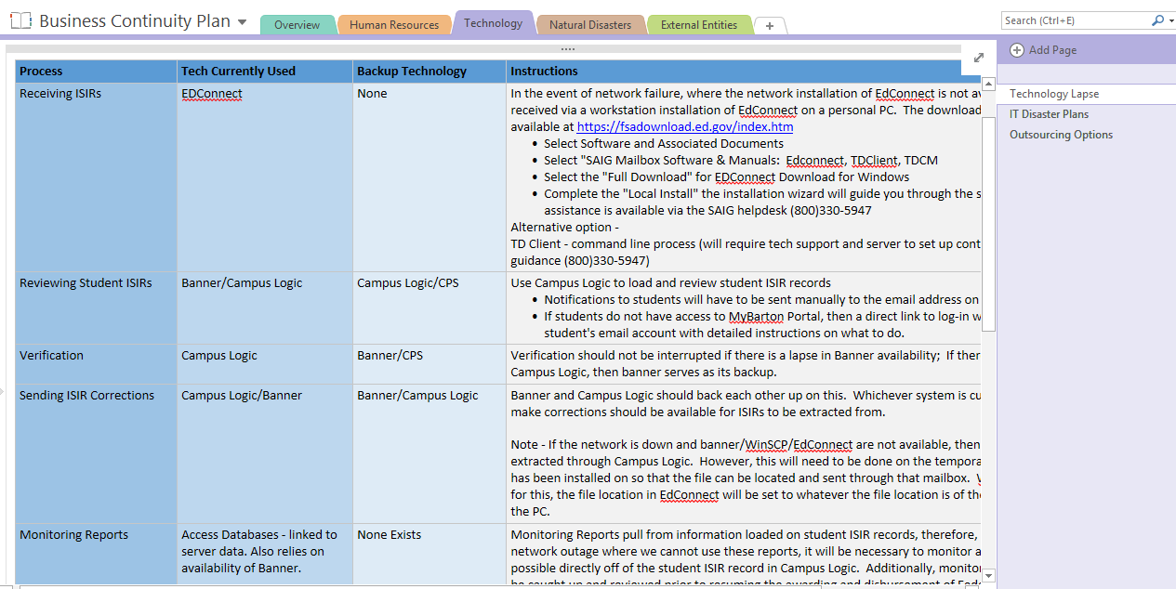
Technology Components
Technology Chart
Office processes, technology needed for those processes, identify backup technology, detailed instructions for deploying the backup system.

Slide 15
Technology Components
Outsourcing options
Identify in advance viable options for outsourcing office processes if software will be unavailable for a lengthy period of time.

Slide 16
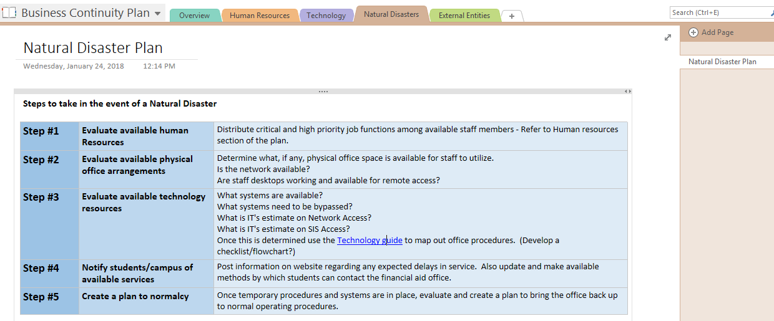
Natural Disaster Components
Outline necessary steps to resume normal operations
Human resources, physical office arrangements, available technology, communication with students, plan to normalcy

Slide 17
Sharing and Storing the Plan
The completed business continuity plan was shared with campus administration so that they are aware of the plan and where/how it is stored.
Copies will be updated and archived annually (or more frequently as needed) on institutional network
Current copy of the plan, in addition to a current copy of our procedure guide will be stored in a shared Drop Box account so that it will be accessible in the event of a network outage or other disaster.
Recent implementation of Office 365 has made sharing and access more manageable. However, we will continue to store the plan in multiple ways.

Slide 18
Maintaining the Plan
Review the plan and individual processes/procedures at time of annual reviews.
Archive copies along with policy and procedure manuals.
Visit it regularly when planning times out of office. (Use it!!!)

Slide 19
Impact
Clear organization of the financial aid office
Demonstrates stability to administration
Peace of Mind
Awareness and motivation for financial aid staff members and other departments on campus

Slide 20
Recommendations
Don’t work on this alone. Involve all office staff, at minimum in the outlining of job responsibilities.
Spend time talking to IT and other support services for the technology that you use.
Establish a method to keep the plan updated.
Try and help other departments on your campus see the value in building this type of plan. Our plan will be much more successful if other departments have backup procedures in place as well.

Slide 21
QUESTIONS??

