Slide 1
What You
Need to Know
About Financial Aid

Slide 2
Topics We Will Discuss
What is financial aid?
Cost of attendance (COA)
Expected family contribution (EFC)
Financial need
Categories, types, and sources of financial aid
Free Application for Federal Student Aid (FAFSA®)
Special circumstances

Slide 3

What is Financial Aid?
Financial aid consists of funds provided to students and families to help pay for postsecondary educational expenses

Slide 4




What is Cost of Attendance (COA)?
Tuition and fees
Room and board
Books and supplies
Transportation
Miscellaneous personal expenses

Slide 5
What is Expected Family Contribution (EFC)?
Measurement of student’s and family’s ability to pay postsecondary educational expenses
Student contribution
Parent contribution
(for dependent students)

Slide 6
What is Financial Need?
Cost of attendance (COA) – Expected family contribution (EFC) = Financial need

Slide 7
Categories of Financial Aid
Need-based aid
Non-need-based aid

Slide 8
Types of Financial Aid
Scholarships
Grants
Work-Study Employment
Loans
Self-Help Aid
Gift Aid

Slide 9
Scholarships
Scholarships
Grants
Work-Study Employment
Loans
Self-Help Aid
Gift Aid

Slide 10
Grants
Scholarships
Grants
Work-Study Employment
Loans
Self-Help Aid
Gift Aid

Slide 11
Work-Study Employment
Scholarships
Grants
Work-Study Employment
Loans
Self-Help Aid
Gift Aid

Slide 12
Loans
Scholarships
Grants
Work-Study Employment
Loans
Self-Help Aid
Gift Aid

Slide 13
Sources of Financial Aid
Federal Government
Employers
States
Private Sources
College and Universities

Slide 14
Federal Government
Largest source of financial aid
Aid awarded primarily on the basis of financial need
Must apply each year using the FAFSA
Eligibility requirements must be met

Slide 15
Federal Student Aid Programs
Federal Pell Grant
Federal Supplemental Educational Opportunity Grant (FSEOG)
Teacher Education Assistance for College and Higher Education (TEACH) Grant
Federal Work-Study (FWS)
Federal Direct Student Loans (Direct Loans)
Iraq Afghanistan Service Grant
Federal PLUS Loans

Slide 16
States
Residency requirements usually apply
Award aid on the basis of both merit and need
Use information from the FAFSA and/or state aid applications
Deadlines vary by state

Slide 17
Colleges and Universities
Award aid on the basis of both merit and need
Aid may be gift aid or self-help aid
Use information from the FAFSA and/or institutional applications
Deadlines and application requirements vary by institution

Slide 18
Private Sources
Foundations, businesses, churches, civic, and charitable organizations
Deadlines and applications procedures vary
Begin researching private sources early

Slide 19
Employers
May have scholarships available to the
children of employees
May have educational benefits for their employees

Slide 20
Free Application for Federal Student Aid (FAFSA®)
Collects demographic and financial information
Information used to calculate the expected family contribution (EFC)
Colleges use EFC to award financial aid
Available in English and Spanish

Slide 21
Free Application for Federal Student Aid (FAFSA®)
May be filed at any time during an academic year, but no earlier than October 1st prior to the academic year for which the student requests aid
For the 2020-21 academic year, the FAFSA may be filed beginning October 1, 2019
Colleges may set FAFSA priority dates

Slide 22





Free Application for Federal Student Aid (FAFSA®)
FAFSA on the Web (FOTW)
myStudentAid mobile app
Paper or PDF FAFSA
FAA Access to CPS Online
FAFSA on the Phone (FOTP)

Slide 23
Benefits of Using FOTW or myStudentAid
Built-in edits to prevent costly errors
Skip-logic allows student and/or parent to skip unnecessary questions
Option to use Internal Revenue Service (IRS) Data Retrieval Tool to import tax data

Slide 24
Benefits of Using FOTW or myStudentAid
More timely submission of original application and any necessary corrections
More detailed instructions and “help” for common questions
Ability to check application status online
Simplified application process in the future

Slide 25
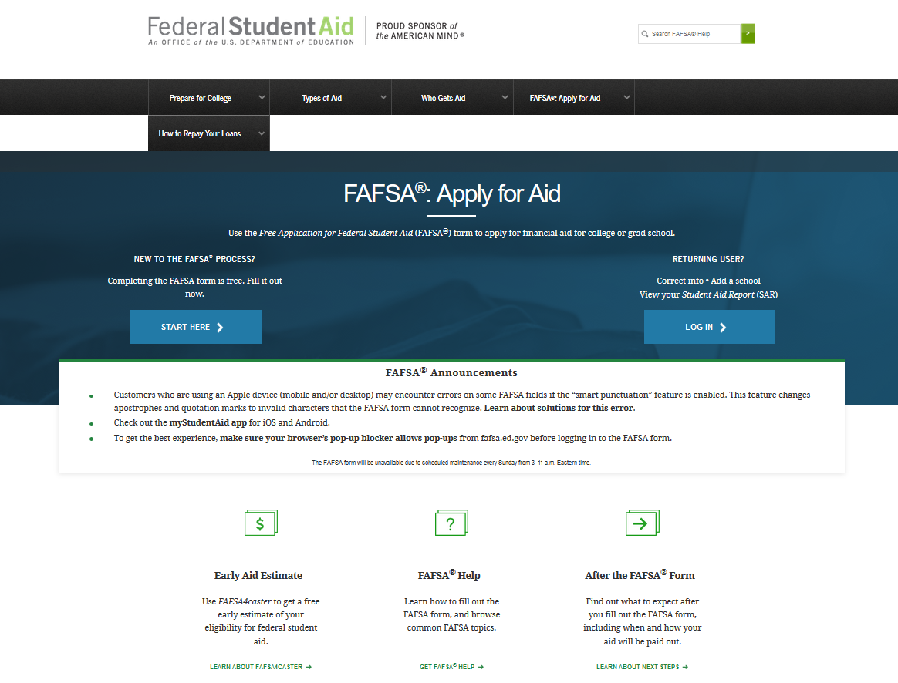
FAFSA on the Web (FOTW)

Slide 26
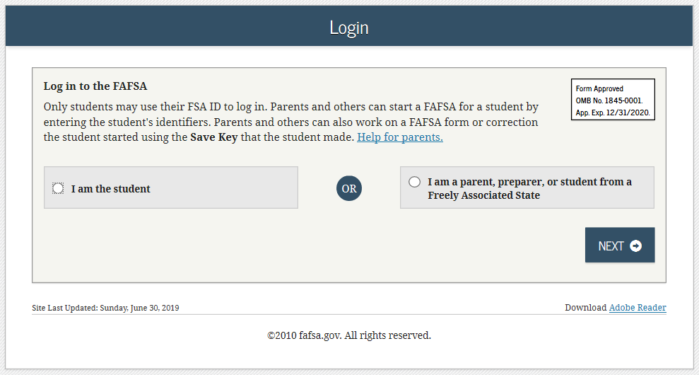
FAFSA on the Web (FOTW)

Slide 27
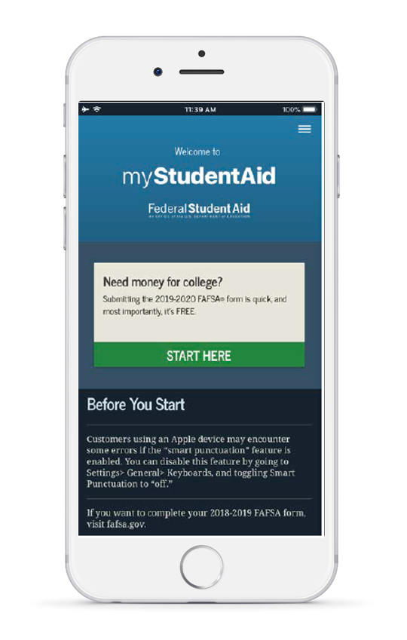

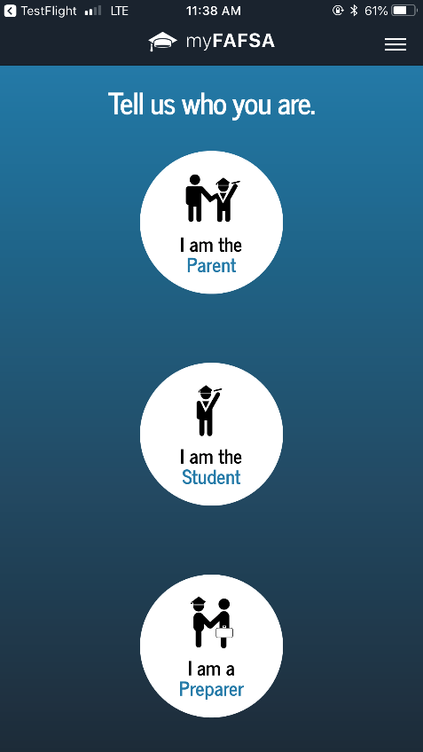
myStudentAid Mobile App
Mobile ability to begin, complete, save, and submit the FAFSA

Slide 28
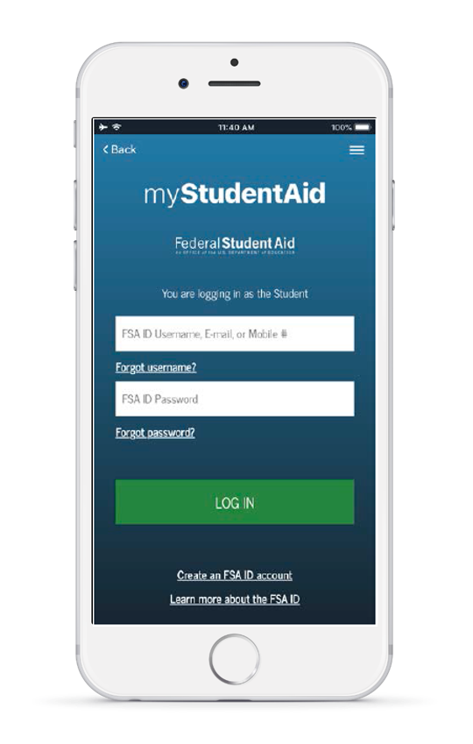
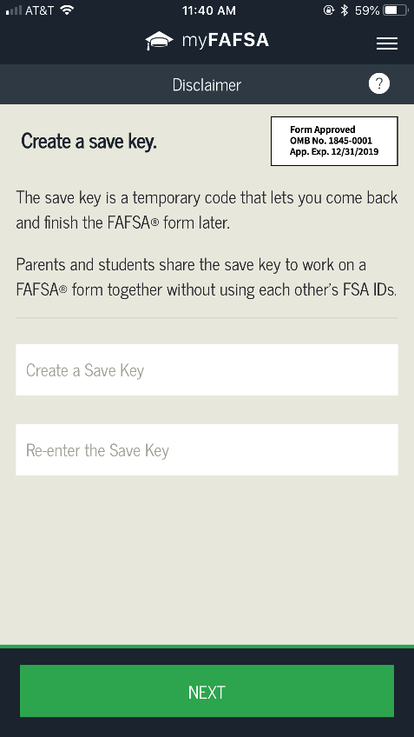
myStudentAid Mobile App
Information protected the same as FOTW
Prompts applicant to create a save key, allowing completion at later time

Slide 29
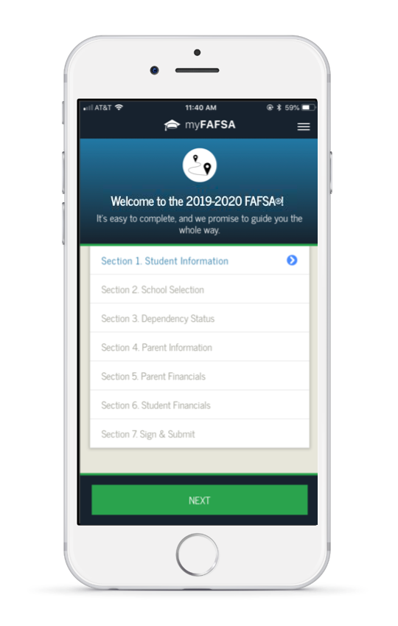
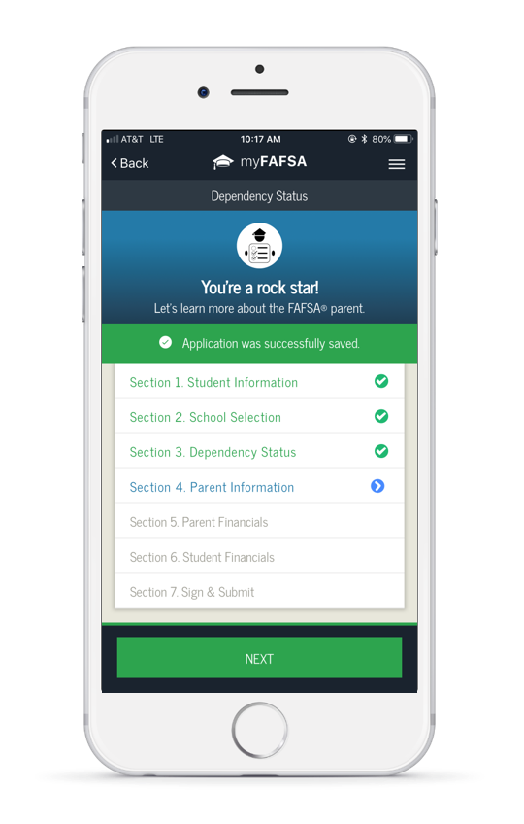
myStudentAid Mobile App
FAFSA completion tracked
Successful completion of each section indicated

Slide 30
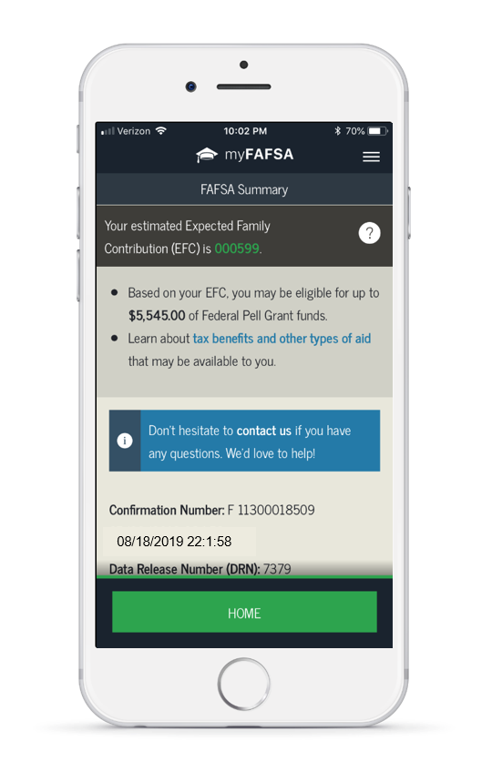
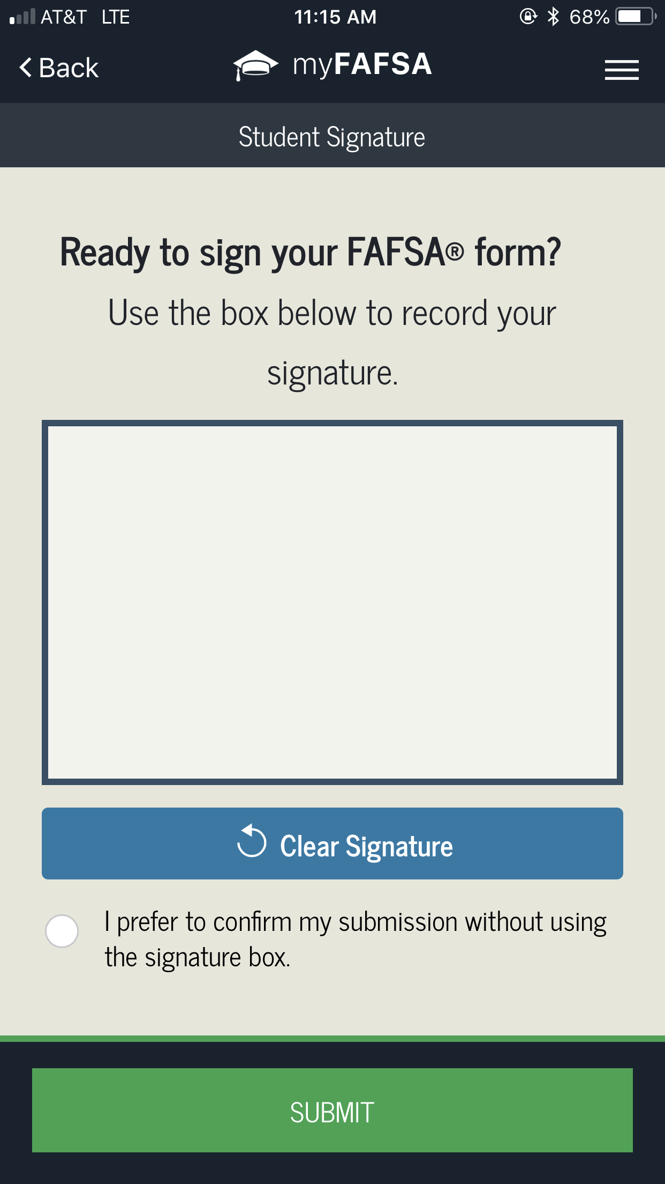
myStudentAid Mobile App
Agreement of Terms checkbox
Confirmation of submission
Estimated EFC calculation

Slide 31
IRS Data Retrieval Tool (DRT)
Allows for certain tax return information to be transferred from the IRS database
Participation is voluntary and student chooses whether or not to transfer data to FOTW
IRS will authenticate taxpayer’s identity
If tax record is found, IRS transfers information to populate the FAFSA
Reduces documents requested by financial aid office

Slide 32
IRS Data Retrieval Tool
Certain tax filers cannot use the
IRS Data Retrieval Tool
Did not indicate on FAFSA a tax return was completed
Marriage date is January 2019, or later
First three digits of the SSN are 666
Filed a non-U.S. tax return
Married and filed as head of household, or filed separate returns
Neither married parent entered a valid SSN
Non-married parent or both married parents entered all zeroes for the SSN

Slide 33
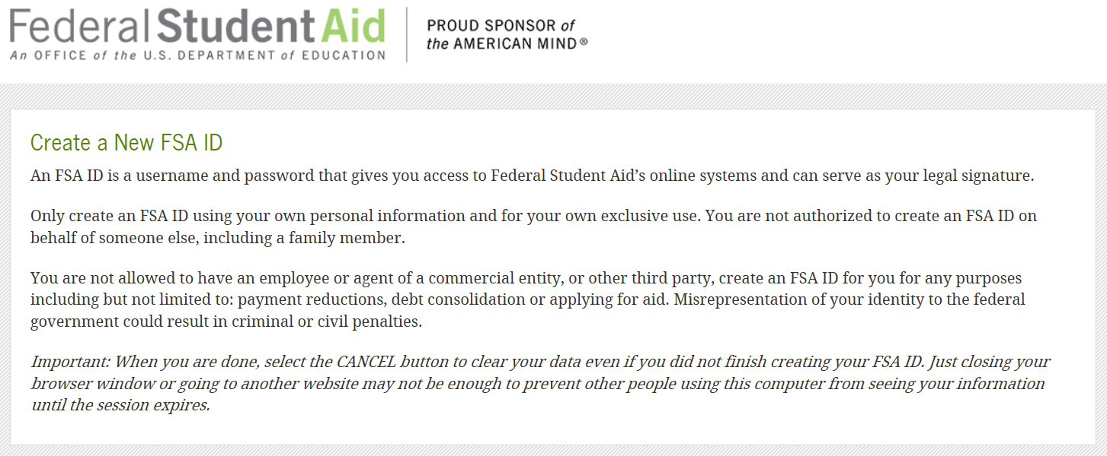
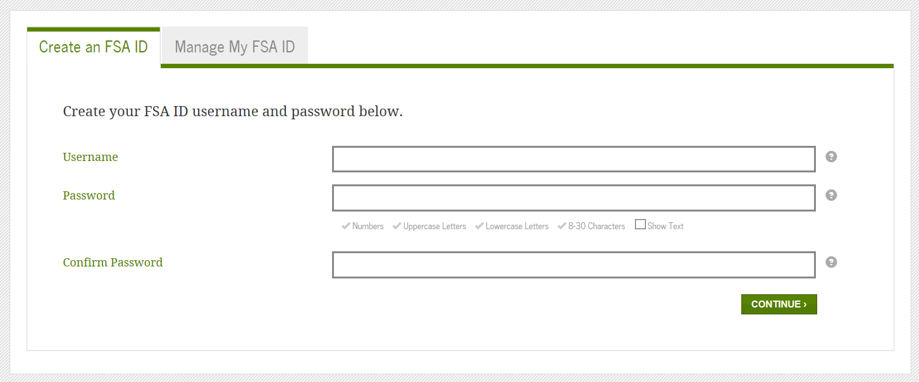
FSA ID
Used for FAFSA completion
and allows access to
certain U.S. Department
of Education websites
May be used by students
and parents throughout
financial aid process,
including subsequent
school years
Only the owner should
create a FSA ID
Apply at https://fsaid.ed.gov/npas/index.htm

Slide 34
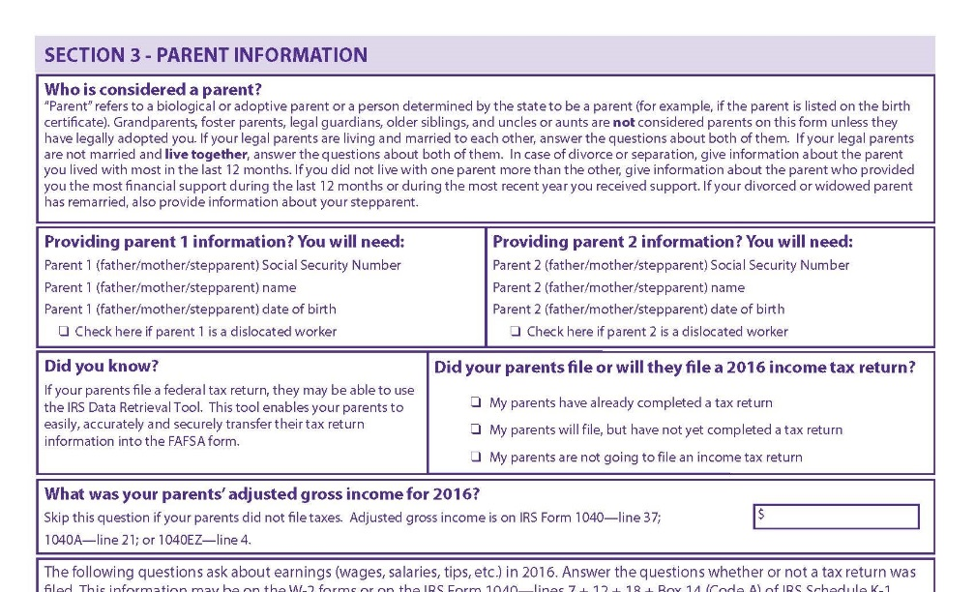
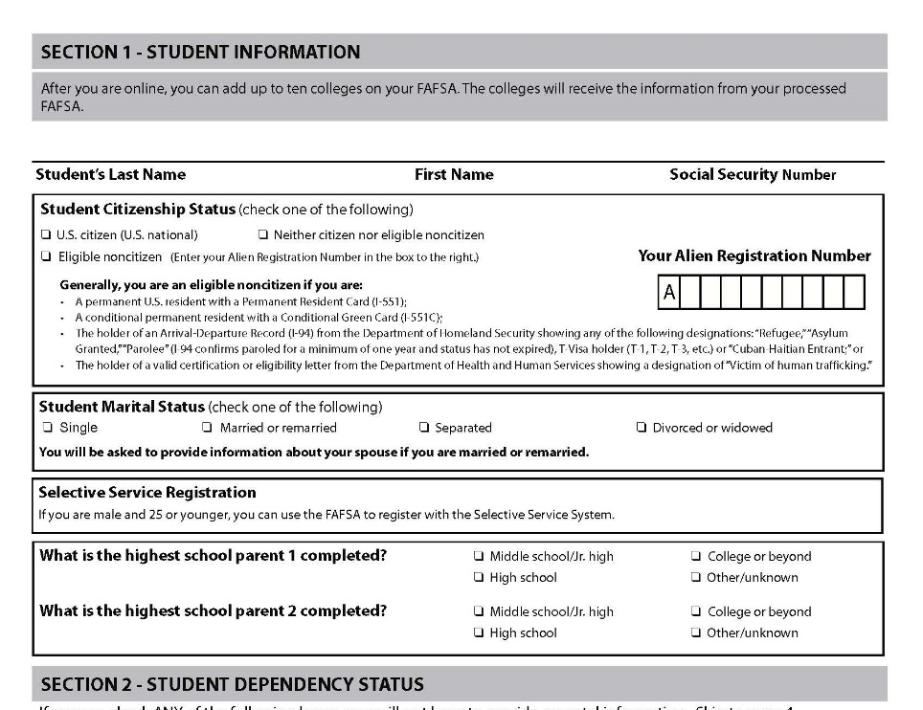
FOTW Worksheet
Preview of questions that may be asked regarding basic information for the student and parent, if applicable

Slide 35
General Student Information
Social Security Number
Citizenship status
Marital status
Drug conviction of possession or sale
Selective Service registration
Highest education level completed by father/mother

Slide 36
Student Dependency Status
FAFSA asks questions to determine dependency status for Title IV federal student aid (not IRS) purposes:
If all “No” responses, student is dependent
If “Yes” to any question, student is independent

Slide 37
Information About Parents of
Dependent Students
Tax, income, and other financial information
Dislocated worker status
Receipt of means-tested federal benefits in the previous two years
Assets
Untaxed income

Slide 38
Information About Student
(and Spouse)
Tax, income, and other financial information
Dislocated worker status
Receipt of means-tested federal benefits in the previous two years
Assets
Untaxed income

Slide 39
Additional Information
College information
Housing plans
FAFSA preparer information

Slide 40
Signatures
Required
  Student
  One parent (dependent students)
Format for submitting signatures
  Electronic using FSA ID
  Signature page
  Paper FAFSA

Slide 41
Frequent FAFSA Errors
Social Security Numbers
Divorced/widowed/remarried parental information
Income earned by parent/stepparent
Untaxed income
U.S. income taxes paid
Household size
Number of household members in college
Real estate and investment net worth

Slide 42



FAFSA Processing Results
CPS
College
Student

Slide 43
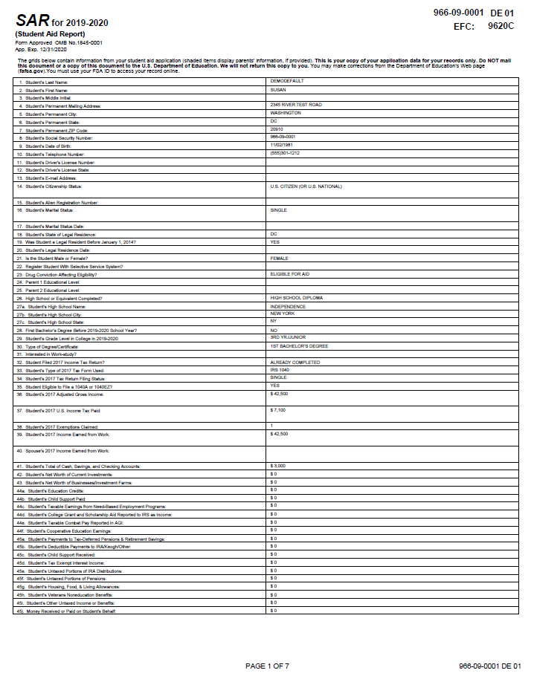
Email Notification of SAR Processing
If valid email address is provided on FAFSA
Provides access to electronic SAR at www.fafsa.gov

Slide 44
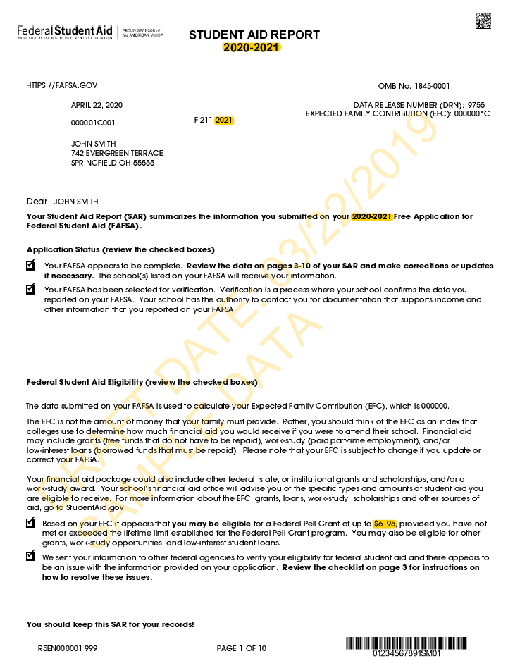
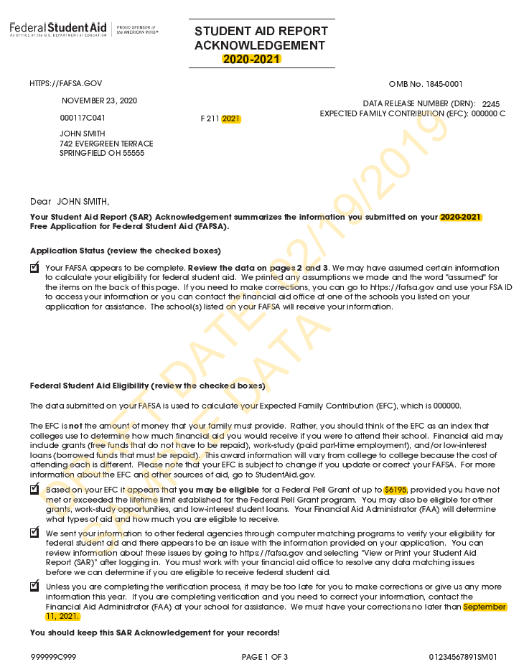
SAR or SAR Acknowledgement
SAR sent if paper FAFSA filed without providing an email address
SAR Acknowledgement sent if FOTW filed without providing an email address

Slide 45
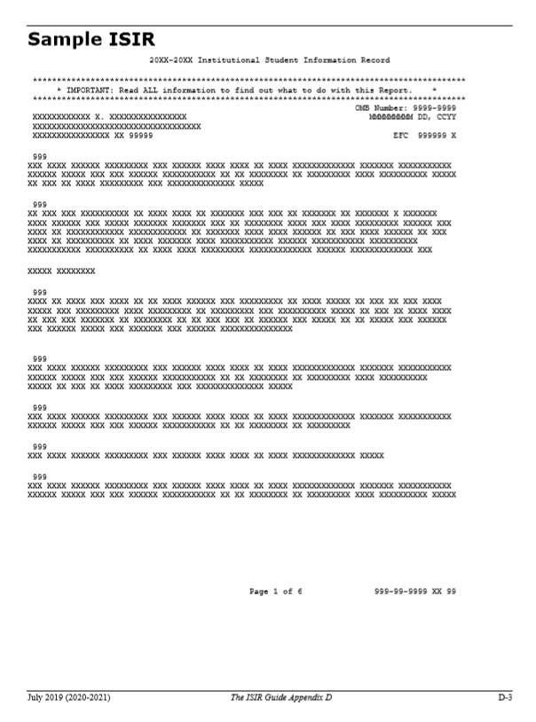
Institutional Student Information Record (ISIR)
CPS sends results to colleges listed on the FAFSA
College reviews ISIR and may request additional documentation

Slide 46
Making Corrections
If necessary, corrections to FAFSA data may be made by:
Using FAFSA on the Web, if student has a FSA ID;
Updating paper SAR; or
Submitting documentation to college’s financial aid office.

Slide 47
Special Circumstances
Conditions exist that cannot be documented with the FAFSA
Send written explanation and documentation to your college’s financial aid office
College will review and request additional information if necessary
Decisions are final and cannot be appealed to U.S. Department of Education

Slide 48

Special Circumstances
Secondary school tuition
Unusual uncovered medical/dental expenses
Extraordinary dependent care
Student cannot obtain parental information
Parent or spouse death
Loss of employment
Divorce

