Slide 2
THE VISION...
Inspire People to
Better Themselves through
Education

Slide 3
ABOUT PR & MARKETING:
Brandon - Director of PR & Marketing
Guides department based on needs.
Writing / Photography
Advertising buys/placement
Social media
Community engagement
Publications & Branding, etc.

Slide 4
ABOUT PR & MARKETING
Micah - PR & Marketing Specialist
Writing
Photography
Primary social media manager

Slide 5
ABOUT PR & MARKETING
Julie - Video Coordinator
Video for social platforms
TV commercials
Editorial coverage of events
Live streaming!

Slide 6
ABOUT PR & MARKETING
Connie - Graphic Designer
Assists Director with brand enforcement
Generates new logos/graphics
Designs countless publications
Assembles display advertisements

Slide 7
ABOUT PR & MARKETING
Sam - Web Content Strategist (new title)
Manages organization and flow of websites
Builds landing pages
Assists director with digital marketing

Slide 8
ABOUT PR & MARKETING
Rita & Rod - Print shop stars (adopted)
Design and print publications and stationery

Slide 9
& Marketing
Public Relations Department

Slide 10
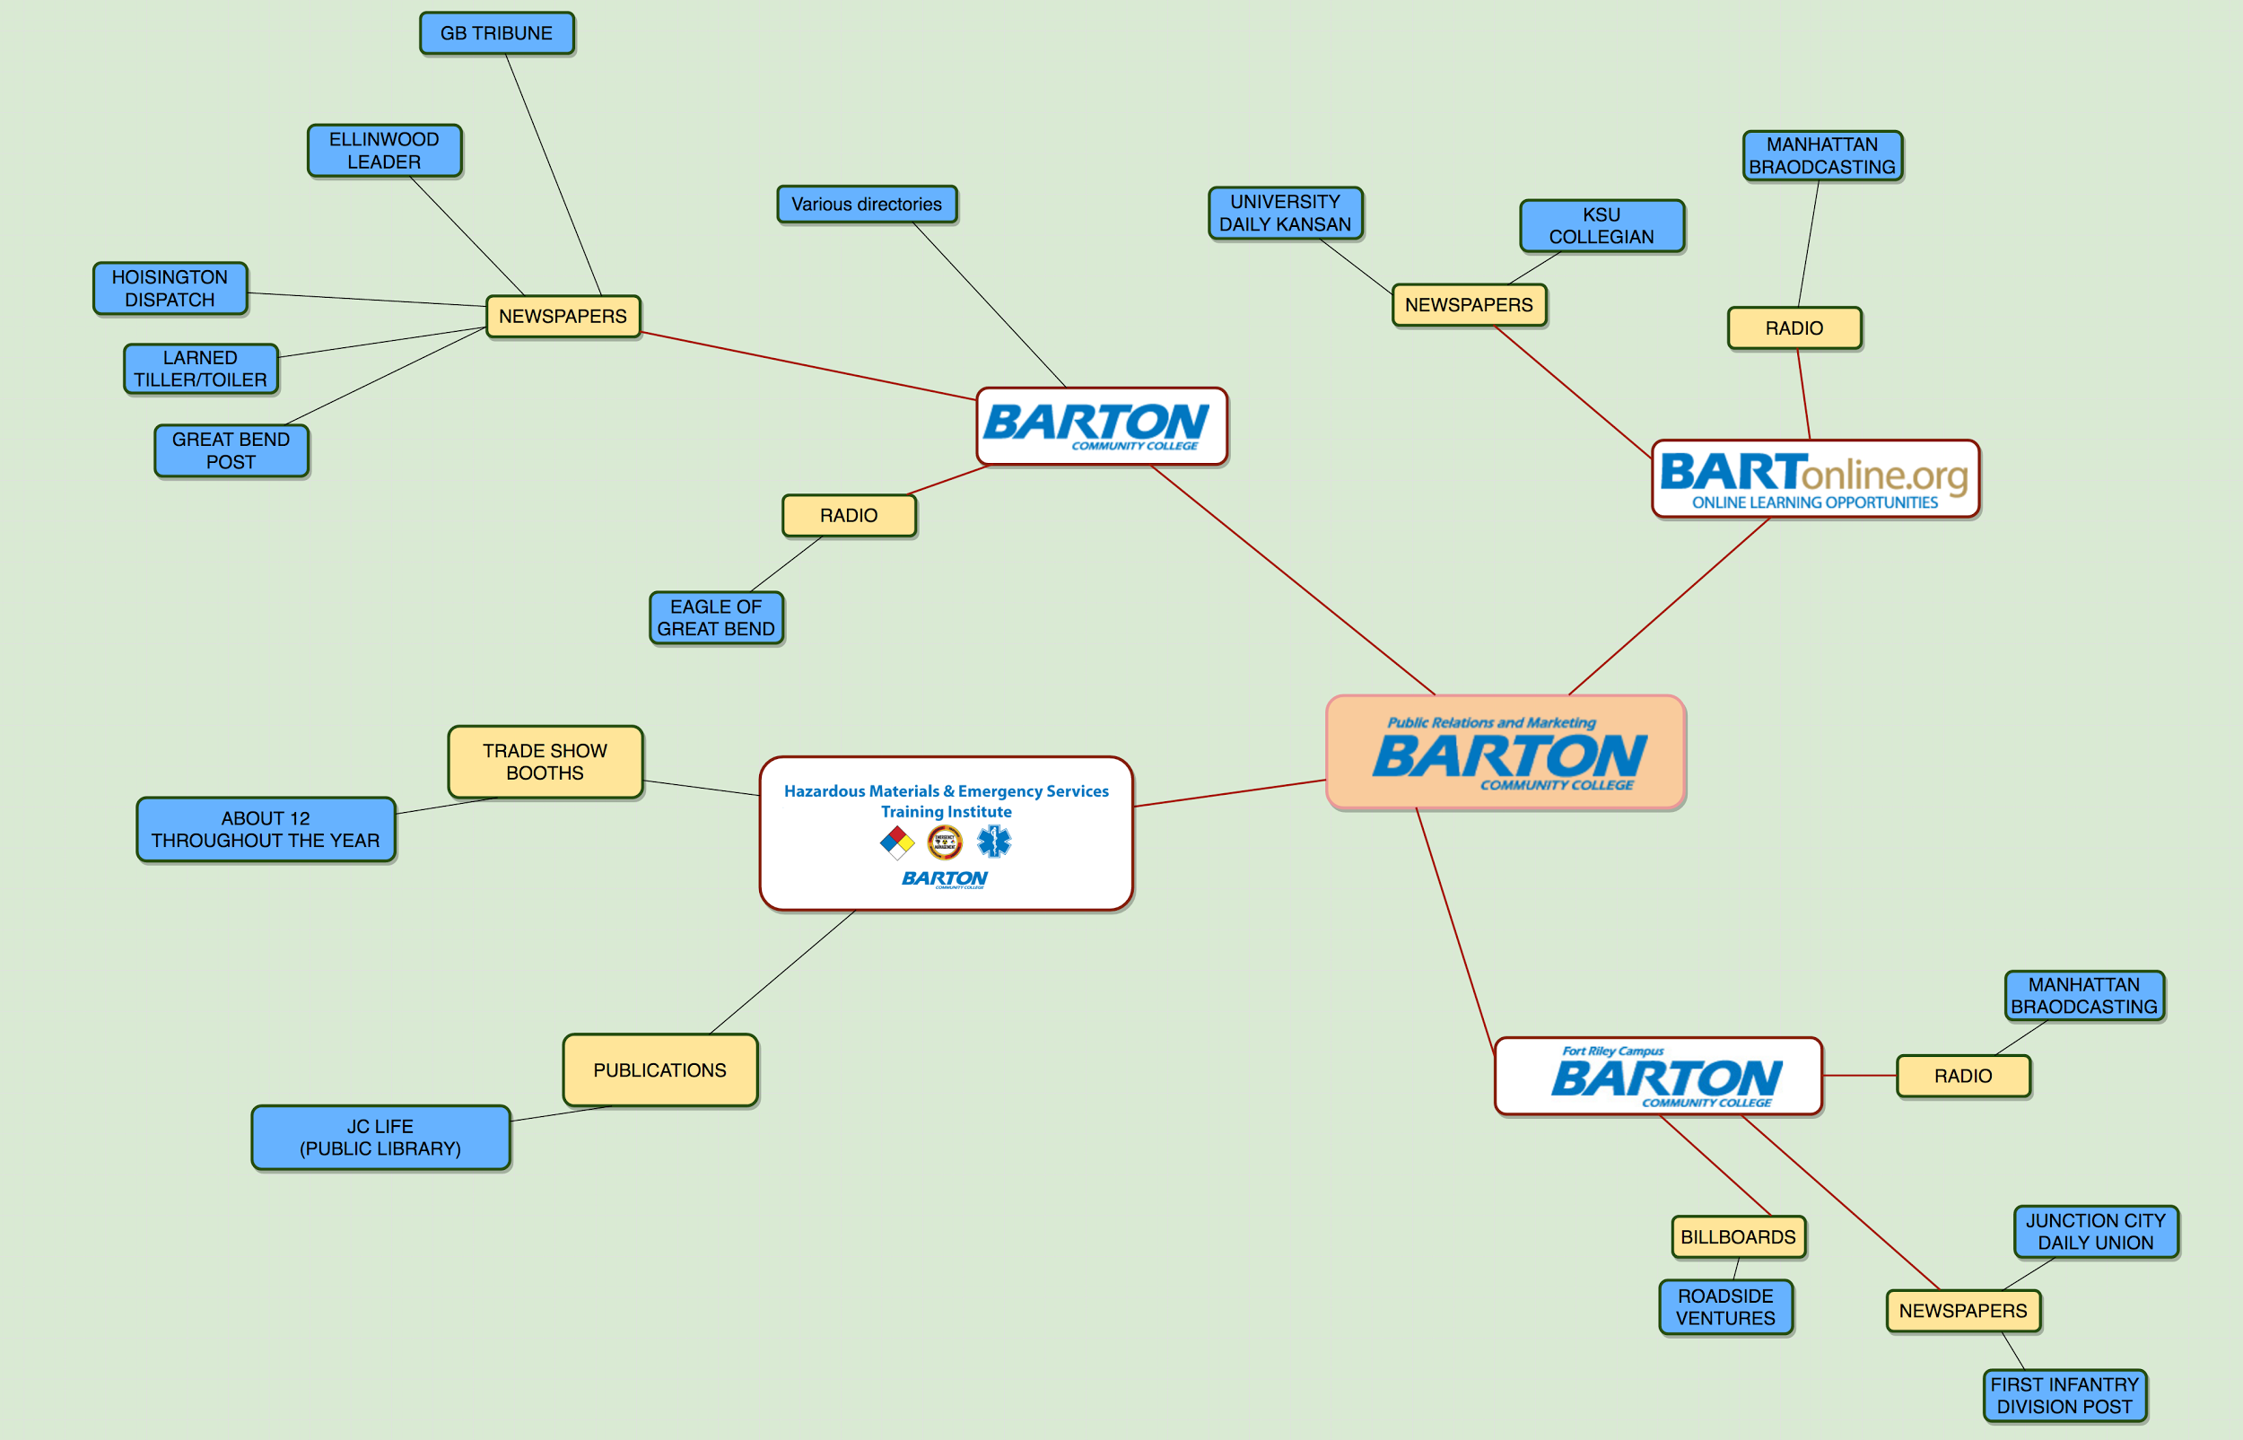
2011-12
Marketing was added to PR.

Slide 11
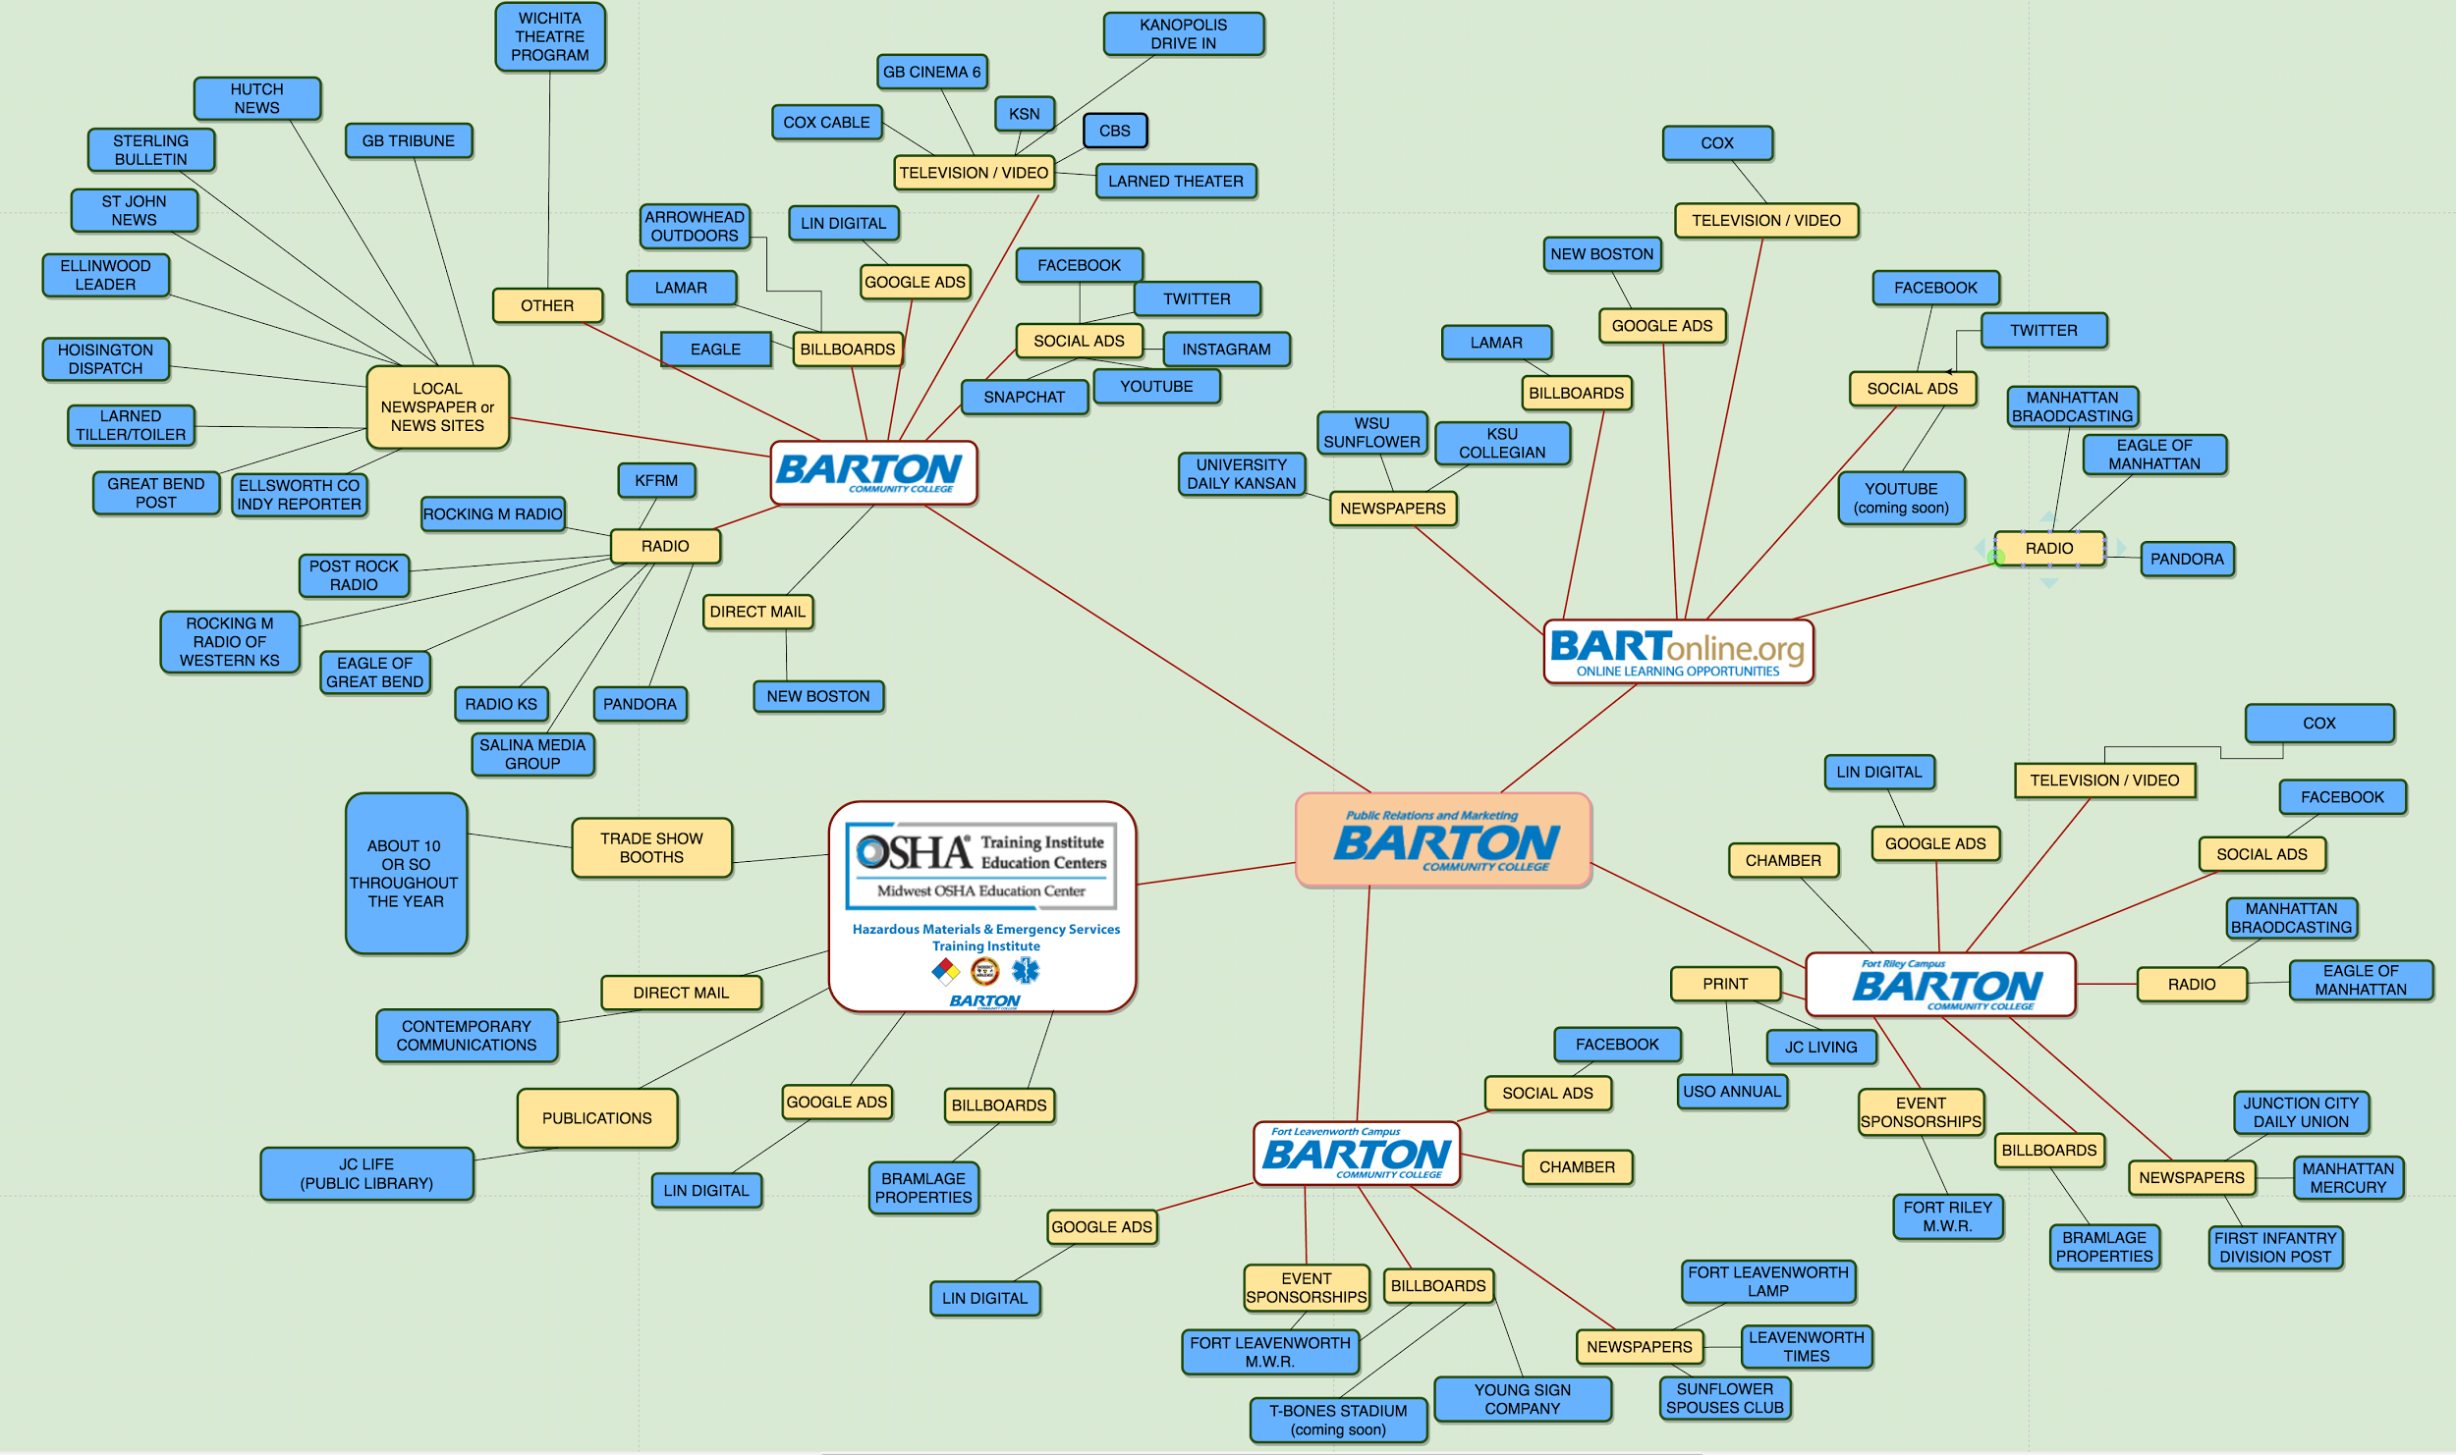
2016-17

Slide 12
New Boston
Creative Group
2016-17

Slide 13
PR & MARKETING - what’s next?
BARTonline.org marketing enhancements.

Slide 14
PR & MARKETING - what’s next?
How much do organizations spend on advertising?
10% of revenue is the magic number for businesses.
2% of tuition/fees revenue is the traditional public college rule of thumb, but we're not traditional anymore.
5-10% - Both public and private colleges are getting more competitive. This is more and more the norm today.
2.5% - Current budget

Slide 15
PR & MARKETING - what’s next?
TOTAL STUDENT REVENUE (tuition/fees): $14,000,000
Current 2.5% $345,000
Raise to 3% $420,000
Just FYI - 10% $1.4 million

Slide 16
PR & MARKETING - what’s next?
2013 Dayton Daily News article
Data from Lipman Hearne

Slide 17
PR & MARKETING - what’s next?
2011
Staff:
Budget:
Social media:
Ad platforms:
2017
Staff:
Budget:
Social media:
Ad platforms
5
$100K
0
16ish
5
$345K
4
70ish

Slide 18
PR & MARKETING - what’s next?
bodies & hours
“Marketing Specialist”?
“Content Specialist”?

Slide 19
BARTON COUNTY CAMPUS
TARGET MARKETS
Traditional Students & Their Parents
Nontraditional Students
Internal (students | faculty | staff)
General Public
Geo: Barton County & surrounding six counties.
Western KS to an extent.

Slide 20
FORT RILEY & FORT LEAVENWORTH CAMPUS
TARGET MARKETS
Military & Their Families*
Internal (students | faculty | staff)
General Public
Geo: Immediate areas (on post + surrounding communities)
*Fort Leavenworth - families are primary.

Slide 21
BARTonline.org
TARGET MARKETS
Transient Students
Traditional Students (online Associate Degree!)
Program-Specific
Geo: EVERYWHERE (focused on Kansas)

Slide 22
GRANDVIEW PLAZA CAMPUS
TARGET MARKETS
Retiring Military
Military Officers
Business / Industry
Geo: It’s complicated...

Slide 23
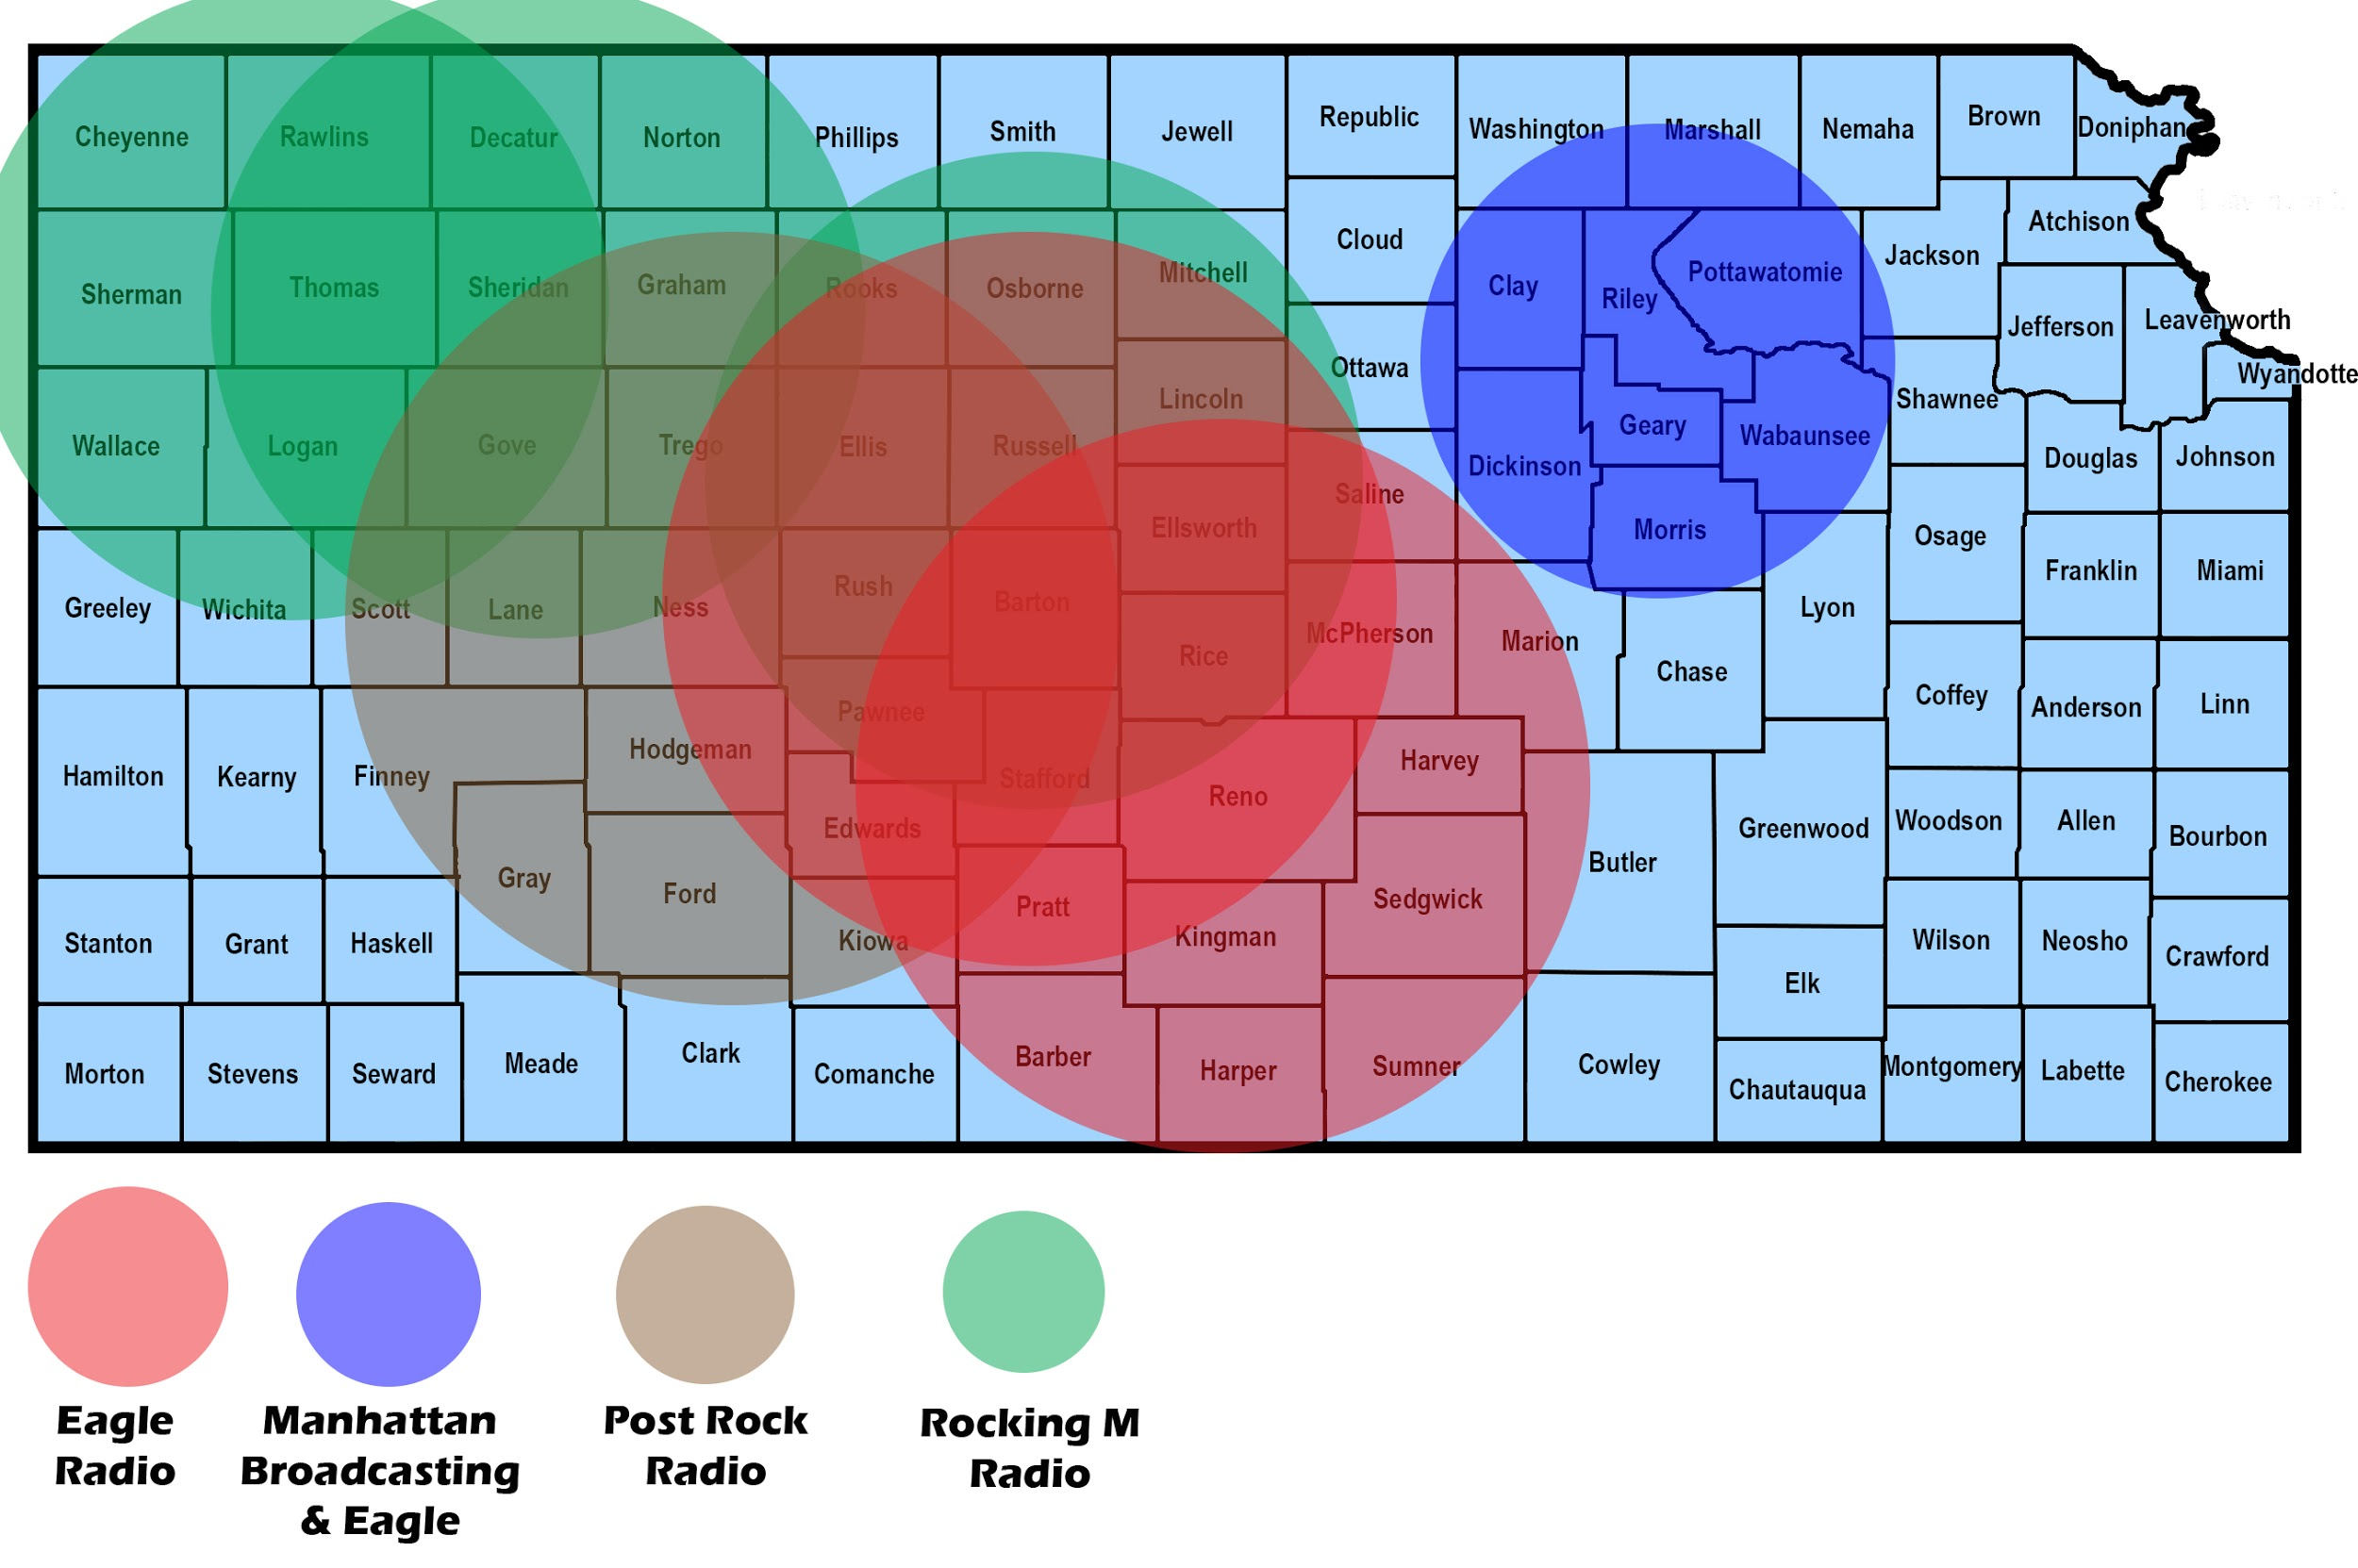
Barton’s Radio Stations

Slide 24
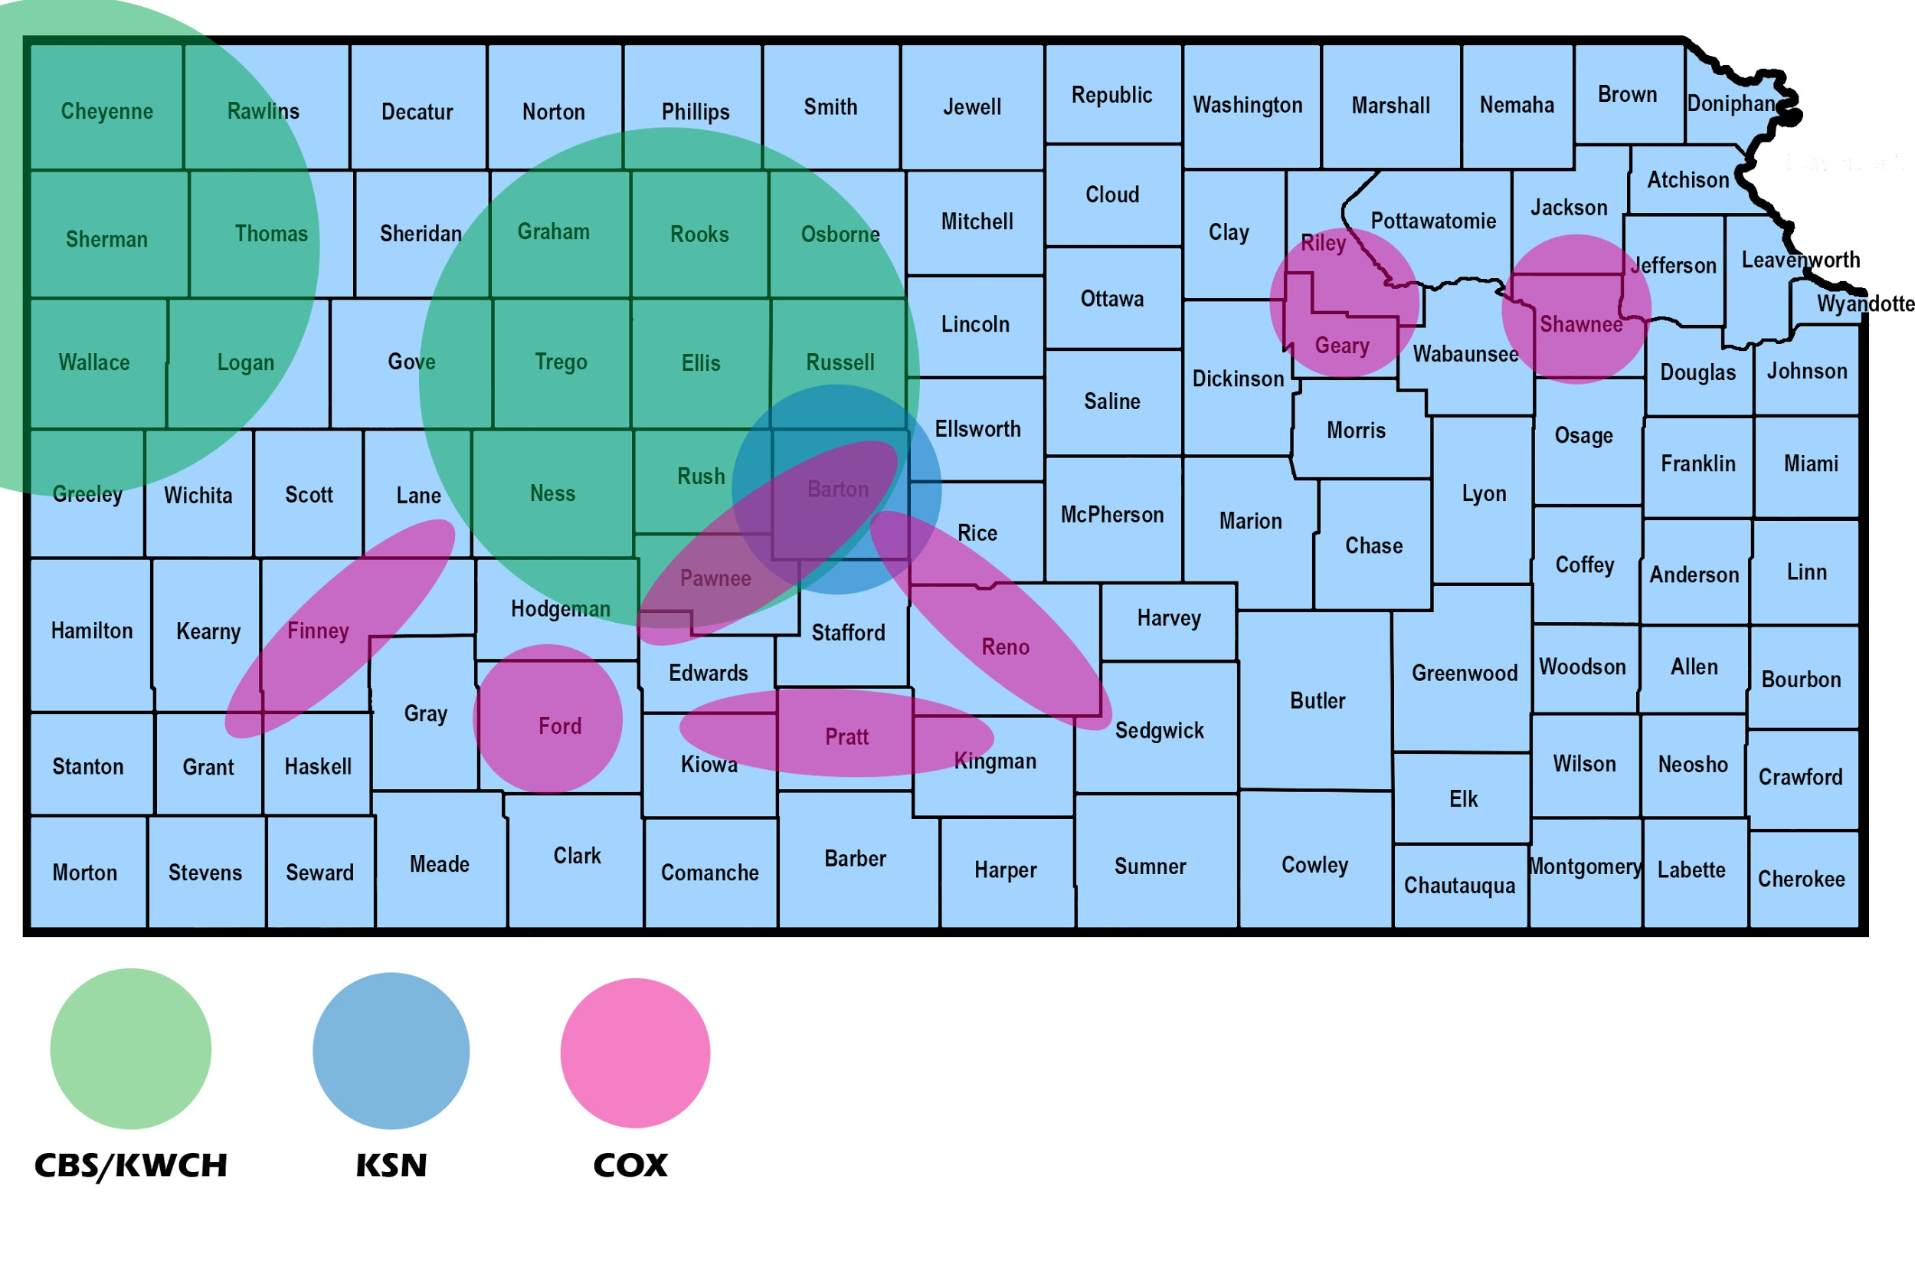
Barton’s TV Stations

Slide 25
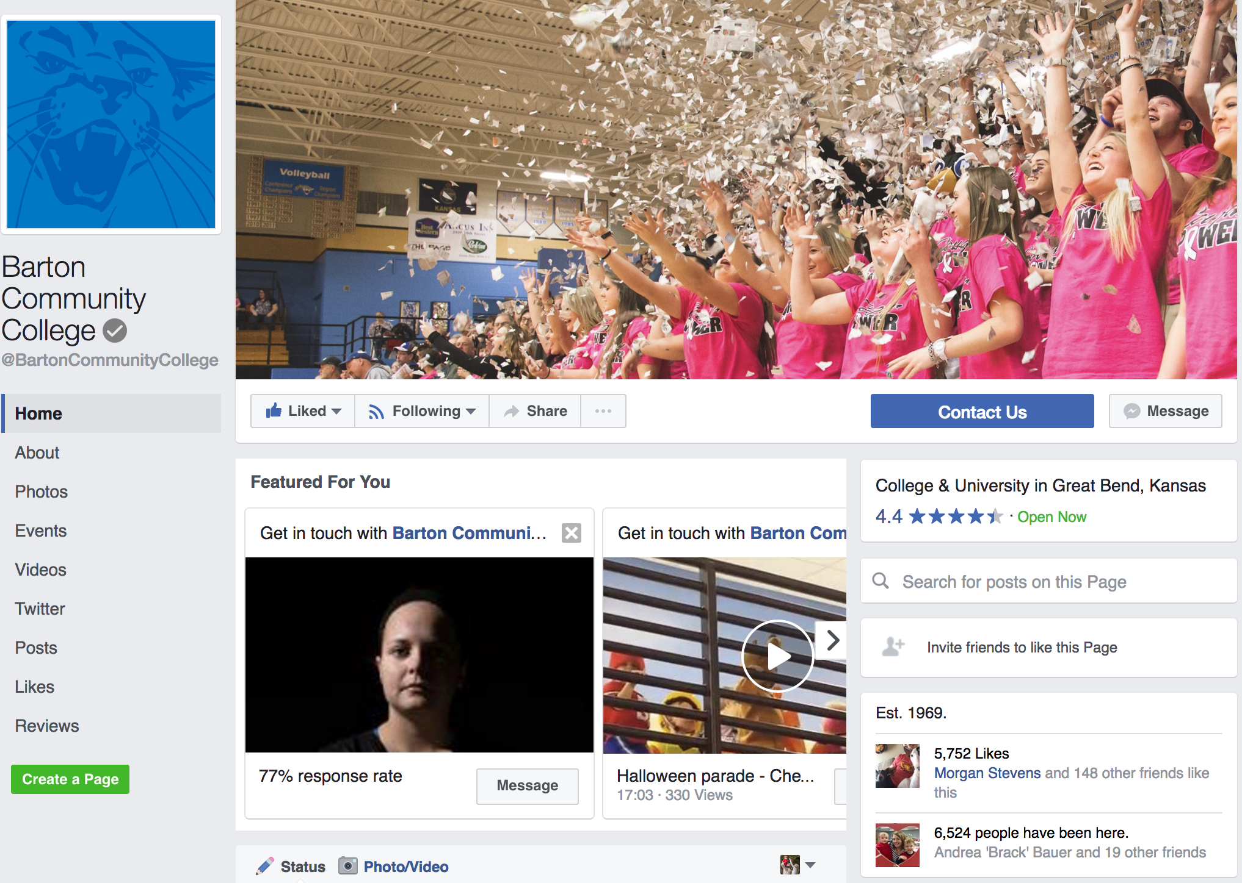
SOCIAL MEDIA
Facebook
5,752 likes
$50 = 4,000 people
28,064
people reached in February
10,371
post engagements
in February

Slide 26
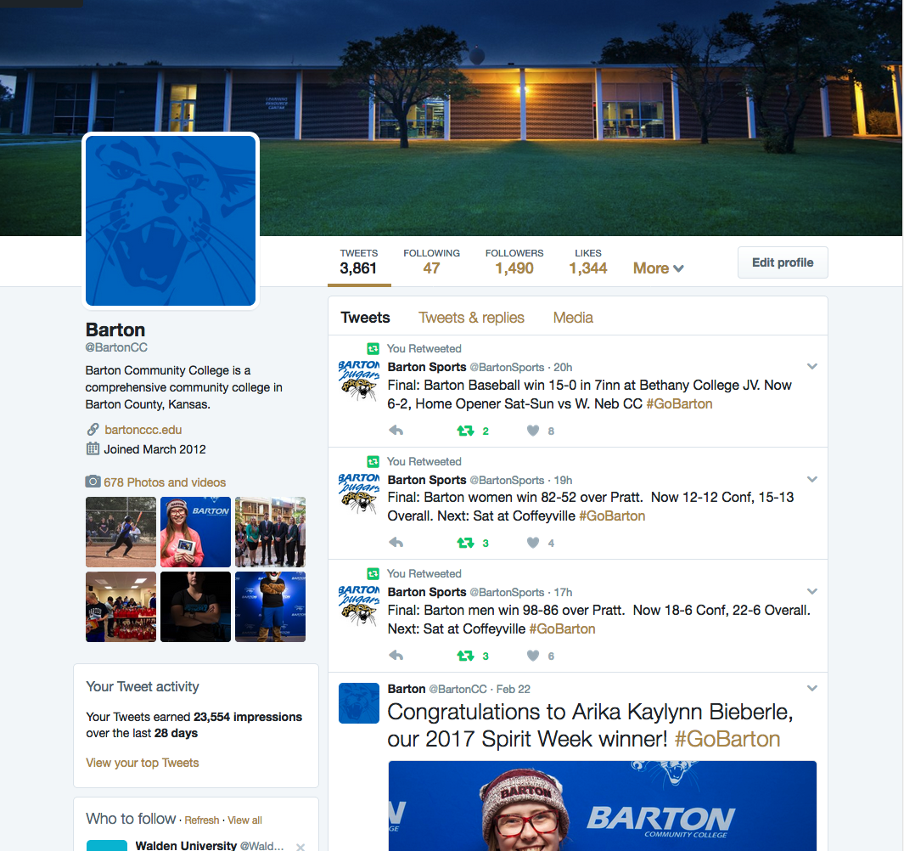
SOCIAL MEDIA
Twitter
1,490 followers
23,550
impressions in February

Slide 27
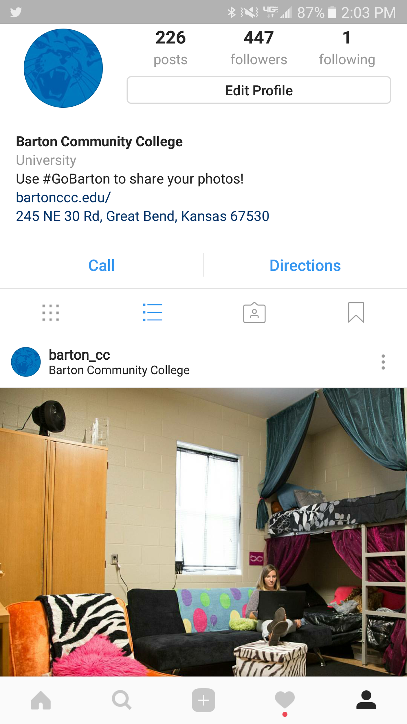
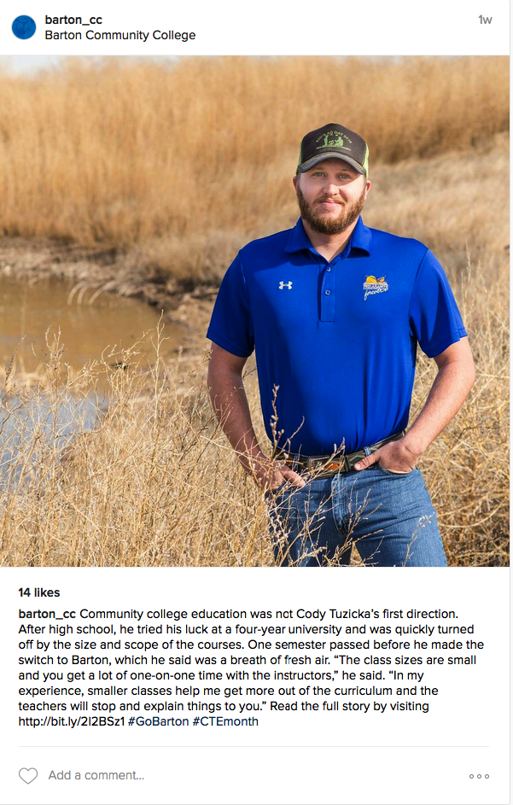
SOCIAL MEDIA
Instagram
447 followers

Slide 28
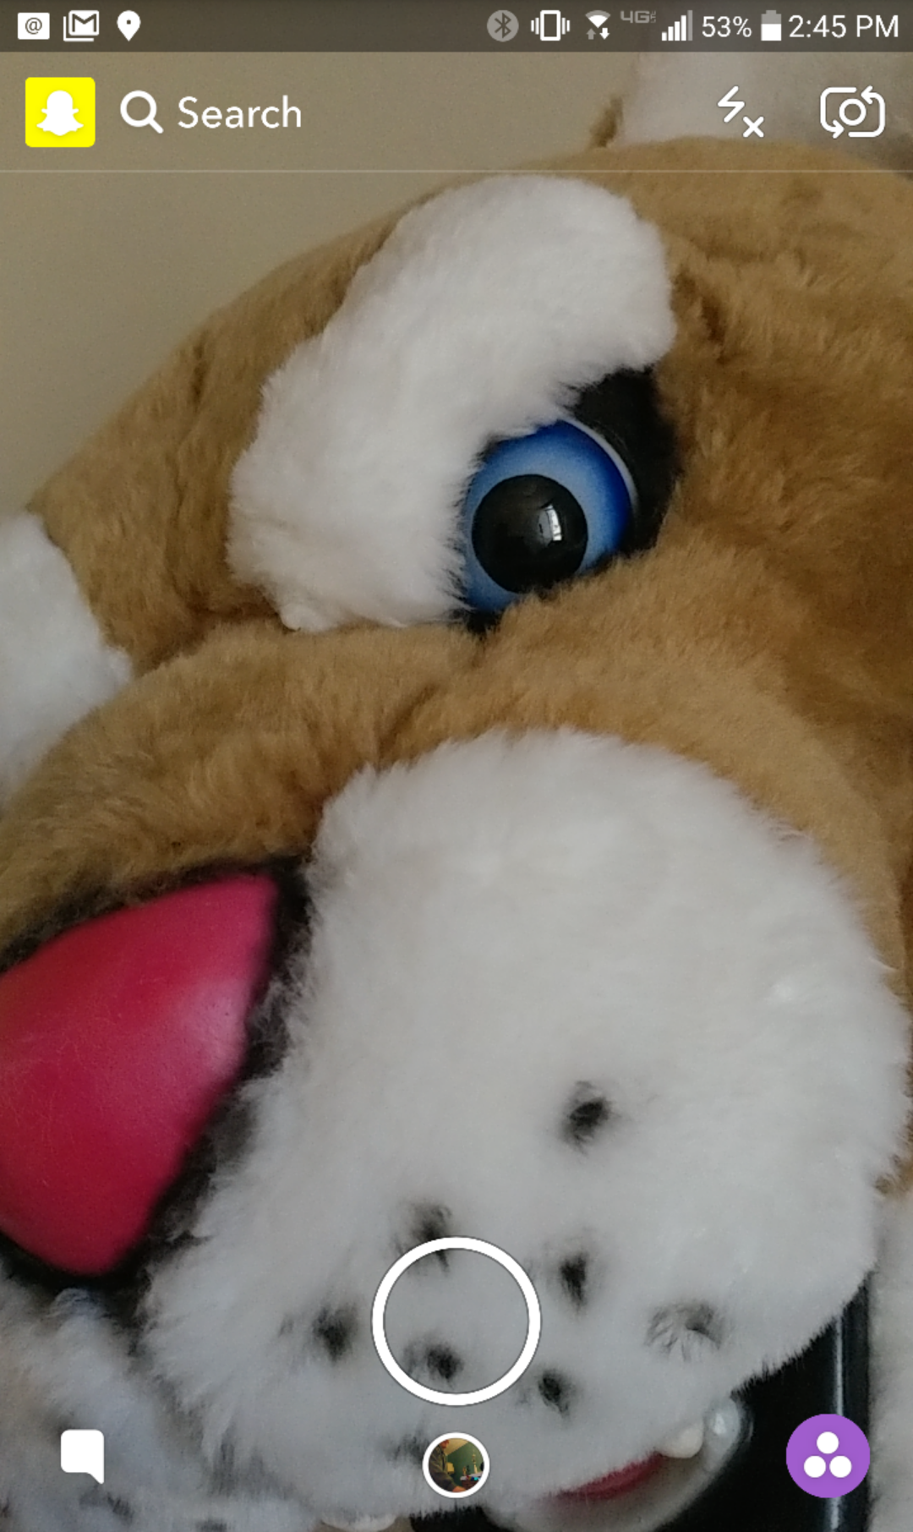
SOCIAL MEDIA
Snapchat
87 added Barton

Slide 29
SOCIAL MEDIA
Other Accounts
BARTonline
Facebook - 549
Twitter - 228
Fort Riley
Facebook - 1,280
Fort Leavenworth
Facebook - 276

Slide 30
SOCIAL MEDIA
Other Accounts
Shafer Gallery
Facebook - 753
Barton Sports
Facebook - 1,326

Slide 31
QUESTIONS?

