Slide 1
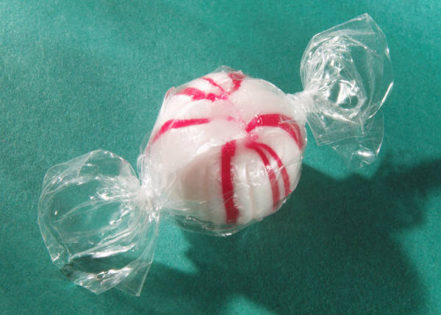
Classroom Assessment Techniques (CATs)
Speaker: Jo Harrington
••••••••••••••••••••••••••••••••••
Notes:
Custom animation effects: dotted line with text fade by letter
(Basic)
To reproduce the text effects on this slide, do the following:
On the Home tab, in the Slides group, click Layout, and then click Blank.
On the Insert tab, in the Text group, click Text Box, and then on the slide, drag to draw a text box that spans the entire width of the slide.
On the Insert tab, in the Text group, click Symbol. In the Symbol dialog box, do the following:
In the Font list, select (normal text).
In the Subset list, select General Punctuation.
In the Character Code box, enter 2022 to select BULLET, and then click Insert.
Click Insert 33 more times until there is a row of 34 bullets in the text box.
In the text box, select the text, and then on the Home tab, in the Font group do the following:
In the Font list, select Arial Black.
In the Font Size list, select 44.
Click the arrow next to Font Color, and then under Theme Colors click White, Background 1 (first row, first option from the left).
On the Home tab, in the Drawing group, click Arrange, point to Align, and then do the following:
Click Align to Slide.
Click Align Center.
Click Align Middle.
On the Insert tab, in the Text group, click Text Box. Drag to draw a text box on the slide.
Enter and select the text. On the Home tab, in the Font group, do the following:
In the Font list, select Corbel.
In the Font Size box, enter 50.
Click the arrow next to Font Color, and then under Theme Colors click White, Background 1 (first row, first option from the left).
Click Bold.
With the text still selected, on the Home tab, in the Paragraph group, click Center.
Select the second text box. On the Home tab, in the Drawing group, click Arrange, point to Align, and then do the following:
Click Align to Slide.
Click Align Center.
Click Align Middle.
To reproduce the background effects on this slide, do the following:
Right-click the slide background area, and then click Format Background. In the Format Background dialog box, click Fill in the left pane, select Gradient fill in the Fill pane, and then do the following:
In the Type list, select Radial.
Click the button next to Direction, and then click From Center (third option from the left).
Under Gradient stops, click Add or Remove until two stops appear in the drop-down list.
Also under Gradient stops, customize the gradient stops that you added as follows:
Select Stop 1 from the list, and then do the following:
In the Stop position box, enter 0%.
Click the button next to Color, and then under Theme Colors select Blue, Accent 1, Darker 25% (fifth row, fifth option from the left).
Select Stop 2 from the list, and then do the following:
In the Stop position box, enter 100%.
Click the button next to Color, and then under Theme Colors select Black, Text 1 (first row, second option from the left).
To reproduce the animation effects on this slide, do the following:
On the Animations tab, in the Animations group, click Custom Animation.
On the slide, select the first text box. In the Custom Animation task pane, do the following:
Click Add Effect, point to Entrance, and then click More Effects. In the Add Entrance Effect dialog box, under Basic, click Fly In.
Select the animation effect (fly-in effect for the first text box). Click the arrow to the right of the selected effect, and then click Effect Options. In the Fly In dialog box, do the following:
On the Effect tab, do the following:
In the Direction list, select From Left.
In the Animate text list, select By Letter.
In the % delay between letters box, enter 10.
On the Timing tab, do the following:
In the Start list, select With Previous.
In the Speed list, select 0.5 seconds (Very Fast).
On the slide, select the first text box. In the Custom Animation task pane, do the following:
Click Add Effect, point to Exit, and then click More Effects. In the Add Exit Effect dialog box, under Subtle, click Fade.
Select the second animation effect (fade effect for the first text box). Click the arrow to the right of the selected effect, and then click Effect Options. In the Fade dialog box, do the following:
On the Effect tab, do the following:
In the Animate text list, select By Letter.
In the % delay between letters box, enter 10.
On the Timing tab, do the following:
In the Start list, select With Previous.
In the Delay box, enter 1.5.
In the Speed list, select 0.5 seconds (Very Fast).
On the slide, select the second text box. In the Custom Animation task pane, do the following.
Click Add Effect, point to Entrance, and then click More Effects. In the Add Entrance Effect dialog box, under Subtle, click Fade.
Select the third animation effect (fade effect for the second text box). Click the arrow to the right of the selected effect, and then click Effect Options. In the Fade dialog box, do the following:
On the Effect tab, do the following:
In the Animate text list, select By Letter.
In the % delay between letters box, enter 6.
On the Timing tab, do the following:
In the Start list, select With Previous.
In the Delay box, enter 2.
In the Speed list, select 0.5 seconds (Very Fast).

Slide 2
The four steps to completing a CAT:
Choose a learning goal to assess
Choose an assessment technique and apply it
Analyze the data and respond to it
Document the assessment
Notes:
Custom animation effects: object spins on end
(Advanced)
To reproduce the background effects on this slide, do the following:
On the Home tab, in the Slides group, click Layout, and then click Blank.
Right-click the slide background area, and then click Format Background. In the Format Background dialog box, click Fill in the left pane, and then select Solid fill in the Fill pane. Click the button next to Color, and then under Theme Colors click White, Background 1 (first row, first option from the left).
To reproduce the rectangle on this slide, do the following:
On the Home tab, in the Drawing group, click Shapes, and then under Rectangles click Rounded Rectangle (second option from the left). On the slide, drag to draw a rounded rectangle.
Select the rectangle. Drag the yellow diamond adjustment handle to the left to decrease the amount of rounding on the corners.
With the rounded rectangle still selected, under Drawing Tools, on the Format tab, in the Size group, do the following:
In the Shape Height box, enter 3.5”.
In the Shape Width box, enter 0.25”.
Under Drawing Tools, on the Format tab, in the bottom right corner of the Shape Styles group, click the Format Shape dialog box launcher. In the Format Shape dialog box, click Fill in the left pane. In the Fill pane, select Solid fill, click the button next to Color, and then under Theme Colors click White, Background 1, Darker 15% (third row, first option from the left).
Also in the Format Shape dialog box, click Line Color in the left pane. In the Line Color pane, select No line.
Also in the Format Shape dialog box, click Shadow in the left pane. In the Shadow pane, click the button next to Presets, under Outer select Offset Bottom (first row, second option from the left), and then do the following:
In the Transparency box, enter 0%.
In the Size box, enter 100%.
In the Blur box, enter 8.5 pt.
In the Angle box, enter 90°.
In the Distance box, enter 1 pt.
Also in the Format Shape dialog box, click 3-D Format in the left pane. In the 3-D Format pane, do the following:
Under Bevel, click the button next to Top, and then under Bevel click Circle (first row, first option from the left). Next to Top, in the Width box, enter 5 pt, and in the Height box, enter 5 pt.
Under Surface, click the button next to Material, and then under Standard click Matte (first row, first option from the left). Click the button next to Lighting, and then under Neutral click Soft (first row, third option from the left).
On the slide, select the rounded rectangle. On the Home tab, in the Clipboard group, click the arrow under Paste, and then click Duplicate.
Select the duplicate rectangle. On the Home tab, in the Drawing group, do the following:
Click the arrow next to Shape Fill, and then click No Fill.
Click the arrow next to Shape Outline, and then click No Outline.
Drag the second rectangle above the first rectangle until the lower edge overlays the top edge of the first rectangle. (Note: When the spinning animation effect is created later for these rectangles, the spin will center where the edges of the rectangles meet.)
Press and hold CTRL, and then select both rectangles. On the Home tab, in the Drawing group, click Arrange, and do the following:
Point to Align, and then click Align Selected Objects.
Point to Align, and then click Align Center.
Click Group.
On the slide, drag the group until it is centered horizontally on the left edge of the slide (straddling the edge).
On the Home tab, in the Drawing group, click Arrange, point to Align, and then do the following:
Click Align to Slide.
Click Align Middle.
To reproduce the dashed arc on this slide, do the following:
On the Home tab, in the Drawing group, click Shapes, and then under Basic Shapes click Arc (third row, 12th option from the left). On the slide, drag to draw an arc.
Select the arc. Under Drawing Tools, on the Format tab, in the Size group, do the following:
In the Shape Height box, enter 7.5”.
In the Shape Width box, enter 7.5”.
With the arc still selected, on the Home tab, in the Drawing group, click the arrow next to Shape Outline, and then do the following:
Under Theme Colors, click White, Background 1, Darker 15% (third row, first option from the left).
Point to Dashes, and then click Dash (fourth option from the top).
On the slide, drag the yellow diamond adjustment handle on the right side of the arc to the bottom of the arc to create a half circle.
Drag the arc until the yellow diamond adjustment handles are on the left edge of the slide.
With the arc still selected, on the Home tab, in the Drawing group, click Arrange, point to Align, and then do the following:
Click Align to Slide.
Click Align Middle.
To reproduce the half circle on this slide, do the following:
On the slide, select the arc. On the Home tab, in the Clipboard group, click the arrow under Paste, and then click Duplicate.
Select the duplicate arc. Under Drawing Tools, on the Format tab, in the Size group, do the following:
In the Shape Height box, enter 3.33”.
In the Shape Width box, enter 3.33”.
With the second arc still selected, under Drawing Tools, on the Format tab, in the Shape Styles group, click the arrow next to Shape Fill, and then under Theme Colors click White, Background 1, Darker 5% (second row, first option from the left).
Under Drawing Tools, on the Format tab, in the Shape Styles group, click the arrow next to Shape Outline, and then click No Outline.
Under Drawing Tools, on the Format tab, in the Shape Styles group, click Shape Effects, point to Shadow, and then click Shadow Options. In the Format Shape dialog box, click Shadow in the left pane. In the Shadow pane, click the button next to Presets, under Inner click Inside Right (second row, third option from the left), and then do the following:
In the Transparency box, enter 86%.
In the Blur box, enter 24 pt.
In the Angle box, enter 315°.
In the Distance box, enter 4 pt.
On the slide, drag the second arc until the yellow diamond adjustment handles are on the left edge of the slide. On the Home tab, in the Drawing group, click Arrange, and then do the following:
Point to Align, and then click Align to Slide.
Point to Align, and then click Align Middle.
Click Send to Back.
To reproduce the button shapes on this slide, do the following:
On the Home tab, in the Drawing group, click Shapes, and then under Basic Shapes click Oval (first row, second option from the left). On the slide, drag to draw an oval.
Select the oval. Under Drawing Tools, on the Format tab, in the Size group, do the following:
In the Shape Height box, enter 0.34”.
In the Shape Width box, enter 0.34”.
Under Drawing Tools, on the Format tab, in the Shape Styles group, click More, and then click Light 1 Outline, Colored Fill – Dark 1 (third row, first option from the left).
Under Drawing Tools, on the Format tab, in the bottom right corner of the Shape Styles group, click the Format Shape dialog box launcher. In the Format Shape dialog box, click Fill in the left pane. In the Fill pane, select Solid Fill. Click the button next to Color, and then under Theme Colors click Olive Green, Accent 3, Lighter 80° (second row, seventh option from the left).
Also in the Format Shape dialog box, click Line Color in the left pane. In the Line Color pane, select No line.
Also in the Format Shape dialog box, click Shadow in the left pane. In the Shadow pane, click the button next to Presets, under Outer click Offset Bottom (first row, second option from the left), and then do the following:
In the Transparency box, enter 0%.
In the Size box, enter 100%.
In the Blur box, enter 8.5 pt.
In the Angle box, enter 90°.
In the Distance box, enter 1 pt.
Also in the Format Shape dialog box, click 3-D Format in the left pane, and then do the following in the 3-D Format pane:
Under Bevel, click the button next to Top, and then under Bevel click Art Deco (third row, fourth option from the left). Next to Top, in the Width box, enter 5 pt, and in the Height box, enter 5 pt.
Under Contour, click the button next to Color, and then under Theme Colors click White, Background 1 (first row, first option from the left). In the Size box, enter 3.5 pt.
Under Surface, click the button next to Material, and then under Standard click Matte (first row, first option from the left). Click the button next to Lighting, and then under Neutral click Soft (first row, third option from the left).
On the slide, select the oval. Under Drawing Tools, on the Format tab, in the bottom right corner of the Size group, click the Size and Position dialog box launcher. In the Size and Position dialog box, on the Position tab, do the following:
In the Horizontal box, enter 2.98”.
In the Vertical box, enter 1.5”.
Select the oval. On the Home tab, in the Clipboard group, click the arrow under Paste, and then click Duplicate.
Select the duplicate oval. Under Drawing Tools, on the Format tab, in the bottom right corner of the Size group, click the Size and Position dialog box launcher. In the Size and Position dialog box, on the Position tab, do the following:
In the Horizontal box, enter 3.52”.
In the Vertical box, enter 2.98”.
Repeat step 9 two more times, for a total of four ovals. Under Drawing Tools, on the Format tab, in the bottom right corner of the Size group, click the Size and Position dialog box launcher. In the Size and Position dialog box, on the Position tab, do the following to position the third and fourth ovals:
Select the third oval on the slide, and then enter 3.52” in the Horizontal box and 4.27” in the Vertical box.
Select the fourth oval on the slide, and then enter 2.99” in the Horizontal box and 5.66” in the Vertical box.
To reproduce the text on this slide, do the following:
On the Insert tab, in the Text group, click Text Box, and then on the slide, drag to draw the text box.
Enter text in the text box and select the text. On the Home tab, in the Font group, do the following:
In the Font list, select Corbel.
In the Font Size list, select 22.
Click the arrow next to Font Color, and then under Theme Colors click White, Background 1, Darker 50% (sixth row, first option from the left).
On the Home tab, in the Paragraph group, click Align Text Left to align the text left in the text box.
On the slide, drag the text box to the right of the first oval.
Select the text box. On the Home tab, in the Clipboard group, click the arrow under Paste, and then click Duplicate.
Click in the text box and edit the text.
Drag the second text box to the right of the second oval.
Repeat steps 5-7 to create the third and fourth text boxes, dragging them to the right of the third and fourth ovals.
To reproduce the animation effects on this slide, do the following:
On the Animations tab, in the Animations group, click Custom Animation.
On the Home tab, in the Editing group, click Select, and then click Selection Pane.
In the Selection and Visibility pane, select the rectangle group. In the Custom Animation task pane, do the following:
Click Add Effect, point to Emphasis, and then click More Effects. In the Add Emphasis Effect dialog box, under Basic, click Spin.
Select the animation effect (spin effect for the rectangle group). Under Modify: Spin, do the following:
In the Start list, select With Previous.
In the Amount list, in the Custom box, enter 123°, and then press ENTER. Also in the Amount list, click Counterclockwise.
In the Speed list, select Fast.
On the slide, select the first oval. In the Custom Animation task pane, do the following:
Click Add Effect, point to Emphasis, and then click More Effects. In the Add Emphasis Effect dialog box, under Basic, click Change Fill Color.
Select the second animation effect (change fill color effect for the first oval). Under Modify: Change Fill Color, do the following:
In the Start list, select After Previous.
In the Fill Color list, click More Colors. In the Colors dialog box, on the Custom tab, enter values for Red: 130, Green: 153, Blue: 117.
In the Speed list, select Very Fast.
On the slide, select the first text box. In the Custom Animation task pane, do the following:
Click Add Effect, point to Entrance, and then click More Effects. In the Add Entrance Effect dialog box, under Subtle, click Fade.
Select the third animation effect (fade effect for the first text box). Under Modify: Fade, do the following:
In the Start list, select With Previous.
In the Speed list, select Very Fast.
In the Selection and Visibility pane, select the rectangle group. In the Custom Animation task pane, do the following:
Click Add Effect, point to Emphasis, and then click More Effects. In the Add Emphasis Effect dialog box, under Basic, click Spin.
Select the fourth animation effect (spin effect for the rectangle group). Under Modify: Spin, do the following:
In the Start list, select On Click.
In the Amount list, in the Custom box, enter 22°, and then press ENTER. Also in the Amount list, click Clockwise.
In the Speed list, select Very Fast.
On the slide, select the second oval. In the Custom Animation task pane, do the following:
Click Add Effect, point to Emphasis, and then click More Effects. In the Add Emphasis Effect dialog box, under Basic, click Change Fill Color.
Select the fifth animation effect (change fill color effect for the second oval). Under Modify: Change Fill Color, do the following:
In the Start list, select After Previous.
In the Fill Color list, click More Colors. In the Colors dialog box, on the Custom tab, enter values for Red: 130, Green: 153, Blue: 117.
In the Speed list, select Very Fast.
On the slide, select the second text box. In the Custom Animation task pane, do the following:
Click Add Effect, point to Entrance and then click More Effects. In the Add Entrance Effect dialog box, under Subtle, click Fade.
Select the sixth animation effect (fade effect for the second text box). Under Modify: Fade, do the following:
In the Start list, select With Previous.
In the Speed list, select Very Fast.
On the slide, select the third oval. In the Custom Animation task pane, do the following:
Click Add Effect, point to Emphasis, and then click More Effects. In the Add Emphasis Effect dialog box, under Basic, click Change Fill Color.
Select the seventh animation effect (change fill color effect for the third oval). Under Modify: Change Fill Color, do the following:
In the Start list, select After Previous.
In the Fill Color list, click More Colors. In the Colors dialog box, on the Custom tab, enter values for Red: 130, Green: 153, Blue: 117.
In the Speed list, select Very Fast.
On the slide, select the third text box. In the Custom Animation task pane, do the following:
Click Add Effect, point to Entrance and then click More Effects. In the Add Entrance Effect dialog box, under Subtle, click Fade.
Select the eighth animation effect (fade effect for the third text box). Under Modify: Fade, do the following:
In the Start list, select With Previous.
In the Speed list, select Very Fast.
On the slide, select the fourth oval. In the Custom Animation task pane, do the following:
Click Add Effect, point to Emphasis, and then click More Effects. In the Add Emphasis Effect dialog box, under Basic, click Change Fill Color.
Select the ninth animation effect (change fill color effect for the fourth oval). Under Modify: Change Fill Color, do the following:
In the Start list, select After Previous.
In the Fill Color list, click More Colors. In the Colors dialog box, on the Custom tab, enter values for Red: 130, Green: 153, Blue: 117.
In the Speed list, select Very Fast.
On the slide, select the fourth text box. In the Custom Animation task pane, do the following:
Click Add Effect, point to Entrance, and then click More Effects. In the Add Entrance Effect dialog box, under Subtle, click Fade.
Select the 10th animation effect (fade effect for the fourth text box). Under Modify: Fade, do the following:
In the Start list, select With Previous.
In the Speed list, select Very Fast.

Slide 3

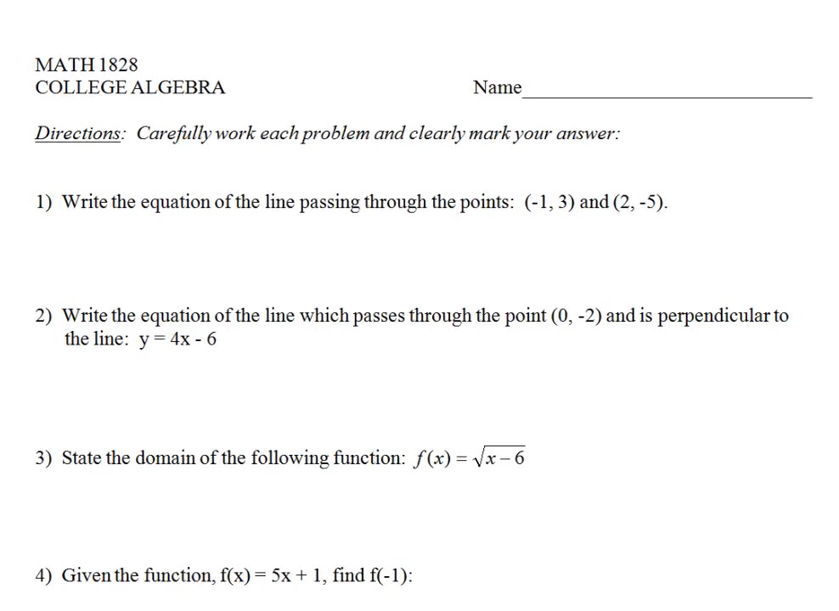

Slide 4
Class Average: 70%
Class Median: 88%

Slide 5
Question Level Analysis
# | Competency | % Correct
1 | Find the equation of a line | 97%
2 | Find a perpendicular line | 87%
3 | Find the domain of a function | 73%
4 | Evaluate a function | 63%
5 | Determine if a given equation is a function | 77%
6 | Find the zeroes of a function | 10%
7 | Find the composition of two functions | 70%
8 | Find the inverse of a function | 90%

Slide 6
Determine the zeros of a function.
3
1
2
Use the quadratic formula
Set the equation equal to 0
Solve the equation
Notes:
Custom animation effects: rotating characters on a curved path
(Intermediate)
Tip: To draw the curved line on this slide, you will need to use the ruler and the drawing guides.
To display the ruler and the drawing guides, do the following:
On the Home tab, in the Slides group, click Layout, and then click Blank.
On the View tab, in the Show/Hide group, select Ruler.
Right-click the slide background area, and then click Grid and Guides. In the Grid and Guides dialog box, under Guide settings, select Display drawing guides on screen. (Note: One horizontal and one vertical guide will display on the slide at 0.00, the default position.)
To reproduce the curved line on this slide, do the following:
On the Home tab, in the Drawing group, click Shapes, and then under Lines click Curve (10th option from the left). To draw the curved line on the slide, do the following:
Click the first point 0.25” to the left of the left edge of the slide and 0.75” below the horizontal drawing guide.
Click the second point 3” to the left of the vertical drawing guide and 1” above the horizontal drawing guide.
Click the third point 1.5” to the right of the vertical drawing guide and 0.5” below the horizontal drawing guide.
Double-click the fourth and final point 0.25” to the right of the right edge of the slide and 1.5” above the horizontal drawing guide.
Select the curved line. Under Drawing Tools, on the Format tab, in the Shape Styles group, click Shape Outline, and then do the following:
Under Theme Colors, click White, Background 1, Darker 35% (fifth row, first option from the left).
Point to Dashes, and then click Square Dot (third option from the top).
Point to Weight, and then click 1 ½ pt.
To reproduce the “1” on this slide, do the following:
On the Home tab, in the Slides group, click Layout, and then click Blank.
On the Insert tab, in the Text group, click Text Box, and then on the slide, drag to draw the text box.
Enter 1 in the text box, and then select the text. On the Home tab, in the Font group, do the following:
In the Font list, select Impact.
In the Font Size box, enter 140.
On the Home tab, in the Paragraph group, click Align Text Left to align the text left in the text box.
Select the text box. Under Drawing Tools, on the Format tab, in the bottom right corner of the WordArt Styles group, click the Format Text Effects dialog box launcher. In the Format Text Effects dialog box, click Text Fill in the left pane, select Gradient fill in the Text Fill pane, and then do the following:
In the Type list, select Linear.
Click the button next to Direction, and then click Linear Down (first row, second option from the left).
Under Gradient stops, click Add or Remove until two stops appear in the drop-down list.
Also under Gradient stops, customize the gradient stops that you added as follows:
Select Stop 1 from the list, and then do the following:
In the Stop position box, enter 0%.
Click the button next to Color, and then under Theme Colors click White, Background 1 (first row, first option from the left).
In the Transparency box, enter 50%.
Select Stop 2 from the list, and then do the following:
In the Stop position box, enter 85%.
Click the button next to Color, and then under Theme Colors click White, Background 1 (first row, first option from the left).
In the Transparency box, enter 0%.
Also in the Format Text Effects dialog box, click Text Outline in the left pane. In the Text Outline pane, select Solid line, click the button next to Color, and then click More Colors. In the Colors dialog box, on the Custom tab, enter values for Red: 49, Green: 133, Blue: 156.
Also in the Format Text Effects dialog box, click Outline Style in the left pane. In the Outline Style pane, in the Width box, enter 2.5 pt.
Also in the Format Text Effects dialog box, click Shadow in the left pane. In the Shadow pane, click the button next to Presets, under Outer click Offset Diagonal Bottom Left (first row, third option from the left), and then do the following:
In the Transparency box, enter 82%.
In the Size box, enter 100%.
In the Blur box, enter 8 pt.
In the Angle box, enter 135°.
In the Distance box, enter 30 pt.
Also in the Format Text Effects dialog box, click 3-D Rotation in the left pane. In the 3-D Rotation pane, under Rotation, in the Z box, enter 15°.
Under Drawing Tools, on the Format tab, in the WordArt Styles group, click Text Effects, point to Glow, and then under Glow Variations click Accent color 1, 8 pt glow (second row, first option from the left).
Under Drawing Tools, on the Format tab, in the WordArt Styles group, click Text Effects, point to Glow, point to More Glow Colors, and then click More Colors. In the Colors dialog box, on the Custom tab, enter values for Red: 29, Green: 199, Blue: 244.
Drag the text box onto the left part of the curved line, slightly to the right of the peak of the curve.
To reproduce the animation effects for the “1” on this slide, do the following:
On the Animations tab, in the Animations group, click Custom Animation.
On the slide, select the text box. In the Custom Animation task pane, do the following:
Click Add Effect, point to Entrance, and then click More Effects. In the Add Entrance Effect dialog box, under Subtle, click Fade.
Select the animation effect (fade effect for the text box). Under Modify: Fade, do the following:
In the Start list, select With Previous.
In the Speed list, select Fast.
On the slide, select the text box. In the Custom Animation task pane, do the following:
Click Add Effect, point to Emphasis, and then click More Effects. In the Add Emphasis Effect dialog box, under Basic, click Spin.
Select the second animation effect (spin effect for the text box). Click the arrow to the right of the selected effect, and then click Effect Options. In the Spin dialog box, do the following:
On the Effect tab, under Settings, do the following:
In the Amount list, in the Custom box, enter 30°, and then press ENTER.
Select Clockwise.
Select Auto-Reverse.
On the Timing tab, do the following:
In the Start list, select With Previous.
In the Speed list, select 1 seconds (Fast).
On the slide, select the text box. In the Custom Animation task pane, click Add Effect, point to Motion Paths, point to Draw Custom Path, and then click Curve.
On the slide, click the first point of the motion path in the middle of the text box, and then click three or four more points to the right along the dashed curved line. Double-click the last point off the right side of the slide. (Note: Click at least 1.5” off the right edge of the slide so that the text and its shadow exit completely.)
In the Custom Animation task pane, select the third animation effect (custom motion path for the “1” text box). Under Modify: Custom Path, do the following:
In the Start box, select With Previous.
In the Speed box, select Medium.
On the slide, right-click the motion path, and then click Reverse Path Direction.
On the View tab, in the Show/Hide group, clear Ruler.
Right-click the slide background area, and then click Grid and Guides. In the Grid and Guides dialog box, under Guide settings, clear Display drawing guides on screen.
To reproduce the animated “2” on this slide, do the following:
Select the first text box. On the Home tab, in the Clipboard group, click the arrow under Paste, and then click Duplicate.
Click in the second text box, delete 1, and then enter 2.
Select the second text box. Under Drawing Tools, on the Format tab, in the bottom right corner of the WordArt Styles group, click the Format Text Effects dialog box launcher. In the Format Text Effects dialog box, click Text Fill in the left pane, select Gradient fill in the Text Fill pane, and then do the following:
In the Type list, select Linear.
Click the button next to Direction, and then click Linear Down (first row, second option from the left).
Under Gradient stops, click Add or Remove until two stops appear in the drop-down list.
Also under Gradient stops, customize the gradient stops that you added as follows:
Select Stop 1 from the list, and then do the following:
In the Stop position box, enter 0%.
Click the button next to Color, and then under Theme Colors click White, Background 1 (first row, first option from the left).
In the Transparency box, enter 50%.
Select Stop 2 from the list, and then do the following:
In the Stop position box, enter 85%.
Click the button next to Color, click More Colors, and then in the Colors dialog box, on the Custom tab, enter values for Red: 198, Green: 217, Blue: 241.
In the Transparency box, enter 0%.
Also in the Format Text Effects dialog box, click Text Outline in the left pane. In the Text Outline pane, select Solid line, click the button next to Color, and then click More Colors. In the Colors dialog box, on the Custom tab, enter values for Red: 228, Green: 108, Blue: 10.
Also in the Format Text Effects dialog box, click 3-D Rotation in the left pane. In the 3-D Rotation pane, under Rotation, in the Z box, enter 350°.
Under Drawing Tools, on the Format tab, in the WordArt Styles group, click Text Effects, point to Glow, point to More Glow Colors, and then click More Colors. In the Colors dialog box, on the Custom tab, enter values for Red: 255, Green: 144, Blue: 4.
Drag the second text box onto the curved line, to the right of the “1” text box and approximately in the middle of the slide.
In the Custom Animation task pane, do the following:
Press and hold CTRL, and then select the fourth and fifth animation effects (fade and spin effects for the second text box). Click the arrow next to one of the selected effects, and then click Timing. In the Effect Options dialog box, on the Timing tab, do the following:
In the Delay box, enter 0.5.
In the Speed box, enter 0.9 seconds.
Select the sixth animation effect (motion path for the second text box). Click the arrow next to the selected effect, and then click Timing. in the Custom Path dialog box, on the Timing tab, do the following:
In the Delay box, enter 0.5.
In the Speed box, enter 1.8 seconds.
In the Custom Animation task pane, select the sixth animation effect. On the slide, right-click the selected motion path, and then click Edit Points. Drag the points on the path to match the path to the curved line. (Note: The starting point will be further to the right of the right edge of the slide than the starting point for the first motion path.)
To reproduce the animated “3” on this slide, do the following:
On the slide, select the second text box. On the Home tab, in the Clipboard group, click the arrow under Paste, and then click Duplicate.
Drag the third text box away from the second text box.
Click in the third text box, delete 2, and then enter 3.
Select the third text box. Under Drawing Tools, on the Format tab, in the bottom right corner of the WordArt Styles group, click the Format Text Effects dialog box launcher. In the Format Text Effects dialog box, click Text Fill in the left pane, select Gradient fill in the Text Fill pane, and then do the following:
In the Type list, select Linear.
Click the button next to Direction, and then click Linear Down (first row, second option from the left).
Under Gradient stops, click Add or Remove until two stops appear in the drop-down list.
Also under Gradient stops, customize the gradient stops that you added as follows:
Select Stop 1 from the list, and then do the following:
In the Stop position box, enter 0%.
Click the button next to Color, and then under Theme Colors click White, Background 1 (first row, first option from the left).
In the Transparency box, enter 50%.
Select Stop 2 from the list, and then do the following:
In the Stop position box, enter 85%.
Click the button next to Color, click More Colors, and then in the Colors dialog box, on the Custom tab, enter values for Red: 198, Green: 217, Blue: 241.
In the Transparency box, enter 0%.
Also in the Format Text Effects dialog box, click Text Outline in the left pane. In the Text Outline pane, select Solid line, click the button next to Color, and then click More Colors. In the Colors dialog box, on the Custom tab, enter values for Red: 119, Green: 147, Blue: 60.
Also in the Format Text Effects dialog box, click 3-D Rotation in the left pane. In the 3-D Rotation pane, under Rotation, in the Z box, enter 5°.
Under Drawing Tools, on the Format tab, in the WordArt Styles group, click Text Effects, point to Glow, point to More Glow Colors, and then click More Colors. In the Colors dialog box, on the Custom tab, enter values for Red: 168, Green: 224, Blue: 52.
Drag the third text box to the right of the second text box, above the curve.
In the Custom Animation task pane, do the following:
Select the seventh animation effect (fade effect for the third text box). Click the arrow next to the selected effect, and then click Timing. In the Fade dialog box, on the Timing tab, do the following:
In the Delay box, enter 0.9.
In the Speed box, enter 0.7 seconds.
Select the eighth animation effect (spin effect for the third text box). Click the arrow next to the selected effect, and then click Timing. In the Spin dialog box, on the Timing tab, do the following:
In the Delay box, enter 0.9.
In the Speed box, enter 0.75 seconds.
Select the ninth animation effect (motion path for the third text box). Click the arrow next to the selected effect, and then click Timing. In the Spin dialog box, on the Timing tab, do the following:
In the Delay box, enter 0.9.
In the Speed box, enter 1.5 seconds.
Also in the Custom Animation task pane, select the ninth animation effect (motion path for the third text box). On the slide, right-click the selected motion path, and then click Edit Points. Drag the points on the path to match the path to the curved line. (Note: The endpoint will be above the curved line and from there the path will eventually meet the curve. The starting point will be further to the right of the right edge of the slide than the starting point for the first motion path.)
To reproduce the background on this slide, do the following:
Right-click the slide background area, and then click Format Background. In the Format Background dialog box, click Fill in the left pane, select Gradient fill in the Fill pane, and then do the following:
In the Type list, select Radial.
Click the button next to Direction, and then click From Corner (fifth option from the left).
Under Gradient stops, click Add or Remove until two stops appear in the drop-down list.
Also under Gradient stops, customize the gradient stops that you added as follows:
Select Stop 1 from the list, and then do the following:
In the Stop position box, enter 0%.
Click the button next to Color, and then under Theme Colors click White, Background 1 (first row, first option from the left).
Select Stop 2 from the list, and then do the following:
In the Stop position box, enter 100%.
Click the button next to Color, and then under Theme Colors click White, Background 1, Darker 35% (fifth row, first option from the left).

Slide 7
CATs
Nods/Audible
  “So, to find the zeros of a function, we first set the equation equal to five, right?”
  “Oh, then to find the zeros of a function, we first evaluate the equation at zero.”

Slide 8



CATs
Documented Problem Solving/Walk-About
  Solve the following equation for x, showing all steps:
  Solve the following equation for x, showing all steps:
  Solve the following equation for x, showing all steps:

Slide 9

CATs
Background Knowledge Probe
  Write out the quadratic formula used to solve:

Slide 10
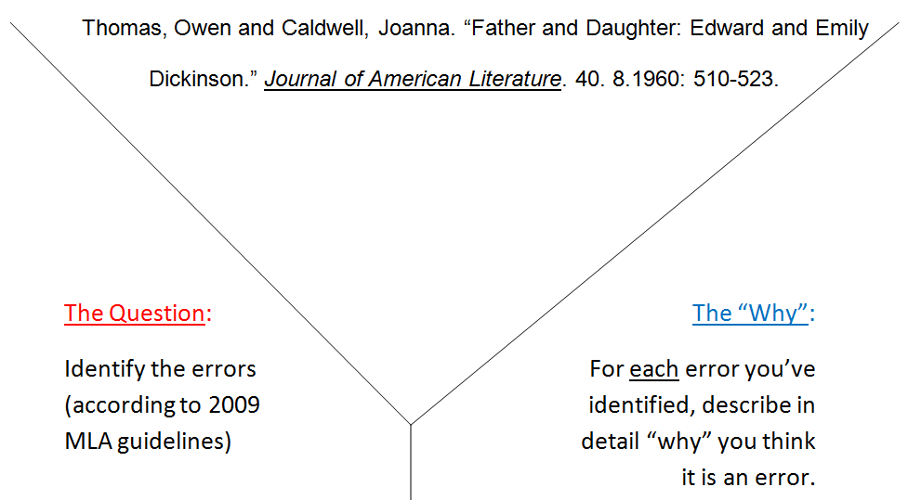
CATs
“Y” Diagram

Slide 11
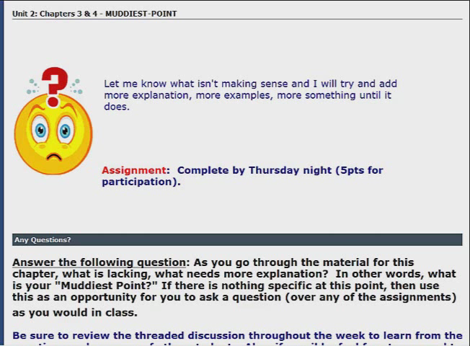
CATs
Muddiest Point

Slide 12
Courses excluded from this analysis:
EduKan courses
0, 0.5, 0 to #, credit hour courses
ITV Receiving courses
0 enrollment courses
PE Activities, PHED (by arrangement courses)
Seminars
Labs
Independent Study
Field Experience
Internship
MSCT 1100, 1101, 1102, 1103, 1104
MLTC 1501, 1519, 1520
Courses less than 2 calendar weeks in length

Slide 13
Total Title 3 Grant Award:
$1,949,666

Slide 14
Goal #1
Increase the percentage of courses that incorporate classroom assessment techniques (CATs) to monitor day-to-day learning of their students to 90% by September 2014
Year | 2010 | 2011 | 2012 | 2013 | 2014
Goal | 58% | 66% | 74% | 82% | 90%
Actual | 60% | 61% | 66% | 57% | -

Slide 15

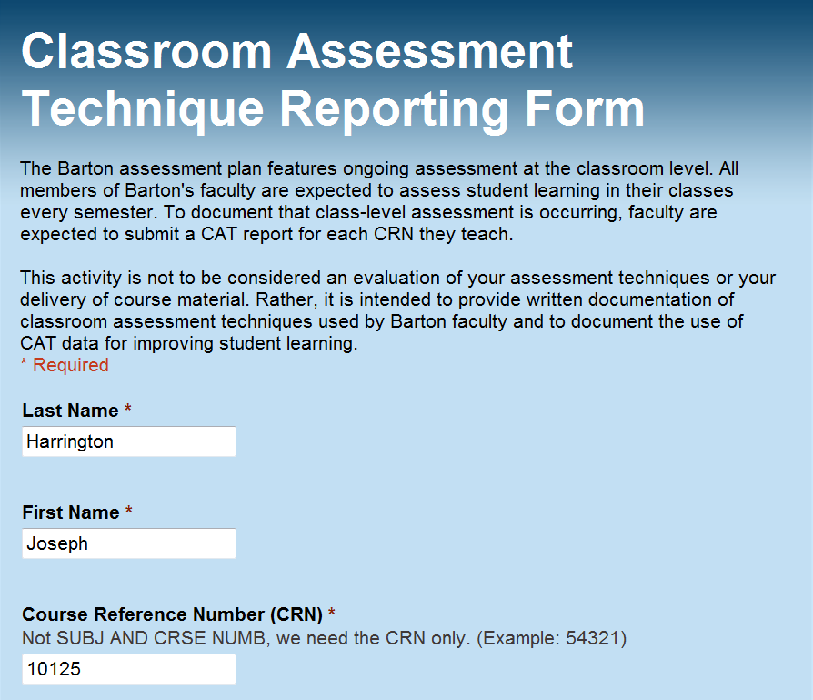
www.tinyurl.com/submitCAT

Slide 16
Goal #2
Increase the percentage of courses who demonstrate incorporation of improvement strategies resulting from assessment data to 90% by September 2014
Year | 2010 | 2011 | 2012 | 2013 | 2014
Goal | 29.50% | 36% | 54% | 72% | 90%
Actual | 54% | 50% | 63% | 72% | -

Slide 17
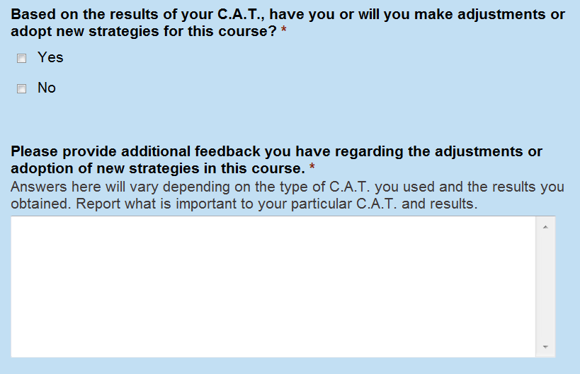
www.tinyurl.com/submitCAT
Something you might not think of:
You thought you were going to cover a topic, but based on the CAT results, you determined that you did not need to and thus decided to move on to another topic.
That is an Adjustment. You made a change based on the CAT that you would not have made otherwise.

Slide 18
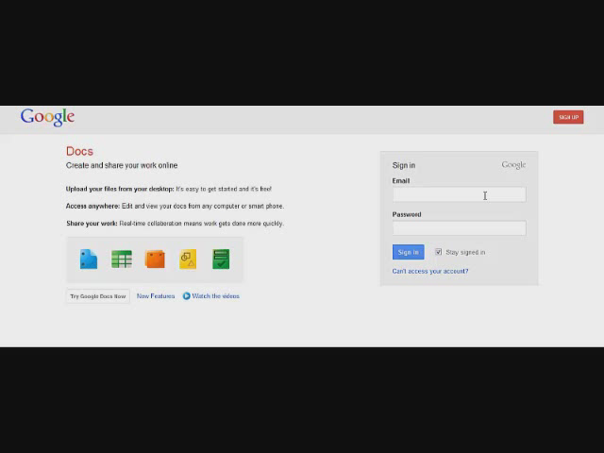
www.tinyurl.com/CATcheck

Slide 19
Thank You!
Notes:
Custom animation effects: sparkle
(Basic)
To reproduce the text on this slide, do the following:
On the Home tab, in the Slides group, click Layout, and then click Blank.
On the Insert tab, in the Text group, click Text Box. On the slide, drag to draw a text box.
Enter text and select it. On the Home tab, in the Font group, in the Font list select Franklin Gothic Heavy, and then in the Font Size box, select 96 pt.
On the Home tab, in the Paragraph group, click Center.
Select the text box, and then under Drawing Tools, on the Format tab, in the WordArt Styles group, click Text Effects, point to Reflection, and under Reflection Variations select Tight Reflection, Touching (first row, the first option from the left).
With the text box still selected, under Drawing Tools, on the Format tab, in the bottom right corner of the WordArt Styles group, click the Format Text Effects: Text Box dialog box launcher. In the Format Text Effects dialog box, click Text Fill in the left pane, select Gradient fill in the Text Fill pane, and then do the following:
Click the button next to Preset colors, and then click Ocean (second row, second option from the left).
In the Type list, select Linear.
Click the button next to Direction, and then click Linear Up (second row, second option from the left).
Also in the Format Text Effects dialog box, click 3-D Format in the left pane. In the 3-D Format pane, under Bevel, click the button next to Top, and then under Bevel click Circle (first row, first option from the left).
To reproduce the first star on this slide, do the following:
On the Home tab, in the Drawing group, click Shapes, and then under Stars and Banners click 4-Point Star (first row, third option from the left). On the slide, drag to draw a star.
On the slide, drag the star onto the top of the first letter (in the example slide, it is “S”) in the text box.
With the star still selected, drag the yellow diamond adjustment handle down to make the points thinner.
On the Home tab, in the bottom right corner in the Drawing group, click the Format Shape dialog box launcher. In the Format Shape dialog box, click Fill in the left pane, select Gradient fill in the Fill pane, and then do the following:
In the Type list, select Radial.
Click the button next to Direction, and then click From Center (third option from the left).
Under Gradient stops, click Add or Remove until two stops appear in the drop-down list.
Also under Gradient stops, customize the gradient stops that you added as follows:
Select Stop 1 from the list, and then do the following:
In the Stop position box, enter 0%.
Click the button next to Color, and then under Theme Colors click White, Background 1 (first row, first option from the left).
Select Stop 2 from the list, and then do the following:
In the Stop position box, enter 100%.
Click the button next to Color, and then under Theme Colors click White, Background 1 (first row, first option from the left).
In the Transparency box, enter 100%.
Also in the Format Shape dialog box, click Line Color in the left pane, and in the Line Color pane click No line.
Under Drawing Tools, on the Format tab, in the bottom right corner of the Size group, click the Size and Position dialog box launcher. In the Size and Position dialog box, on the Size tab, under Size and rotation do the following:
In the Height box, enter 0.51”.
In the Width box, enter 0.51”.
In the Rotation box, enter 15°.
To reproduce the other stars on this slide, do the following:
On the slide, select the star. On the Home tab, in the Clipboard group, click the arrow under Paste, and then click Duplicate.
On the slide, drag the second star until it slightly overlaps the edge of a letter in the text box.
Change the size of the star in the Drawing Tools, on the Format tab, in the Size group.
Repeat steps 1-3 for a total of five stars.
To reproduce the animation effects on this slide, do the following:
On the Animations tab, in the Animations group, click Custom Animation.
On the slide, select the first star from the left. In the Custom Animation task pane, do the following:
Click Add Effect, point to Entrance, and then click More Effects. In the Add Entrance Effect dialog box, under Moderate, click Grow & Turn.
Select the animation effect (grow & turn entrance effect for the first star). Under Modify: Grow & Turn, do the following:
In the Start list, select With Previous.
In the Speed list, select Very Fast.
On the slide, select the first star from the left. In the Custom Animation task pane, do the following:
Click Add Effect, point to Exit, and then click More Effects. In the Add Exit Effect dialog box, under Moderate, click Grow & Turn.
Select the second animation effect (grow & turn exit effect for the first star). Click the arrow to the right of the selected effect, and then click Effect Options. In the Grow & Turn dialog box, on the Timing tab, do the following:
In the Start list, select With Previous.
In the Delay box enter 0.7.
In the Speed list, select 0.5 seconds (Very Fast).
On the slide, select the second star from the left. In the Custom Animation task pane, do the following:
Click Add Effect, point to Entrance, and then click More Effects. In the Add Entrance Effect dialog box, under Moderate, click Grow & Turn.
Select the third animation effect (grow & turn entrance effect for the second star). Click the arrow to the right of the selected effect, and then click Effect Options. In the Grow & Turn dialog box, on the Timing tab, do the following:
In the Start list, select With Previous.
In the Delay box enter 0.2.
In the Speed list, select 0.5 seconds (Very Fast).
On the slide, select the second star from the left. In the Custom Animation task pane, do the following:
Click Add Effect, point to Exit, and then click More Effects. In the Add Exit Effect dialog box, under Moderate, click Grow & Turn.
Select the fourth animation effect (grow & turn exit effect for the second star). Click the arrow to the right of the selected effect, and then click Effect Options. In the Grow & Turn dialog box, on the Timing tab, do the following:
In the Start list, select With Previous.
In the Delay box enter 0.9.
In the Speed list, select 0.5 seconds (Very Fast).
On the slide, select the third star from the left. In the Custom Animation task pane, do the following:
Click Add Effect, point to Entrance, and then click More Effects. In the Add Entrance Effect dialog box, under Moderate, click Grow & Turn.
Select the fifth animation effect (grow & turn entrance effect for the third star). Click the arrow to the right of the selected effect, and then click Effect Options. In the Grow & Turn dialog box, on the Timing tab, do the following:
In the Start list, select With Previous.
In the Delay box enter 0.4.
In the Speed list, select 0.5 seconds (Very Fast).
On the slide, select the third star from the left. In the Custom Animation task pane, do the following:
Click Add Effect, point to Exit, and then click More Effects. In the Add Exit Effect dialog box, under Moderate, click Grow & Turn.
Select the sixth animation effect (grow & turn exit effect for the third star). Click the arrow to the right of the selected effect, and then click Effect Options. In the Grow & Turn dialog box, on the Timing tab, do the following:
In the Start list, select With Previous.
In the Delay box enter 1.1.
In the Speed list, select 0.5 seconds (Very Fast).
On the slide, select the fourth star from the left. In the Custom Animation task pane, do the following:
Click Add Effect, point to Entrance, and then click More Effects. In the Add Entrance Effect dialog box, under Moderate, click Grow & Turn.
Select the seventh animation effect (grow & turn entrance effect for the fourth star). Click the arrow to the right of the selected effect, and then click Effect Options. In the Grow & Turn dialog box, on the Timing tab, do the following:
In the Start list, select With Previous.
In the Delay box enter 0.8.
In the Speed list, select 0.5 seconds (Very Fast).
On the slide, select the fourth star from the left. In the Custom Animation task pane, do the following:
Click Add Effect, point to Exit, and then click More Effects. In the Add Exit Effect dialog box, under Moderate, click Grow & Turn.
Select the eighth animation effect (grow & turn exit effect for the fourth star). Click the arrow to the right of the selected effect, and then click Effect Options. In the Grow & Turn dialog box, on the Timing tab, do the following:
In the Start list, select With Previous.
In the Delay box enter 1.4.
In the Speed list, select 0.5 seconds (Very Fast).
On the slide, select the fifth star from the left. In the Custom Animation task pane, do the following:
Click Add Effect, point to Entrance, and then click More Effects. In the Add Entrance Effect dialog box, under Moderate, click Grow & Turn.
Select the ninth animation effect (grow & turn entrance effect for the fifth star). Click the arrow to the right of the selected effect, and then click Effect Options. In the Grow & Turn dialog box, on the Timing tab, do the following:
In the Start list, select With Previous.
In the Delay box enter 0.9.
In the Speed list, select 0.5 seconds (Very Fast).
On the slide, select the fifth star from the left. In the Custom Animation task pane, do the following:
Click Add Effect, point to Exit, and then click More Effects. In the Add Exit Effect dialog box, under Moderate, click Grow & Turn.
Select the 10th animation effect (grow & turn exit effect for the fifth star). Click the arrow to the right of the selected effect, and then click Effect Options. In the Grow & Turn dialog box, on the Timing tab, do the following:
In the Start list, select With Previous.
In the Delay box enter 1.5.
In the Speed list, select 0.5 seconds (Very Fast).
To reproduce the background effects on this slide, do the following:
Right-click the slide background area, and then click Format Background. In the Format Background dialog box, click Fill in the left pane, select Gradient fill in the Fill pane, and then do the following:
In the Type list, select Radial.
Click the button next to Direction, and then click From Center (third option from the left).
Under Gradient stops, click Add or Remove until two stops appear in the drop-down list.
Also under Gradient stops, customize the gradient stops that you added as follows:
Select Stop 1 from the list, and then do the following:
In the Stop position box, enter 0%.
Click the button next to Color, and then under Theme Colors click Black, Text 1, Lighter 35% (third row, second option from the left).
Select Stop 2 from the list, and then do the following:
In the Stop position box, enter 100%.
Click the button next to Color, and then under Theme Colors click Black, Text 1 (first row, second option from the left).

Slide 20
Thank You!
Notes:
Custom animation effects: sparkle
(Basic)
To reproduce the text on this slide, do the following:
On the Home tab, in the Slides group, click Layout, and then click Blank.
On the Insert tab, in the Text group, click Text Box. On the slide, drag to draw a text box.
Enter text and select it. On the Home tab, in the Font group, in the Font list select Franklin Gothic Heavy, and then in the Font Size box, select 96 pt.
On the Home tab, in the Paragraph group, click Center.
Select the text box, and then under Drawing Tools, on the Format tab, in the WordArt Styles group, click Text Effects, point to Reflection, and under Reflection Variations select Tight Reflection, Touching (first row, the first option from the left).
With the text box still selected, under Drawing Tools, on the Format tab, in the bottom right corner of the WordArt Styles group, click the Format Text Effects: Text Box dialog box launcher. In the Format Text Effects dialog box, click Text Fill in the left pane, select Gradient fill in the Text Fill pane, and then do the following:
Click the button next to Preset colors, and then click Ocean (second row, second option from the left).
In the Type list, select Linear.
Click the button next to Direction, and then click Linear Up (second row, second option from the left).
Also in the Format Text Effects dialog box, click 3-D Format in the left pane. In the 3-D Format pane, under Bevel, click the button next to Top, and then under Bevel click Circle (first row, first option from the left).
To reproduce the first star on this slide, do the following:
On the Home tab, in the Drawing group, click Shapes, and then under Stars and Banners click 4-Point Star (first row, third option from the left). On the slide, drag to draw a star.
On the slide, drag the star onto the top of the first letter (in the example slide, it is “S”) in the text box.
With the star still selected, drag the yellow diamond adjustment handle down to make the points thinner.
On the Home tab, in the bottom right corner in the Drawing group, click the Format Shape dialog box launcher. In the Format Shape dialog box, click Fill in the left pane, select Gradient fill in the Fill pane, and then do the following:
In the Type list, select Radial.
Click the button next to Direction, and then click From Center (third option from the left).
Under Gradient stops, click Add or Remove until two stops appear in the drop-down list.
Also under Gradient stops, customize the gradient stops that you added as follows:
Select Stop 1 from the list, and then do the following:
In the Stop position box, enter 0%.
Click the button next to Color, and then under Theme Colors click White, Background 1 (first row, first option from the left).
Select Stop 2 from the list, and then do the following:
In the Stop position box, enter 100%.
Click the button next to Color, and then under Theme Colors click White, Background 1 (first row, first option from the left).
In the Transparency box, enter 100%.
Also in the Format Shape dialog box, click Line Color in the left pane, and in the Line Color pane click No line.
Under Drawing Tools, on the Format tab, in the bottom right corner of the Size group, click the Size and Position dialog box launcher. In the Size and Position dialog box, on the Size tab, under Size and rotation do the following:
In the Height box, enter 0.51”.
In the Width box, enter 0.51”.
In the Rotation box, enter 15°.
To reproduce the other stars on this slide, do the following:
On the slide, select the star. On the Home tab, in the Clipboard group, click the arrow under Paste, and then click Duplicate.
On the slide, drag the second star until it slightly overlaps the edge of a letter in the text box.
Change the size of the star in the Drawing Tools, on the Format tab, in the Size group.
Repeat steps 1-3 for a total of five stars.
To reproduce the animation effects on this slide, do the following:
On the Animations tab, in the Animations group, click Custom Animation.
On the slide, select the first star from the left. In the Custom Animation task pane, do the following:
Click Add Effect, point to Entrance, and then click More Effects. In the Add Entrance Effect dialog box, under Moderate, click Grow & Turn.
Select the animation effect (grow & turn entrance effect for the first star). Under Modify: Grow & Turn, do the following:
In the Start list, select With Previous.
In the Speed list, select Very Fast.
On the slide, select the first star from the left. In the Custom Animation task pane, do the following:
Click Add Effect, point to Exit, and then click More Effects. In the Add Exit Effect dialog box, under Moderate, click Grow & Turn.
Select the second animation effect (grow & turn exit effect for the first star). Click the arrow to the right of the selected effect, and then click Effect Options. In the Grow & Turn dialog box, on the Timing tab, do the following:
In the Start list, select With Previous.
In the Delay box enter 0.7.
In the Speed list, select 0.5 seconds (Very Fast).
On the slide, select the second star from the left. In the Custom Animation task pane, do the following:
Click Add Effect, point to Entrance, and then click More Effects. In the Add Entrance Effect dialog box, under Moderate, click Grow & Turn.
Select the third animation effect (grow & turn entrance effect for the second star). Click the arrow to the right of the selected effect, and then click Effect Options. In the Grow & Turn dialog box, on the Timing tab, do the following:
In the Start list, select With Previous.
In the Delay box enter 0.2.
In the Speed list, select 0.5 seconds (Very Fast).
On the slide, select the second star from the left. In the Custom Animation task pane, do the following:
Click Add Effect, point to Exit, and then click More Effects. In the Add Exit Effect dialog box, under Moderate, click Grow & Turn.
Select the fourth animation effect (grow & turn exit effect for the second star). Click the arrow to the right of the selected effect, and then click Effect Options. In the Grow & Turn dialog box, on the Timing tab, do the following:
In the Start list, select With Previous.
In the Delay box enter 0.9.
In the Speed list, select 0.5 seconds (Very Fast).
On the slide, select the third star from the left. In the Custom Animation task pane, do the following:
Click Add Effect, point to Entrance, and then click More Effects. In the Add Entrance Effect dialog box, under Moderate, click Grow & Turn.
Select the fifth animation effect (grow & turn entrance effect for the third star). Click the arrow to the right of the selected effect, and then click Effect Options. In the Grow & Turn dialog box, on the Timing tab, do the following:
In the Start list, select With Previous.
In the Delay box enter 0.4.
In the Speed list, select 0.5 seconds (Very Fast).
On the slide, select the third star from the left. In the Custom Animation task pane, do the following:
Click Add Effect, point to Exit, and then click More Effects. In the Add Exit Effect dialog box, under Moderate, click Grow & Turn.
Select the sixth animation effect (grow & turn exit effect for the third star). Click the arrow to the right of the selected effect, and then click Effect Options. In the Grow & Turn dialog box, on the Timing tab, do the following:
In the Start list, select With Previous.
In the Delay box enter 1.1.
In the Speed list, select 0.5 seconds (Very Fast).
On the slide, select the fourth star from the left. In the Custom Animation task pane, do the following:
Click Add Effect, point to Entrance, and then click More Effects. In the Add Entrance Effect dialog box, under Moderate, click Grow & Turn.
Select the seventh animation effect (grow & turn entrance effect for the fourth star). Click the arrow to the right of the selected effect, and then click Effect Options. In the Grow & Turn dialog box, on the Timing tab, do the following:
In the Start list, select With Previous.
In the Delay box enter 0.8.
In the Speed list, select 0.5 seconds (Very Fast).
On the slide, select the fourth star from the left. In the Custom Animation task pane, do the following:
Click Add Effect, point to Exit, and then click More Effects. In the Add Exit Effect dialog box, under Moderate, click Grow & Turn.
Select the eighth animation effect (grow & turn exit effect for the fourth star). Click the arrow to the right of the selected effect, and then click Effect Options. In the Grow & Turn dialog box, on the Timing tab, do the following:
In the Start list, select With Previous.
In the Delay box enter 1.4.
In the Speed list, select 0.5 seconds (Very Fast).
On the slide, select the fifth star from the left. In the Custom Animation task pane, do the following:
Click Add Effect, point to Entrance, and then click More Effects. In the Add Entrance Effect dialog box, under Moderate, click Grow & Turn.
Select the ninth animation effect (grow & turn entrance effect for the fifth star). Click the arrow to the right of the selected effect, and then click Effect Options. In the Grow & Turn dialog box, on the Timing tab, do the following:
In the Start list, select With Previous.
In the Delay box enter 0.9.
In the Speed list, select 0.5 seconds (Very Fast).
On the slide, select the fifth star from the left. In the Custom Animation task pane, do the following:
Click Add Effect, point to Exit, and then click More Effects. In the Add Exit Effect dialog box, under Moderate, click Grow & Turn.
Select the 10th animation effect (grow & turn exit effect for the fifth star). Click the arrow to the right of the selected effect, and then click Effect Options. In the Grow & Turn dialog box, on the Timing tab, do the following:
In the Start list, select With Previous.
In the Delay box enter 1.5.
In the Speed list, select 0.5 seconds (Very Fast).
To reproduce the background effects on this slide, do the following:
Right-click the slide background area, and then click Format Background. In the Format Background dialog box, click Fill in the left pane, select Gradient fill in the Fill pane, and then do the following:
In the Type list, select Radial.
Click the button next to Direction, and then click From Center (third option from the left).
Under Gradient stops, click Add or Remove until two stops appear in the drop-down list.
Also under Gradient stops, customize the gradient stops that you added as follows:
Select Stop 1 from the list, and then do the following:
In the Stop position box, enter 0%.
Click the button next to Color, and then under Theme Colors click Black, Text 1, Lighter 35% (third row, second option from the left).
Select Stop 2 from the list, and then do the following:
In the Stop position box, enter 100%.
Click the button next to Color, and then under Theme Colors click Black, Text 1 (first row, second option from the left).

